Slide 1
Experimental and CFD investigations into slamming of small, high speed craft
Dominic Hudson, Simon Lewis, Stephen Turnock
ONR Hull slamming workshop, Caltech
17-18th February 2009

Slide 2
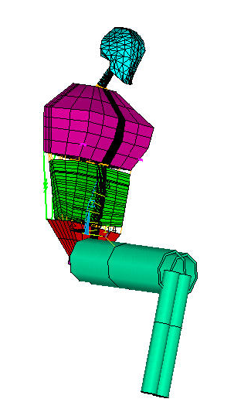
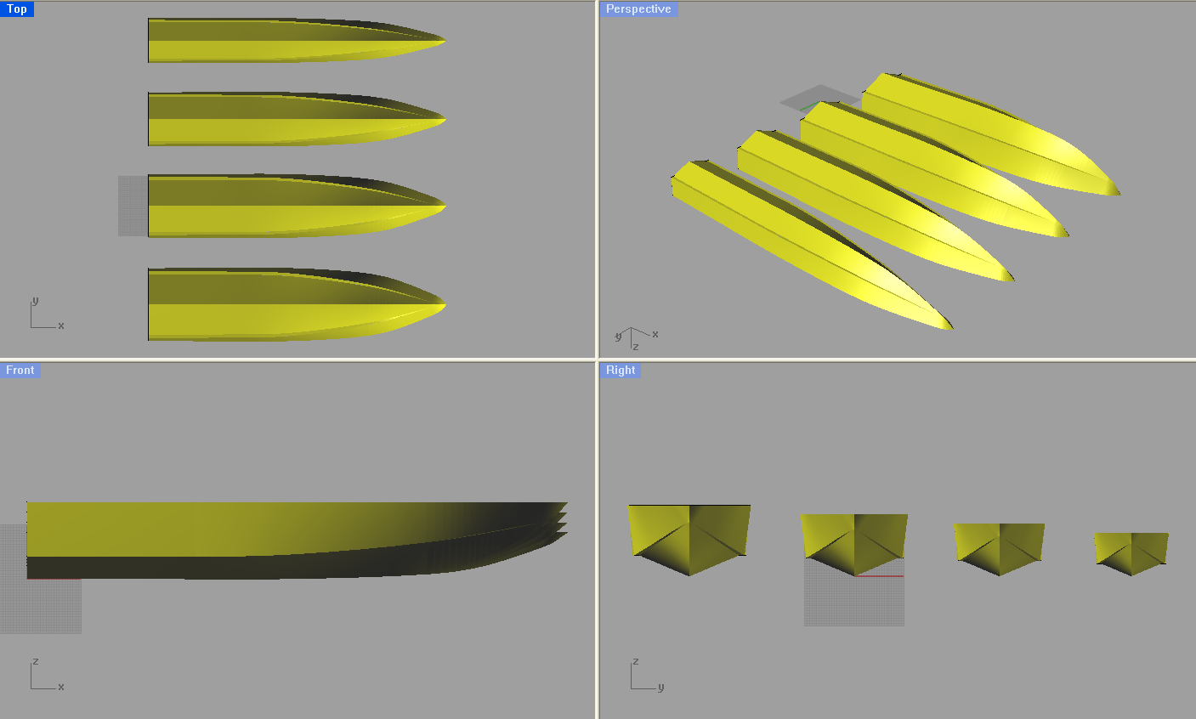
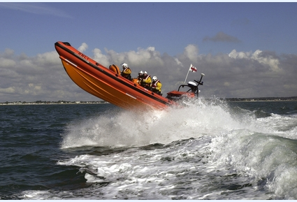
Background
Work in support of Design of High Performance Craft from a Human Factors Perspective
This involves:
Model and full scale testing
Measurements of muscle fatigue and heart rate on passengers on board
Suspension seat design
Prediction of motions of high speed craft

Slide 3
Outline
Methods for prediction of planing craft motions
Computational Fluid Dynamics (CFD) to predict vertical motion
Improvements to CFD - boundary layer flow
Wedge impact experiment
Conclusions and future work

Slide 4
Prediction of motions
Potential flow theory
Advantages:
Simple
Computationally efficient
Disadvantages:
Difficulties modelling more complex shapes
Computational Fluid Dynamics
Advantages:
Potential for accurate results
Disadvantages
Complex setup
Computationally expensive
Notes:
Strip theory provides a means of simplifying a 3D shape into a series of 2D sections. The force on each section can be calculated, and then integrated along the length of the hull to produce the overall craft motions.

Slide 5
2D CFD - wedge impact
Computational fluid dynamics method using
RANS equations (ANSYS CFX 11)
Transient simulation
Equations of motion solved at each timestep
Initial investigations used published experimental data for validation

Slide 6
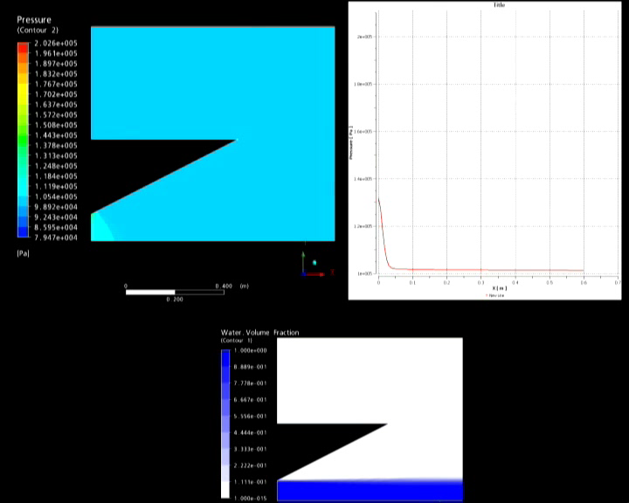
Results - wedge impact

Slide 7
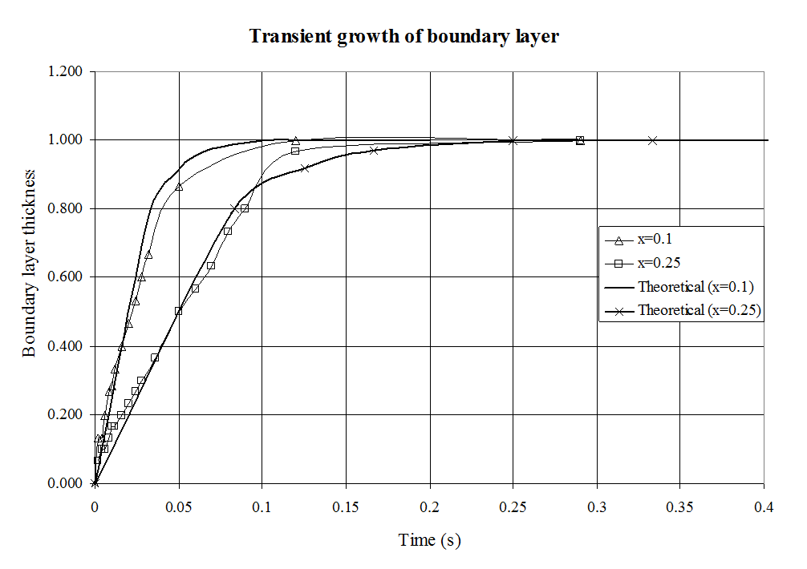
CFD Improvements
Boundary layer development on an impulsively started flat plate
mesh size, domain size, turbulence model, and first cell distance from the wall

Slide 8
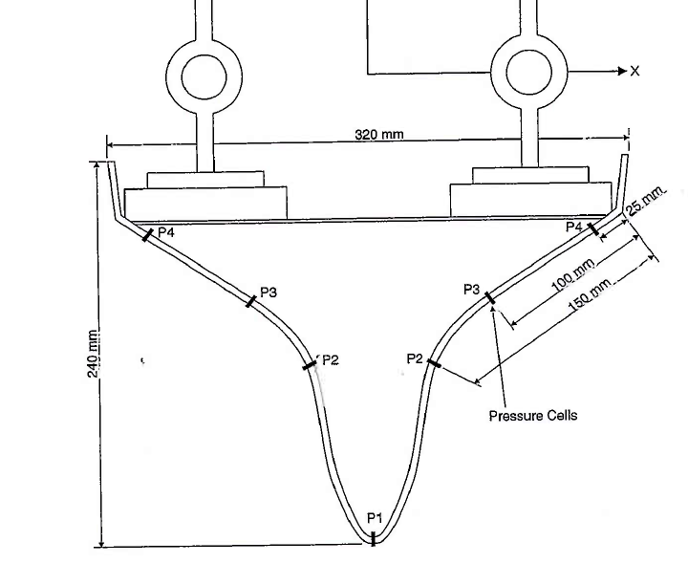
Bow section motion
Experiments conducted at MARINTEK
Test parameters
Water entry velocity 2.44m/s
Mass: 261kg
Measured pressures, accelerations and forces

Slide 9
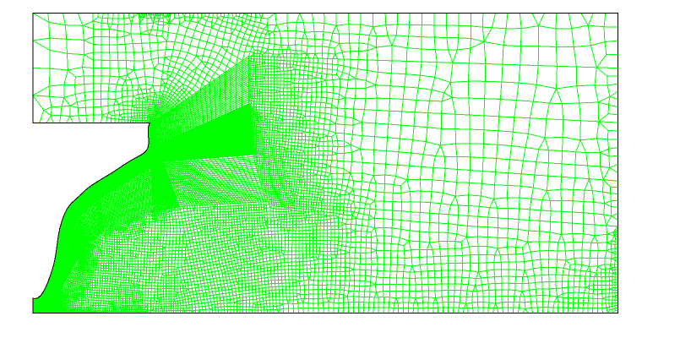
CFD simulation
Outflow boundary condition
Symmetry plane
0.8m
Smooth wall, no slip condition
0.4m
Inflow boundary

Slide 10
CFD Parameters
Using Ansys CFX v11.0
Finest mesh: 30000 cells
First element situated 2*10⁻⁵m from the wall
Turbulence model used is k-omega
Y+ value at the wall is 0.6
Inhomogeneous multiphase model
Motions are calculated through user defined functions in Matlab for each timestep

Slide 11
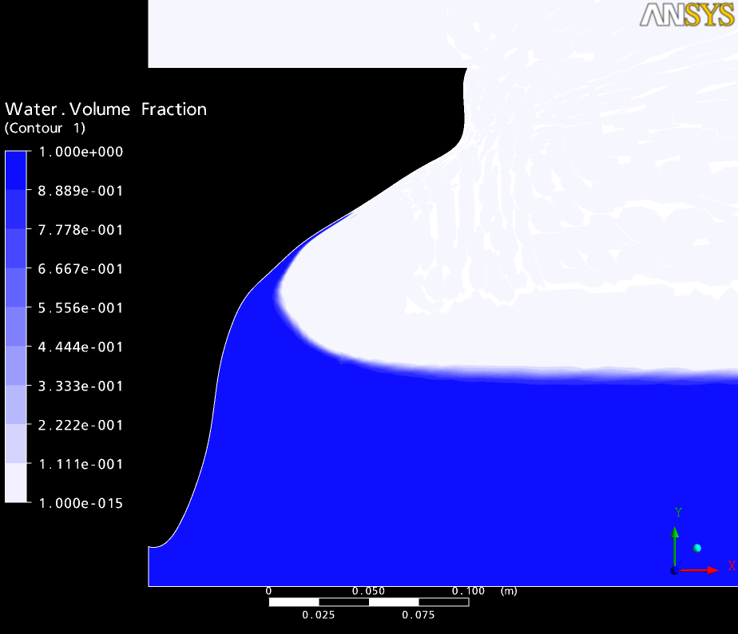
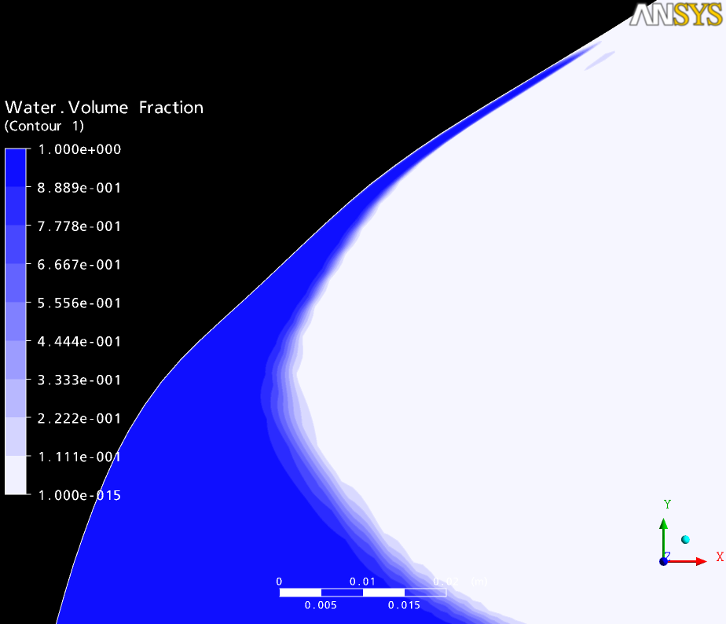
Results - visualisation
Images of flow

Slide 12
Results – pressure (1)

Slide 13
Results – pressure (2)

Slide 14
Experimental testing
Rig designed to investigate free-falling wedge
Provide detailed validation data
Include uncertainty analysis
Improve understanding
Synchronised high speed video, pressure and acceleration data
Pressure, acceleration sampled at 10kHz
Mass and drop height varied

Slide 15
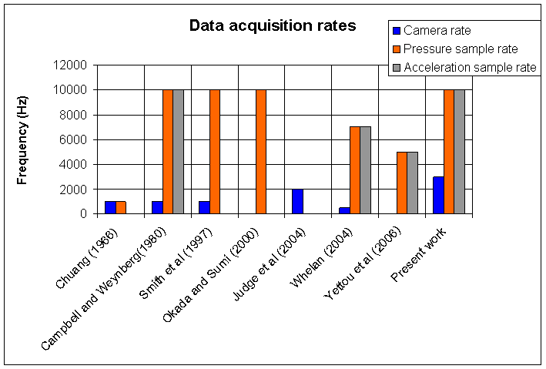
Comparison of sample rates

Slide 16
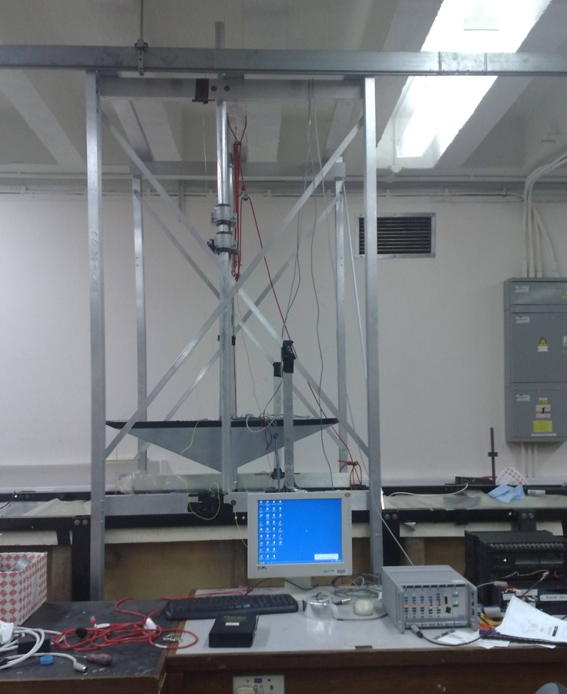
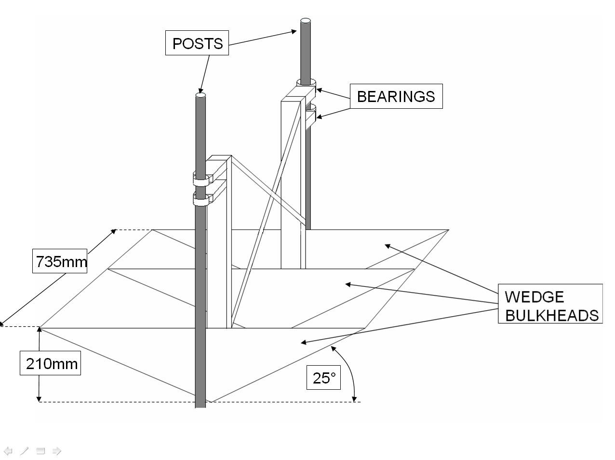
Drop test rig

Slide 17
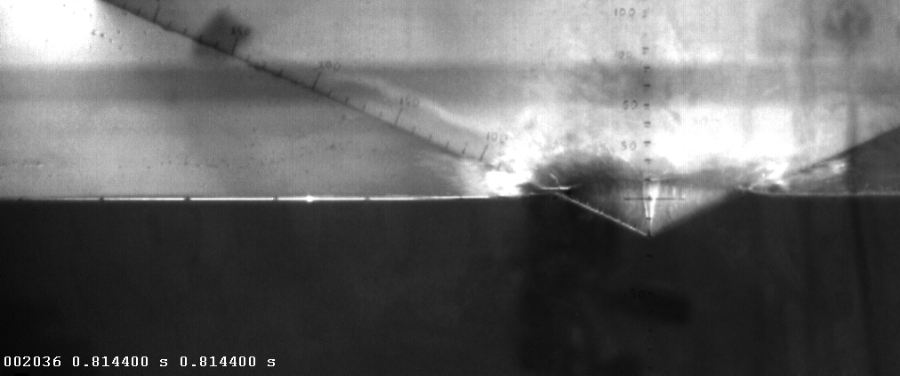
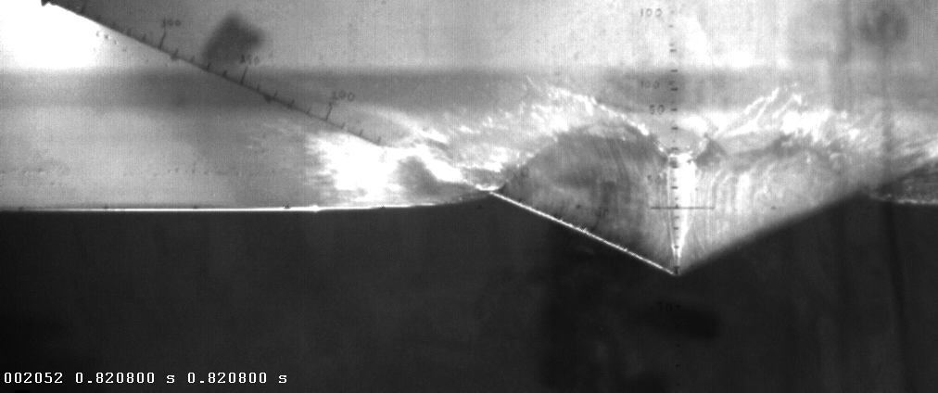
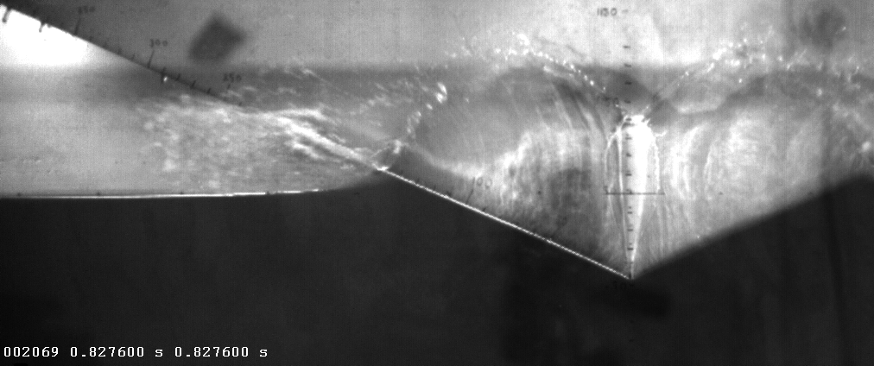
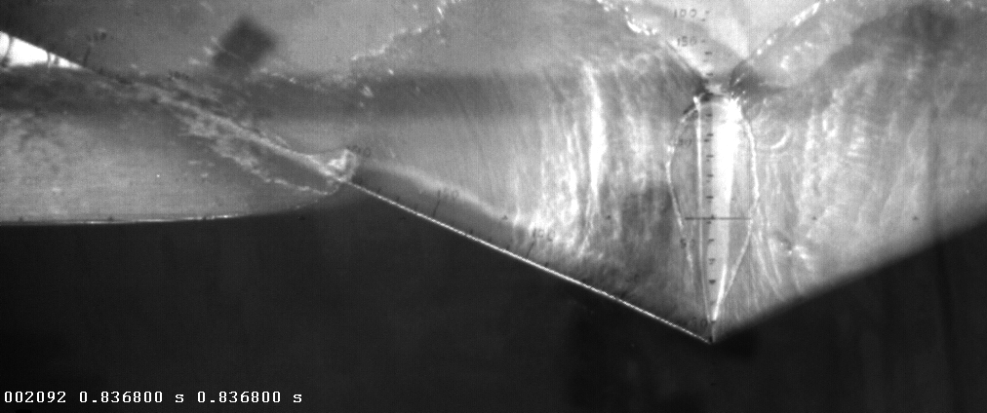
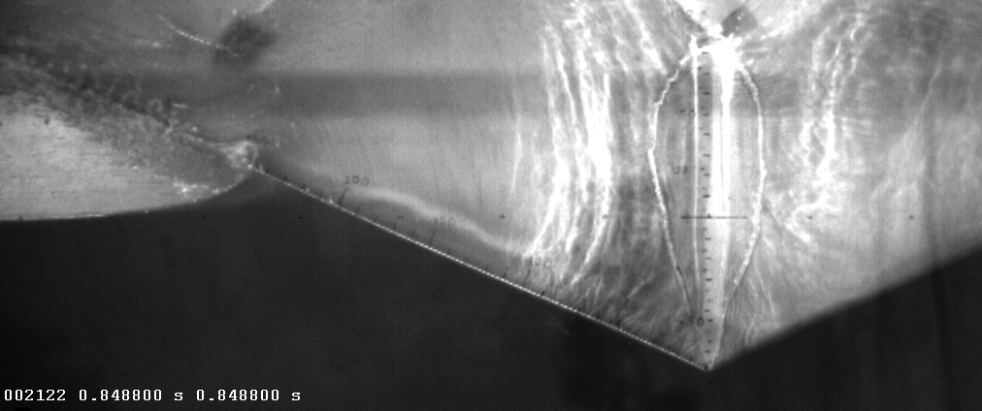
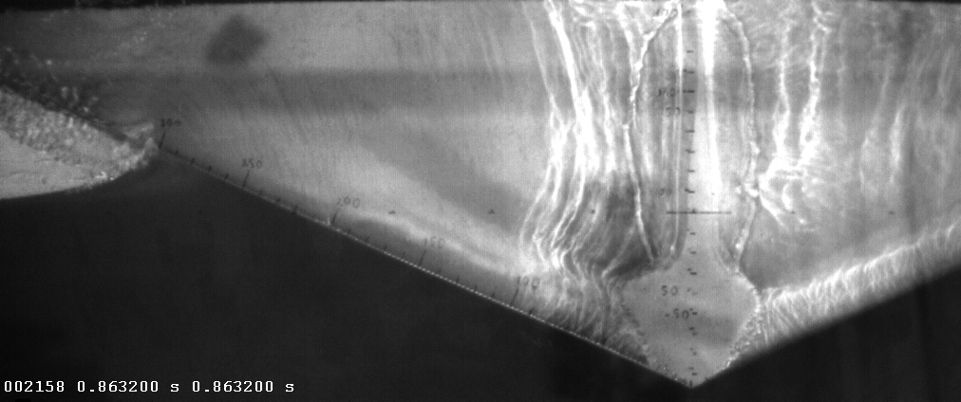
Results – experimental (1)
P6 P5 P4 P3 P2 P1
Pressure N/m²
Horizontal distance from wedge apex (mm)

Slide 18
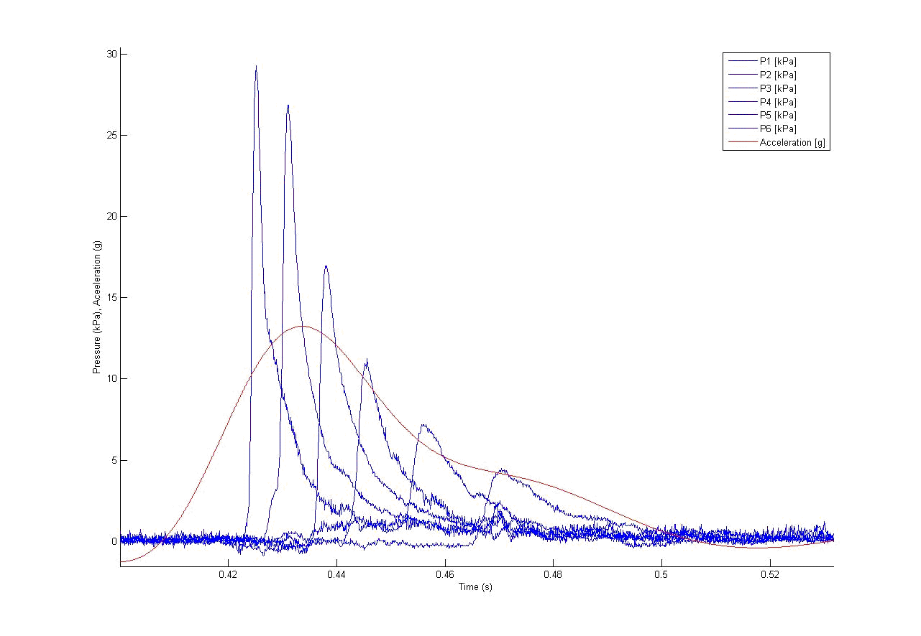
Results – experimental (2)

Slide 19
Results - uncertainty

Slide 20
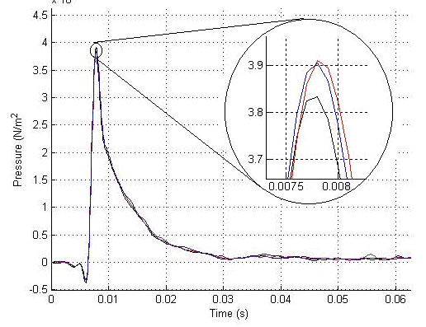
Results - repeatability

Slide 21
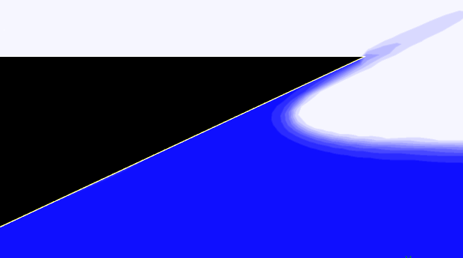
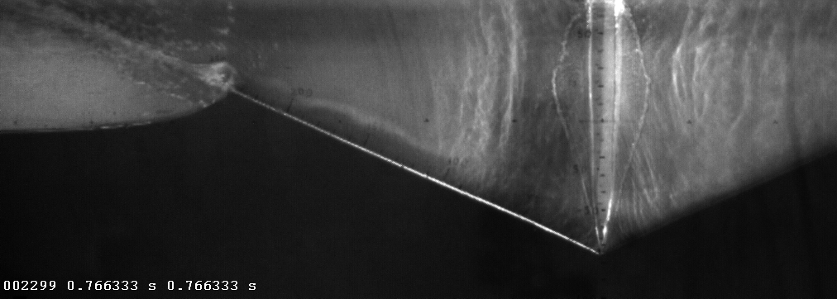
Outcomes of experiment
Synchronisation of measurements enhances understanding of impact.
Images allow comparison between CFD and experiment.

Slide 22
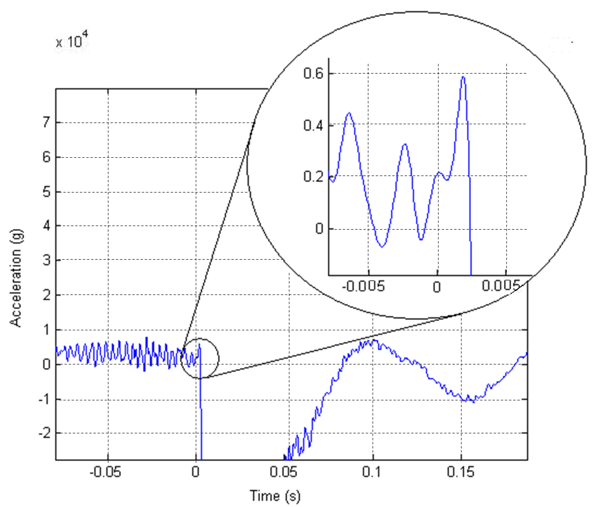
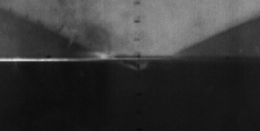
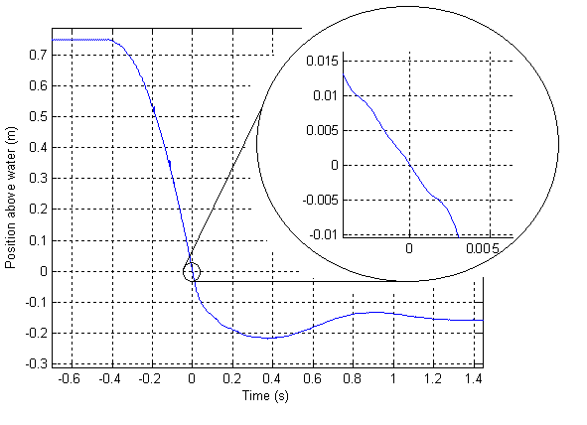
Determining point of impact
- Accelerometer responds to impact at 2.5 ms
after apex enters water
- Video indicates distance travelled approx. 1cm
- Position sensor agrees with video

Slide 23
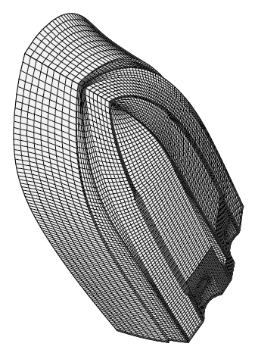
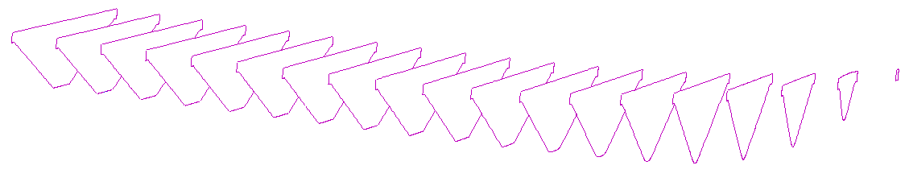
Future work - motions
Potential Flow solver
using strip theory
Computational Fluid Dynamics
Hybrid model
3D CFD mesh (Azcueta,2002)
The hybrid approach is used to improve the accuracy of the numerical predictions.

Slide 24
Future work - general
Use ‘flexible’ wedge – measure structural responses
Strain gauges, thermo-elastic stress analysis?, digital image correlation?
Effect of hull features on flow – deadrise, spray rails, hull shape, RIB collars
Inclined wedge entry – heeled conditions
Use high-speed video to investigate spray characteristics
Modify rig for forced wedge entry/exit

Slide 25
Conclusions
Experimental study provides good data for validation of wedge impact.
Improvements to CFD predictions for highly non-linear flows such as water impact.
Hybrid approach can be used to improve the accuracy of high speed craft motions prediction.

Slide 26
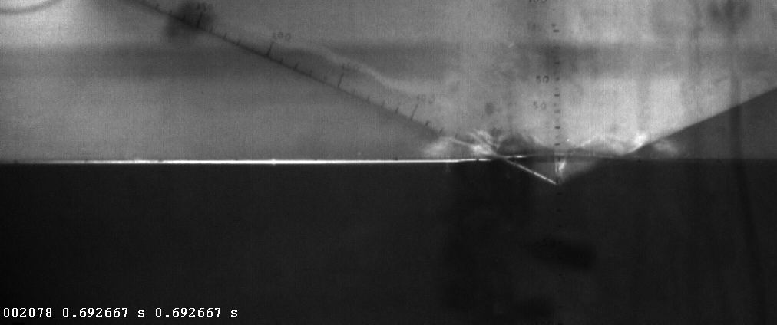
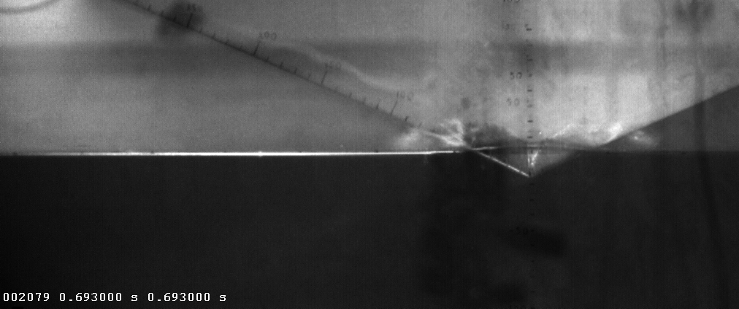

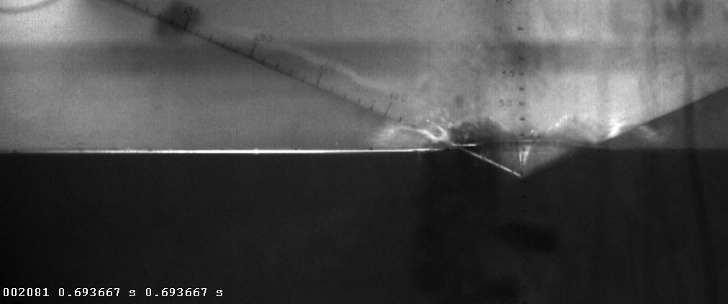
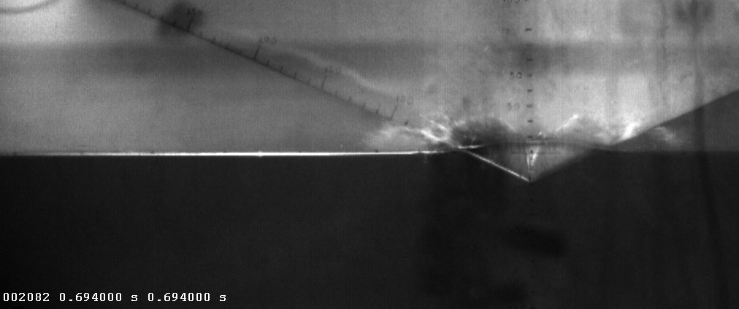


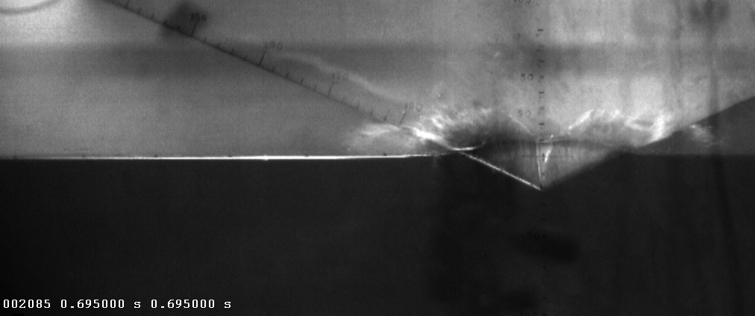
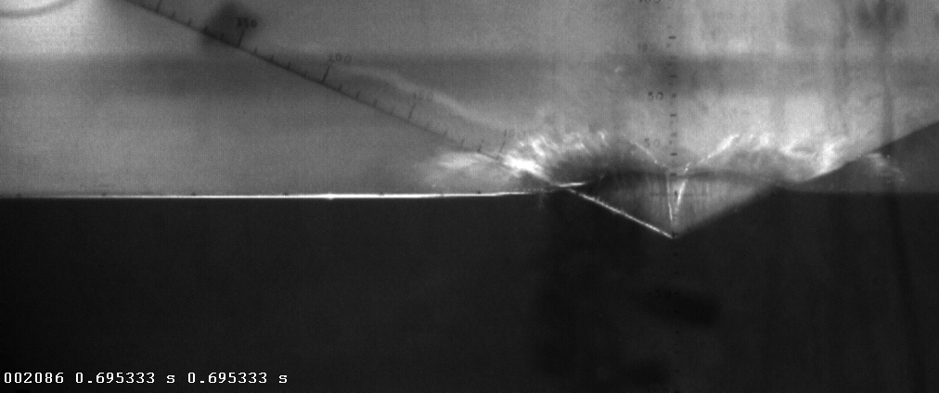
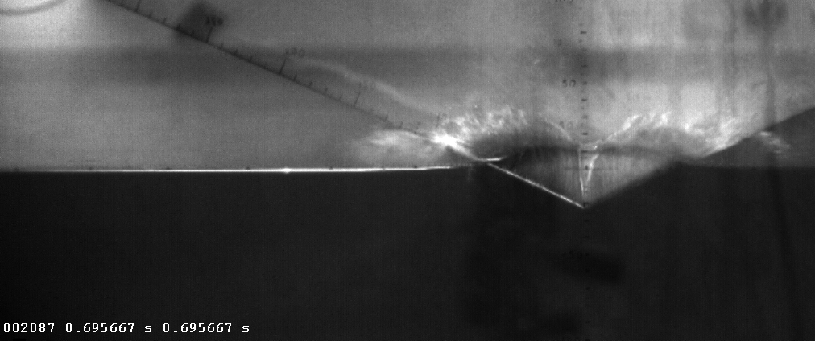
0.005s
0.005667s
0.00533s
0.006s
0.006333s
0.006667s
0.007s
0.007333s
0.007667s
0.008s
P1

Slide 27
Questions
?
Thank you for your attention.

