Slide 1
Supporting the Digital Humanities
Vienna, 19–20 October 2010
Findings and Outcomes of the musicSpace Project
Speaker: David Bretherton (D.Bretherton@soton.ac.uk)
Co-Authors: Daniel A. Smith, mc schraefel, Joe Lambert

Slide 2
Presentation overview
I am going to focus on one particular outcome of musicSpace: a successor project called ‘MusicNet’.
I will concentrate on how musicSpace provided the motivation for MusicNet

Slide 3
musicSpace
3-year project that concluded September 2010
http://musicspace.mspace.fm

Slide 4
musicSpace’s goals
To integrate access to leading online music resources using the mSpace faceted browser.
Demonstrate that integration could support rapid exploration & knowledge building.
Enable complex, multipart queries.

Slide 5
MusicNet
July 2010 – June 2011
http://musicnet.mspace.fm

Slide 6
MusicNet’s goals
Mint URIs for composers so that content providers can unambiguously identify them.
  Hope to expand to include all music-related entities.
Publish alignment data to back-link into our data partners’ catalogues, and to other resources.
Build a suite of tools to support the alignment and integration of new linked data resources.
Build a demonstration service to illustrate the uses and benefits of the URIs and alignment data.

Slide 7
Contents
Brief overview of musicSpace
How musicSpace provided
the motivation for ‘MusicNet’
MusicNet’s alignment tool

Slide 8
1. Brief overview of musicSpace

Slide 9
Problem

Slide 10
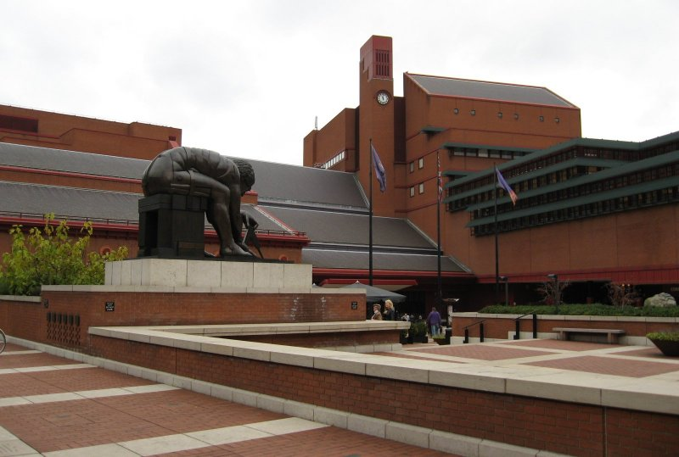
Centuries of material ...
Notes:
Only a decades or so ago, researchers in musicology – in common with many humanities disciplines – had to criss-cross the globe to consult material held in libraries, archives and museums all over the world.
These days, thanks to efforts over the past decade that continue today, ... [change slide]

Slide 11

... is now increasingly digitised
Notes:
… research data is increasingly available digitally, from the comfort and convenience of one’s computer.
This should mean that data is now readily accessibly and usable for research purposes, but this has not entirely been the case.

Slide 12
Yet data is often ‘siloed’.
Geographical dispersal has been replaced by virtual dispersal on the web. Data is now segregated into countless online repositories by:
  Media type (text, image, audio, video)
  Date of creation/publication
  Subject
Notes:
Research data has become ‘siloed’.
Geographical dispersal has been replaced by virtual dispersal on the web.
Data is now segregated into countless online repositories according to:
Media type (whether the data relates to text, image, audio or video objects)
Date of creation and/or publication
The Subject area of the material [change slide]

Slide 13
Yet data is often ‘siloed’.
Geographical dispersal has been replaced by virtual dispersal on the web. Data is now segregated into countless online repositories by:
  Language
  Copyright holder
  Ad hoc/insecure nature of project funding
Notes:
Language of the material
Copyright holder
And even the ad hoc, often insecure nature of project funding (lots of small digitisation grants = lots of small datasets).

Slide 14
Yet data is often ‘siloed’.
Interoperability has generally not been given a high enough priority.

Slide 15
Using current online music data resources presents barriers at all stages of the research process:
It is hard to speculatively browse
around a subject area.
‘Real-world’ multipart queries
are effectively intractable.

Slide 16
The barriers to tractability and their solutions
Solutions:
Integration
Increase granularity
Optimally interactive UI (‘mSpace’)
Need to consult several sources
… and metadata from one source cannot guide searches of another source.
Insufficient granularity of data and/or search option.
Multi-part queries have to be broken down and results collated manually.
Notes:
[NB: The three ‘solutions’ named here are discussed in turn in the following section.]

Slide 17
Solution

Slide 18
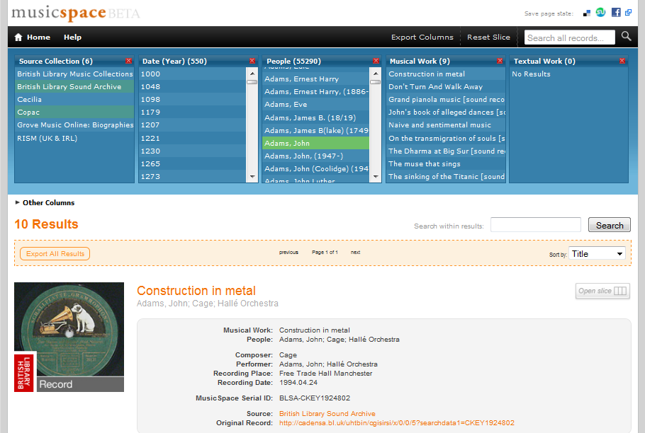
‘musicSpace’ is a faceted browser
Notes:
‘musicSpace’ uses the ‘mSpace’ faceted browser.
Facets are represented as columns list attributes of the data, allowing the user to make selections in the columns in order to filter down results.
The interface is reactive, so that subsequent choices are limited to those that would yield results.
The faceted and reactive nature of the interface enables complex queries to be addressed, as the following screencast illustrates … [change slide]

Slide 19
Demonstration
‘What recording of works by Cage exist, which performers have recorded a particular work by Cage, and what else by Cage have they recorded?
Screencast 1:
http://www.youtube.com/watch?v=keTN12OWies&hd=1
Notes:
[The cage.mp4 screencast shows musicSpace being used to answer the Cage multipart question that was discussed earlier in ‘1. Motivation’. It also demonstrates various aspects of the musicSpace interface’. The outline below gives time indexed comments on what is being shown in the screencast, and could be used as a the basis for a ‘script’]
00:00 – musicSpace offers standard text functionality, so we can search a collection for references to ‘cage’.
00:16 – We can click on ‘Open slice’ to open a particular record in the columns at the top of the page.
00:19 – And of course we can search the database by selecting items in the columns and rearranging the columns.
00:23 – So to address the first part of this multipart query, to search for records by cage, I move the ‘Composer’ column before the ‘Musical Work’ column.
00:34 – And by making sections in the ‘Musical Work’, I can a list of results of recording of a particular work. In this case, I’ve looked for recordings of Cage’s composition ‘Dream’.
00:45 – I can add other columns to continue searching. Here I’m adding the ‘Performer’ column to address the second part of the query, which performers have recorded a particular work.
00:52 – You’ll see that as the column is added, it automatically populates with the names of performers that meet the previously selected criteria (Composer = Cage, Musical Work = Dream).
00:56 – Furthermore, we can add additional columns, such as ‘Place’, to discover where the recordings were made.
01:05 – By clicking ‘Export columns’ we can bring up the selections and lists contained in the facets, so that this information can exported for later use by the researcher.
01:14 – Columns that are no longer needed can be closed.
01:18 – To perform the last part of the query, I can select a performer in the last column (‘Performer’), and then drag this column to the left so that it precedes the ‘Musical Work’ column.
01:25 – The ‘Musical Works’ column now updates to list all the works by Cage that the selected performer (here John Tilbury) has recorded.
01:30 – Again, this information can be exported for later use.
01:34 – Each record returned by musicSpace contains a hyperlink to the source record, so that it can be viewed in its original context.

Slide 20
2. How musicSpace provided the motivation for MusicNet

Slide 21
Data is not ‘clean’...
Schubert, Franz Peter‏
Schubert, Franz Peter,‏ ‎‡d 1797-1828‏
Schubert, Franz Peter‏ ‎‡d 1797-1828‏
Schubert, François,‏ ‎‡d 1797-1828‏
Schubert.‏
Schubert‏ ‎‡d 1797-1828‏
Shu-po-tʿe‏ ‎‡d 1797-1828‏
Shubert, F. (Frant︠s︡)‏ ‎‡d 1797-1828‏
Shubert, F.‏ ‎‡q (Frant︠s︡),‏ ‎‡d 1797-1828‏
Shubert, Frant︠s︡,‏ ‎‡d 1797-1828‏
Shubert, Frant︠s︡‏ ‎‡d 1797-1828‏
Shūberuto, F.‏
Shūberuto, Furantsu‏ ‎‡d 1797-1828‏
Šubert, Franc‏ ‎‡d 1797-1828‏
Šubertas, F. (Francas),‏ ‎‡d 1797-1828‏
Schubert‏
Schubert, Franz‏
Schubert, Franz Peter‏
Shu-po-tʻe,‏ ‎‡d 1797-1828‏
Schubert‏ ‎‡d 1797-1828‏
F. P. Schubert‏
Schubert, ...‏ ‎‡d 1797-1828‏
Schubert, F.‏
Schubert, F.‏ ‎‡d 1797-1828‏
Schubert, Fr.‏
Schubert, Fr.‏ ‎‡d 1797-1828‏
Schubert, Franciszek.‏
Schubert, Franç.‏ ‎‡d 1797-1828‏
Schubert, François‏ ‎‡d 1797-1828‏
Schubert, Franz P.‏ ‎‡d 1797-1828‏
Šubertas, Francas Peteris,‏ ‎‡d 1797-1828‏
Šubert, F.‏
Šubertas, F.‏ ‎‡d 1797-1828‏
שוברט, פרנץ‏
シューベルト, F., 1797-1828‏
シューベルト, フランツ‏ ‎‡d 1797-1828‏
舒柏特, 弗朗茨‏
Schubert, François‏ ‎‡d 1797-1828‏
Schubert, Franz Peter‏ ‎‡d 1797-1828‏

Slide 22
Causes of dirty data
Different naming conventions;
  e.g. ‘Bach, Johann Sebastian’ or ‘J. S. Bach’
Inclusion of non-name data in name field;
  e.g. ‘Schubert, Franz, 1797-1828. Songs’,
  or ‘Allen, Betty (Teresa)’
Different languages (and alphabets);
User input errors.
  e.g. ‘Bach, Johan Sebastien’

Slide 23
Dirty data degrades the user experience
Searching for compositions by the composer Franz Schubert (1797–1828)...
Screencast 2:
http://www.youtube.com/watch?v=pFsYfz1vlAg&hd=1

Slide 24
3. MusicNet’s alignment tool

Slide 25
Prototype 1
(musicSpace era)

Slide 26
Used Alignment API & Google Docs
We used Alignment API to compare the names as strings, using WordNet to enable word stemming, synonym support, etc.
Alignment API produces a similarity measure for each possible match.
We planned to set a threshold for automatic approval.
Matches below that threshold would be sent to a Google Docs spreadsheet for expert review.

Slide 27
Shortcoming 1: no threshold
It was not possible to identify a threshold for automatic approval.
Terms are judged to be similar if they have just, say, one different character, but a difference of one character is usually significant in a name.
Names are proper nouns, and so are unsuited to WordNet’s assumptions about misspelling.

Slide 28


Shortcoming 1: no threshold
False matches with high similarity measures:
True matches with low similarity measures:

Slide 29
Shortcoming 2: no context
Alignment API compares names as strings, and the system strips the names of their context (i.e. additional metadata).
  Lack of context meant the musicologist had no way to verify the match.
Significant flaw; automation had failed so we where relying on manual review.

Slide 30
Prototype 2
(building a custom tool for MusicNet)

Slide 31
Lessons learned
From Prototype 1:
  A completely automated solution is out of the question (for the moment...).
  We needed a custom tool with a human-friendly UI (we also wanted keyboard shortcuts for speed).
  Access to additional metadata (i.e. context), so matches can be researched by the reviewer.
From experience with faceted browsers:
  Alphabetically sorted columns enable one to spot synonymous names at a glance.
    Normally sources give names surname first; duplication arises from the different representation of given names.

Slide 32
Alignment process
Data*
Algorithm compares
hash of alpha-only l.c. version of name
Suggested groups
No groups suggested
User verified*
or rejected*
Manual grouping (research*)
Synonym groups
URIs
• Alternative names • Back links*

Slide 33
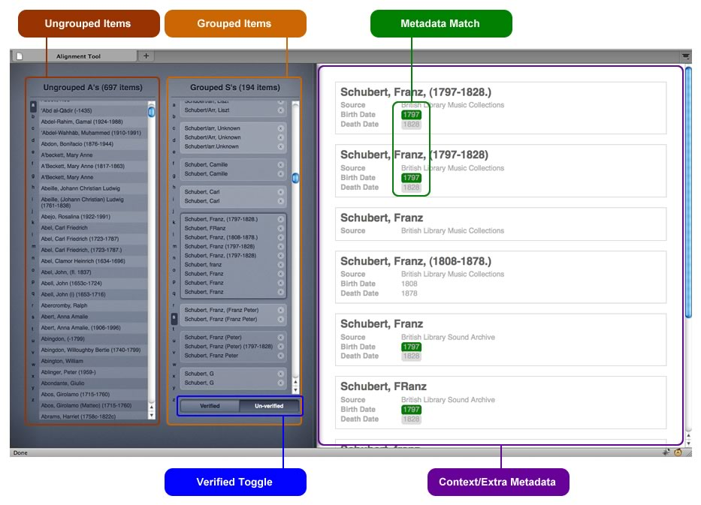
UI of Prototype 2

Slide 34
Prototype 2 demo
Screencast 3:
http://www.youtube.com/watch?v=5f8iaryZMk0&hd=1

Slide 35
Indicative use cases
Composer URIs:
  Music(ological) content providers
  Basis of a (re)search portal
Alignment tool:
  Aligning databases with no authorities;
  Or where authorities are inconsistent.

Slide 36
Thank you for listening!

