Slide 1
Music Linked Data Workshop
12 May 2011 • JISC, London
http://musicnet.mspace.fm
MusicNet: Aligning Musicology’s Metadata
David Bretherton (Music), Daniel Alexander Smith,
Joe Lambert and mc schraefel (Electronics and Computer Science)

Slide 2
David Bretherton

Slide 3
musicSpace, the precursor to MusicNet

Slide 4
Problem

Slide 5
Digitised data is often ‘siloed’.
Geographical dispersal has been replaced by virtual dispersal on the web. Data is now segregated into countless online repositories by:
  Media type (text, image, audio, video)
  Date of creation/publication
  Subject
Notes:
Research data has become ‘siloed’.
Geographical dispersal has been replaced by virtual dispersal on the web.
Data is now segregated into countless online repositories according to:
Media type (whether the data relates to text, image, audio or video objects)
Date of creation and/or publication
The Subject area of the material [change slide]

Slide 6
Digitised data is often ‘siloed’.
Geographical dispersal has been replaced by virtual dispersal on the web. Data is now segregated into countless online repositories by:
  Language
  Copyright holder
  Ad hoc/insecure nature of project funding
Notes:
Language of the material
Copyright holder
And even the ad hoc, often insecure nature of project funding (lots of small digitisation grants = lots of small datasets).

Slide 7
Digitised data is often ‘siloed’.
Interoperability has generally not been given a high enough priority.
And, because the datasets are ‘mature’ the data isn’t Linked Data.

Slide 8
Solution

Slide 9
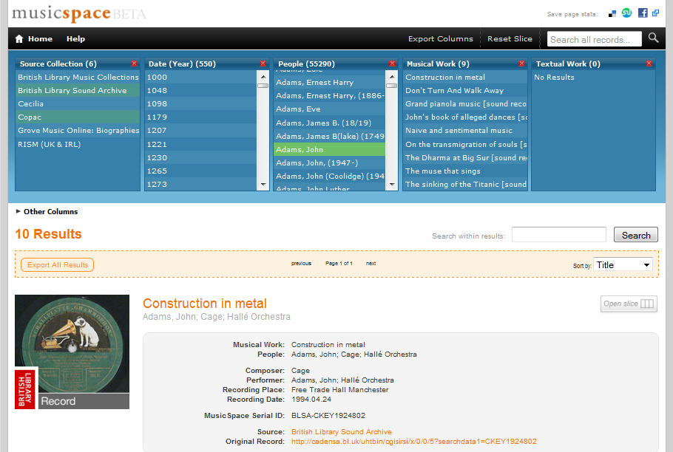
‘musicSpace’ is a faceted browser
Notes:
‘musicSpace’ uses the ‘mSpace’ faceted browser.
Facets are represented as columns list attributes of the data, allowing the user to make selections in the columns in order to filter down results.
The interface is reactive, so that subsequent choices are limited to those that would yield results.
The faceted and reactive nature of the interface enables complex queries to be addressed, as the following screencast illustrates … [change slide]

Slide 10
Demonstration
‘What recording of works by Cage exist, which performers have recorded a particular work by Cage, and what else by Cage have they recorded?
Screencast 1:
http://www.youtube.com/watch?v=keTN12OWies&hd=1
Notes:
[The cage.mp4 screencast shows musicSpace being used to answer the Cage multipart question that was discussed earlier in ‘1. Motivation’. It also demonstrates various aspects of the musicSpace interface’. The outline below gives time indexed comments on what is being shown in the screencast, and could be used as a the basis for a ‘script’]
00:00 – musicSpace offers standard text functionality, so we can search a collection for references to ‘cage’.
00:16 – We can click on ‘Open slice’ to open a particular record in the columns at the top of the page.
00:19 – And of course we can search the database by selecting items in the columns and rearranging the columns.
00:23 – So to address the first part of this multipart query, to search for records by cage, I move the ‘Composer’ column before the ‘Musical Work’ column.
00:34 – And by making sections in the ‘Musical Work’, I can a list of results of recording of a particular work. In this case, I’ve looked for recordings of Cage’s composition ‘Dream’.
00:45 – I can add other columns to continue searching. Here I’m adding the ‘Performer’ column to address the second part of the query, which performers have recorded a particular work.
00:52 – You’ll see that as the column is added, it automatically populates with the names of performers that meet the previously selected criteria (Composer = Cage, Musical Work = Dream).
00:56 – Furthermore, we can add additional columns, such as ‘Place’, to discover where the recordings were made.
01:05 – By clicking ‘Export columns’ we can bring up the selections and lists contained in the facets, so that this information can exported for later use by the researcher.
01:14 – Columns that are no longer needed can be closed.
01:18 – To perform the last part of the query, I can select a performer in the last column (‘Performer’), and then drag this column to the left so that it precedes the ‘Musical Work’ column.
01:25 – The ‘Musical Works’ column now updates to list all the works by Cage that the selected performer (here John Tilbury) has recorded.
01:30 – Again, this information can be exported for later use.
01:34 – Each record returned by musicSpace contains a hyperlink to the source record, so that it can be viewed in its original context.

Slide 11
How musicSpace provided the motivation for MusicNet

Slide 12
Problem: you can align metadata fields, but this doesn’t align the data in those fields
Schubert, Franz Peter‏
Schubert, Franz Peter,‏ ‎‡d 1797-1828‏
Schubert, Franz Peter‏ ‎‡d 1797-1828‏
Schubert, François,‏ ‎‡d 1797-1828‏
Schubert.‏
Schubert‏ ‎‡d 1797-1828‏
Shu-po-tʿe‏ ‎‡d 1797-1828‏
Shubert, F. (Frant︠s︡)‏ ‎‡d 1797-1828‏
Shubert, F.‏ ‎‡q (Frant︠s︡),‏ ‎‡d 1797-1828‏
Shubert, Frant︠s︡,‏ ‎‡d 1797-1828‏
Shubert, Frant︠s︡‏ ‎‡d 1797-1828‏
Shūberuto, F.‏
Shūberuto, Furantsu‏ ‎‡d 1797-1828‏
Šubert, Franc‏ ‎‡d 1797-1828‏
Šubertas, F. (Francas),‏ ‎‡d 1797-1828‏
Schubert‏
Schubert, Franz‏
Schubert, Franz Peter‏
Shu-po-tʻe,‏ ‎‡d 1797-1828‏
Schubert‏ ‎‡d 1797-1828‏
F. P. Schubert‏
Schubert, ...‏ ‎‡d 1797-1828‏
Schubert, F.‏
Schubert, F.‏ ‎‡d 1797-1828‏
Schubert, Fr.‏
Schubert, Fr.‏ ‎‡d 1797-1828‏
Schubert, Franciszek.‏
Schubert, Franç.‏ ‎‡d 1797-1828‏
Schubert, François‏ ‎‡d 1797-1828‏
Schubert, Franz P.‏ ‎‡d 1797-1828‏
Šubertas, Francas Peteris,‏ ‎‡d 1797-1828‏
Šubert, F.‏
Šubertas, F.‏ ‎‡d 1797-1828‏
שוברט, פרנץ‏
シューベルト, F., 1797-1828‏
シューベルト, フランツ‏ ‎‡d 1797-1828‏
舒柏特, 弗朗茨‏
Schubert, François‏ ‎‡d 1797-1828‏
Schubert, Franz Peter‏ ‎‡d 1797-1828‏

Slide 13
Causes of ‘dirty’ data (for names)
Different naming conventions;
  e.g. ‘Bach, Johann Sebastian’ or ‘J. S. Bach’
Inclusion of non-name data in name field;
  e.g. ‘Schubert, Franz, 1797-1828. Songs’,
  or ‘Allen, Betty (Teresa)’
Different languages (and alphabets);
User input errors.
  e.g. ‘Bach, Johhan Sebastien’

Slide 14
Dirty data degrades the user experience
Searching for compositions by the composer Franz Schubert (1797–1828)...
Screencast 2:
http://www.youtube.com/watch?v=pFsYfz1vlAg&hd=1

Slide 15
MusicNet’s alignment tool

Slide 16
Prototype 1
(musicSpace era)

Slide 17
Used Alignment API & Google Docs
We used Alignment API to compare the names as strings, using WordNet to enable word stemming, synonym support, etc.
Alignment API produces a similarity measure for each possible match.
We planned to set a threshold for automatic approval.
Matches below that threshold would be sent to a Google Docs spreadsheet for expert review.

Slide 18


Shortcoming: no threshold
False matches with high similarity measures:
True matches with low similarity measures:

Slide 19
Prototype 2
(building a custom tool for MusicNet)

Slide 20
Design considerations
From Prototype 1:
  A completely automated solution is out of the question (for the moment...).
  We needed a custom tool with a human-friendly UI (we also wanted keyboard shortcuts for speed).
  Access to additional metadata (i.e. context), so matches can be researched by the reviewer.
From experience with faceted browsers:
  Alphabetically sorted columns enable one to spot synonymous names at a glance.
    Normally sources give names surname first; duplication arises from the different representation of given names.

Slide 21
Alignment process
Data*
Algorithm compares
hash of alpha-only l.c. version of name
Suggested groups
No groups suggested
User verified*
or rejected*
Manual grouping (research*)
Synonym groups
URIs
• Alternative names • Back links*

Slide 22
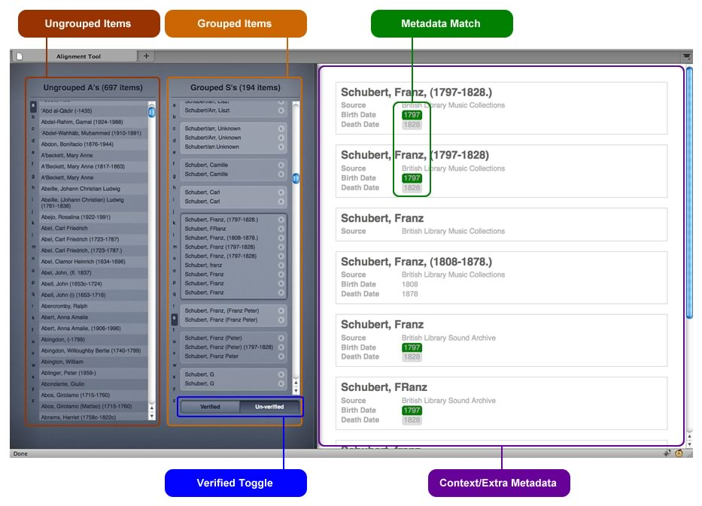
UI of Prototype 2

Slide 23
Prototype 2 demo
Screencast 3:
http://www.youtube.com/watch?v=5f8iaryZMk0&hd=1

Slide 24
Daniel Alexander Smith

Slide 25
Linked Data
URI for everything
e.g. Beethoven is:
  http://musicnet.mspace.fm/person/367b107e07a7f9db8aed7c72d2ebeab2#id
  http://dbpedia.org/resource/Ludwig_van_Beethoven
  http://www.bbc.co.uk/music/artists/1f9df192-a621-4f54-8850-2c5373b7eac9#artist

Slide 26
Contribution
MusicNet provides links between composers in multiple scholarly repositories
We also link to MusicBrainz and BBC /music
This can be fed back into projects like musicSpace where disambiguation is a problem

Slide 27
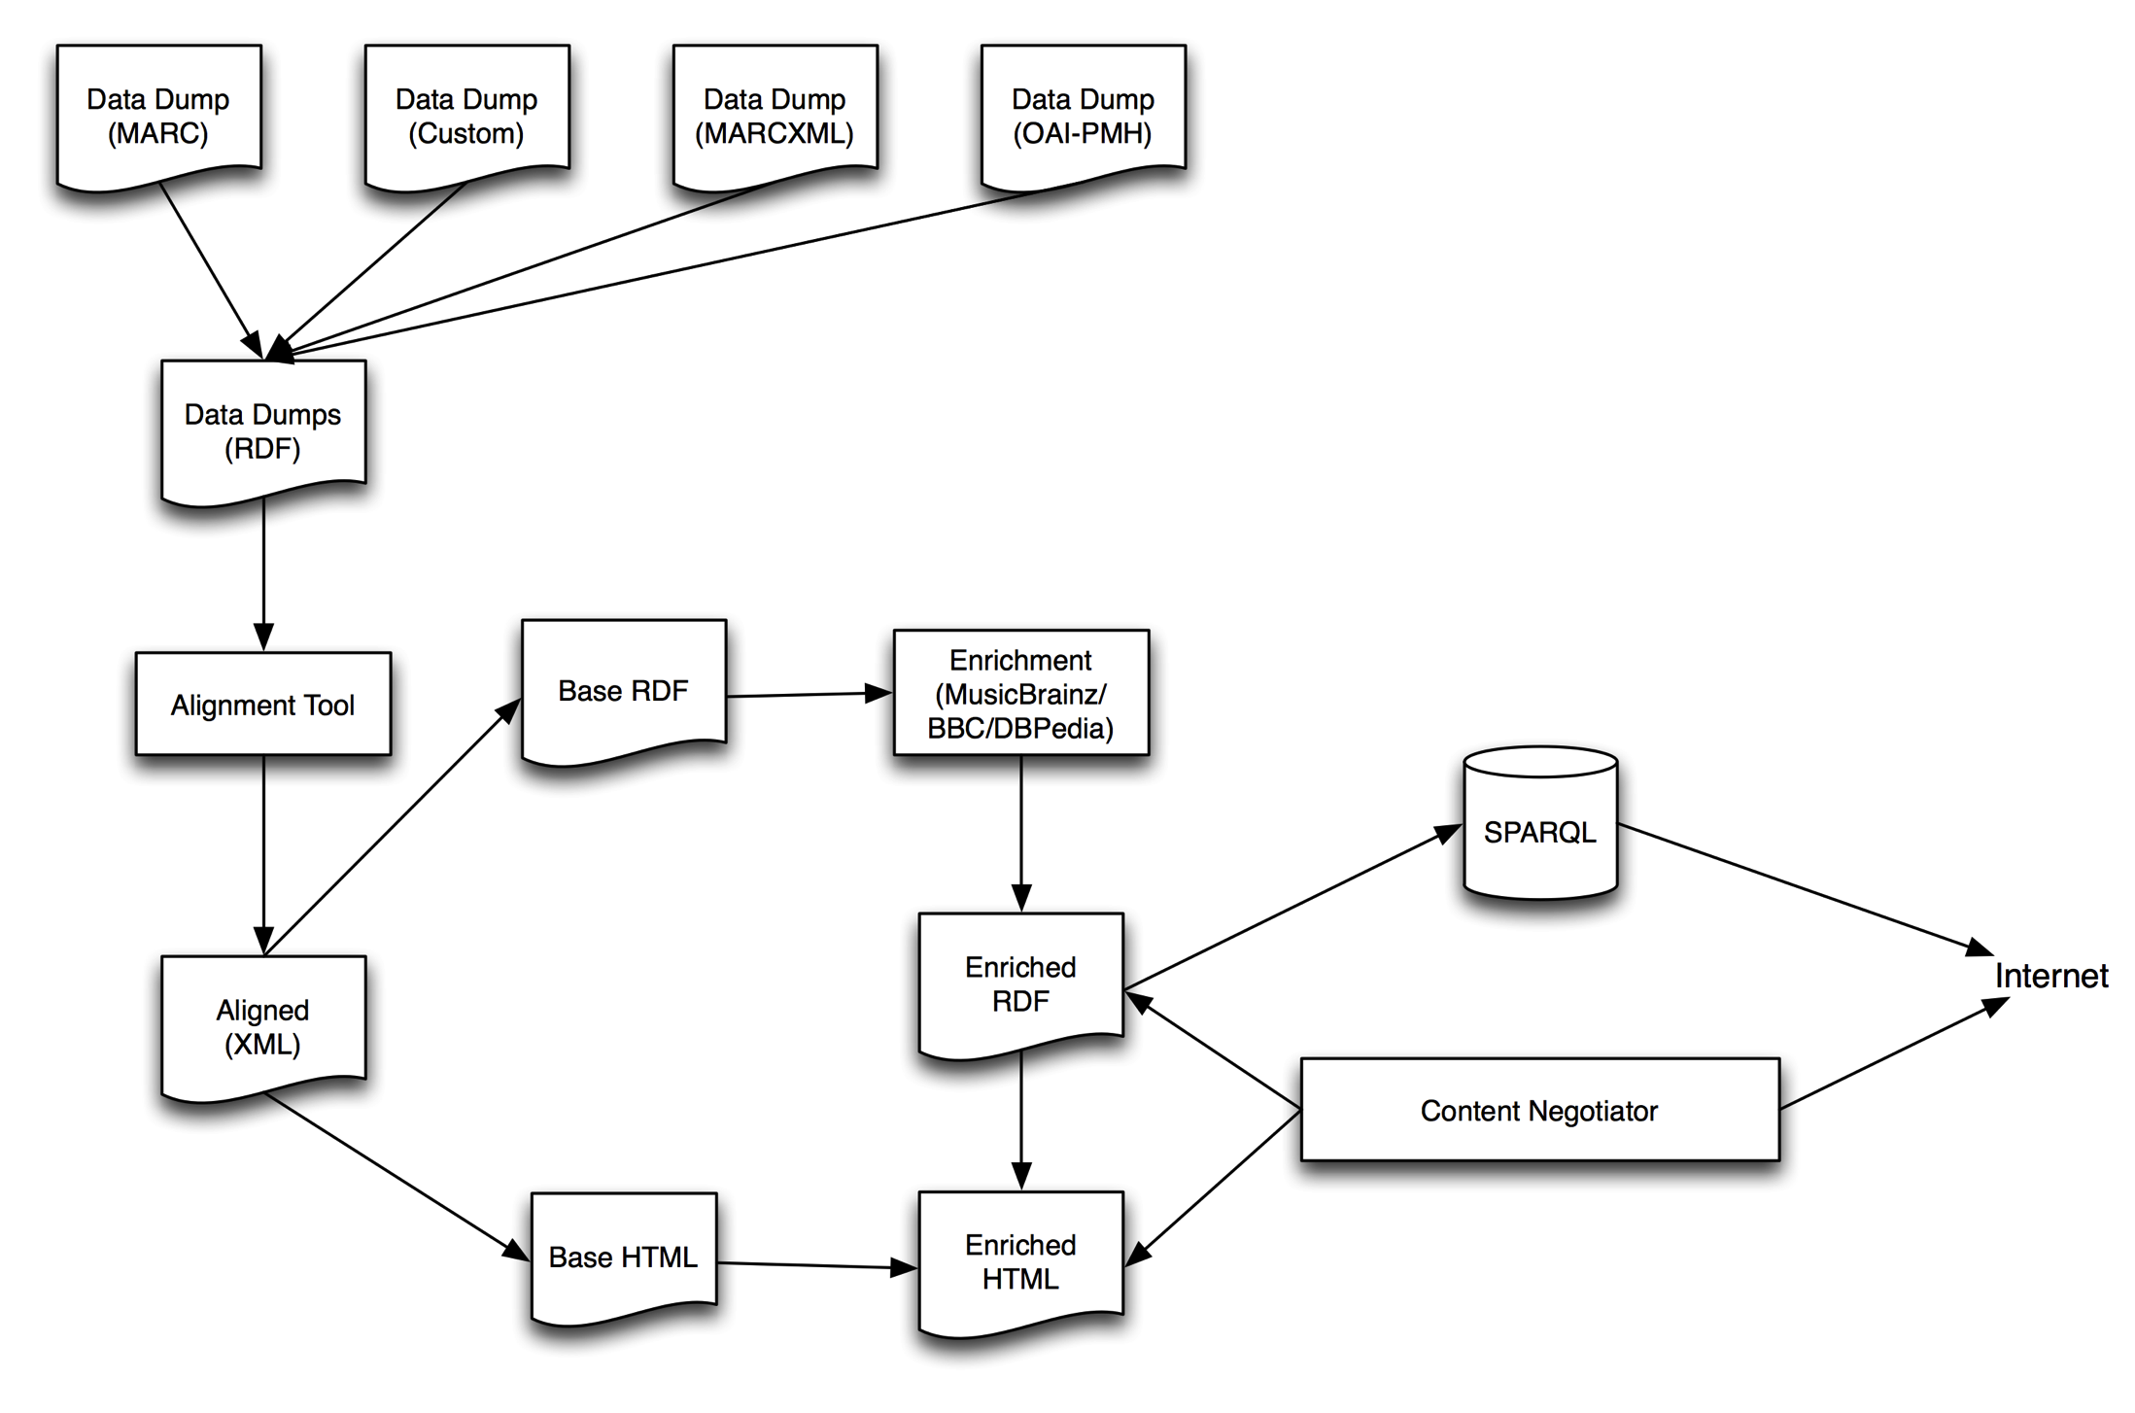

Slide 28
MusicNet Published Data
Links between multiple URIs
Representations from each source
Machine-readable, standardised to build applications over this data
Human searchable and usable too
http://musicspace.mspace.fm

Slide 29
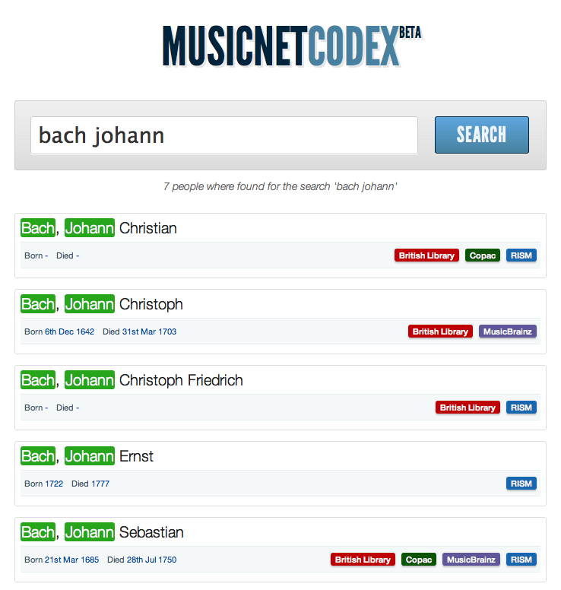

Slide 30
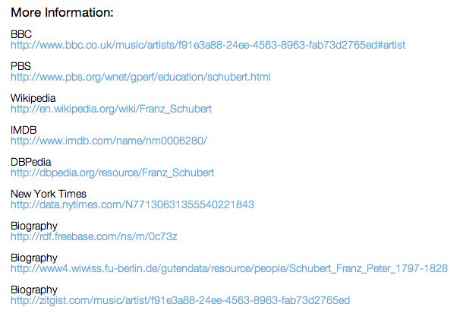

Slide 31
Provenance
Retains source of information
e.g. that Grove say “Schubert, Franz (Peter)” and British Library say “Schubert, Franz” and “Schubert”

Slide 32
Provenance
When they don’t exist already, musicnet provides individual URIs for a composer from each source, e.g.:
  http://musicnet.mspace.fm/person/7ca5e11353f11c7d625d9aabb27a6174#blcollection
Then links back to search URLs, e.g.:
  http://catalogue.bl.uk/F/?func=find-b&request=Schubert%2C+Franz&find_code=WNA

Slide 33
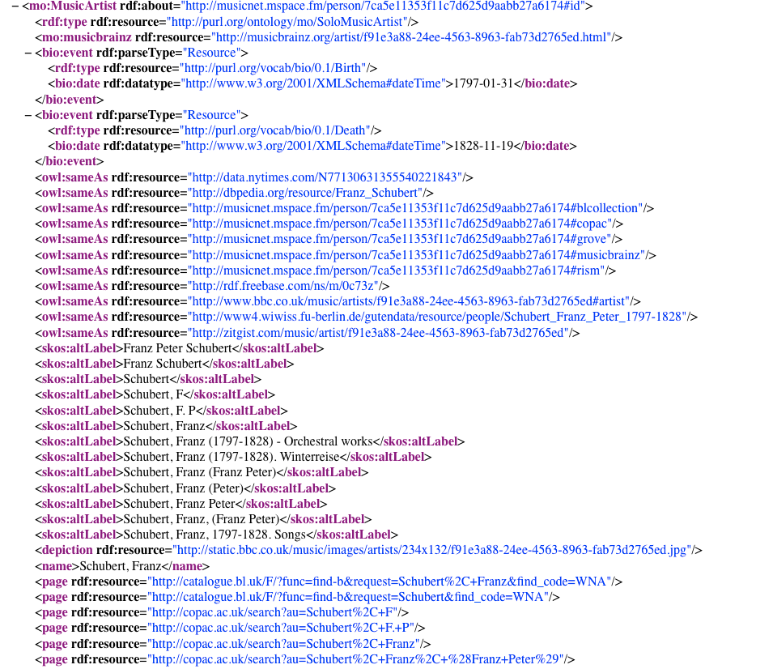

Slide 34
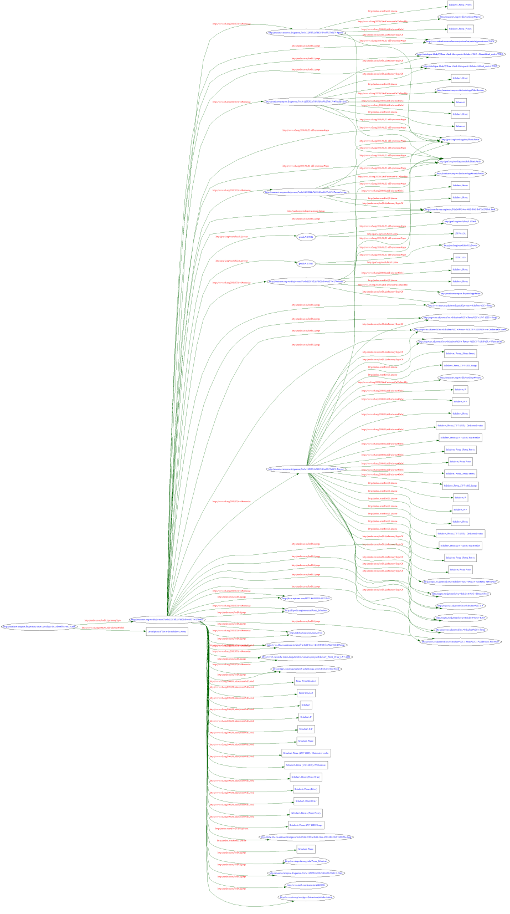

Slide 35
Links from BBC /music
Harvested links from BBC to:
  DBPedia
  New York Times
  IMDB
  PBS
  etc.

Slide 36
Thank you for listening!

