Slide 1
Open Access and
Open Data
(with particular reference to the role of journals)
Alma Swan
Key Perspectives Ltd
Truro, UK
2nd NERC Data Management Workshop, Oxford, 17-18 February 2009

Slide 2
Open Access: articles
All seven Research Councils now have a mandatory OA policy
Details differ but the requirement is to make publications OA through some means within a certain (short) period of time
Other funders and institutions (and now governments) implementing similar policies
Increasing amount of freely available research summaries (journal articles)
Key Perspectives Ltd

Slide 3
Open Data: datasets
Recognition that research summaries (articles) are only partially informative and relatively useless
Research outputs in STM now all digital
Datasets ‘are a resource in their own right’ *
Digital data have a vastly increased utility:
    Easily passed around
    More easily re-used
    Opportunities for educational or commercial exploitation
Data already becoming the primary outputs of research in some fields
* NERC Data Handbook
Key Perspectives Ltd

Slide 4
The issues
Ownership
Ease of re-use
Curation
Key Perspectives Ltd

Slide 5
Ownership
Publishers do not claim ownership
Usually
Key Perspectives Ltd

Slide 6
… as a general principle, … the raw data outputs of research, should wherever possible be made freely accessible to other scholars
… best practice … is to separate supporting data from the article itself, and not to require any transfer of or ownership in such data or data sets as a condition of publication of the article in question
… it would be highly desirable, whenever feasible, to provide free access to that [sic] data, immediately or shortly after publication, whether the data is [sic] hosted on the publisher’s own site or elsewhere
ALPSP / STM Statement on databases, data sets and data accessibility, 2006
Key Perspectives Ltd

Slide 7
Ownership
Publishers do not claim ownership
Usually
Funders may own data
Employers may own data
Several entities may share ownership
Creators frequently do not legally own the data they produce
Creators make many assumptions, and express little knowledge, about this
Key Perspectives Ltd

Slide 8
Ownership questions
Most data creators don’t know and don’t care
They share, if that’s their thing
Or withhold, if they fear being exploited or just wish to stop others getting the use of their data
They may share before the data owner (e.g. funder) wishes them to
They may discard the data (even when they don’t own them)
Ownership implies a duty of care
Key Perspectives Ltd

Slide 9
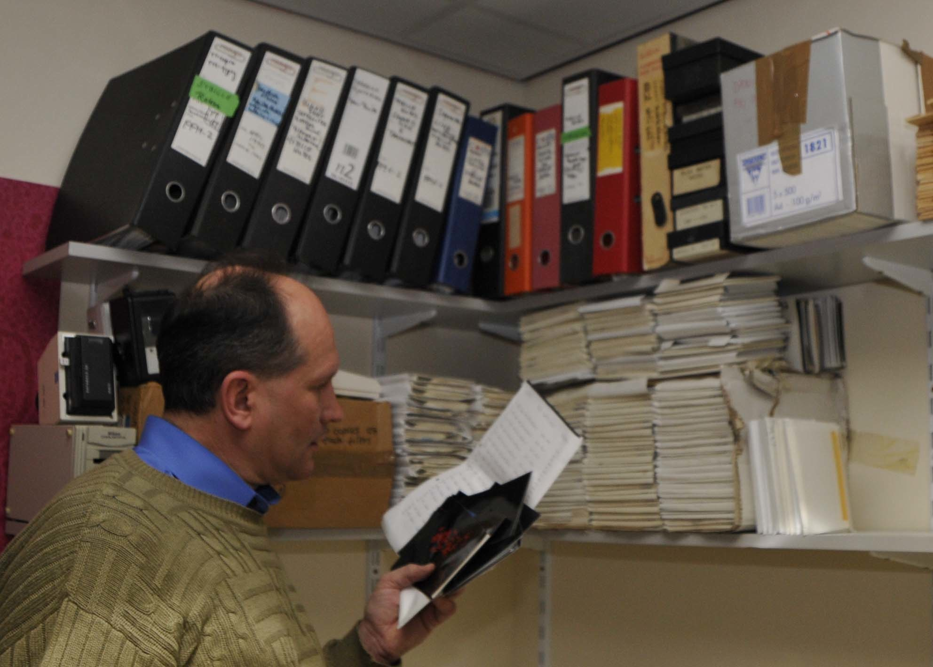
Key Perspectives Ltd

Slide 10
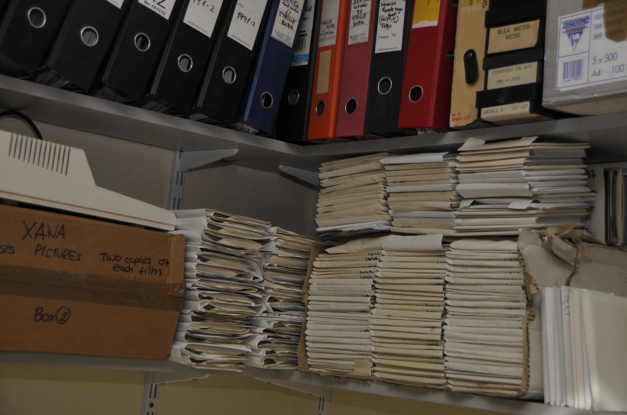
Key Perspectives Ltd

Slide 11
The role of journals I
In some areas of research, journals play the role of enforcer/policeman
May require accession numbers (e.g. for molecular biology datasets in Genbank)
May require datasets themselves (e.g. chemical crystallography)
May even BE the data
Key Perspectives Ltd

Slide 12
Key Perspectives Ltd

Slide 13
Key Perspectives Ltd

Slide 14
Key Perspectives Ltd

Slide 15
The role of journals I
In many areas of research, journals play the role of enforcer/policeman
May require accession numbers (e.g. for molecular biology datasets in Genbank)
May require datasets themselves (e.g. chemical crystallography)
May even BE the data
This is likely to increase as publishers see providing research context (i.e. linking articles to underlying data) as another value-creating service
Key Perspectives Ltd

Slide 16
The role of journals II
This is both helpful and not helpful:
  Helpful because metadata are relatively good
  Helpful because the system begins to create the linked web environment (limited semantics, but a start on the syntax)
  Especially unhelpful if they don’t police their requirement
  Journal websites almost always store and share only flat files (mostly PDF), so the 1s and 0s are missing
Key Perspectives Ltd

Slide 17
Key Perspectives Ltd

Slide 18
Key Perspectives Ltd

Slide 19
Key Perspectives Ltd

Slide 20
Key Perspectives Ltd

Slide 21
The role of journals II
This is both helpful and not helpful:
  Helpful because metadata are relatively good
  Helpful because the system begins to create the linked web environment (limited semantics, but a start on the syntax)
  Especially unhelpful if they don’t police their requirement
  Journal websites almost always store and share only flat files (mostly PDF), so the 1s and 0s are missing
  Some DO claim ownership of data in the text
Key Perspectives Ltd

Slide 22
Key Perspectives Ltd

Slide 23
Key Perspectives Ltd

Slide 24
Key Perspectives Ltd

Slide 25
The role of journals II
This is both helpful and not helpful:
  Especially unhelpful if they don’t police their requirement
  Journal websites almost always store and share only flat files (mostly PDF)
  Some DO claim ownership of data in the text
Do we leave the curation of datasets to publishers? (for all time?)
Key Perspectives Ltd

Slide 26
Where should data go?
To places where they can be found by others
To places where they can be accessed in a usable (re-usable) form
To places where they can be accessed without price or permission barriers
To places where they can be accessed in perpetuity
Key Perspectives Ltd

Slide 27
Current patterns
NERC and ESRC: first off the block – provide centralised national-level Data Centres
Later adopters : Delegate responsibility to the PI and institutions (the other RCs, with some sub-exceptions – e.g. Archaeology DS, Astronomy DCs)
Better than nothing
Good in disciplines where there are public databanks
Questionable merit in leaving institutions to take on the responsibility
Key Perspectives Ltd

Slide 28
Thank you for listening
aswan@keyperspectives.co.uk
www.keyperspectives.co.uk
www.keyperspectives.com
Key Perspectives Ltd

