Slide 1
What a repository can do for you – and for your university
Alma Swan
Key Perspectives Ltd
Truro, UK

Slide 2
Some context

Slide 3
Old paradigms of research dissemination
Use of proxy measures of an individual scholar’s merit is as good as it gets
The responsibility for disseminating your work rests with the publisher
The printed article is the format of record
Other scholars have time to search out what you want them to know
Key Perspectives Ltd

Slide 4
New paradigms of research dissemination
Rich, deep, broad metrics for measuring the contributions of individual scholars
Effective dissemination of your work is now in your hands (at last)
The digital format will be the format of record (is already in many areas)
Unless you routinely publish in Nature or Science, ‘getting it out there’ is up to you
Key Perspectives Ltd

Slide 5
Key Perspectives Ltd

Slide 6
The system is broken
WHO survey (2000):
56% of research-based institutions in lower-income countries had NO current subscriptions to research journals
Nor had they for the previous 5 years
We will never close the “10/90 gap” unless we change the system
Publicly-funded research should be freely available to the ‘public’
Key Perspectives Ltd

Slide 7
The solution: Open Access
Key Perspectives Ltd

Slide 8
Open Access
Immediate
Free (to use)
Free (of restrictions)
Access to the peer-reviewed literature (and data)
Not vanity publishing
Not a ‘stick anything up on the Web’ approach
Moving scholarly communication into the Web Age
Key Perspectives Ltd

Slide 9
Open Access: Who benefits?
Researchers
Institutions
National economies
Science and society
Key Perspectives Ltd

Slide 10
Why Open Access
Greater impact from scientific endeavour
More rapid and more efficient progress of science
Novel information-creation using new and advanced technologies
Better assessment, better monitoring, better management of science
Key Perspectives Ltd

Slide 11
Open Access: how
Open Access journals (www.doaj.org)
Open Access repositories
Key Perspectives Ltd

Slide 12
How to make your work Open Access through a repository
Prepare your paper and submit it to your journal of choice for peer review
Make any changes required as a result of the peer review process
Submit the final version to the journal
Deposit that same final version to your repository through the normal deposit procedure that applies in your institution
N.B. Your repository staff may check journal copyright conditions on your behalf, or you may do so yourself using the SHERPA RoMEO service at http://www.sherpa.ac.uk/romeo/
Key Perspectives Ltd

Slide 13
Open Access repositories
Digital collections
Most usually institutional
Sometimes centralised (subject-based)
Interoperable
Form a network across the world
Create a global database of openly-accessible research
Currently >1400
Key Perspectives Ltd

Slide 14
Where repositories are
Total at September 2009: 1422
Key Perspectives Ltd

Slide 15
What they contain
Key Perspectives Ltd

Slide 16
A well-filled repository
Key Perspectives Ltd

Slide 17
And it gets used
Key Perspectives Ltd

Slide 18
What about authors (researchers)?
Key Perspectives Ltd

Slide 19
An institutional repository provides researchers with:
The means to disseminate their work, free, to the world
Secure storage (for completed work and for work-in-progress)
A location for supporting data that are unpublished
One-input-many outputs (CVs, publications)
Tool for research assessment
Personal marketing tool
The route to maximal visibility and impact for their work
Key Perspectives Ltd

Slide 20
Impact
Range = 36%-200%
(Data: Stevan Harnad and co-workers)
Key Perspectives Ltd

Slide 21
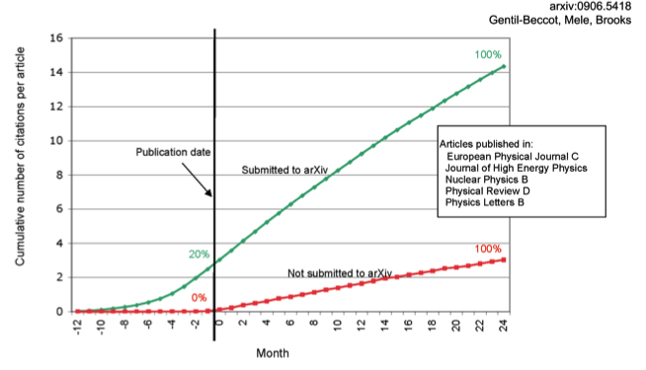
The early bird …
Key Perspectives Ltd

Slide 22
An author’s own testimony on open access visibility
“Self-archiving in the PhilSci Archive has given instant world-wide visibility to my work. As a result, I was invited to submit papers to refereed international conferences/journals and got them accepted.”
Key Perspectives Ltd

Slide 23
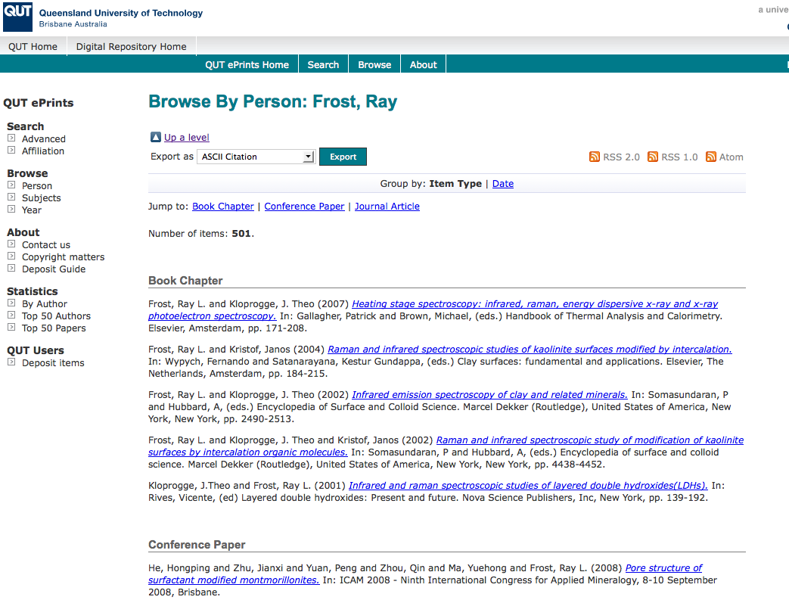
What it means to a researcher
Key Perspectives Ltd

Slide 24
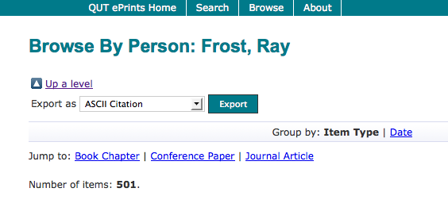
Key Perspectives Ltd

Slide 25
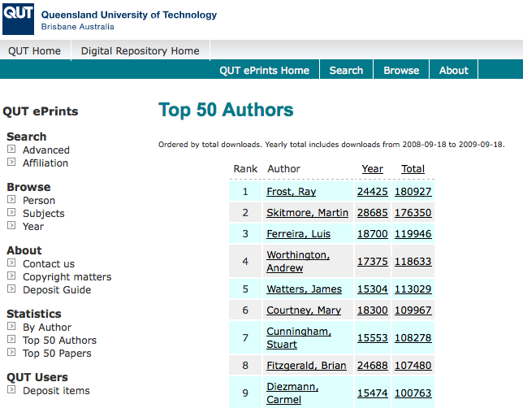
Key Perspectives Ltd

Slide 26
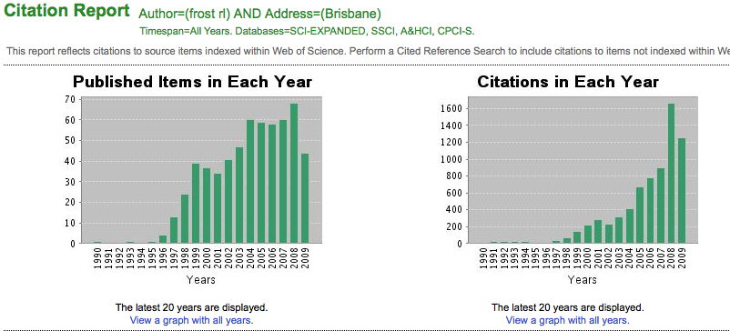
Ray Frost’s impact
Key Perspectives Ltd

Slide 27
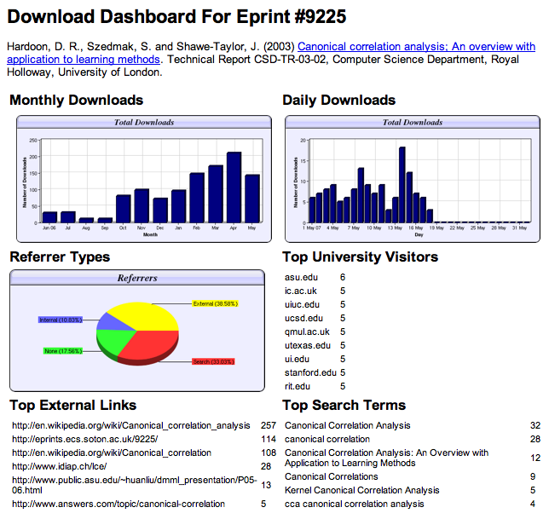

Slide 28
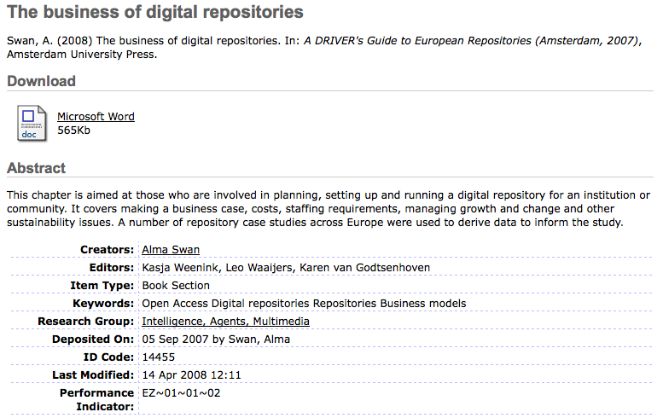
Key Perspectives Ltd
Notes:
28

Slide 29
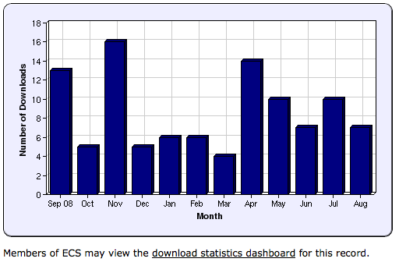
Key Perspectives Ltd
Notes:
29

Slide 30
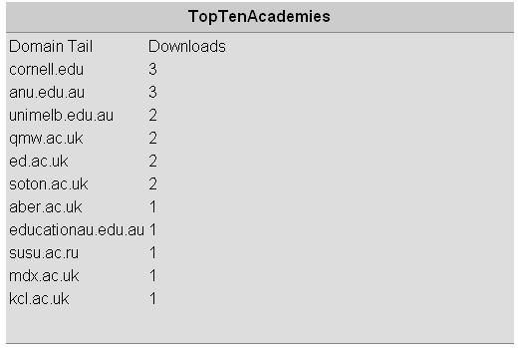
N.B. Downloads are a good predictor of eventual citations
Key Perspectives Ltd
Notes:
30

Slide 31
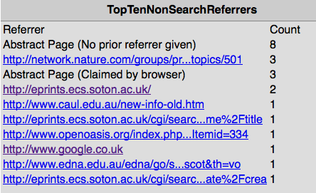
Key Perspectives Ltd

Slide 32
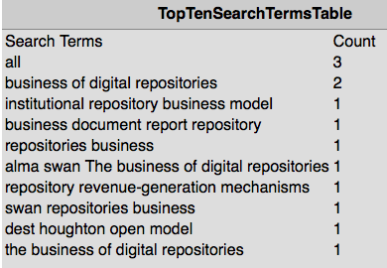
Key Perspectives Ltd

Slide 33
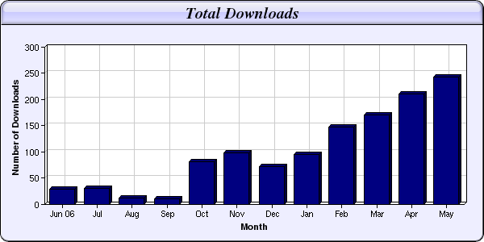
Every e-print tells a story…
Link placed on “Canonical correlation” page in Wikipedia
NIPS Workshop linked to this eprint from its web page
Key Perspectives Ltd

Slide 34
And for institutions?
Key Perspectives Ltd

Slide 35
What is a university for?
Key Perspectives Ltd

Slide 36
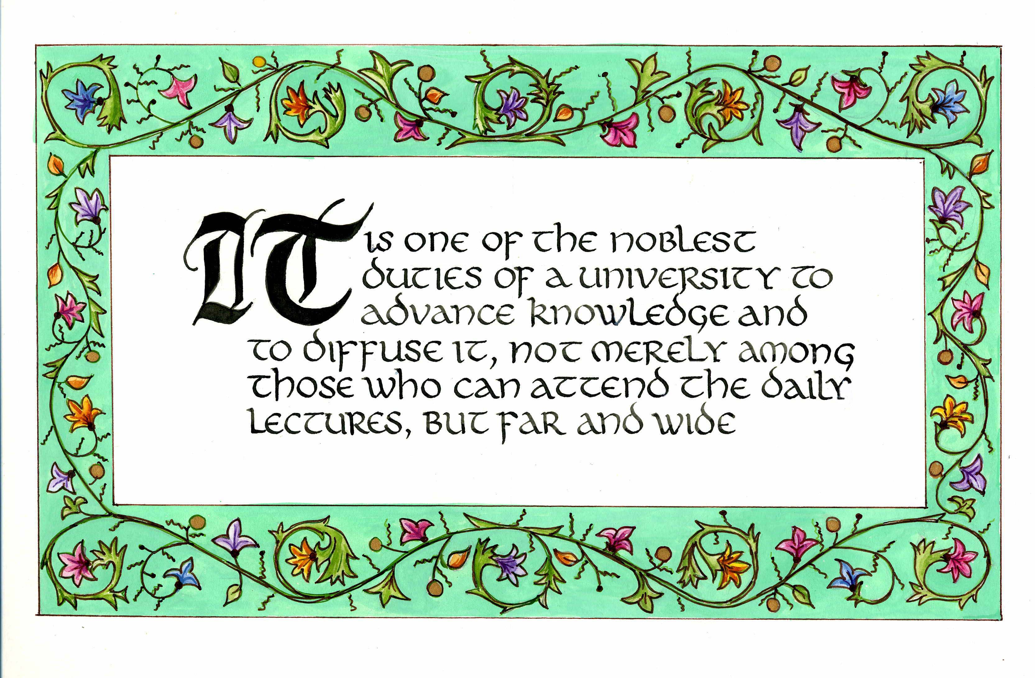
Daniel Coit Gilman First President, Johns Hopkins University (1878)
Key Perspectives Ltd

Slide 37
University of Edinburgh Strategic Plan 2008-12
“The mission of our University is the creation, dissemination and curation of knowledge.”
Key Perspectives Ltd

Slide 38
An institutional repository …
Fulfils a university’s mission to engender, encourage and disseminate scholarly work
Complete record of its intellectual effort
Permanent record of all digital output
Research management tool
Marketing tool for universities
Provides maximum Web impact for the institution
Key Perspectives Ltd

Slide 39
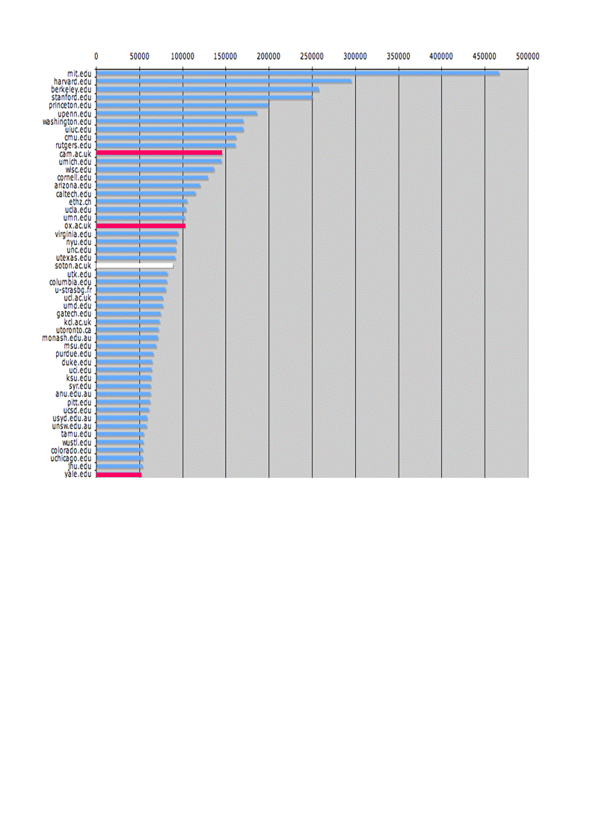
The U.Southampton conundrum
The G-Factor (universitymetrics.com)
Key Perspectives Ltd

Slide 40
Key Perspectives Ltd

Slide 41
Impact
Range = 36%-200%
(Data: Stevan Harnad and co-workers)
Key Perspectives Ltd

Slide 42
Lost citations, lost impact
Say, Open Access brings 50% more citations
Only around 15% of research is Open Access
….. so 85% is not
University X is therefore losing 85% of the 50% increase in citations (conservative end of the range) that Open Access brings (= 42.5%)
Key Perspectives Ltd

Slide 43
What this means to University X
2008: 2500 articles
Number of citations: 10000
If all had been OA, there would have been (42.5% more) 14250 citations, and ….
Since University X invests £100m in research per annum …
…this means lost impact worth £42.5m to the university in one year
Key Perspectives Ltd

Slide 44
Open Access policies
Key Perspectives Ltd

Slide 45
Repositories… “are vital to universities’ economies and to the UK economy as a whole.”
Professor J Drummond Bone
Past President, Universities UK
Key Perspectives Ltd

Slide 46
OECD
“Governments would boost innovation and get a better return on their investment in publicly funded research by making research findings more widely available …. and by doing so they would maximise social returns on public investments.”
OECD Report on Scientific Publishing, 2005
Key Perspectives Ltd

Slide 47
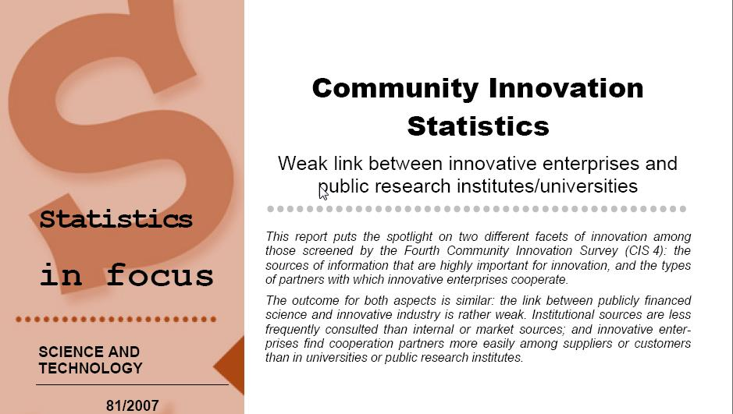
EU CIS studies
Key Perspectives Ltd

Slide 48
EU CIS studies, continued …
“Institutional sources are less frequently consulted than internal or market sources; and innovative enterprises find cooperation partners more easily among suppliers or customers than in universities or public research institutes.”
Key Perspectives Ltd

Slide 49
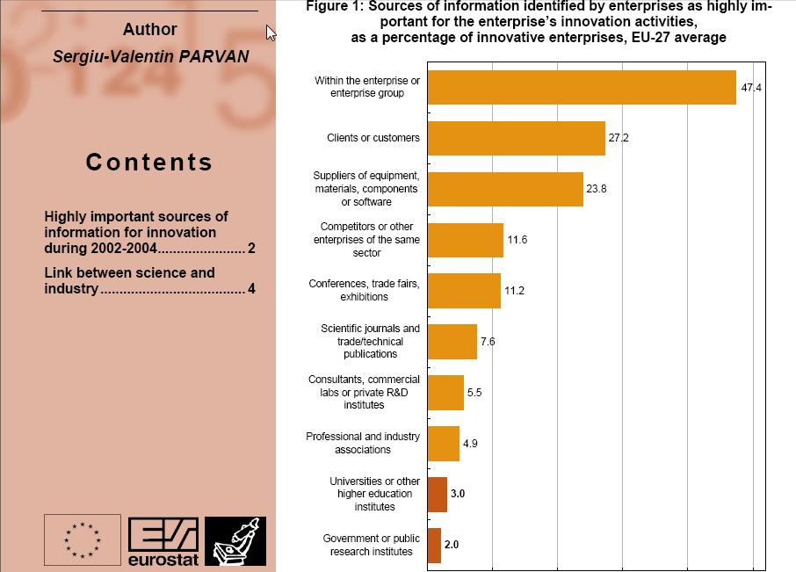
Key Perspectives Ltd

Slide 50
Total Research Income: QUT and sector
Data: Tom Cochrane
Deputy Vice-Chancellor, QUT
Key Perspectives Ltd

Slide 51
Finally, a solution to the researcher’s – and university’s – dilemma …
“My enemy isn’t plagiarism, it’s obscurity”
Key Perspectives Ltd

Slide 52
Thank you for listening
aswan@keyperspectives.co.uk
www.keyperspectives.co.uk
www.openoasis.org
Key Perspectives Ltd

