Slide 1
Bringing things together for Open Access – How are we doing?
4.ª CONFERÊNCIA SOBRE O ACESSO LIVRE AO CONHECIMENTO
University of Minho, Braga, Portugal 26 - 27 November 2009
Alma Swan
Key Perspectives Ltd
Truro, UK

Slide 2
Joining up the dots
Things:
  Articles and Conference papers
  Theses
  Books
  Datasets
Mechanisms
  Policies
  Infrastructure
  Organisations
  Economics
Key Perspectives Ltd

Slide 3
Things
Articles and conference papers: further evidence for increased impact with OA
Theses are increasingly being addressed
Humanities are NOT being left behind
Datasets are now being treated as VERY IMPORTANT!
Key Perspectives Ltd

Slide 4
Impact
Gentil-Beccot, Mele and Brooks (2009)
“Immense Open Access advantage” for papers deposited in arXiv before formal publication
“Do not detect any citation advantage from publication in open Access journals in HEP.”
Key Perspectives Ltd

Slide 5
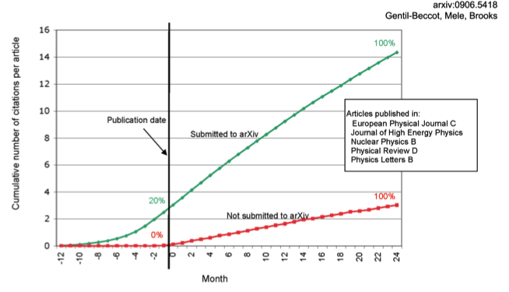
The early bird …
Key Perspectives Ltd

Slide 6
Theses
Key Perspectives Ltd

Slide 7
Humanities are OA too
Humanities journal articles are covered by mandates
New platforms appearing for humanities outputs
  Open Humanities Press
New business models are being explored for books:
  US university presses
  OAPEN Project (www.oapen.org)
  Commercial publishers (Bloomsbury Academic)
Key Perspectives Ltd

Slide 8
Datasets
“No rights reserved”
  CC0 licensing
  Avoids ‘attribution stacking’
  http://creativecommons.org/about/cc0
Key Perspectives Ltd

Slide 9
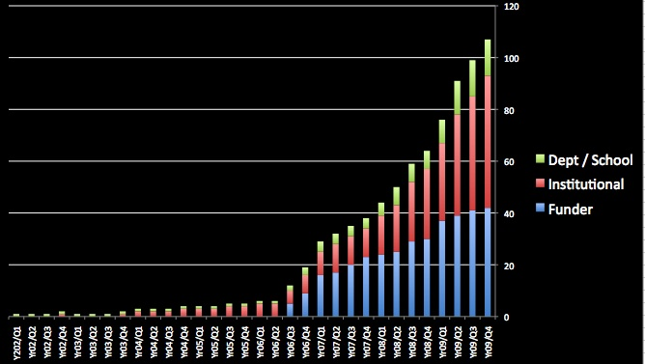
Policies
Key Perspectives Ltd

Slide 10
Queensland University of Technology
EPrints repository
Mandatory policy since 2004
14,269 items, of which almost 9000 are full-text, OA
Further 1000 in embargo area
2088 active depositors
Key Perspectives Ltd

Slide 11
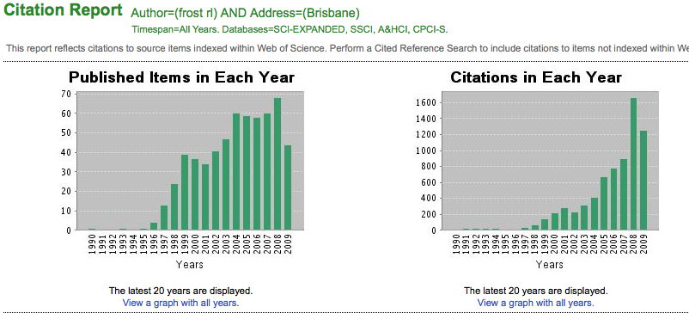
Ray Frost’s impact
Key Perspectives Ltd

Slide 12
Total Research Income: QUT and sector
Data: Tom Cochrane
Deputy Vice-Chancellor, QUT
Key Perspectives Ltd

Slide 13
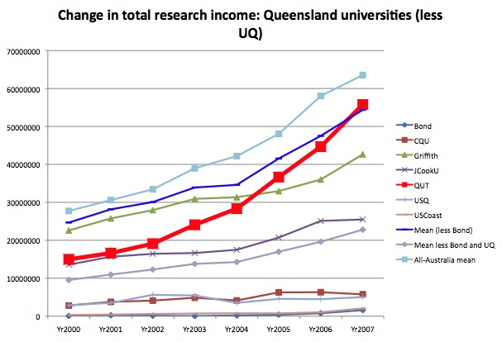
Key Perspectives Ltd

Slide 14
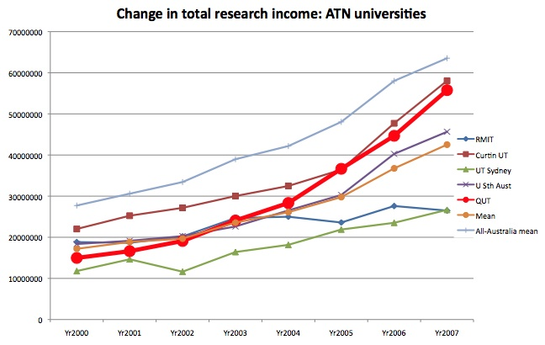
Key Perspectives Ltd

Slide 15
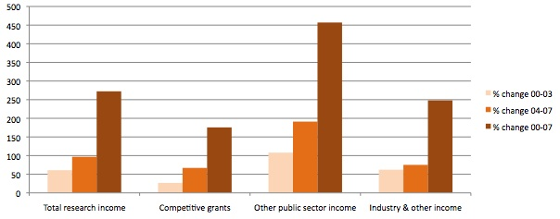
QUT: research income components
Key Perspectives Ltd

Slide 16
Economics
John Houghton’s studies:
  Australia
  UK
  Netherlands
  Denmark
New UK study at institution-level (publishing January 2010; early results Berlin 7 Conference)
Other developments:
  SCOAP3 (Sponsoring Consortium for OA Publishing in Particle Physics)
  COPE (Compact for OA Publishing Equity)
  Knowledge Exchange study on submission charges
Key Perspectives Ltd

Slide 17
Infrastructures
e-science infrastructures
Repository infrastructures:
  Deposit (e.g. SWORD)
  Discovery (metadata)
  Re-use (XML)
Preserve e.g. PLANETS (Preservation and Long-Term Access through Networked Services) Project http://www.planets-project.eu/
Services:
  DOAJ
  National harvesters/portals for OA content
    Scielo (journals)
    RCAAP (Portugal) http://www.rcaap.pt/about_en.jsp
    Recolecta (Spain) http://search.recolecta.driver.research-infrastructures.eu/
Joining things up on campus
  Campus profiling services (e.g. VIVO, bibApp)
  CRIS-repository linking
Key Perspectives Ltd

Slide 18
Organisations
OASPA (Open Access Scholarly Publishers Association) www.oaspa.org
COAR (Confederation of Open Access Repositories) http://www.driver-repository.eu/DRIVER-COAR.html
EOS (Enabling Open Scholarship) www.openscholarship.org
Open Access Week http://www.openaccessweek.org/
Key Perspectives Ltd

Slide 19
Thank you for listening
aswan@keyperspectives.co.uk
www.keyperspectives.co.uk
www.openoasis.org
Key Perspectives Ltd
Key Perspectives Ltd

