Slide 1
Open access what’s in it for poland?
Alma Swan
Key Perspectives Ltd
Truro, UK

Slide 2
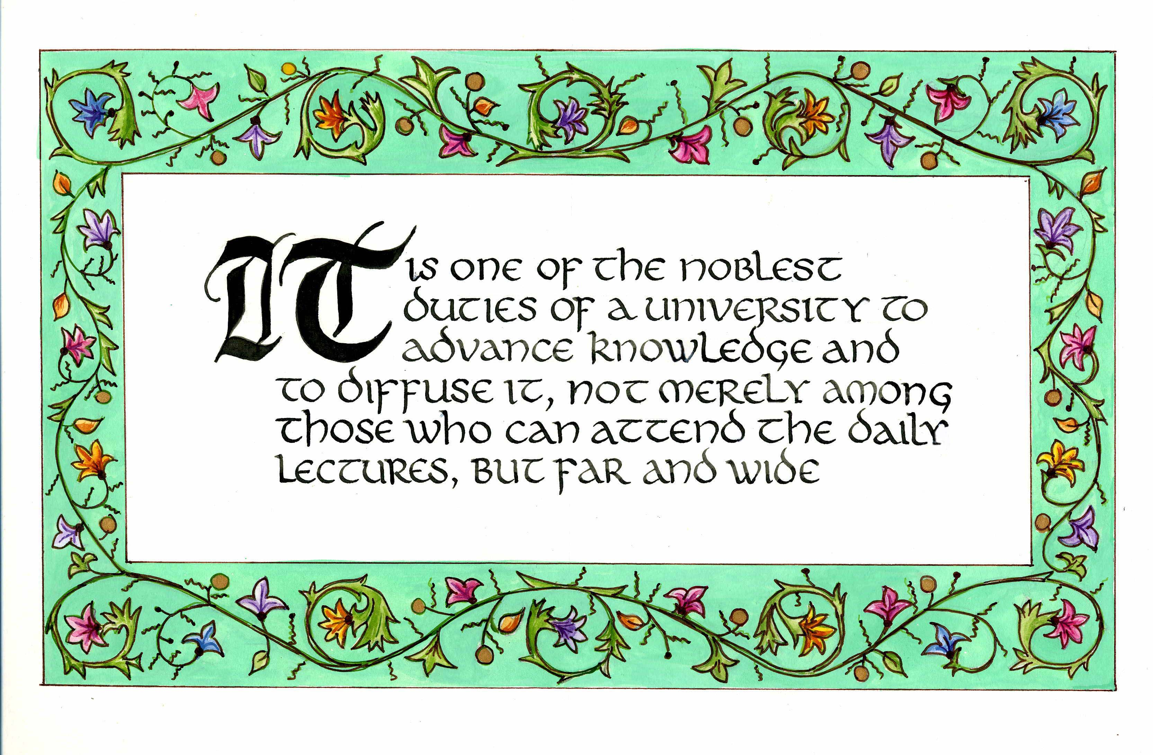
Daniel Coit Gilman
First President, Johns Hopkins University
Key Perspectives Ltd

Slide 3
Open Access
Immediate
Free (to use)
Free (of restrictions)
Access to the peer-reviewed literature (and data)
Not vanity publishing
Not a ‘stick anything up on the Web’ approach
Moving scholarly communication into the Web Age
Key Perspectives Ltd

Slide 4
Open Access – Why?
Science moves faster and more efficiently
Greater visibility and impact
Better monitoring, assessment and evaluation of research
Enables new semantic technologies (text-mining and data-mining)
Key Perspectives Ltd

Slide 5
Open Access: Who benefits?
Benefits to researchers themselves
Benefits to institutions
Benefits to national economies
Benefits to science and society
Key Perspectives Ltd

Slide 6
Open Access: how
Open Access repositories
Open Access journals (www.doaj.org)
Open Access monographs
Key Perspectives Ltd

Slide 7
Open Access repositories
Digital collections
Most usually institutional
Sometimes centralised (subject-based)
Interoperable
Form a network across the world
Create a global database of openly-accessible research
Currently >1400
Key Perspectives Ltd

Slide 8
Where repositories are
Total at September 2009: 1422
Key Perspectives Ltd

Slide 9
What they contain
Key Perspectives Ltd

Slide 10
What about authors?
Key Perspectives Ltd

Slide 11
How to make your work
Open Access through a repository
Prepare your paper and submit it to your journal of choice for peer review
Make any changes required as a result of the peer review process
Submit the final version to the journal
Deposit that same final version to your repository through the normal deposit procedure that applies in your institution
N.B. Your repository staff may check journal copyright conditions on your behalf, or you may do so yourself using the SHERPA RoMEO service at http://www.sherpa.ac.uk/romeo/
Key Perspectives Ltd

Slide 12
A well-filled repository
Key Perspectives Ltd

Slide 13
And it gets used
Key Perspectives Ltd

Slide 14
Impact
Range = 36%-200%
(Data: Stevan Harnad and co-workers)
Key Perspectives Ltd

Slide 15
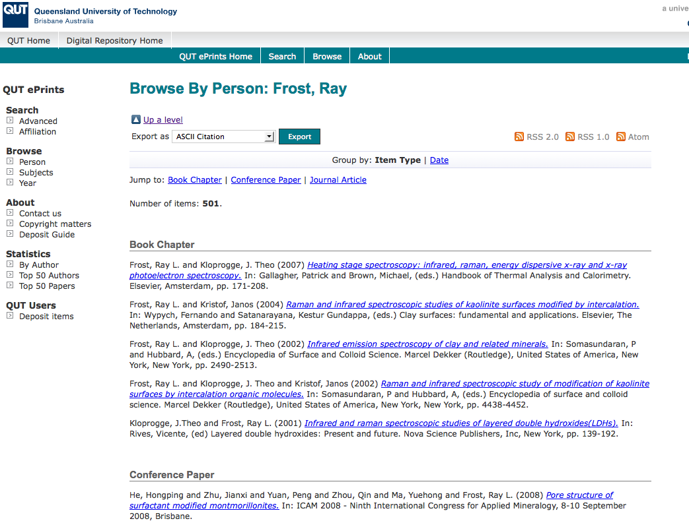
What OA means to a researcher
OpenScholarship.org

Slide 16
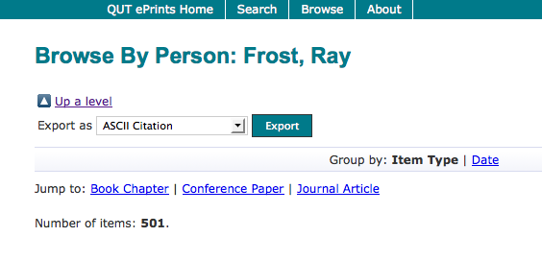
OpenScholarship.org

Slide 17
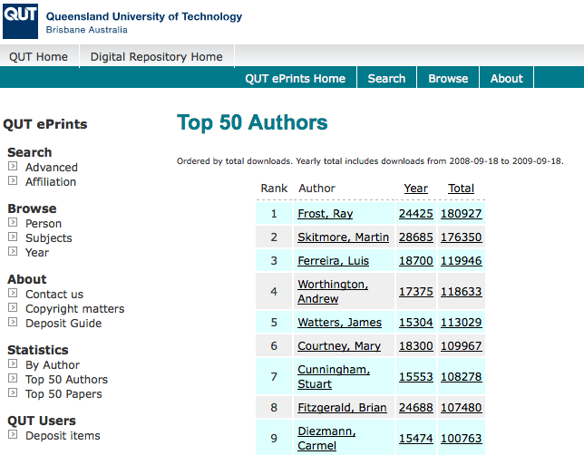
OpenScholarship.org

Slide 18
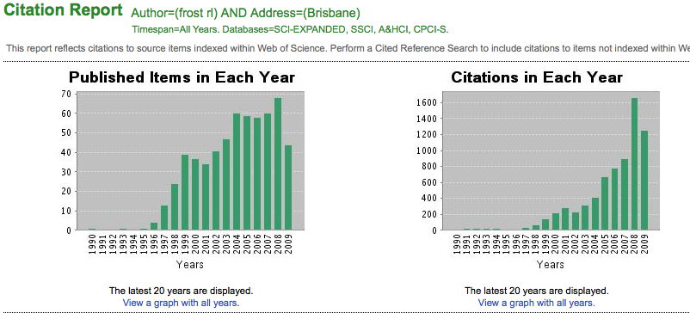
Ray Frost’s impact
OpenScholarship.org

Slide 19
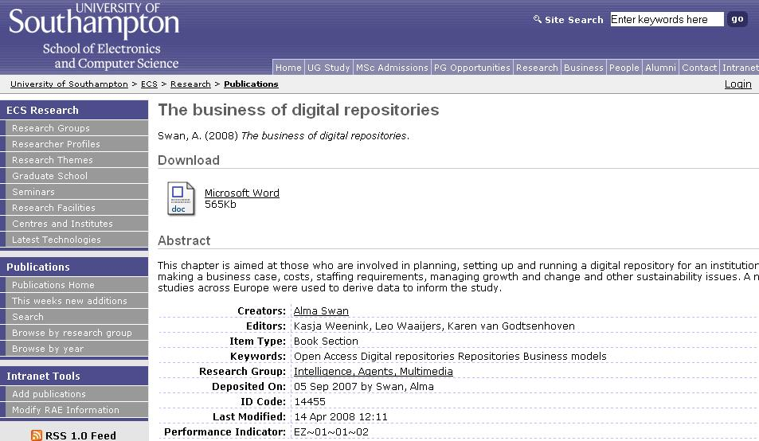
Key Perspectives Ltd
Notes:
19

Slide 20
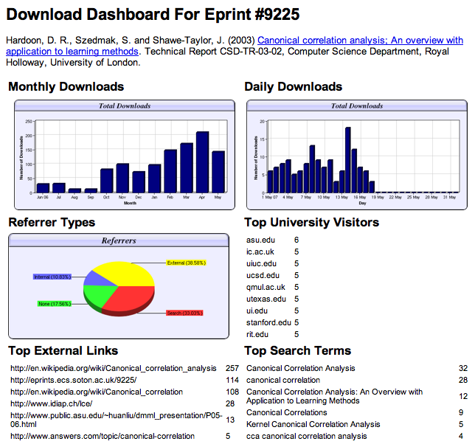

Slide 21
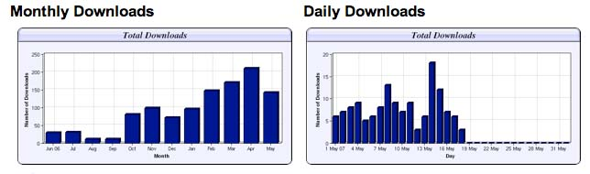
Download timelines
Key Perspectives Ltd

Slide 22
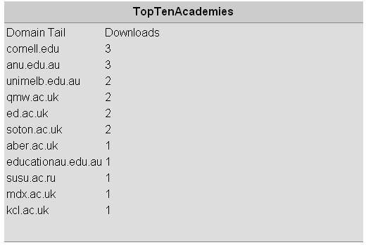
N.B. Downloads are a good predictor of eventual citations
Key Perspectives Ltd
Notes:
22

Slide 23
For institutions?
Key Perspectives Ltd

Slide 24
Why an institutional repository?
Fulfils a university’s mission to engender, encourage and disseminate scholarly work
Complete record of its intellectual effort
Permanent record of all digital output
Research management tool
‘Marketing’ tool for universities
Provides maximum Web impact for the institution
Key Perspectives Ltd

Slide 25
Impact
Range = 36%-200%
(Data: Stevan Harnad and co-workers)
Key Perspectives Ltd

Slide 26
What lack of Open Access means to a university (the University of Warsaw)
Articles: 1249 articles per year
Number of citations: 3642 per year
If all had been OA, there would have been (42.5% more) 4190 citations, and ….
Say, the University invests €50m in research per annum …
…this means lost impact worth €21.3m to the university in one year
Key Perspectives Ltd

Slide 27
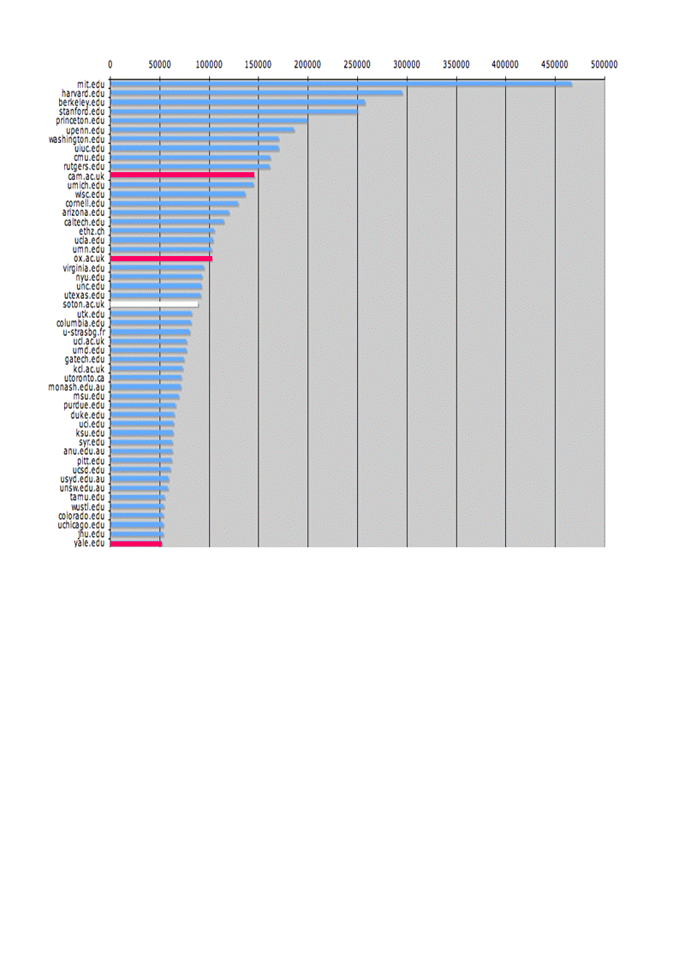
The U.Southampton conundrum
The G-Factor (universitymetrics.com)
Key Perspectives Ltd

Slide 28
Key Perspectives Ltd

Slide 29
OECD
“Governments would boost innovation and get a better return on their investment in publicly funded research by making research findings more widely available …. and by doing so they would maximise social returns on public investments.”
OECD Report on Scientific Publishing, 2005
Key Perspectives Ltd

Slide 30
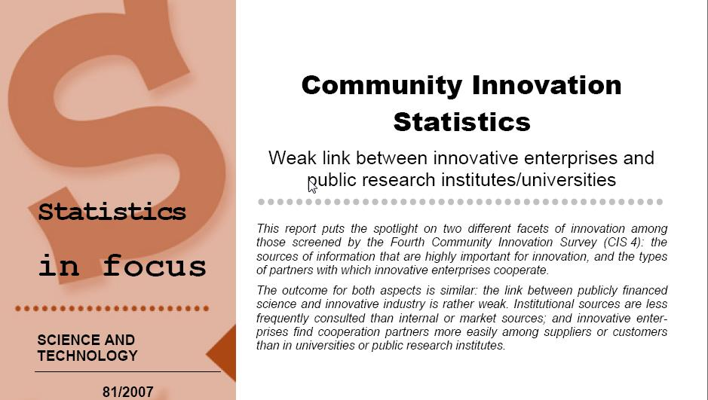
EU CIS studies
Key Perspectives Ltd

Slide 31
EU CIS studies, continued …
“Institutional sources are less frequently consulted than internal or market sources; and innovative enterprises find cooperation partners more easily among suppliers or customers than in universities or public research institutes.”
Key Perspectives Ltd

Slide 32
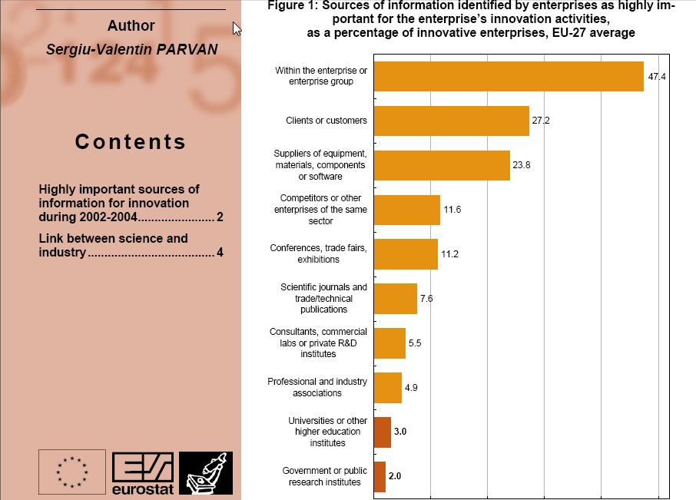
Key Perspectives Ltd

Slide 33
Total Research Income: QUT and sector
Data: Tom Cochrane
Deputy Vice-Chancellor, QUT
Key Perspectives Ltd

Slide 34
And for university publishers?
Key Perspectives Ltd

Slide 35
Open Access journals
Journals that charge an article-processing fee instead of a subscription
Over to BioMed Central …
Key Perspectives Ltd

Slide 36
Open Access monographs
Free online, paid-for in print
University presses already publish using this business model (e.g. Amsterdam UP, Michigan UP, Australian National University Press)
AUP ‘rents’ space in Amsterdam University’s repository for e-publishing in Open Access
Evidence suggests that OA monographs have increased print sales
OAPEN (www.oapen.org)
Key Perspectives Ltd

Slide 37
Resources
1. General, comprehensive resource on Open Access:
OASIS
(Open Access Scholarly Information Sourcebook)
www.openoasis.org
Resource for policymakers, institutional managers:
EOS
(Enabling Open Scholarship)
www.openscholarship.org
Key Perspectives Ltd

Slide 38
Thank you for listening
aswan@keyperspectives.co.uk
www.keyperspectives.co.uk
www.keyperspectives.com
Key Perspectives Ltd

