Slide 1
Connecting Preservation Planning and Plato with Digital Repository Interfaces
David Tarrant
davetaz@ecs.soton.ac.uk

Slide 2











The digital preservation landscape
DROID
DAF

Slide 3
Overview
Bit Preservation
Identification
Characterisation
Digital Repository
Risk Assessment
Planning
Action

Slide 4
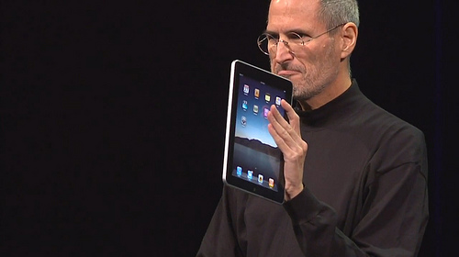
Interfaces…
“75 million people already own iPod Touches and iPhones. That's all people who already know how to use the iPad.”
Picture by curiouslee http://www.flickr.com/photos/curiouslee/4320074421/

Slide 5
Message 1
“Digital preservation can be simplified by integrating tools and services with existing digital repository interfaces #ipres2010”

Slide 6
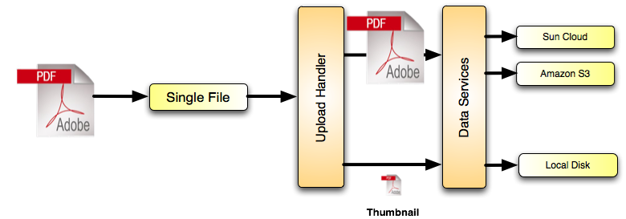
EPrints Storage Controller
Bit Preservation
Flexible Decision Logic
Periodic
md5 sum checks
Multiple Copies
Multiple Services

Slide 7
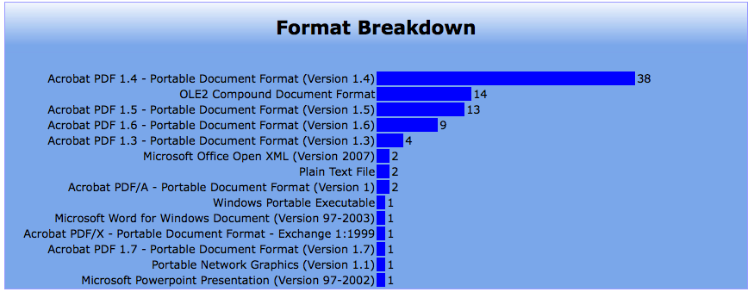
DROID in the Repository
Identification

Slide 8
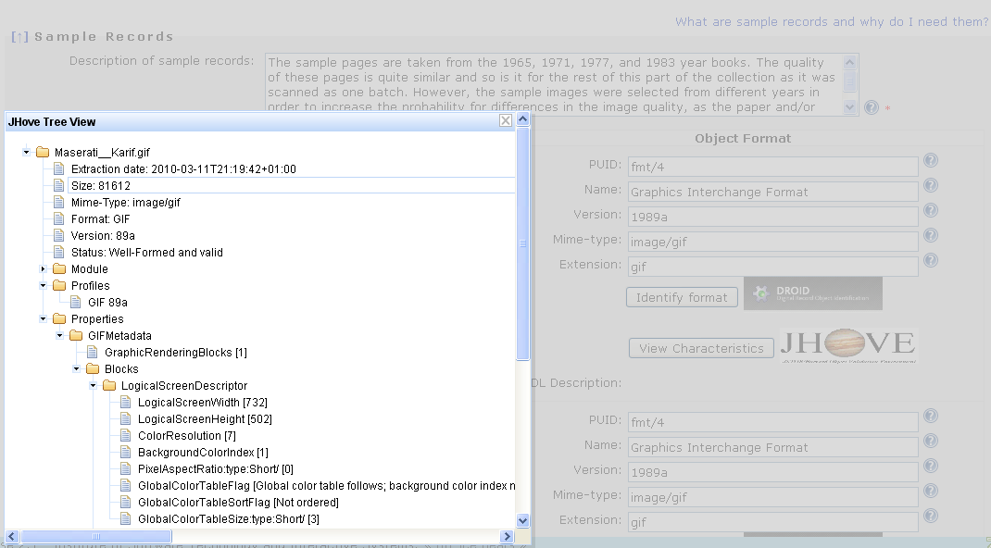
JHove in Plato
Characterisation
Done as part of Preservation Planning

Slide 9
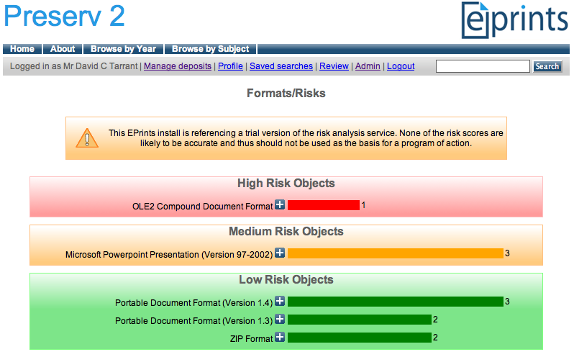
Risk Analysis in EPrints
Risk Assessment
Factual vs Subjective Information

Slide 10
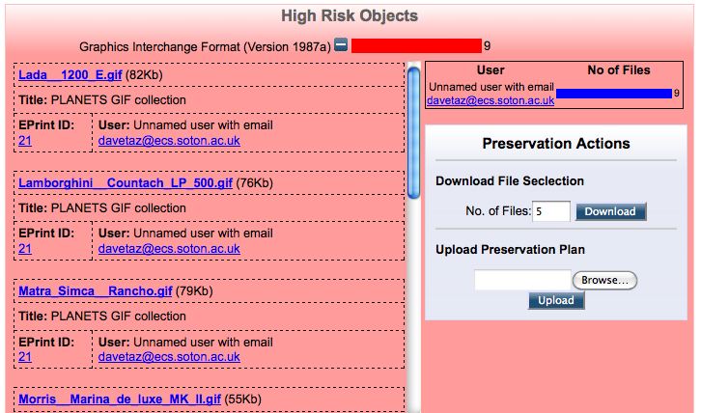
Risk Assessment

Slide 11
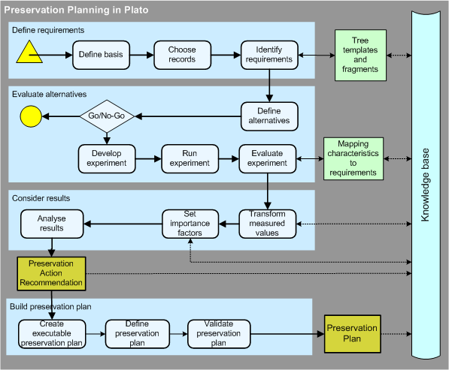
The Planets Planning Workflow
Planning

Slide 12
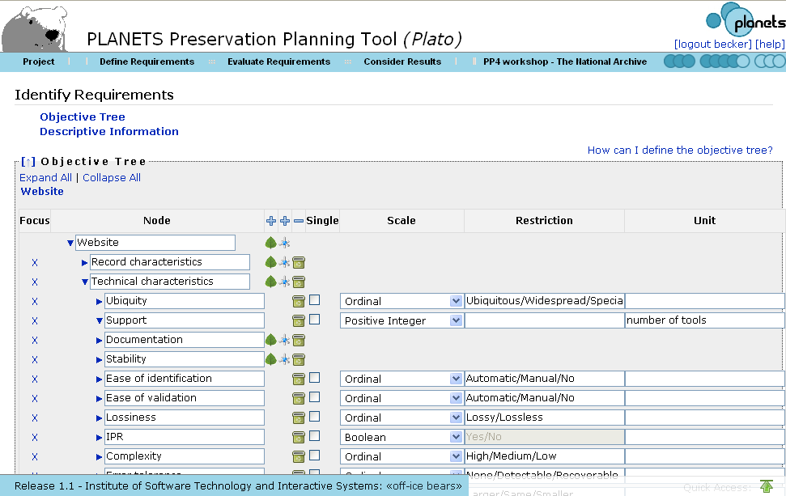
Plato
Planning

Slide 13
The Action Plan
A Small part of the Plato preservation plan
<eprintsPlan>
<tool>
<toolIdentifier uri="http://dbpedia.org/data/ImageMagick"/>
<parameters toolParameters="-verbose -compress None -quality 100 %INFILE% %OUTFILE%"/>
<targetFormat>PNG</targetFormat>
</tool>
</eprintsPlan>

Slide 14
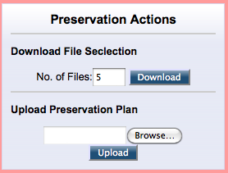
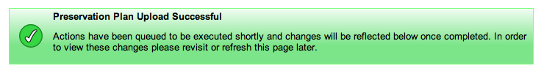
Performing Actions
Action
Each set of “at risk” classified files can have a single related preservation plan.
Once uploaded, any defined actions will be performed on all files of that classification.

Slide 15

Trust, Authenticity and Provenance
Before
After

Slide 16
The KeepIT Training Modules
Module 1. Organisational issues
  Scoping, selection, assessment, institutional parameters
Module 2. Costs
  Lifecycle costs for managing digital objects, based on the LIFE approach, and institutional costs
Module 3. Description
  Describing content for preservation: provenance, significant properties and preservation metadata
Module 4. Preservation workflow tools
  Format management, risk assessment and storage, and linked to the Plato planning tool from Planets
Module 5. Trust
  The repository’s approach to preservation; trust (by the repository) of the tools and services it chooses

Slide 17
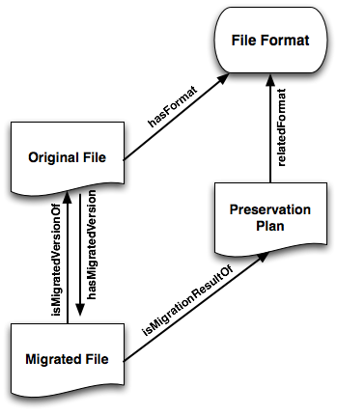
Provenance Information
Open Provenance Model (OPM) compliant
Stored in RDF triple form using the EPrints relation manager added in 3.2
OPM @ http://openprovenance.org/

Slide 18


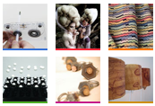

The KeepIT exemplars
Nectar
UAL Research
Online

Slide 19
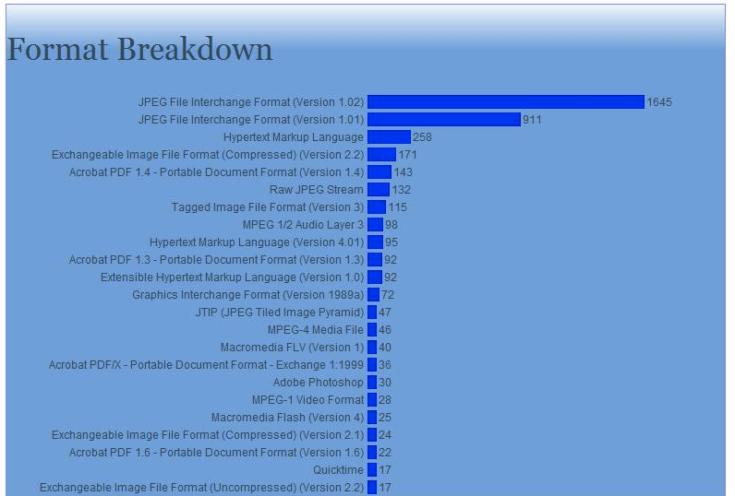
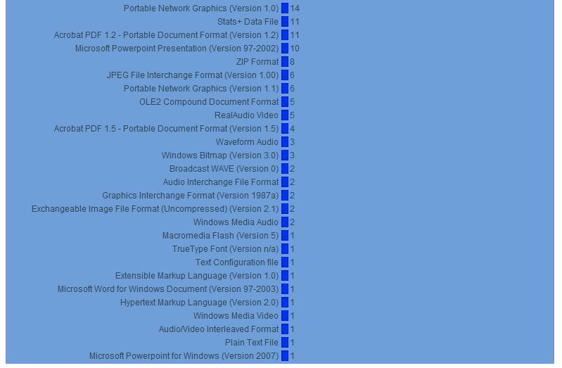
UALResearch Online
“Much more time-consuming and complicated”
“It's not just for the university/tech people to do it's part of the manager's job too”
“Somewhat less confident…but that's because I know what it really means now”
“I feel well-informed about what is available to help me”
“I would be quite confident teaching other managers, giving a talk etc. to share what I have learned”

Slide 20
EdShare
“Participation in the KeepIt Project has provided me with an excellent practical grasp of the realities of preservation and brought an apparently enormous and daunting area into the realms of approachable and practical possibilities”

Slide 21
Northampton University
“The KeepIT project has shown me that Digital Preservation is not be the scary thing it can appear to be.”
“There isn't a quick fix.”
“The secret is to take small steps; to set preservation planning within the bigger institutional context; and to engage stakeholders through advocacy and training”
“My confidence has undoubtedly grown but the more I know, the more I realise there is to know.”

Slide 22
Summary
Bit Preservation
EPrints Storage Controller
Identification
DROID, file
Characterisation
JHOVE, FITS, FFMPEG
Digital Repository
Risk Assessment
Pronom, P2 Registry…
Planning
Plato
Action
Migration, Emulation

Slide 23
Message 2
“Can we pass XML between systems to enable breakthroughs in digital preservation?”

Slide 24
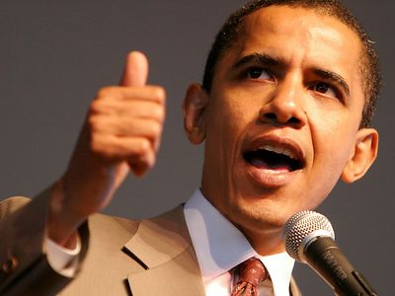
Message 2
“Can we pass XML between systems to enable breakthroughs in digital preservation?”

Slide 25



Thank You

