Slide 1
The explanatory value of some post-connectionist models
Jason Noble, Eric Silverman and Manuel de Pinedo
University of Southampton
Universidad de Granada

Slide 2
Where we’re coming from
Two out of three of us are not professional philosophers
Our work is in:
  Cognitive science
  Modelling & simulation
  Artificial life / AI / robotics
Consider our talk as a “report from the front”.

Slide 3
Prehistory to the debate
Descartes
Freud
Behaviourism (Thorndike, Skinner)
Cybernetics (Wiener, McCulloch, et al.)
Physical symbol system hypothesis (Newell & Simon)
(Our point here is that the Fodorian viewpoint was itself the latest arrival in a long series of paradigm shifts.)

Slide 4
Old-fashioned connectionism
Against the backdrop of the idea that cognition is all about using propositional logic on internal representations…
Rumelhart and McClelland (1986) resurrect connectionism: simple neuron-like units held to be a viable cognitive architecture
Enthusiasm for the new paradigm leads to the bold claim that it is comprehensive

Slide 5
Fodor & Pylyshyn’s challenge
F&P disagreed about the possibility of a connectionist architecture explaining human cognition
At least, they said it could not do so without implementing a language-of-thought architecture
Appeal to the compositional capacities of human cognizers (John loves Mary, Mary loves John, John hates Mary, etc., etc.)

Slide 6
Response to the challenge?
Question evaded more than answered: no systematic architectures built using 1980s connectionism
Post-connectionist movement (PCM) emerges:
  Enactivism
  Behaviour-based AI
  Embodied and distributed cognition
  Dynamical systems theory
PCM shares anti-dualist and anti-representational themes; unclear whether it gets around the challenge

Slide 7
What were F&P really saying?
That connectionism should be “relegated” to understanding some low-level aspects of cognition
That the language-of-thought hypothesis is the right level of description for cognition (?)
Understandable resistance to the “explanatory imperialism” of the connectionists: you can’t explain everything about thought by talking only about nodes and weights

Slide 8
Excessive explanatory ambition?
Consider psychology (P) and sociology (S).
P theorists might claim that unless S theorists can show a bridging explanation from P to S, then S is not a legitimate level of description.
S theorists might say much the same: unless P can show how their low-level entities give rise to the phenomena of S, then P is not to be taken seriously.
Few would argue this way in the P/S case: why does it seem more acceptable in cognitive science?

Slide 9
Is systematicity the real issue?
Clearly it’s a phenomenon of great interest to cognitive science that people possess concepts, reasoning, propositional logic, productivity, systematicity, etc. (or at least do a good impression of such).
It’s also reasonable to point out that the substrate that supports all this is neurological, chemical, and ultimately physical.
However: the strength of the current debate seems to rest on an assumption that one or the other form of explanation must win out.

Slide 10
An illustration from ALife
What’s the practical alternative to a battle between mutually exclusive paradigms?
Artificial life is a helpful source of examples here.
Focus on emergence: showing how a higher-level description of a system can emerge from interactions between simpler, lower-level components.
Potential for supplying bridging explanations between (e.g.) connectionism and LOT accounts.

Slide 11
The evolution of communication
Drawing on two papers:
  Quinn, M. (2001). Evolving communication without dedicated communication channels. In Advances in Artificial Life: Sixth European Conference on Artificial Life (ECAL'01), vol. 2159, 357-366. Springer.
  Arranz, J., Noble, J., and Silverman, E. (2011). The origins of communication revisited. Submitted to this year’s European Conference on Artificial Life.

Slide 12
Quinn’s back-to-basics approach
Earlier work on the evolution of communication had built into the model such features as:
  A signalling channel
  Pre-defined “meaning states”
  Ready-made symbols
Quinn agreed with the early ethologists that signalling doesn’t make any sense in a world without receivers.
He therefore began with only a pair of agents in sensory-motor engagement with their world.

Slide 13
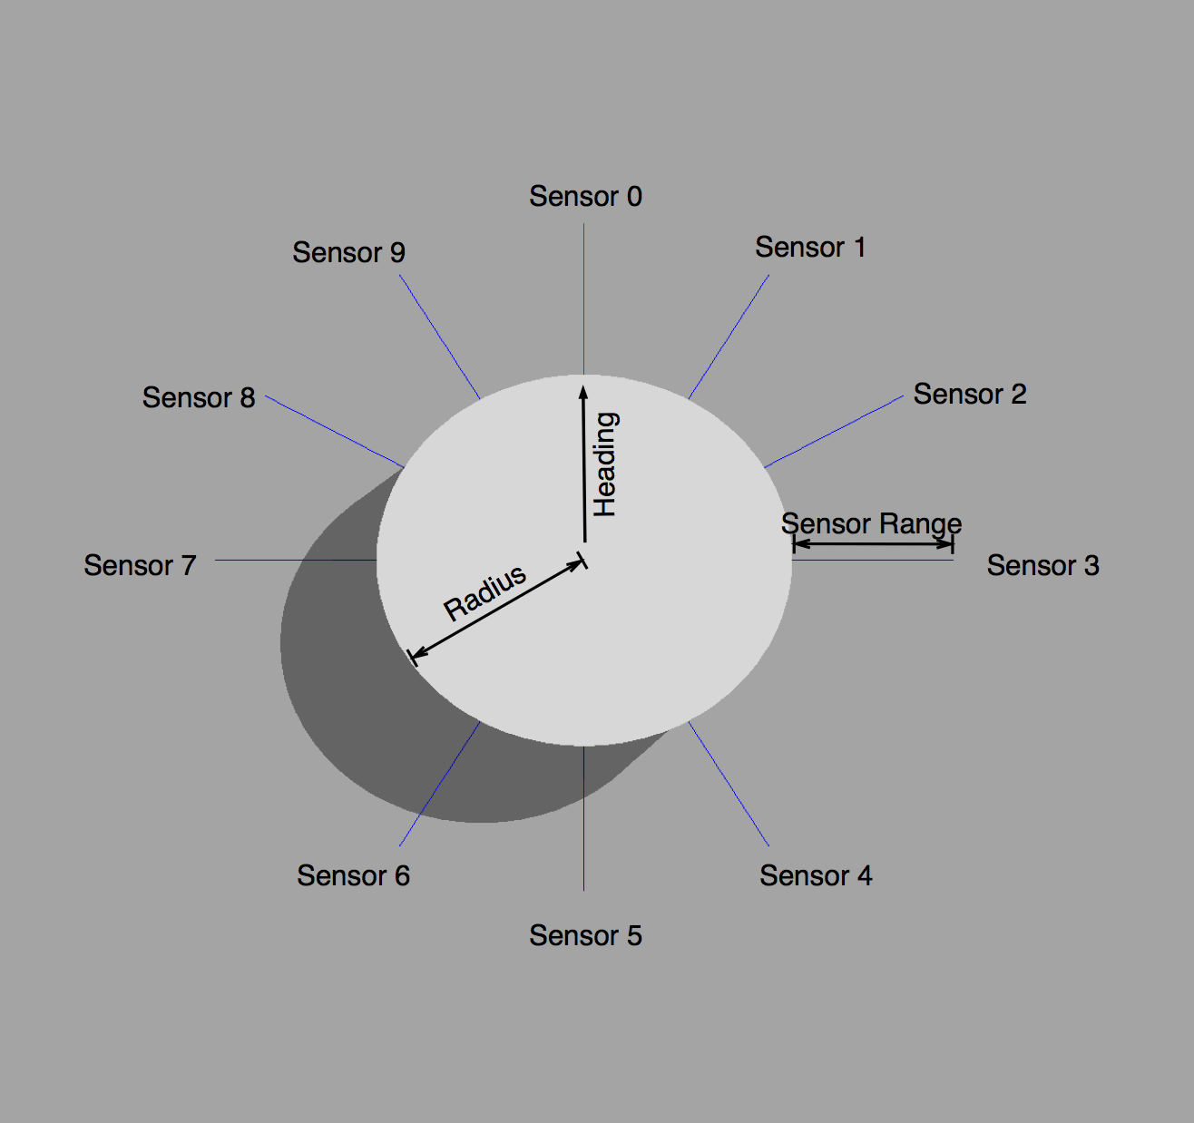
Quinn’s agent

Slide 14
The task
Quinn assumed a cooperative goal for the agents.
Their task was to move their joint centre of mass as far as possible.
The best way to achieve this is to meet, pick a direction, and move off together.
Coordinating this is harder than it sounds: agents start in random positions and there is no role assignment.
Evolutionary search finds a successful strategy involving a “coordination dance”.

Slide 15
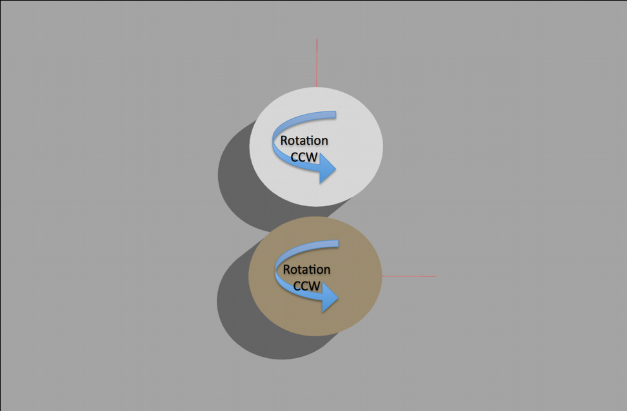
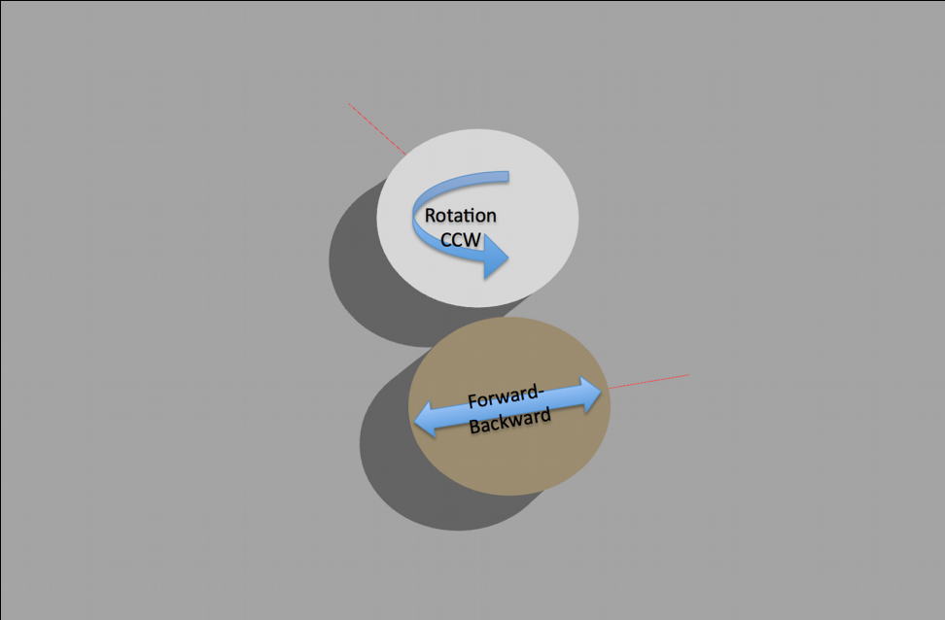
The evolved behaviour

Slide 16
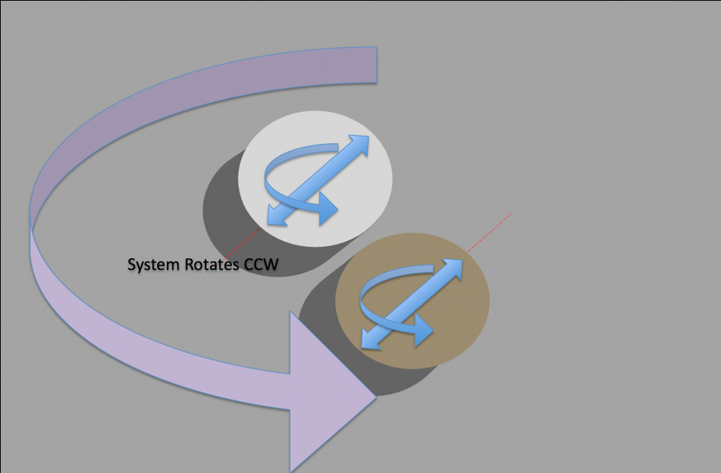
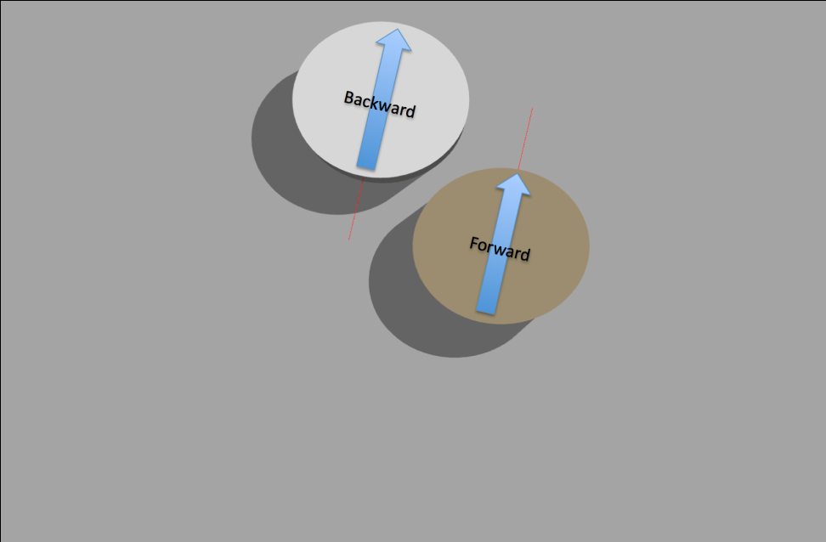
The evolved behaviour

Slide 17
Two interpretations
One way to read Quinn’s result is eliminativist:
Concepts like “communication”, “signal”, “symbol”, and “channel” turn out not to be necessary in explaining coordinated action.
Thus we have no further need for that level of description.
Accounts of coordinated action should henceforth be phrased in enactivist terms, involving sensory-motor feedback loops, etc.

Slide 18
Two interpretations
Note the similarity with some of Randy Beer’s work on understanding evolved agents using dynamical systems theory.
Our main argument against such an approach is simply that it does not seem to scale very well in practice.

Slide 19
Two interpretations
A second way to read Quinn’s results is in terms of providing a bridging explanation between levels of description.
Quinn has shown that a Shannon-type signalling channel can evolve/emerge from lower-level interactions between agents.
This licences further modelling and theorizing at the level of signalling systems.
Not every ALife model needs to start with a primordial soup!

Slide 20
A call for humility
Mentioned earlier that no systematic connectionist architectures have been constructed.
On the other hand, it should be noted that practical language-of-thought architectures, such as Lenat’s CYC project, have also run into difficulties.
What to make of this?
We have argued elsewhere for explanatory pluralism in cognitive science.

Slide 21
A call for humility
We note the success of Tinbergen’s account of four different explanatory modes in biology:
  Mechanism
  Function (adaptive value)
  Ontogeny
  Phylogeny
None of these is to be reduced to the others; complete understanding in biology is a patchwork of all four.
Envisage a mature cognitive science as being similar.

Slide 22
A call for humility
There is a tendency to think that behind every empirical question is a philosophical question
This can lead to a one-size-fits-all approach to explanation that is not in the service of the empirical project, and is philosophically problematic

Slide 23
Questions for discussion
Ours is a very pragmatic, Wittgensteinian position: do the empirical and modelling work, and see which explanations turn out to be useful. What kinds of contributions do we leave room for from philosophy of mind?
What if bridging explanations don’t seem to be possible, e.g., anomalous monism?
What are the implicit metaphysics of our position?

Slide 25
Ryle/Ludwig rejecting both the ghost and the machine (M)
Contrast Marr and Gibson: G was not a lazy version of M (E)
History of the Fodorian challenge
Explanatory fascism in cognitive science
Introduction/description of Quinn's model
Explanatory pluralism in cognitive science
Bridging explanations/supervenience
Two ways to interpret Quinn's message
Wittgensteinian/Rylean metaphysics?
In L1/L2 cases, neither side uniquely responsible for bridging
Enthusiasm for new paradigms to explain all
Laboratory rather than armchair
Systematicity in the brain? Ridiculous

Slide 26
Context: philosophy of mind as part of the empirical cognitive science project
Troublesome tendency to think: behind every empirical question is a philosophy question
This can lead to a one-size-fits-all approach to explanation that is*not* in service of the empirical project - and is philosophically problematic
We call this explanatory fascism!

