Slide 1




  A repository based framework for capture, management, curation and dissemination of research data
  Simon Coles
  School of Chemistry,
  University of Southampton, U.K.
  s.j.coles@soton.ac.uk
This work is licensed under a Creative Commons Licence
Attribution-ShareAlike 3.0
http://creativecommons.org/licenses/by-sa/3.0/

Slide 2
The Research Data Lifecycle
Presentation services: subject, media-specific, data, commercial portals
Searching , harvesting, embedding
Data creation / capture / gathering: laboratory experiments, Grids, fieldwork, surveys, media
Resource discovery, linking, embedding
Liz Lyon, Ariadne, 2003
Design a generic architecture, based on the institutional repository model to effectively:
Capture
Manage
Preserve
Publish
research data
Data analysis, transformation, mining, modelling
Aggregator services: national, commercial
Harvestingmetadata
Research & e-Science workflows
Repositories : institutional, e-prints, subject, data, learning objects
Deposit / self-archiving
Validation
Validation
Publication
Linking
Peer-reviewed publications: journals, conference proceedings
Data curation: databases & databanks

Slide 3
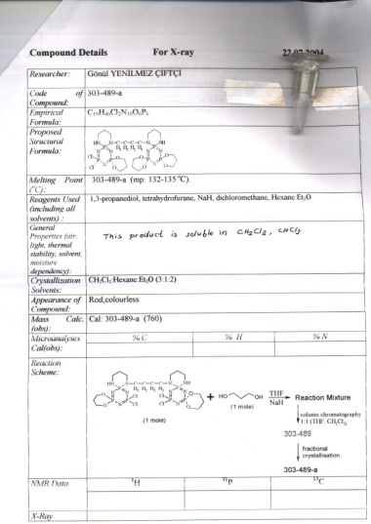
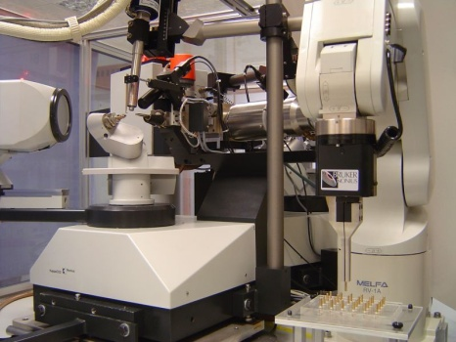
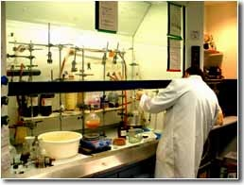
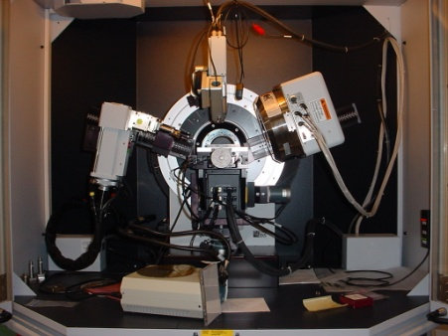

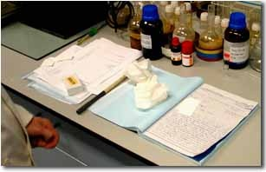

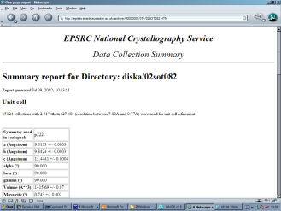

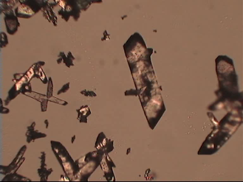
The Problem: Data Generation
Synthesis
Characterisation

Slide 4
The Problem: Data Management
“Data from experiments conducted as recently as six months ago might be suddenly deemed important, but those researchers may never find those numbers – or if they did might not know what those numbers meant”
“Lost in some research assistant’s computer, the data are often irretrievable or an undecipherable string of digits”
“To vet experiments, correct errors, or find new breakthroughs, scientists desperately need better ways to store and retrieve research data”
“Data from Big Science is … easier to handle, understand and archive. Small Science is horribly heterogeneous and far more vast. In time Small Science will generate 2-3 times more data than Big Science.”
‘Lost in a Sea of Science Data’ S.Carlson, The Chronicle of Higher Education (23/06/2006)

Slide 5

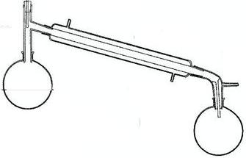












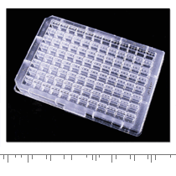
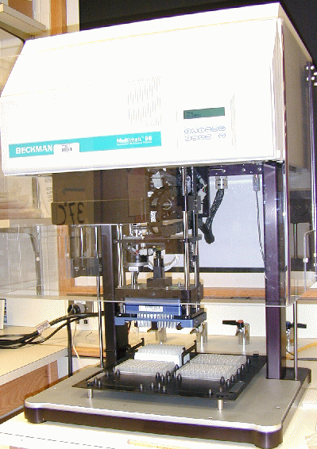
The Problem: Data Deluge
2,000,000
30,000,000
450,000

Slide 6

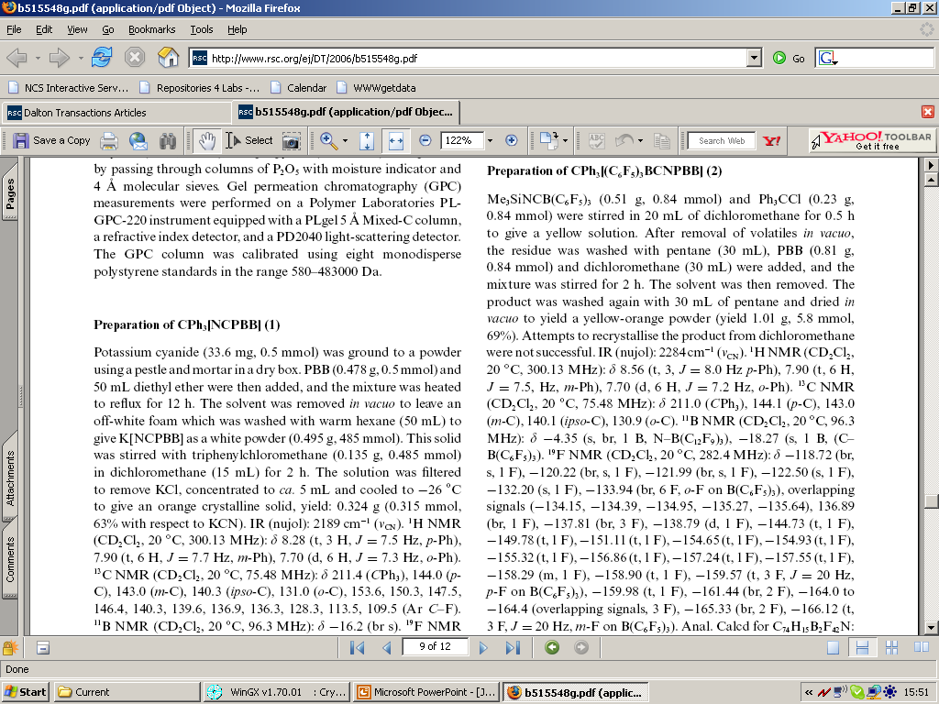
The Problem: Data and Publishing

Slide 7
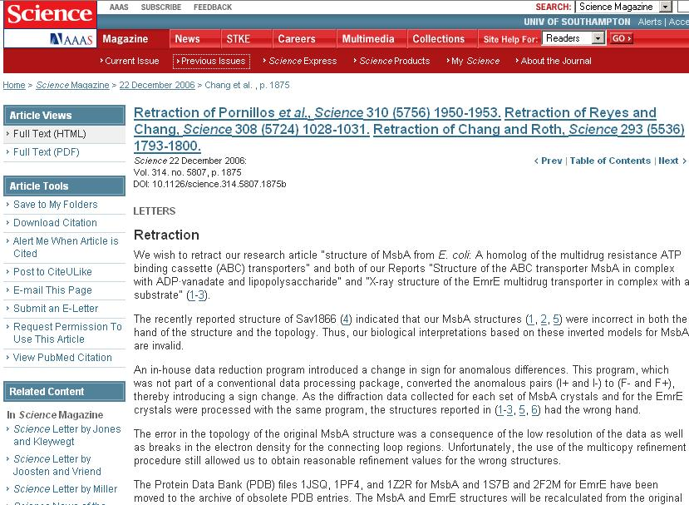
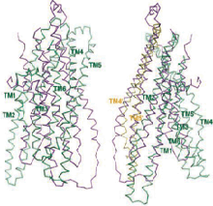
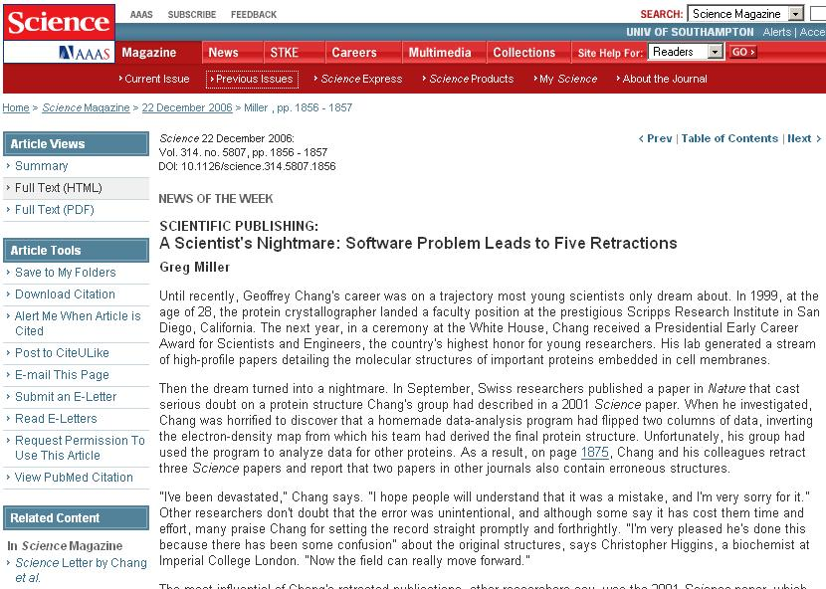
The Problem: Validation & Peer Review

Slide 8
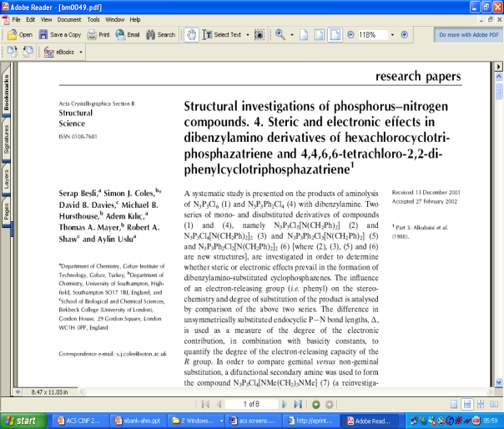
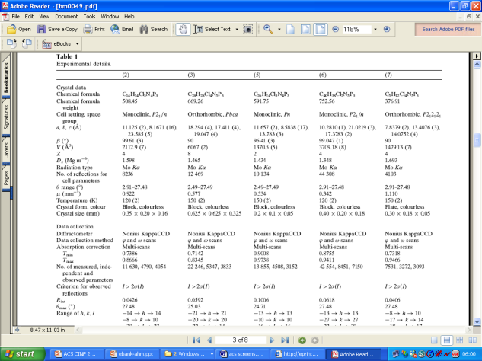
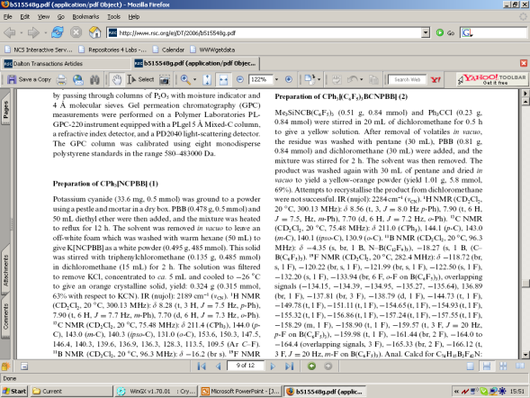
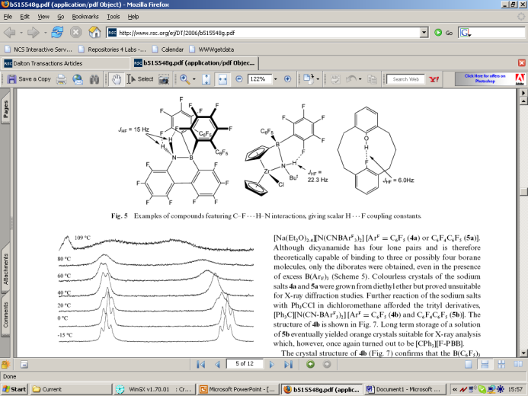
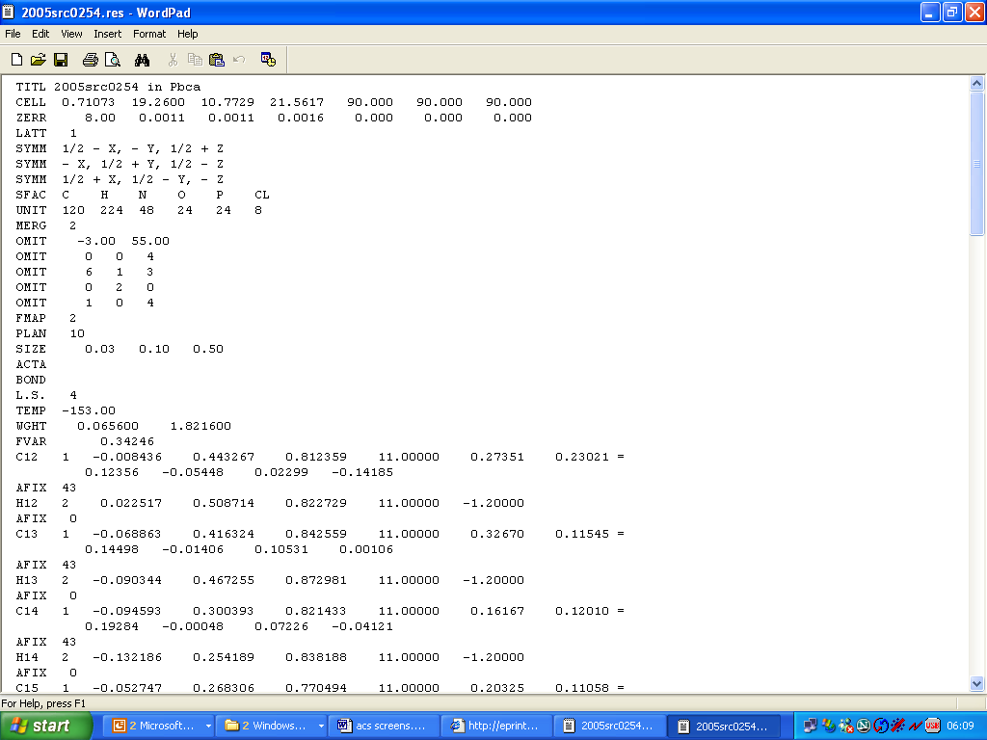
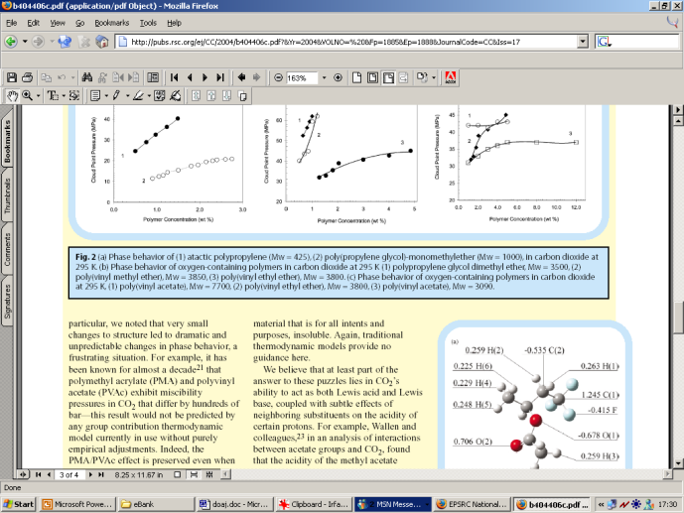
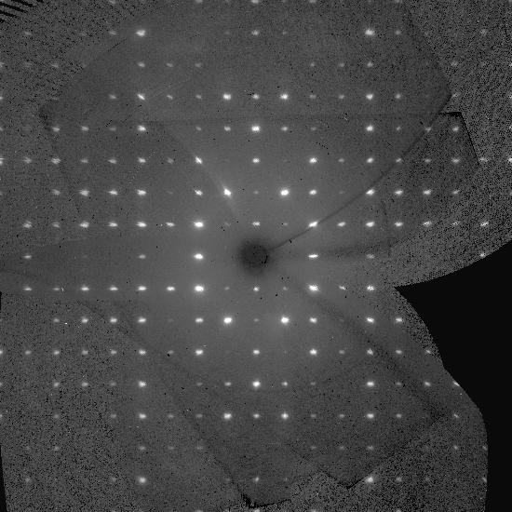
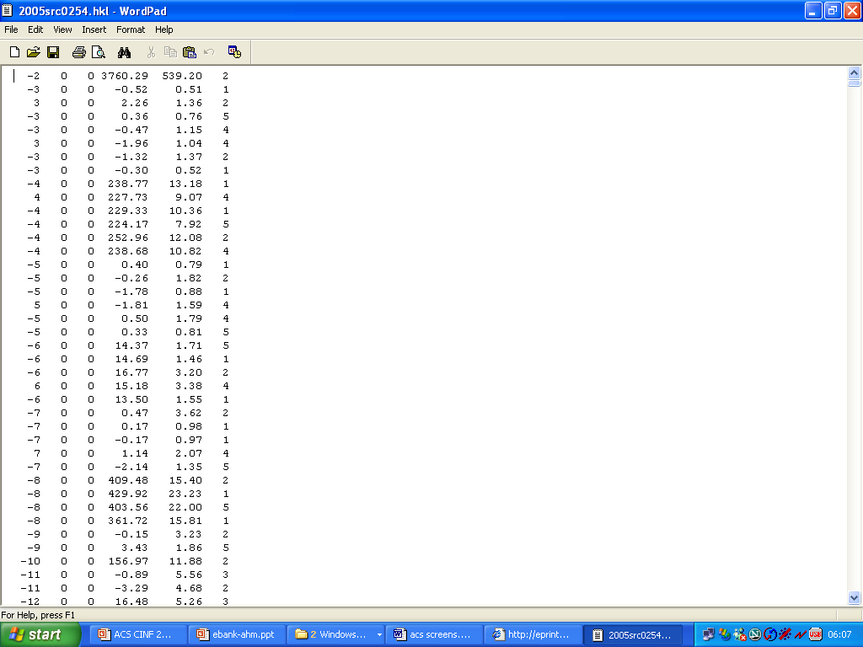
Separating Data from Interpretations
Intellect & Interpretation (Journal article, report, etc)
Underlying data (Institutional data repository)

Slide 9

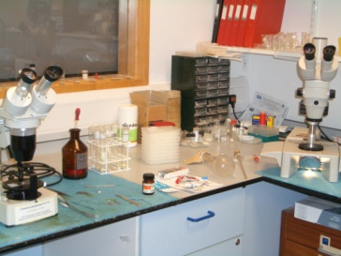




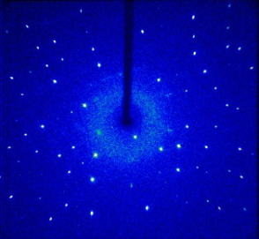

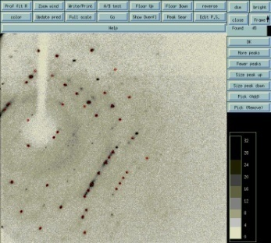


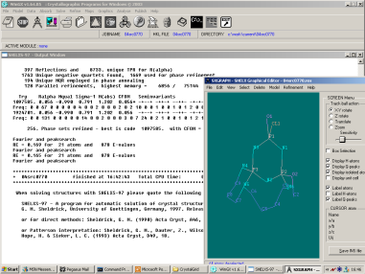
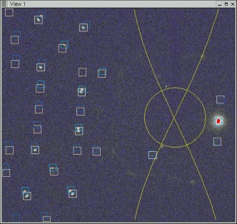
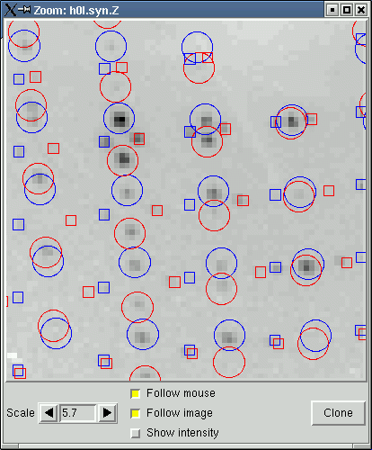

Research Study Workflow
Synthesis
Preparation
Data Collection
Publication
Structure Solution
Data Processing

Slide 10
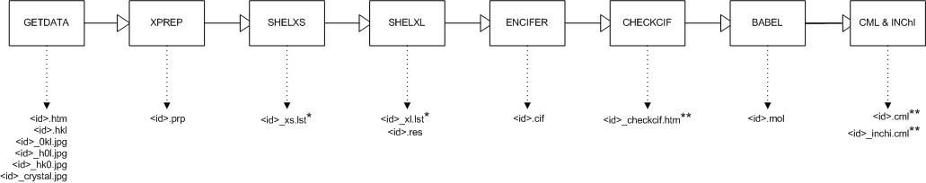
Workflow analysis
RAW DATA
DERIVED DATA
RESULTS DATA
Data Collection: collect data
Processing: process and correct images
Solution: solve structure
Refinement: refine structure
Validation: generate report from structure checks
Final Result: Completed structure files

Slide 11
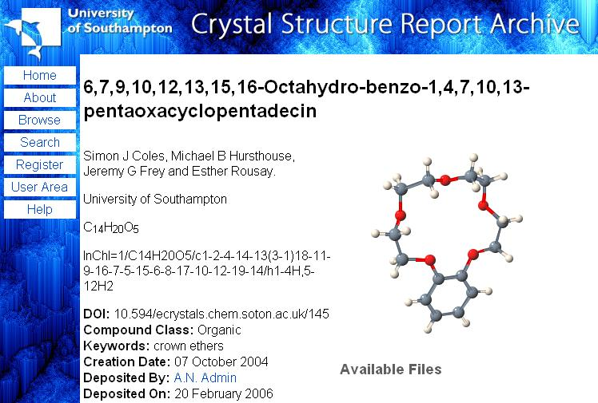
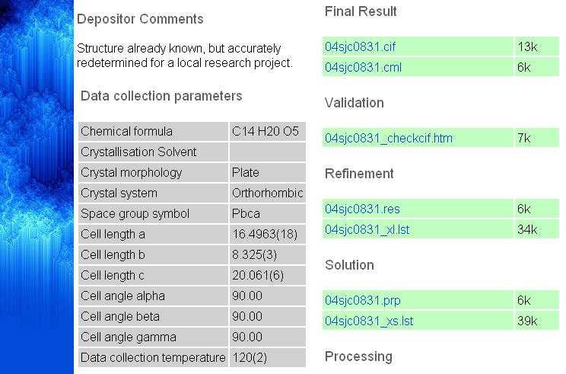
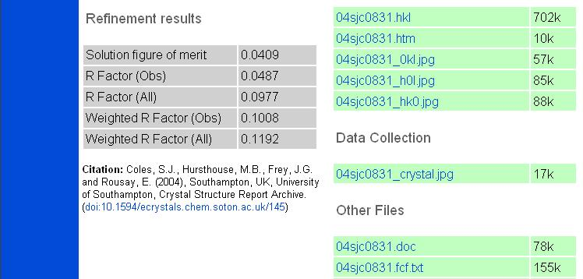
The eCrystals Public Data Archive
http://ecrystals.chem.soton.ac.uk

Slide 12
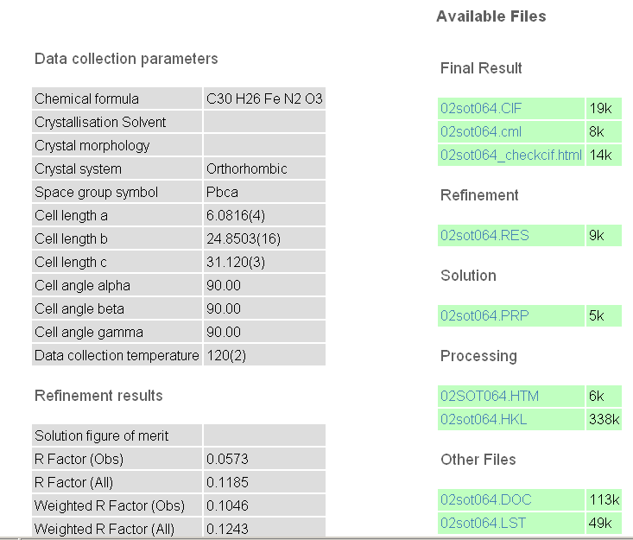
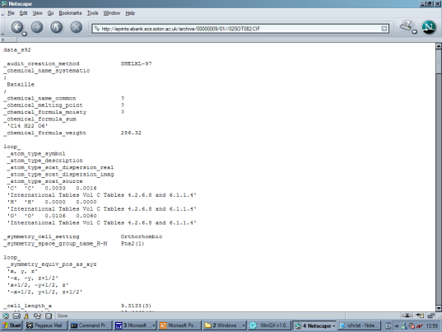
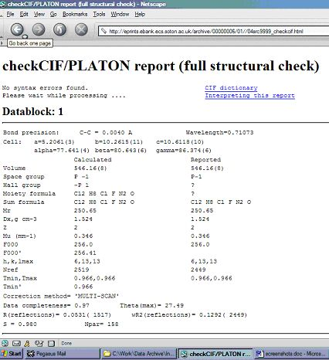
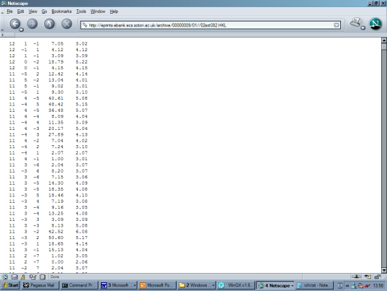
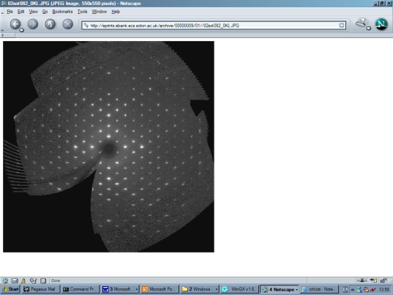
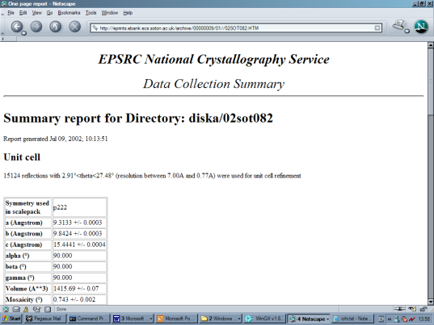
Access to ALL the underlying data

Slide 13

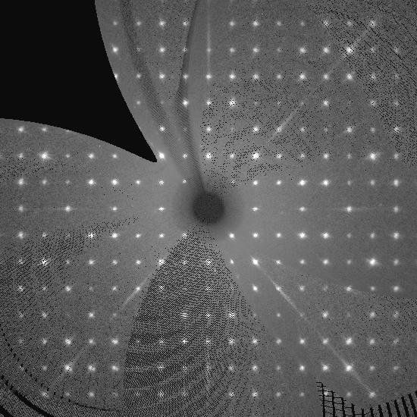
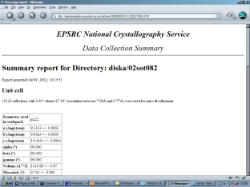

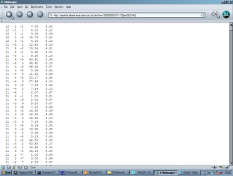

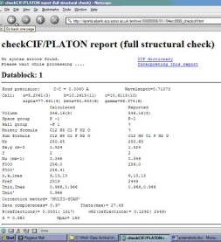



Interactions and Curation Issues
M bytes
G bytes
http://www.ukoln.ac.uk/projects/ebank-uk/curation/
Lab / Institution
Subject Repository / Data Centre / Public Domain
k bytes

Slide 14
Socio-Political Issues & Lessons
Need to address every aspect of the lifecycle and engage all stakeholders – archivists, librarians, subject repositories, data centres, publishers, information providers and data/knowledge miners
IPR, copyright and jeopardising publication
Public / private archives and embargo mechanisms
Minimum impact on current lab working practice
What data is worth storing?
Complexity and specialisation of data creates huge problems for preservation
How to account for different lab working practices?
Provenance and workflow
The need for peer review?!

Slide 15
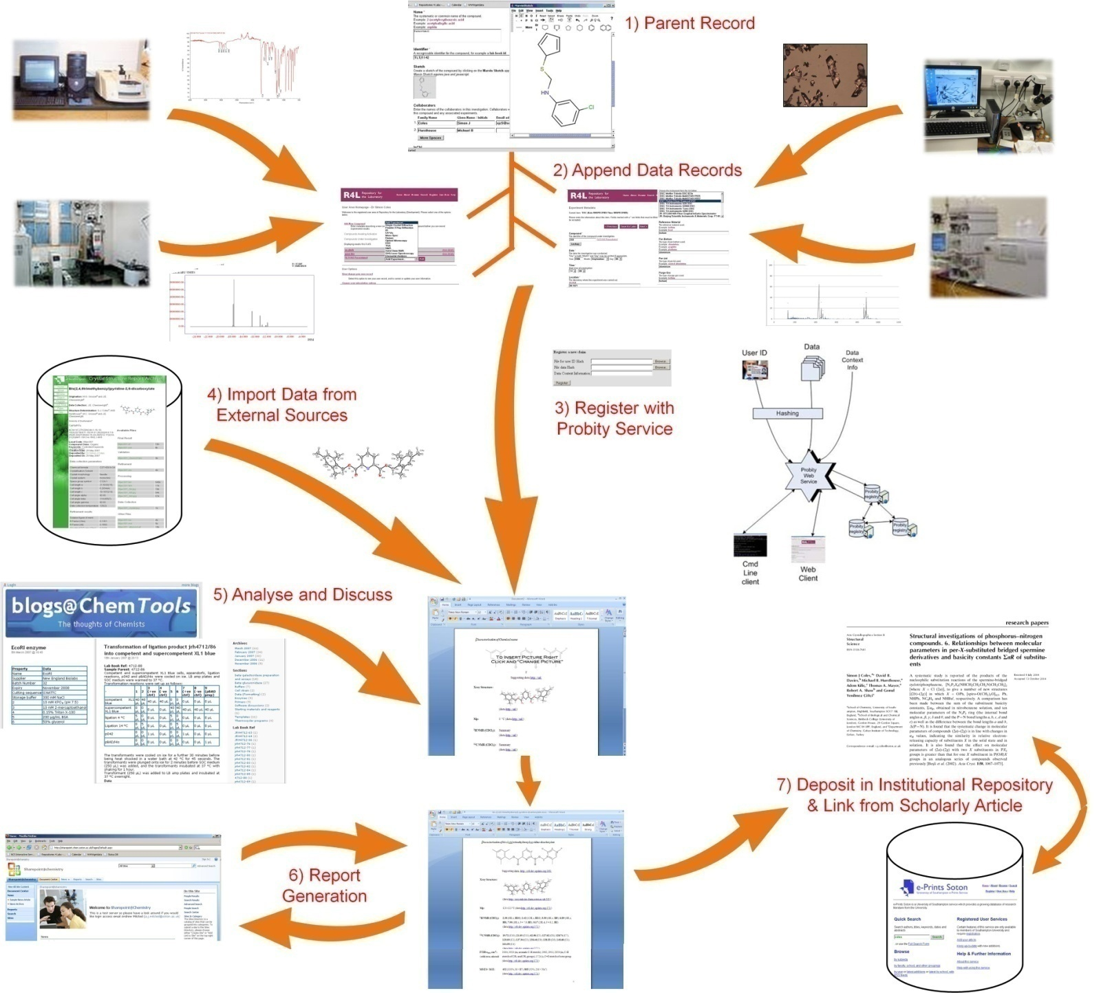
Laboratory IRs and Data Management

Slide 16
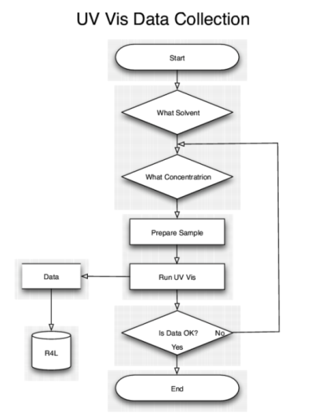
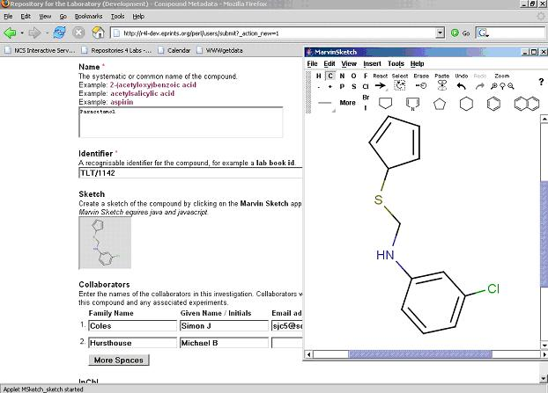

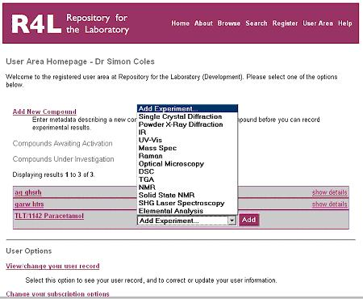
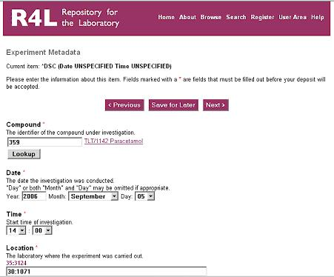
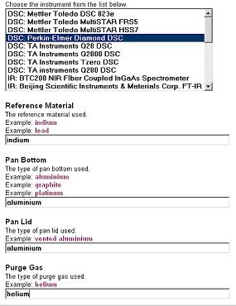
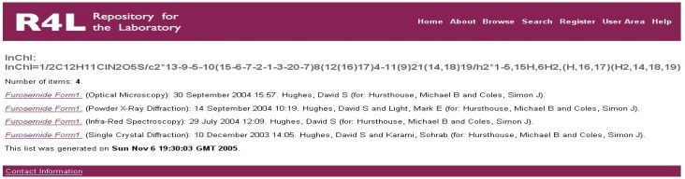
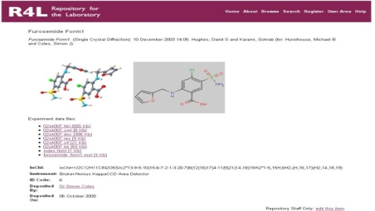



The R4L Repository
First design ‘mash up’ / build one to throw away
Population informed design of actual repository
Population informed workflow capture and analysis
Create new compound
Add experiment data and metadata
Deposit
Search / Browse

Slide 17


The ‘Probity’ Service
Process to assert originality of work
Incorporation into ePrints software?

Slide 18
The eCrystals Federation

Slide 19

Metadata Publication
ecrystals.chem.soton.ac.uk/perl/oai2

Slide 20

Metadata Publication
Using simple Dublin Core
    Crystal structure
    Title (Systematic IUPAC Name)
    Authors
    Affiliation
    Creation Date
Additional chemical information through Qualified Dublin Core
    Empirical formula
    International Chemical Identifier (InChI)
    Compound Class & Keywords
Specifies which ‘datasets’ are present in an entry
DOI http://dx.doi.org/10.1594/ecrystals.chem.soton.ac.uk/145
Rights & Citation http://ecrystals.chem.soton.ac.uk/rights.html
Application Profile http://www.ukoln.ac.uk/projects/ebank-uk/schemas/

Slide 21



Linking Data and Publications
Link data and associated ‘publications’
Dataset annotated with metadata
Semantic publishing on WWW and in journals
http://www.ukoln.ac.uk/projects/ebank-uk/pilot/

Slide 22


Search and Discovery

Slide 23


Controlled Vocabulary and Semantics
http://www.rsc.org/Publishing/Journals/ProjectProspect/index.asp

Slide 24

The importance of workflows
Web2.0 Virtual Research Environment
Encapsulated my experiment objects (EMO’s)…
Validation & Provenance
Re-running
Re-use with different data
Incorporation into new studies

Slide 25













The eChemistry
Object Reuse and Exchange

