Slide 1
Imaging x-ray generation and Scattering
Tabletop soft x-ray coherent imaging microscopes

Slide 2
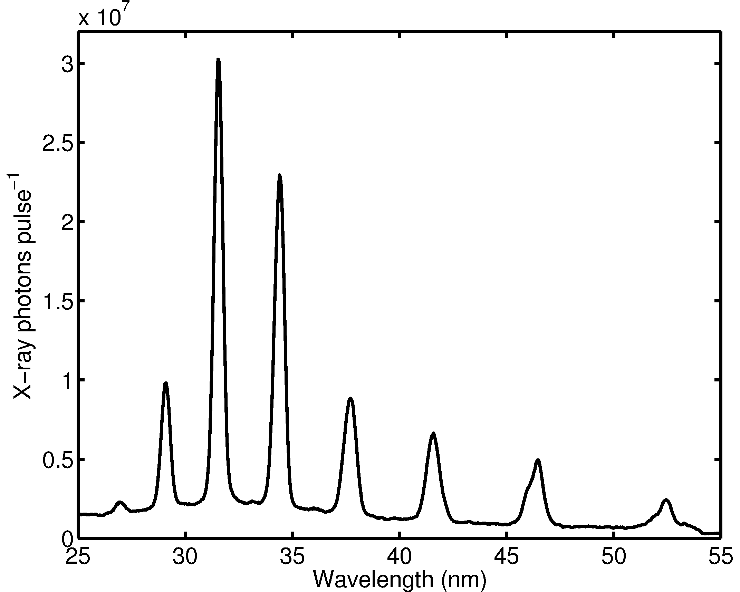
High Harmonic Generation for ultrafast soft x-rays
Ti:sapphire seed laser
Diode pump
Amplifier pump
Pump beam
Regenerative amplifier
3mJ, 35fs, 1kHz
Vacuum chamber
Gas cell
CCD camera
Al foil filter
Sample
XUV multilayer mirror

Slide 3
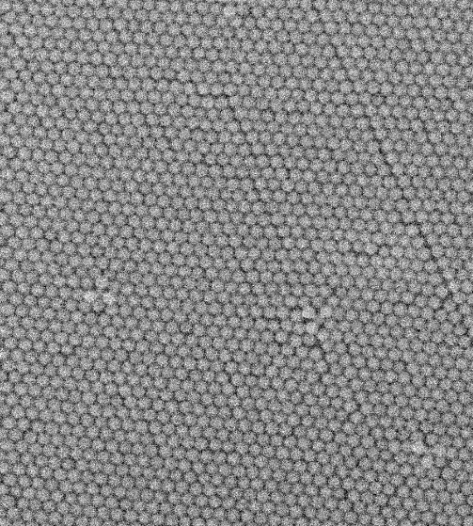
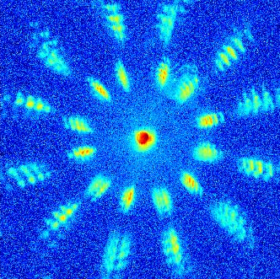
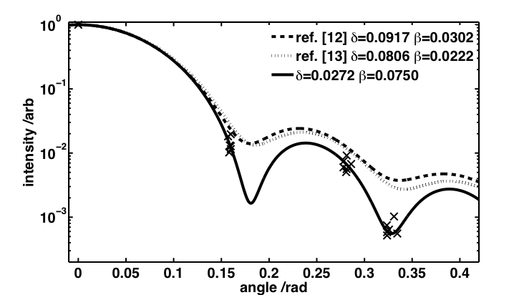
The sate of play at our last COST talk
Diffraction from self assembled 200 nm PMMA spheres showing domain structures
Allowing the complex refractive index to be determined to high precision
SEM
X-Ray diffraction image
Mie Scattering comparison

Slide 4
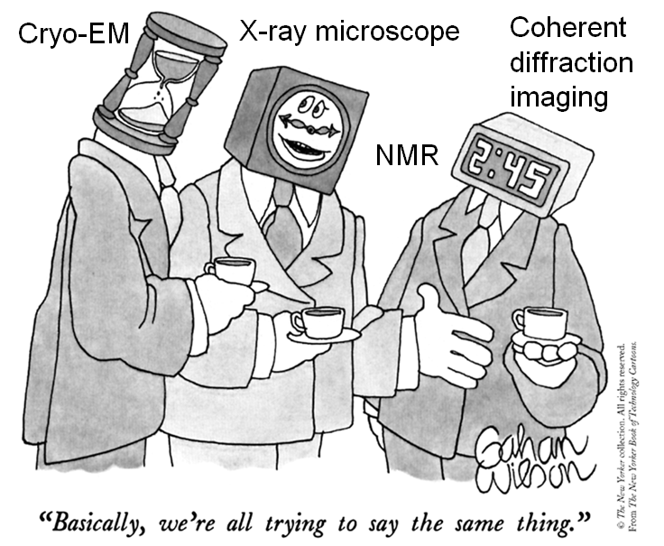
X-Ray Microscopy
Microscopy in XUV is hard because of lack of optics
  Possible using zone plates, or multilayer mirror objectives
Imaging without a lens
CCD detector
Phase retrieval algorithms can be used to replace the objective lens

Slide 5
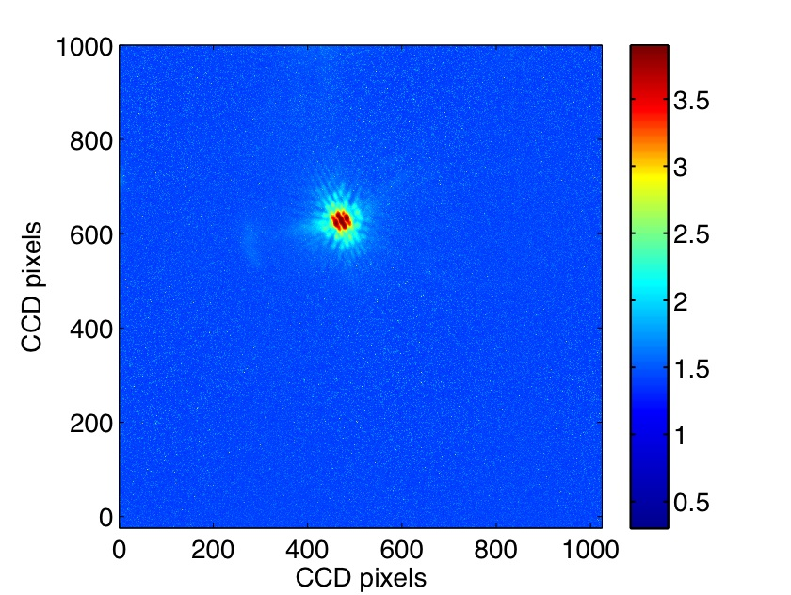
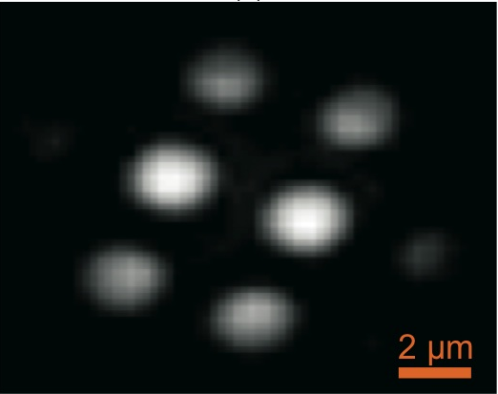
Computational phase retrieval
Fourier space
Guess object from autocorrelation & random phase
Take FFT
Reverse FFT
replace intensity with known pattern (Fourier space constraint)
is the outer region black? – make it black (real space constraint)
Log₁₀ of scattered intensity from pinhole/mask object
Real space
Make use of constraints

Slide 6
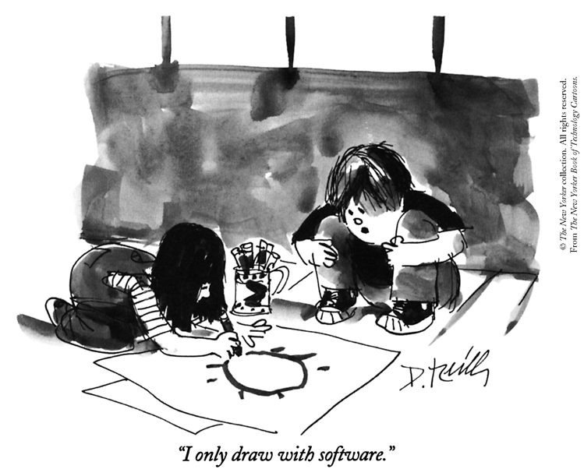
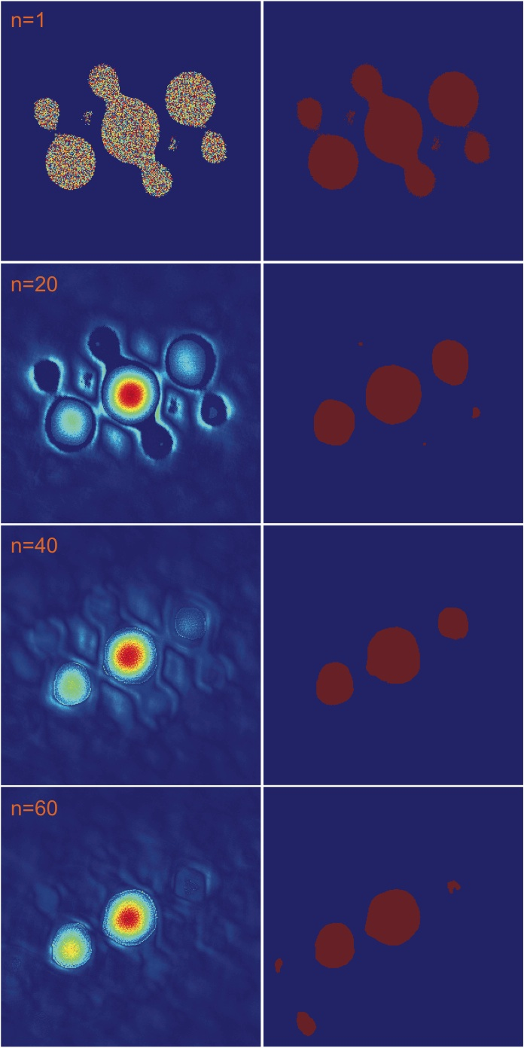
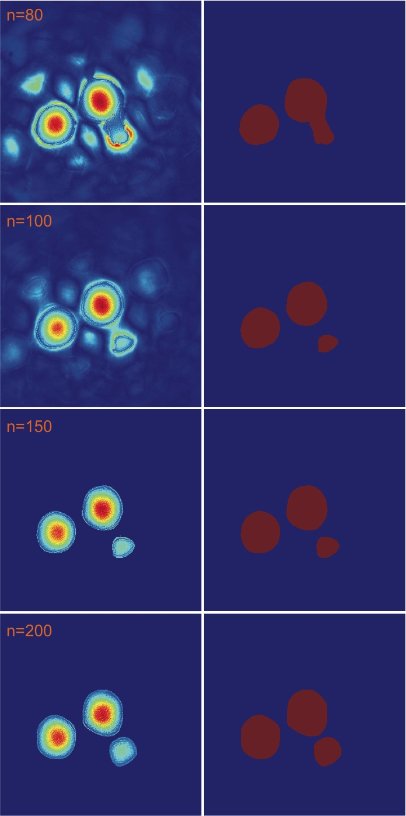
Several versions of the algorithm, run with range of staring phases, typically for 100’s of cycles

Slide 7
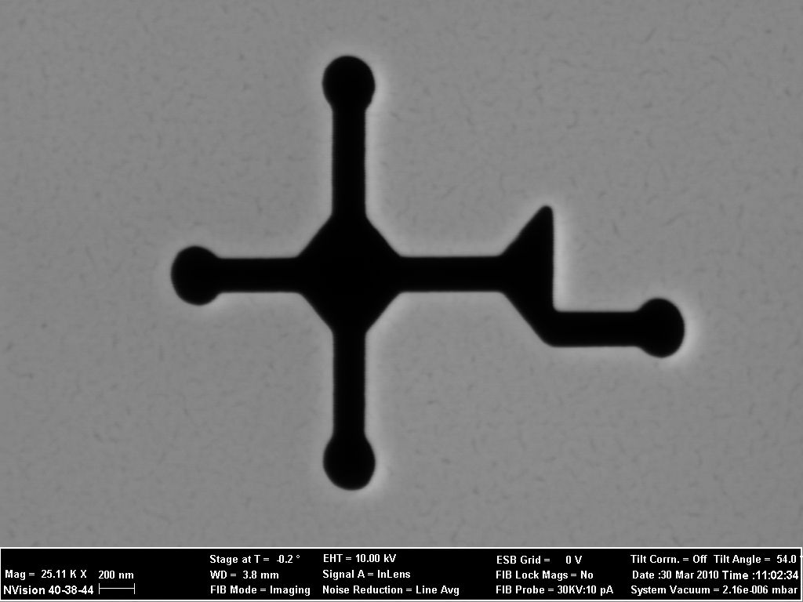
Test sample Au on SiN made using ORC FIB
200 nm

Slide 8
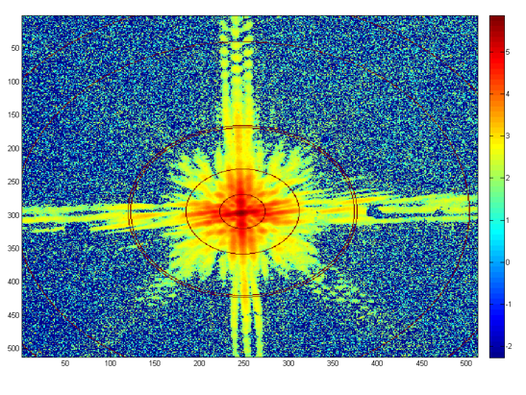
Coherent Scattering/Diffraction Image showing features out to better than 100 nm resolution. New camera position now able to achieve 50 nm resolution
Double line is 100 nm resolution

Slide 9
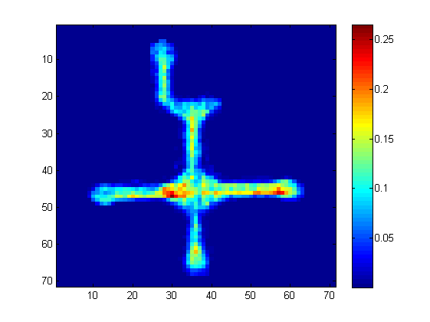
Reconstructed intensity image

Slide 10
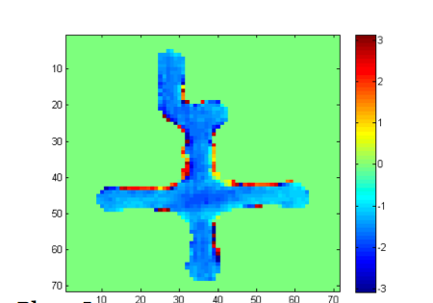
Phase of the reconstructed image
The sample is either transmitting or blocking but the x-ray pulse may have a non-uniform phase front.

Slide 11
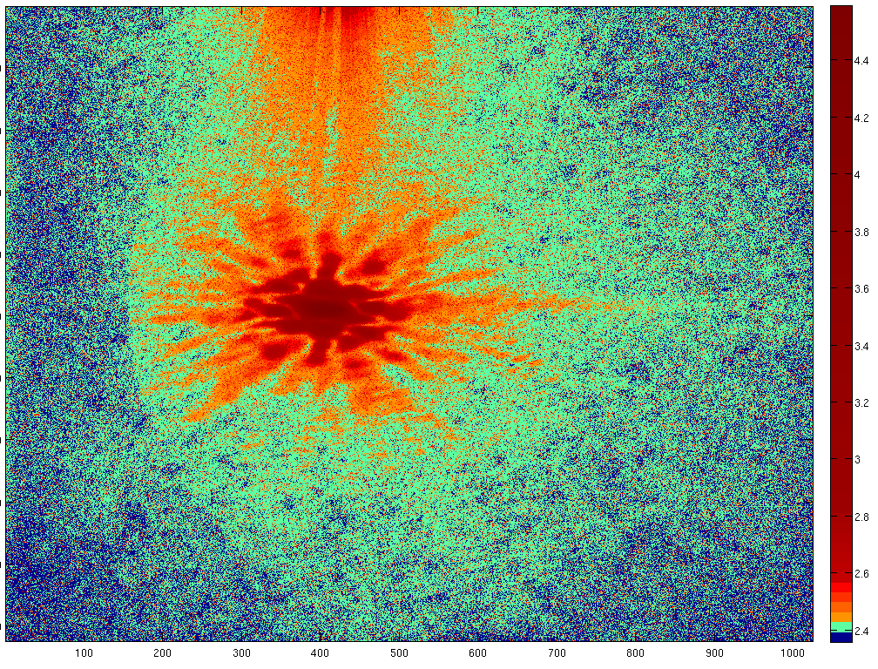
Image of a diatom fragment
Taken without using a focussing mirror, some issues of laser scatter to be resolved

Slide 12
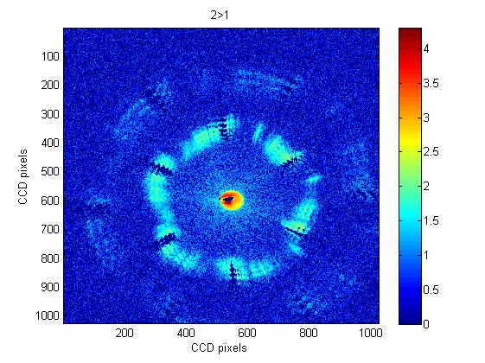
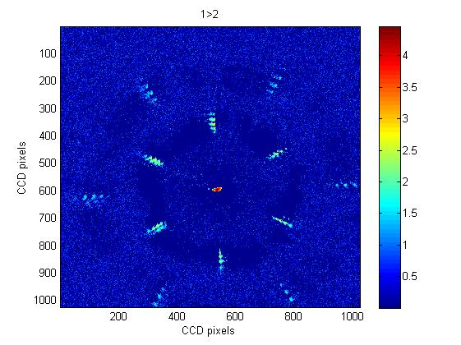
Back to the spheres……
By comparing diffraction images taken at slightly different positions and at different proportions of the harmonics then we can begin to separate the diffraction from the 2D crystal lattice from the scattering image of the defects.
We are looking at how to reconstruct the defect image

Slide 13
Issues
Flux
Multiple wavelengths
Sample size
Optimize using x-ray and visible diagnostics and via a model of the HHG process

Slide 14
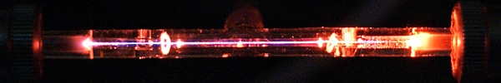
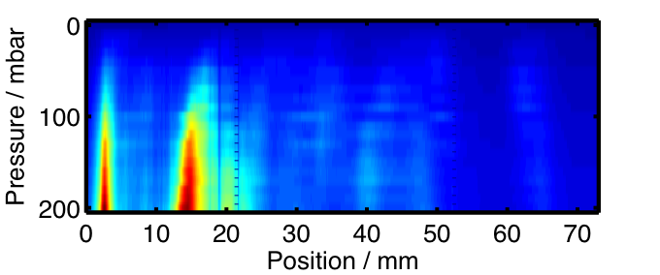
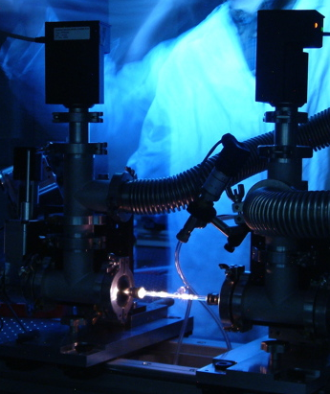
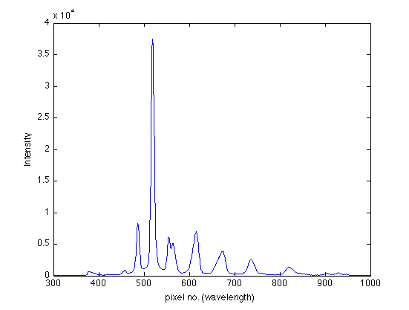
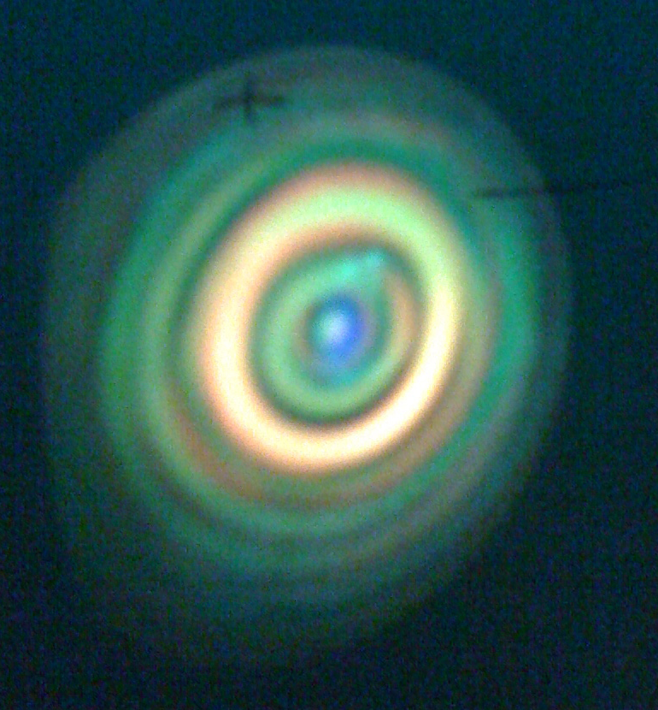
Capillary
Optimizing Ar pressure and laser power to give a dominant single harmonic peak

Slide 15
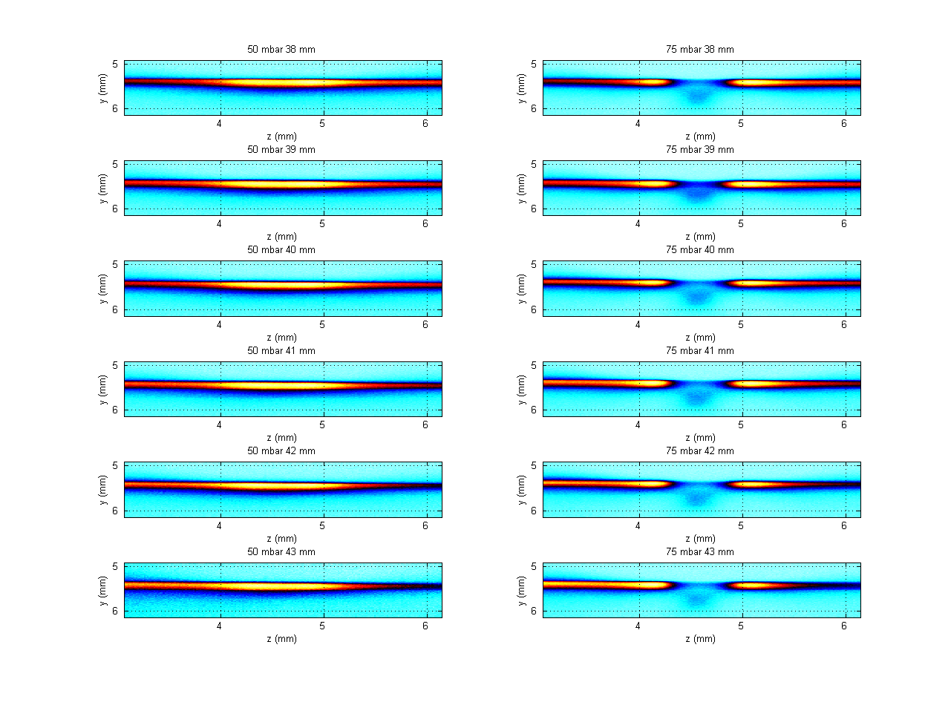
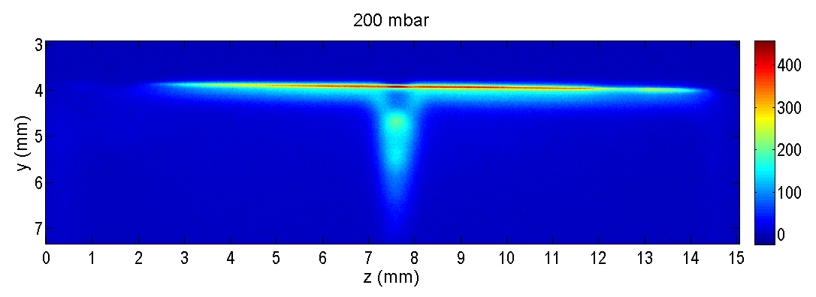
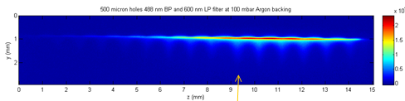
Diagnostics – X-Ray Generation
JET

Slide 16
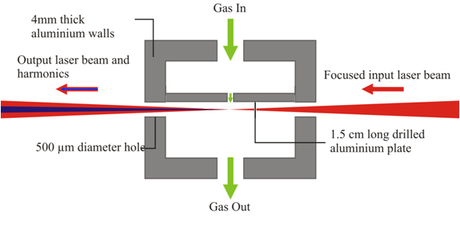
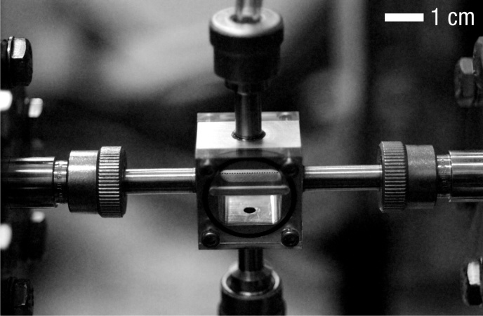
Cell

Slide 17
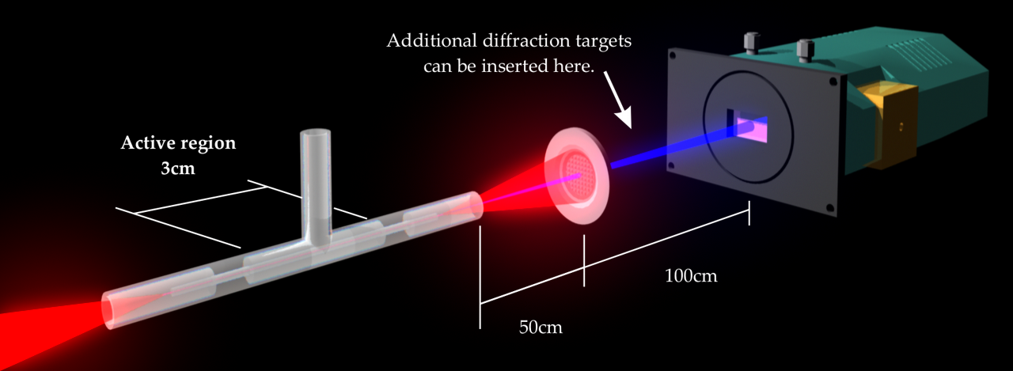
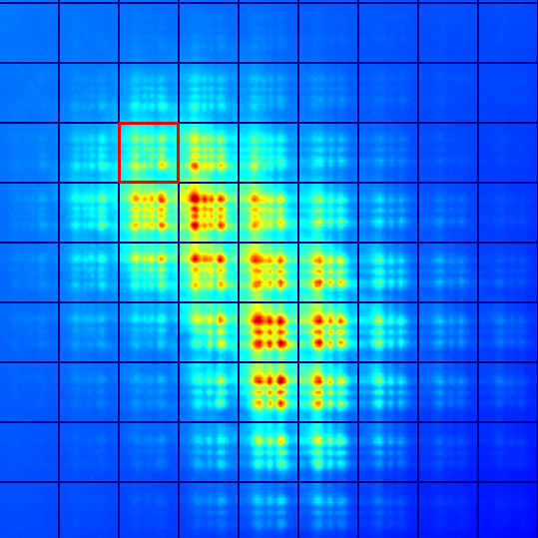
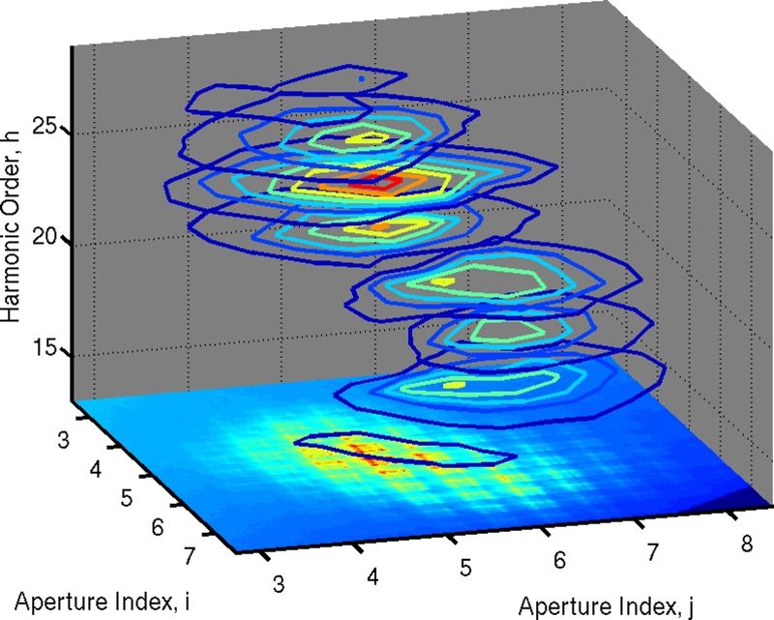
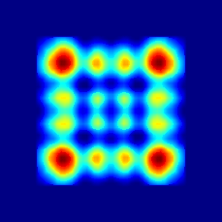
Diagnostics – X-Rays
Advanced diagnostics - Spatio-spectral beam imaging using Fresnel diffraction

Slide 18
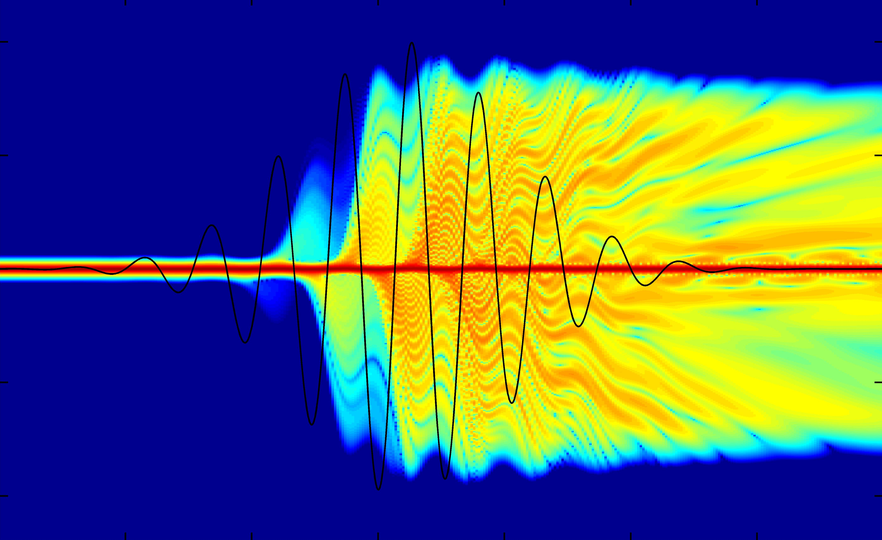
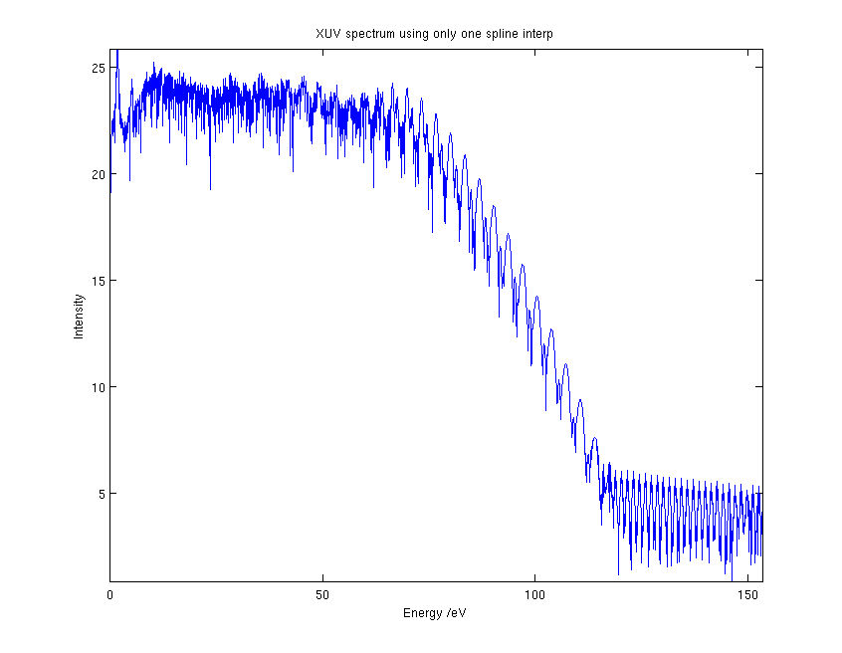
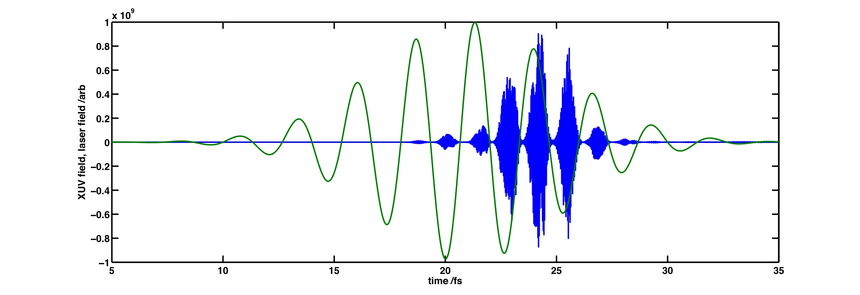
Generating X-rays using nonlinear optics
High harmonic generation – X-rays using very nonlinear optics
Now close to a full model of the process for capillary, jet and cell HHG

Slide 19
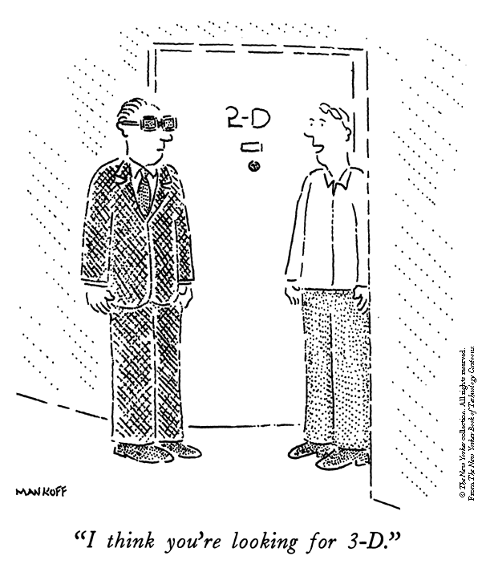
The Future
4 nm Water Window source for table top 2D and 3D cellular imaging
Spectroscopic Imaging
Time resolved spectroscopy
1 A coherent source?

Slide 20




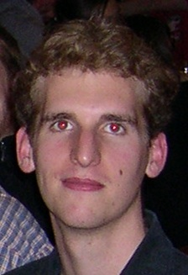





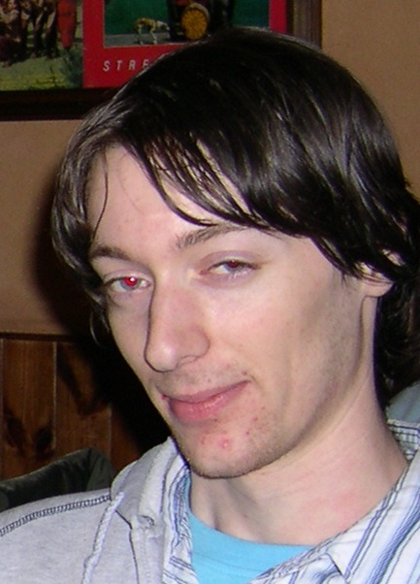

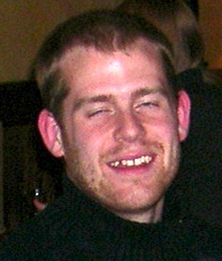



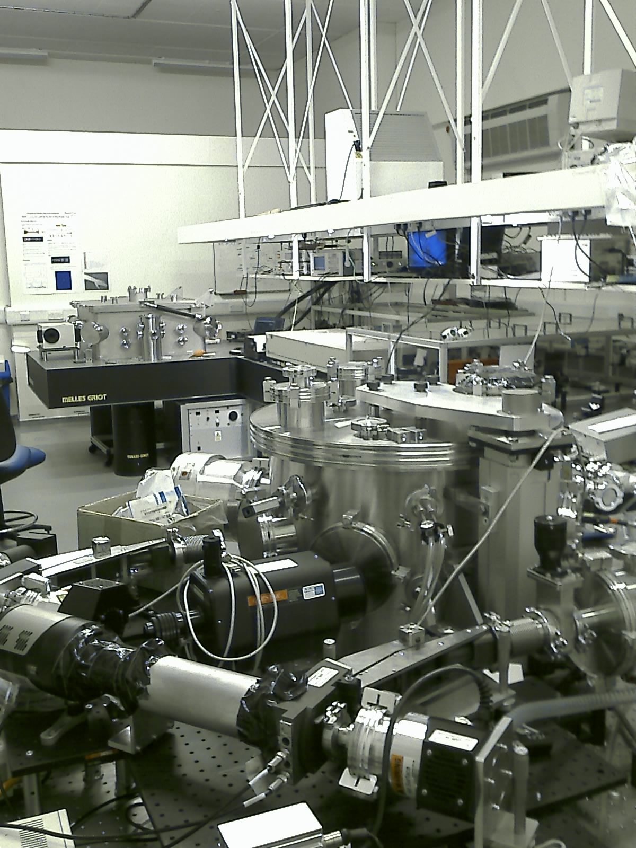
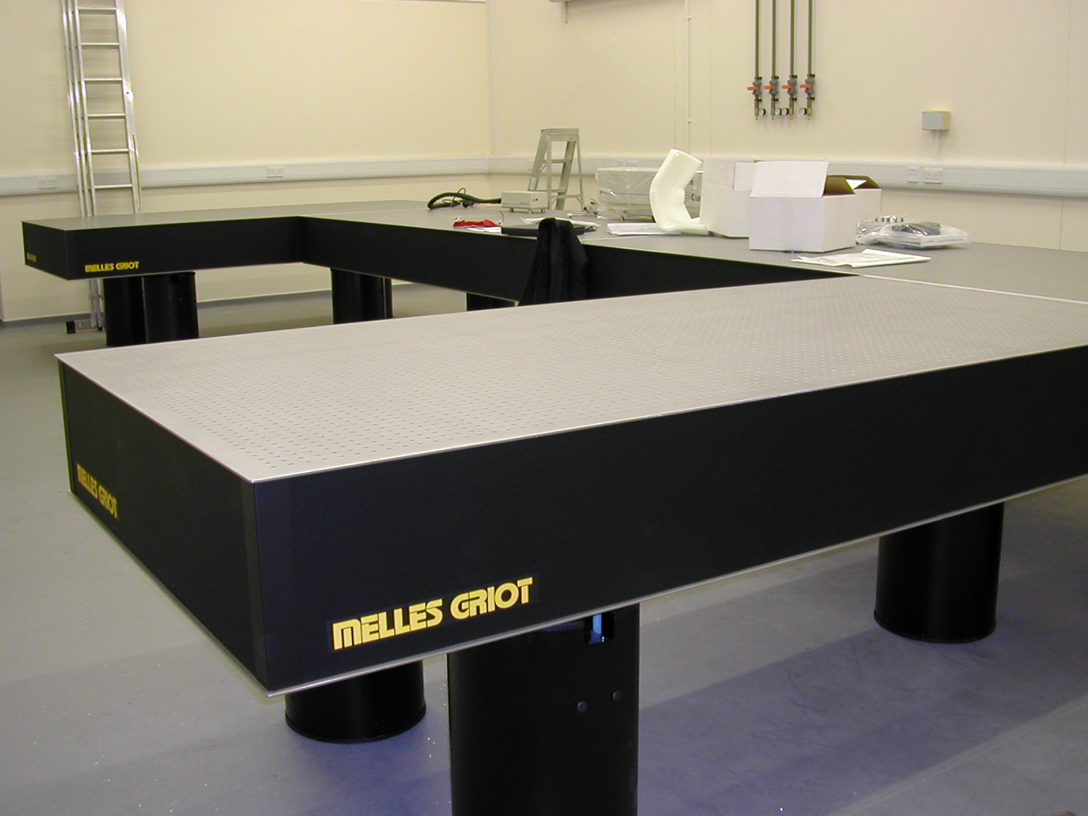
The Group
(…….well some of them)
EPSRC
RCUK
The start
2010

Slide 21
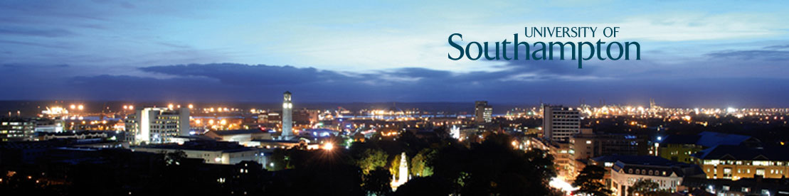
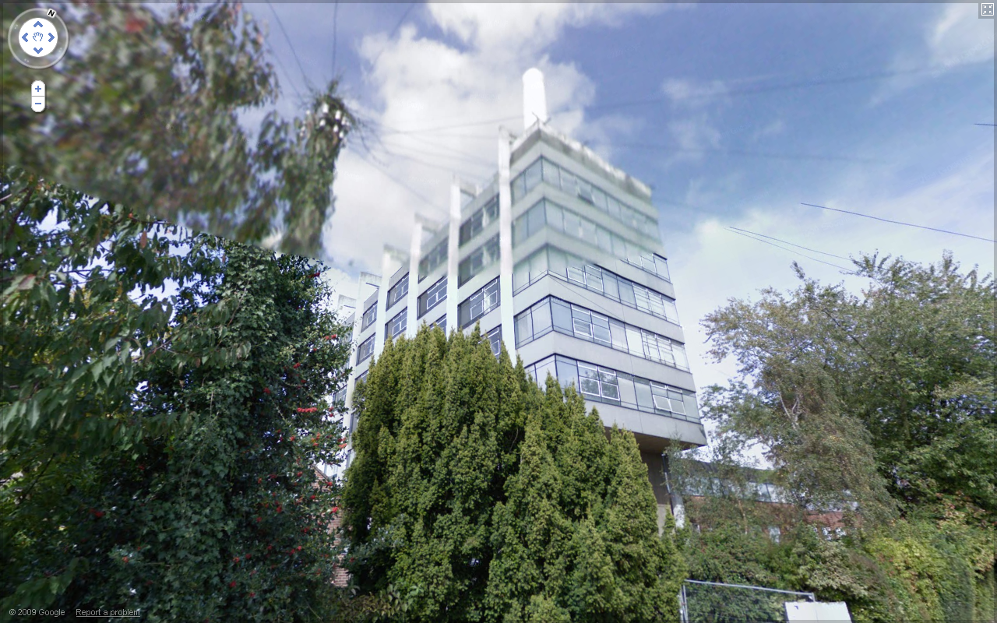


Next COST Meeting 18-19 Nov 2010
University of Southampton
ORC Buildings
Southampton Airport, Good connections to London and Heathrow via train & Coach

