Slide 1
BlogMyData
A Virtual Research Environment for collaborative visualization of environmental data
Andrew Milsted | a.j.milsted@soton.ac.uk
14 September 2010 – AHM2010
Notes:
Please use the dd month yyyy format for the date for example 11 January 2008. The main title can be one or two lines long.

Slide 2
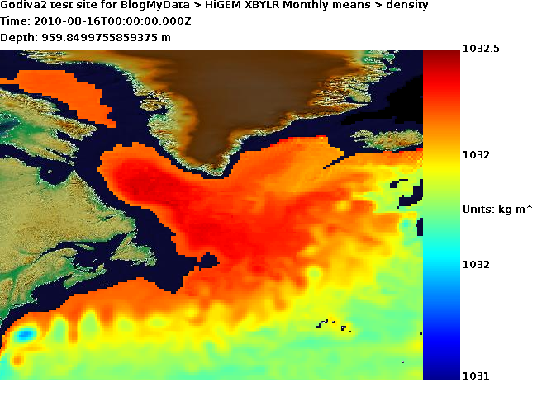
Environmental data needs to be visualized
Detecting features in models (e.g. Storms)
Diagnosing problems in models
Preview data before downloading
Make sense of large datasets
Puts data into wider context
Communicate complex concepts
Notes:
If using a school logo, make sure that if you have a long page title, it does not encroach on the logo. Allow about 2cm around the logo. Run the page title onto two lines if necessary.

Slide 3
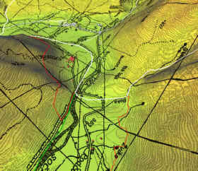
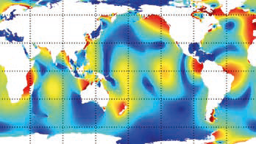
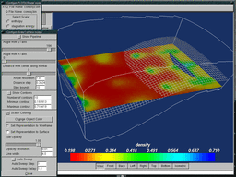
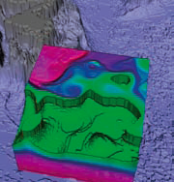
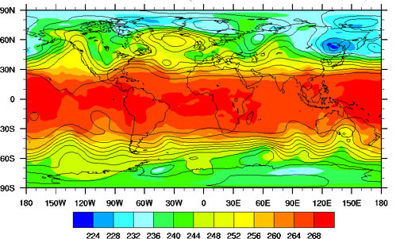
Existing scientific visualization software
Problem-solving environments Matlab, IDL
3-D desktop visualization MayaVi
3-D remote visualization Silicon Graphics
Web-based Live Access Server
Geographic Information Systems (GIS)
All require expert knowledge
Limited interoperability between systems
Notes:
If using a school logo, make sure that if you have a long page title, it does not encroach on the logo. Allow about 2cm around the logo. Run the page title onto two lines if necessary.

Slide 4
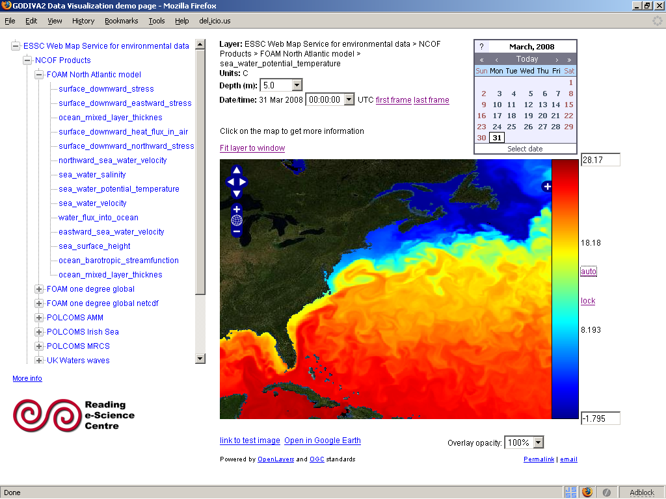
Godiva2
Interactively explore 4D geospatial raster datasets on the web
~40 datasets
Research data, operational forecasts, satellite products
Images generated dynamically for maximum flexibility
http://www.nerc-essc.ac.uk/godiva/
Notes:
If using a school logo, make sure that if you have a long page title, it does not encroach on the logo. Allow about 2cm around the logo. Run the page title onto two lines if necessary.

Slide 5
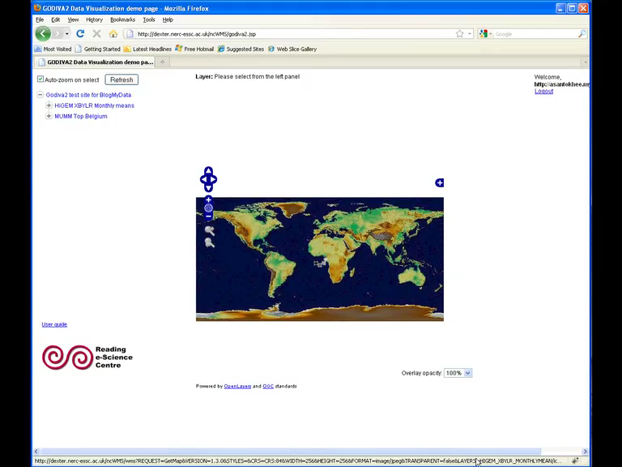
Godiva2
Notes:
If using a school logo, make sure that if you have a long page title, it does not encroach on the logo. Allow about 2cm around the logo. Run the page title onto two lines if necessary.

Slide 6

The need to discuss/collaborate/record
Discuss the models with other researchers
Collaborate with people from different sites
The discussion needs to be recorded as part of the research record.
flickr.com/julia_manzerova
Notes:
If using a school logo, make sure that if you have a long page title, it does not encroach on the logo. Allow about 2cm around the logo. Run the page title onto two lines if necessary.

Slide 7
LabTrove: The blog
Web-based blogging tool specifically designed for the practising scientist.
Can also be used as a collaboration tool that allows discussion between colleagues.
For open science work, the blog can publish its content to the public domain via standard protocols (Sitemaps, RSS Feeds)
Colleagues provide input through comments and by linking blog entries together
Notes:
If using a school logo, make sure that if you have a long page title, it does not encroach on the logo. Allow about 2cm around the logo. Run the page title onto two lines if necessary.

Slide 8
LabTrove: beyond the blog
Version control of content to record the full historic record.
Complex metadata framework to enable effective classification of content.
Plug-in based architecture, for easy customisation.
Notes:
If using a school logo, make sure that if you have a long page title, it does not encroach on the logo. Allow about 2cm around the logo. Run the page title onto two lines if necessary.

Slide 9
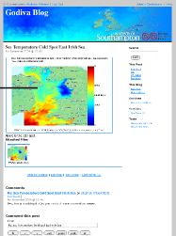

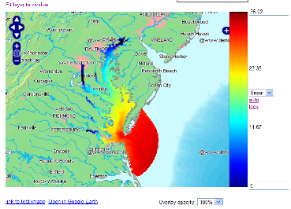
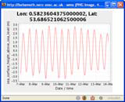
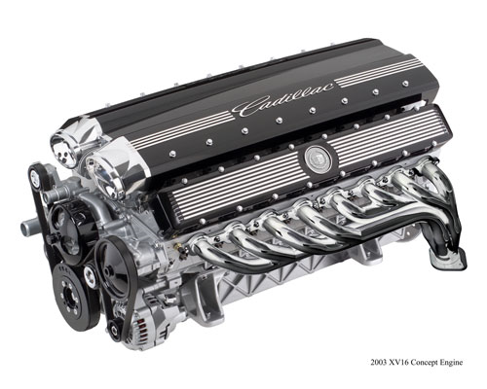

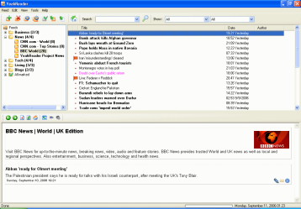

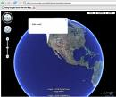
Godiva2 sites
RSS
Blog engine
Geo
database
GeoRSS

Slide 10
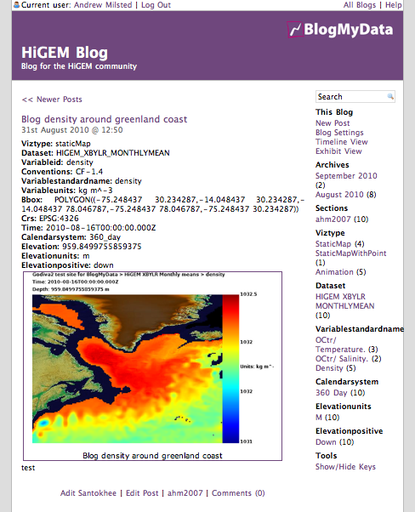
BlogMyData: Key features
OpenID was used as common authentication service.
All facilitated with rest APIs
Spatial Features provided by existing framework (PostGIS)
Notes:
If using a school logo, make sure that if you have a long page title, it does not encroach on the logo. Allow about 2cm around the logo. Run the page title onto two lines if necessary.

Slide 11

Prototype Users
http://www.higem.nerc.ac.uk/
Notes:
If using a school logo, make sure that if you have a long page title, it does not encroach on the logo. Allow about 2cm around the logo. Run the page title onto two lines if necessary.

Slide 12
Prototype Response
The privacy controls are regarded as essential, without these, the users would hesitate before posting their most interesting thoughts.
“Content is king”: the VRE must display exactly those data that the users are interested in
Animations are a must, prototype was very quickly changed to enable them.
Notes:
If using a school logo, make sure that if you have a long page title, it does not encroach on the logo. Allow about 2cm around the logo. Run the page title onto two lines if necessary.

Slide 13
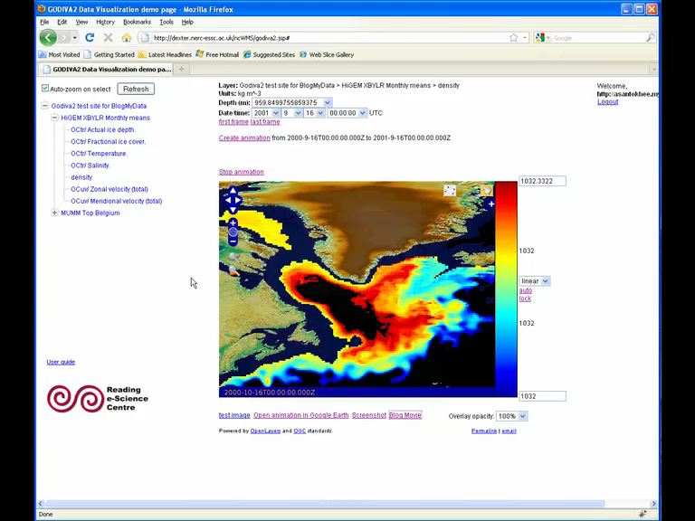

Slide 14
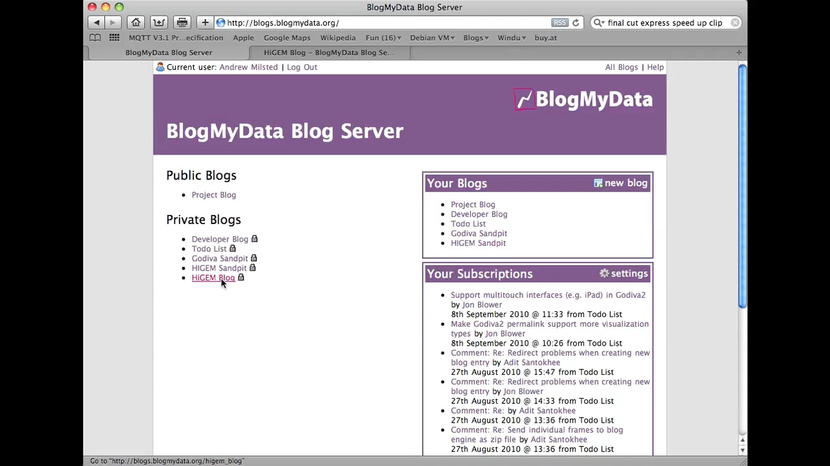

Slide 15
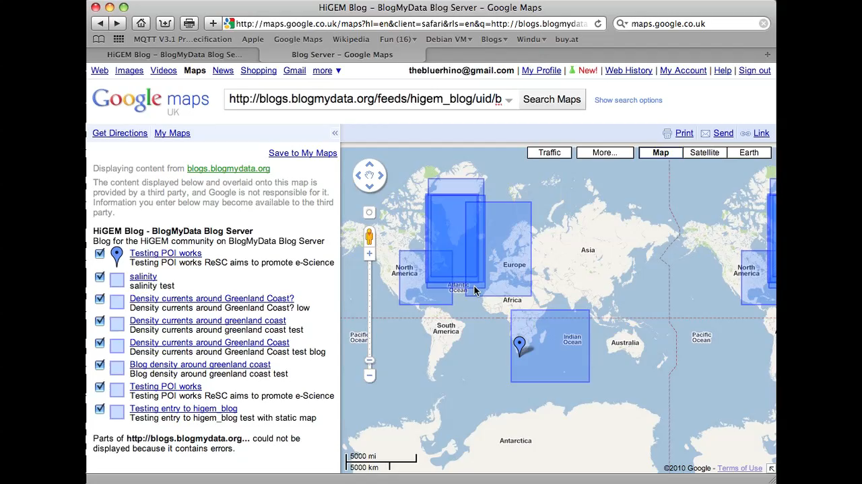

Slide 16
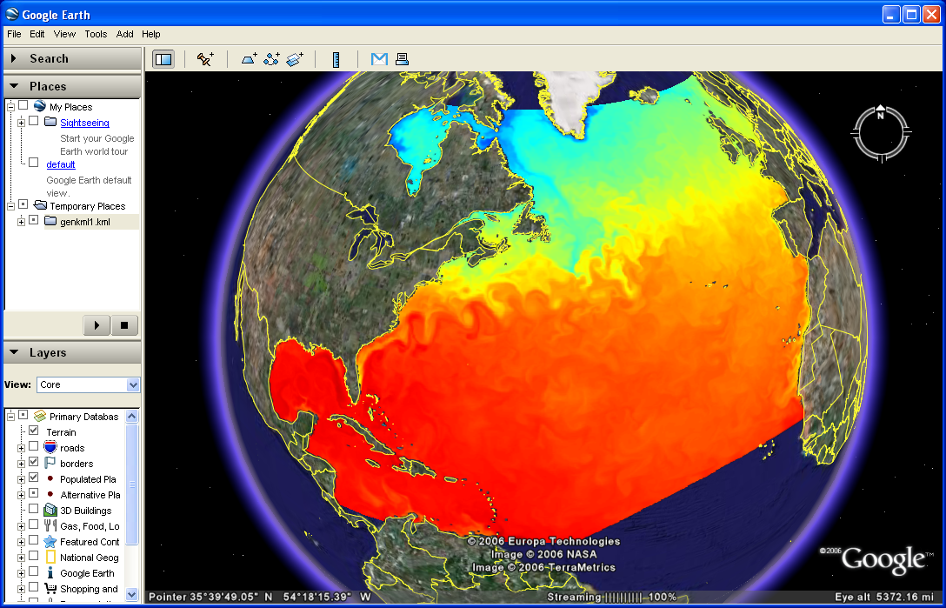
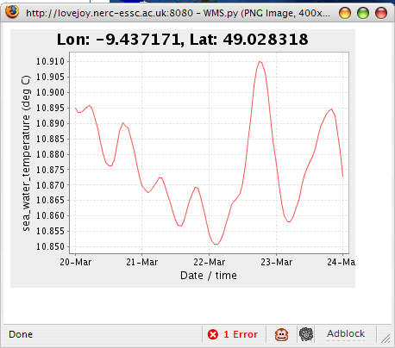
Future Features
Overlay blogged data onto other visualisation clients e.g. Google Earth™
Utilising the spatial database to offer customized GeoRSS feeds of blog entries.
Increase the number of data types of supported (e.g. depth profiles, time series plots)
Notes:
If using a school logo, make sure that if you have a long page title, it does not encroach on the logo. Allow about 2cm around the logo. Run the page title onto two lines if necessary.

Slide 17
Questions?
Notes:
Use divider pages to break up your presentation into logical sections and to provide a visual break for the viewer. The title can be one or two lines long.

