Slide 1
All Hands Meeting 2010, Cardiff
The MusicNet Composer
URI Project
Today’s speaker: David Bretherton (D.Bretherton@soton.ac.uk)
Co-Authors: Daniel A. Smith, Joe Lambert, mc schraefel (PI)
http://musicnet.mspace.fm

Slide 2
Contents
Project Outline
Motivation
Towards a Solution
Up-Take

Slide 3
1. Project Outline

Slide 4
Key facts
MusicNet runs July 2010 – June 2011.
Funded by the ‘JISC Expose’ scheme.
In partnership with leading music(ological) data providers.
MusicNet is a spin-off from musicSpace.

Slide 5
Deliverables
Mint URIs for composers so that content providers can unambiguously identify them.
  We hope to expand this work to include all music-related persons and musical ‘works’.
Publish alignment data to back-link into our data partners’ catalogues (and to other resources).
Build a suite of tools to support the alignment and integration of new linked data resources.
Build a demonstration service to illustrate the benefits of the URIs.

Slide 6
2. Motivation
Addressing Non-Alignment

Slide 7
Non-alignment
The impetus for MusicNet was musicSpace.
musicSpace:
Integrated access to leading online music resources using the mSpace faceted browser.
Demonstrated that integration could support rapid exploration & knowledge building.
Enabled complex, multipart queries.

Slide 8
musicSpace demo
‘What recording of works by Cage exist, which performers have recorded a particular work by Cage, and what else by Cage have they recorded?
Screencast 1: Clean Data

Slide 9
But partners’ data isn’t ‘clean’...
Schubert, Franz Peter‏
Schubert, Franz Peter,‏ ‎‡d 1797-1828‏
Schubert, Franz Peter‏ ‎‡d 1797-1828‏
Schubert, François,‏ ‎‡d 1797-1828‏
Schubert.‏
Schubert‏ ‎‡d 1797-1828‏
Shu-po-tʿe‏ ‎‡d 1797-1828‏
Shubert, F. (Frant︠s︡)‏ ‎‡d 1797-1828‏
Shubert, F.‏ ‎‡q (Frant︠s︡),‏ ‎‡d 1797-1828‏
Shubert, Frant︠s︡,‏ ‎‡d 1797-1828‏
Shubert, Frant︠s︡‏ ‎‡d 1797-1828‏
Shūberuto, F.‏
Shūberuto, Furantsu‏ ‎‡d 1797-1828‏
Šubert, Franc‏ ‎‡d 1797-1828‏
Šubertas, F. (Francas),‏ ‎‡d 1797-1828‏
Schubert‏
Schubert, Franz‏
Schubert, Franz Peter‏
Shu-po-tʻe,‏ ‎‡d 1797-1828‏
Schubert‏ ‎‡d 1797-1828‏
F. P. Schubert‏
Schubert, ...‏ ‎‡d 1797-1828‏
Schubert, F.‏
Schubert, F.‏ ‎‡d 1797-1828‏
Schubert, Fr.‏
Schubert, Fr.‏ ‎‡d 1797-1828‏
Schubert, Franciszek.‏
Schubert, Franç.‏ ‎‡d 1797-1828‏
Schubert, François‏ ‎‡d 1797-1828‏
Schubert, Franz P.‏ ‎‡d 1797-1828‏
Šubertas, Francas Peteris,‏ ‎‡d 1797-1828‏
Šubert, F.‏
Šubertas, F.‏ ‎‡d 1797-1828‏
שוברט, פרנץ‏
シューベルト, F., 1797-1828‏
シューベルト, フランツ‏ ‎‡d 1797-1828‏
舒柏特, 弗朗茨‏
Schubert, François‏ ‎‡d 1797-1828‏
Schubert, Franz Peter‏ ‎‡d 1797-1828‏

Slide 10
Causes of dirty data
Different naming conventions;
  e.g. ‘Bach, Johann Sebastian’ or ‘J. S. Bach’
Inclusion of non-name data in name field;
  e.g. ‘Schubert, Franz, 1797-1828. Songs’,
  or ‘Allen, Betty (Teresa)’
Different languages (and alphabets);
User input errors.
  e.g. ‘Bach, Johan Sebastien’

Slide 11
Dirty data degrades the user experience
Searching for compositions by the composer Franz Schubert (1797–1828)...
Screencast 2: Dirty Data

Slide 12
3. Towards a Solution
Assisted Synonymous Entity Alignment

Slide 13
Prototype 1
(musicSpace era)

Slide 14
Used Alignment API & Google Docs
We used Alignment API to compare the names as strings, using WordNet to enable word stemming, synonym support, etc.
Alignment API produces a similarity measure for each possible match.
We planned to set a threshold for automatic approval.
Matches below that threshold would be sent to a Google Docs spreadsheet for expert review.

Slide 15
Shortcoming 1: no threshold
It was not possible to identify a threshold for automatic approval.
Terms are judged to be similar if they have just, say, one different character, but a difference of one character is significant in a name.
Names are proper nouns, and so are unsuited to WordNet’s assumptions of misspelling.

Slide 16


Shortcoming 1: no threshold
False matches with high similarity measures:
True matches with low similarity measures:

Slide 17
Shortcoming 2: no context
Alignment API compares names as strings, and the system strips the names of their context (i.e. additional metadata).
  Lack of context meant the musicologist had no way to verify the match.
Significant flaw; automation had failed so we where relying on manual review.

Slide 18
Prototype 2
(building a custom tool for MusicNet)

Slide 19
Lessons learned
From Prototype 1:
  A completely automated solution is out of the question (for the moment...).
  We needed a custom tool with a human-friendly UI (also, we wanted keyboard shortcuts for speed).
  Access to additional metadata (i.e. context), so matches can be researched by the reviewer.
From experience with faceted browsers:
  Alphabetically sorted columns enable one to spot synonymous names at a glance.
    Normally: sources give names surname first; duplication arises from the different representation of given names.

Slide 20
Alignment process
Data*
Algorithm compares
hash of alpha-only lc version of name
Suggested groups
No groups suggested
User verified*
or rejected*
Manual grouping (research*)
Synonym groups
URIs
• Alternative names • Back links*

Slide 21
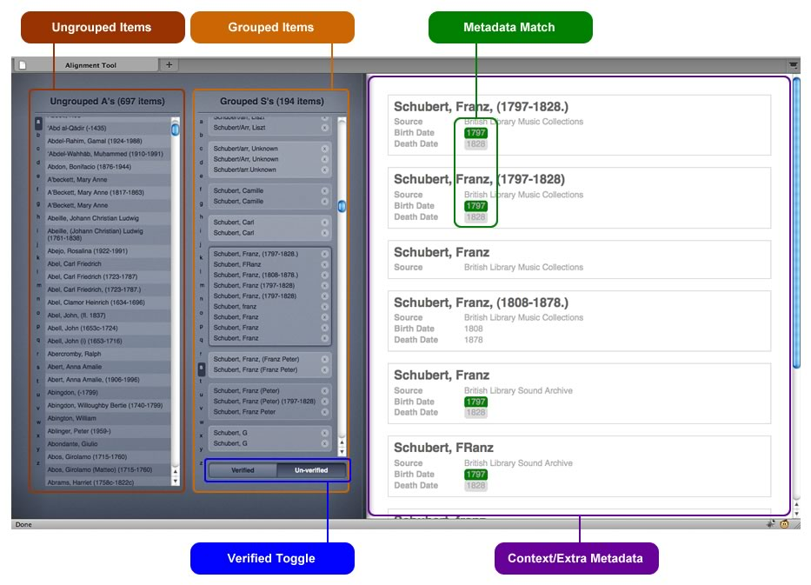
UI of Prototype 2

Slide 22
Prototype 2 demo
Screencast 3: Prototype 2

Slide 23
4. Up-Take

Slide 24
Indicative use cases
Composer URIs:
  Music(ological) content providers
  Basis for a research portal
Alignment tool:
  Aligning databases with no authorities;
  Or where authorities are inconsistent.

Slide 25
Thank you for listening!
Acknowledgments
JISC (http://www.jisc.ac.uk)
The British Library (http://www.bl.uk)
Copac (http://copac.ac.uk)
Grove Music Online (OUP) (http://www.oxfordmusiconline.com)
RISM UK and Ireland (http://www.rism.org.uk)

