Slide 1
OVERVIEW OF Open Access: The NEXT FIVE YEARS
Open Access and Research Conference, Brisbane, 24-26 September 2008
Alma Swan
Key Perspectives Ltd, Truro, UK

Slide 2
Where we are now
Focus = research articles
Latest estimates show level of OA for research articles is still <20% (c11% in repositories or elsewhere on the Web)
Patchy: ‘OA quotient’ for different subject areas varies hugely
Key Perspectives Ltd

Slide 3
Focus: journal articles
Expect even more attempts by (some) publishers at obstruction:
Arguments often fallacious
Arguments sometimes dishonest
The argument always wrong
Weapon: copyright
Wield it, now, against the interests of academia and the paying public
Reason for the panic: OA mandates
Key Perspectives Ltd

Slide 4
Open Access policies
A lot of almost-there, well-meaning policies
Come in various flavours
Not all taste good
NIH
Key Perspectives Ltd

Slide 5
Open Access policies
 | Policies | Mandates
 |  | Current | Proposed
Institutional | 27 | 23 | 2
Departmental | 2 | 4
Multi-institutional |  |  | 3
Funder | 7 | 27 | 5
Totals | 36 | 54 | 10
Key Perspectives Ltd

Slide 6
OA policies
A growing number of mandates
Because they work
Because the outcome makes glorious sense for research institutions and funders
Management tool
Marketing tool
Makes the best use of the Web
Key Perspectives Ltd

Slide 7
Repositories: state of play
Around 1200 worldwide
Growing at a rate of around 1 per day
Institutional, mostly
Sometimes ‘centralised’ (subject-based)
Key Perspectives Ltd

Slide 8
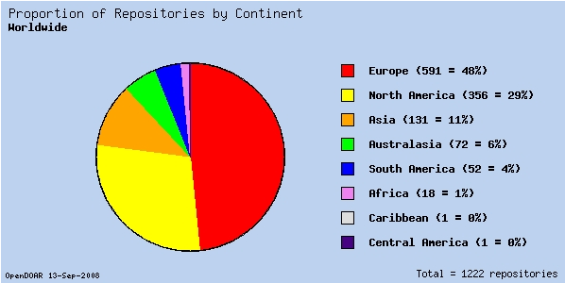
Where they are
Key Perspectives Ltd

Slide 9
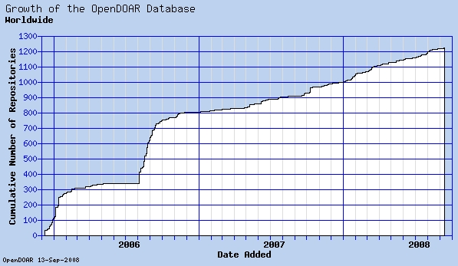
Growth in numbers
Key Perspectives Ltd

Slide 10
Copyright
Is a completely resolvable issue…
… yet it is the major barrier to simple acceptance and practice of OA by researchers
Oh, how many times we have seen this issue raise its head, and ..
Oh, how many times does it obfuscate institutional mandates
Key Perspectives Ltd

Slide 11
Copyright futures
Actually a tendency towards the legal strengthening of copyright in general
Research community practices will demonstrate that the way copyright is applied to scholarly articles is out-of-time
Author agreements that retain copyright (LTPs)
New, ‘liberal’ practices with respect to publishing findings
Anyway, Open Access is completely compatible with copyright
Key Perspectives Ltd

Slide 12
New, ill-defined issue: research data
Increasingly the primary output in some fields
Key Perspectives Ltd

Slide 13
‘Atkins’ Report (NSF, 2005)
“The primary access to the latest findings in a growing number of fields is through the Web, then through classic preprints and conferences, and lastly through refereed archival papers”.
Key Perspectives Ltd

Slide 14
New, ill-defined issue: research data
Increasingly the primary output in some fields
Data have yet to be properly recognised as a research output
Are copyright-free
Increasingly the subject of mandates, too
Key Perspectives Ltd

Slide 15
New research approaches…
…. depend upon OA
e-research (‘big’ research)
Collaborative ‘small’ research
Interdisciplinary research
Web 2.0 outputs becoming a norm
Early examples of institutional solutions
Key Perspectives Ltd

Slide 16
Key Perspectives Ltd

Slide 17
Key Perspectives Ltd

Slide 18
Pragmatic solutions
Joining articles, data and other related outputs in better ways
More (and more) work on standards
‘Surfacing’ Web content
Better ways to ‘show off’ Open Access content
New services built across repository networks
Clearer vision of how to reach a repository-based scholarly communication system
Key Perspectives Ltd

Slide 19
Semantic / exploitative technologies
Search / retrieve
Aggregate / display
Editorial
Count / assess
Peer review
REPOSITORIES
and other open content
Ingest layer services
Key Perspectives Ltd
Notes:
19

Slide 20
Wrong solutions: Impact and assessment
For too long we’ve used a proxy measure
With an OA corpus, multiple metrics and indicators are possible
The more, the better, and the more meaningful overall
We can be adventurous and free-thinking on this
Key Perspectives Ltd

Slide 21
A scientific article
Key Perspectives Ltd

Slide 22
Key Perspectives Ltd

Slide 23
The impact of that article …
AUS$ 9 billion of spending
Will tell us the secrets of the Universe!
Key Perspectives Ltd

Slide 24
New indicators
UK: RAE becomes the REF and ‘metrics-based’
Australia: IDG - new quality indicators
European project: EERQI
COIMBRA: QIs in the arts & humanities
Usage
‘Quality’
More complex metrics
Key Perspectives Ltd

Slide 25

Mahatma Gandhi
Key Perspectives Ltd

Slide 26
Everything ‘open’ started as a big joke…
Open Source
Open Society
Open Access
Open Science
Open Education
Open Innovation
Open Data
Open Licensing
Key Perspectives Ltd

Slide 27
The tipping point
“I think the tipping point will come when scientists look at someone next to them using the open system and getting more discoveries and saying, ‘I want that’.”
John Wilbanks Executive Director, Science Commons
Key Perspectives Ltd

Slide 28
Faculty action
Harvard Faculty of Arts and Sciences
Harvard Law School
Stanford School of Education
Key Perspectives Ltd

Slide 29
It’s been too easy to dismiss the issue
Institutions have been notably disengaged
Scholarly communication has been low on the agenda
Yet is is central to the core mission of a university
Key Perspectives Ltd

Slide 30
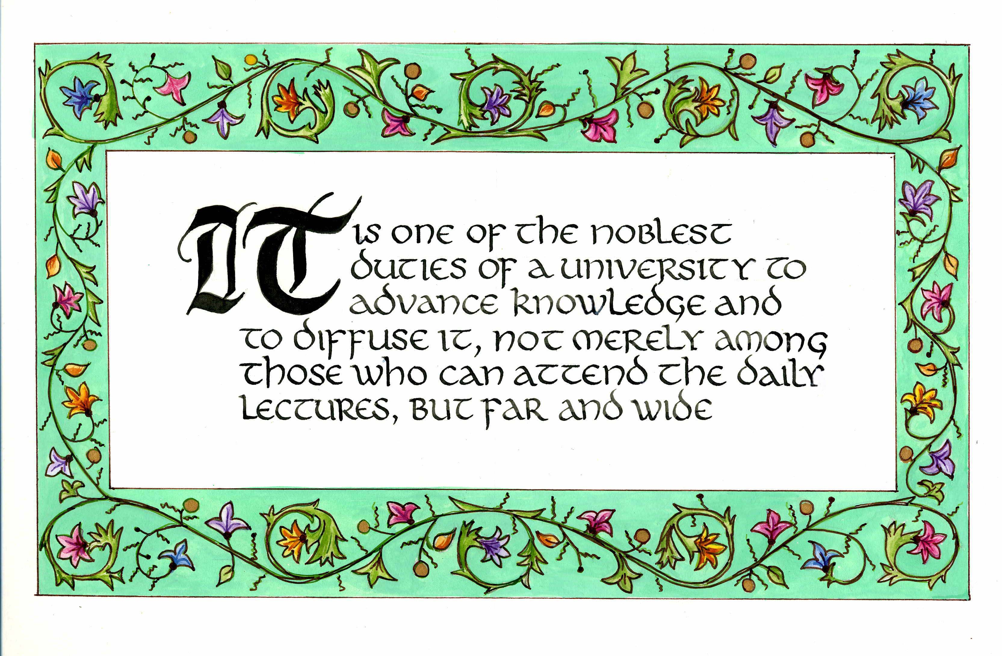
Daniel Coit Gilman First President, Johns Hopkins University
Key Perspectives Ltd

Slide 31
University of Edinburgh Strategic Plan 2008-12
“The mission of our University is the creation, dissemination and curation of knowledge.”
Key Perspectives Ltd

Slide 32
Questions universities will be addressing
What are we here for?
What measures of ROI work for us?
What do we want to measure?
How can this be done?
What new reward systems can we build?
What can we do with the Web?
How important is Web impact going to be?
How do we maximise ours?
Key Perspectives Ltd

Slide 33
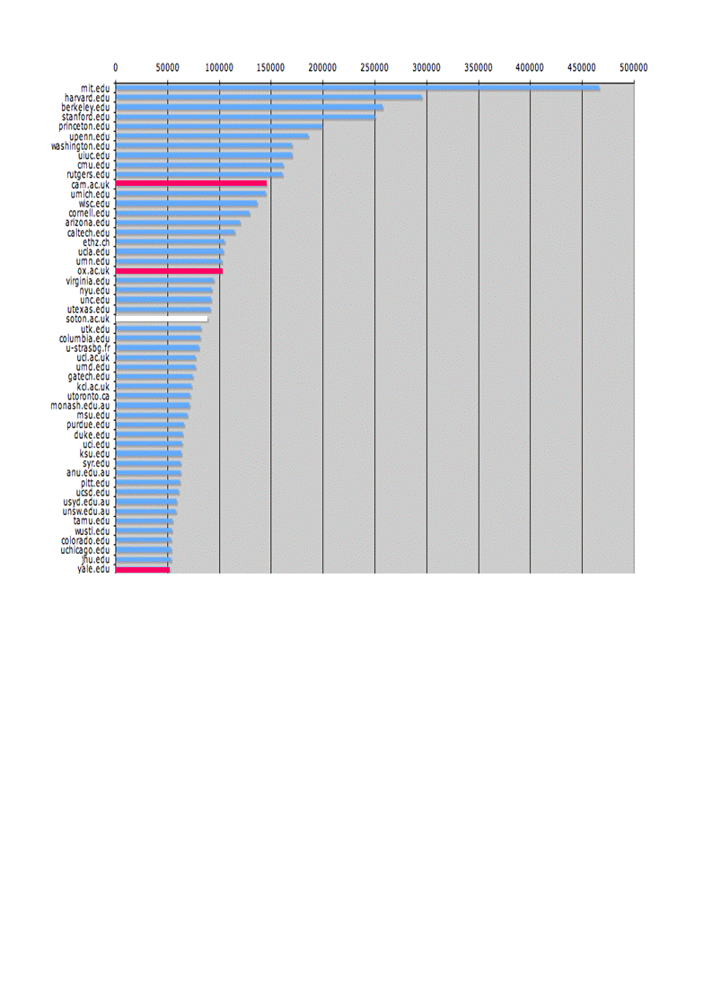
The U.Southampton conundrum
The G-Factor (universitymetrics.com)
Key Perspectives Ltd

Slide 34
Key Perspectives Ltd

Slide 35
Joining up the institutional dots
Link the repository to the CRIS and other institutional databases
Enables a complete picture of institutional research-related activity
Research workforce, its characteristics, dynamics and effectiveness
How variables interact or play out
New return on investment measures
Key Perspectives Ltd

Slide 36
Managing innovative environments: “Rhetoric of rationality”
Where do institutional responsibilities start and end, with respect to scholarly communication?
Scholarly communication adhocracy is developing
Universities should be taking control (back)
Offices of Scholarly Communication
University Presses are waxing again
Enabling infrastructures (e.g. VIVO)
Enabling innovation
Key Perspectives Ltd

Slide 37
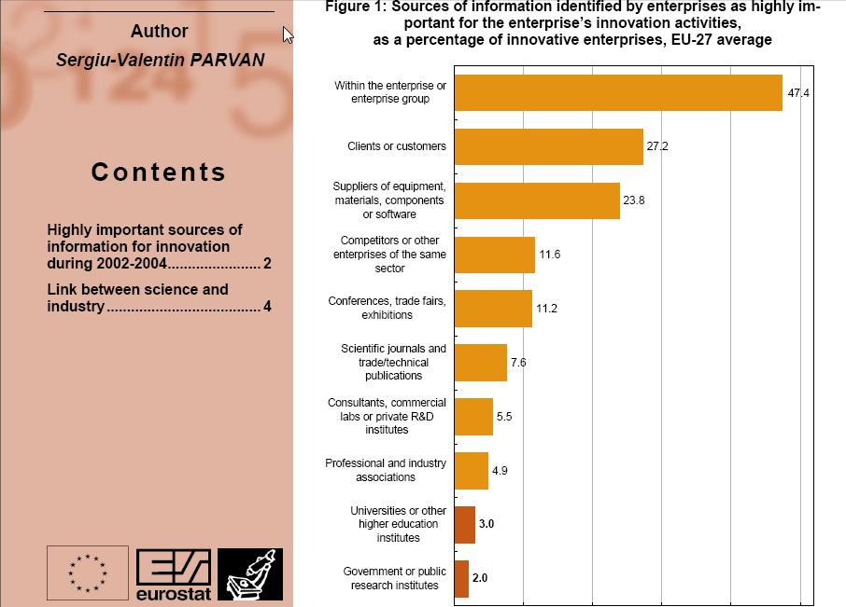
Key Perspectives Ltd

Slide 38
“Innovative enterprises find cooperation partners more easily among suppliers or customers than in universities or public research institutes.”
Key Perspectives Ltd

Slide 39
Terence Dolak (SDR Pharmaceuticals)
“With a small oncology company … it is imperative that I have access to the literature.
But small companies do not have the "deep pockets" necessary... The for-profit journal publishers have effectively barred access to key scientific information except to those who can afford their outrageous fees.
Much of the most innovative work is being done at companies like mine that cannot afford to pay $30+ per paper or pay per-search charges in abstracts or journal collections.”
Key Perspectives Ltd

Slide 40
OECD’s conclusions
“Governments would boost innovation and get a better return on their investment in publicly funded research by making research findings more widely available …. and by doing so they would maximise social returns on public investments.”
OECD Report on Scientific Publishing, 2005
Key Perspectives Ltd

Slide 41
The public good
Universities: the drivers: Are they changing? And should they?
Whatever the drivers, the system is not optimal
More effective embedding of publicly-funded research, for the public good
Key Perspectives Ltd

Slide 42
“The arguments for stepping out first on open access are the same as the arguments for stepping out first on emissions trading – the more willing we are to show leadership on this, we more chance we have of persuading other countries to reciprocate.”
Kim Carr
Minister for Industry, Innovation, Science and Research, Australia
Key Perspectives Ltd

Slide 43
“We’re a generation who expects all information is a Google search away. Not only is it a Google search away, but it is also released immediately.”
Barry Canton
Bioengineer, MIT
Key Perspectives Ltd

Slide 44
Thank you for listening
aswan@keyperspectives.co.uk
www.keyperspectives.co.uk
www.keyperspectives.com
Key Perspectives Ltd

