Slide 1

EPrints
Preservation Update
Notes:
Welcome to the EPrints 3.2 5 minute demos
In this demo we are going to look at web based file uploading and the new architecture which has been built in eprints 3.2. The new architecture allows more flexability to perform processes on different types of files as they are uploaded.

Slide 2

EPrints Preservation
New EPrints Preservation Team
Overseeing integration of preservation into EPrints software as well as involvement with preservation projects
Preserv2 – Ended March 2009
Keep-It! – Just Beginning
http://preservation.eprints.org

Slide 3



Keep-It! Project Overview
Aim: To create a number of exemplar preservation repositories from which others can learn
Small number of very diverse repositories
Training
Deployment
Development
http://preservation.eprints.org

Slide 4
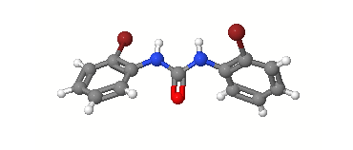
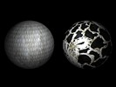


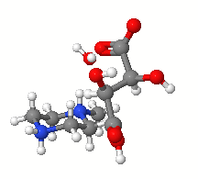


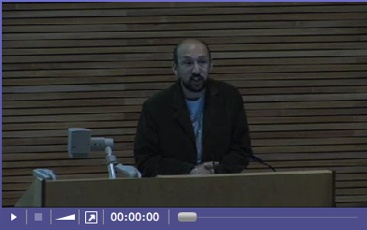



Repository Content
http://preservation.eprints.org

Slide 5


Keep-It Focuses
Long Term
Reliable Storage
Risk Analysis
Mitigation / Action
http://preservation.eprints.org

Slide 6
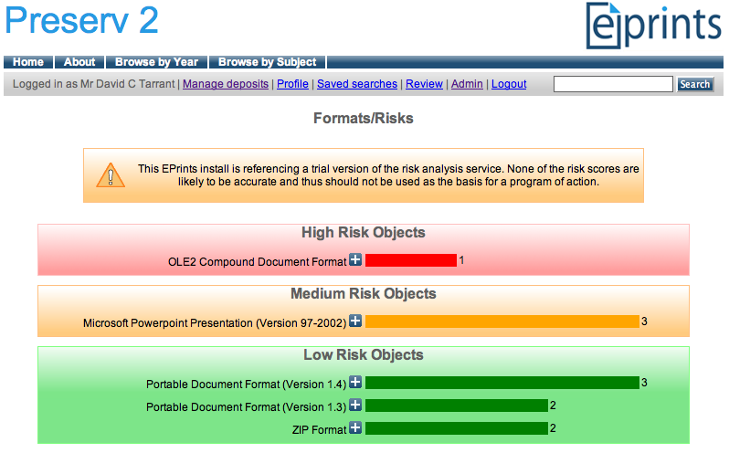
From Preserv2 - Risk Analysis
http://preservation.eprints.org

Slide 7
Risk Analysis - Problems
Data pertaining to Risks is distributed across the web
Bringing all this data together into one registry is hard if that registry has a well controlled data model
Not so much of a problem if you harness linked data and the semantic web
http://preservation.eprints.org

Slide 8
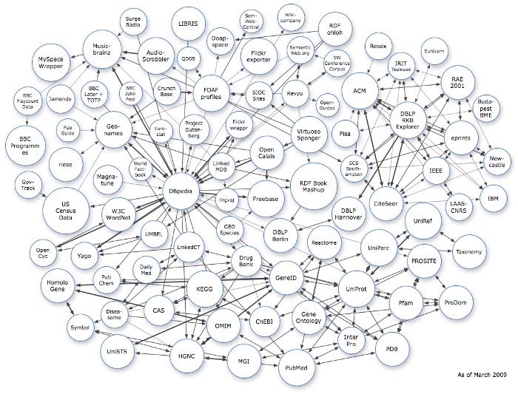
Linked Data Web
As of March 2009
http://linkeddata.org/
http://preservation.eprints.org

Slide 9
The P2-Registry
A preservation focused registry
  Imports openly available data (Pronom, dbpedia)
Provides a set of restful services
  Data export
  Risk Analysis Profile Data
  Processed Risk Analysis Data
  Migration Pathways
SPARQL Endpoint
http://p2-registry.ecs.soton.ac.uk

Slide 10
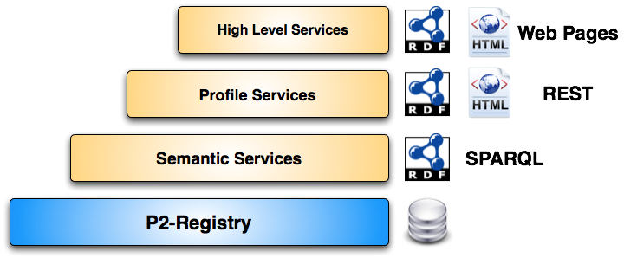
The P2-Registry
http://p2-registry.ecs.soton.ac.uk

Slide 11
Example Input – PDF v1.3
PRONOM Data
  Format Documentation
  Format age and newer versions
  Identification Type
  4 Software Tools
dbpedia Data
  Format Complexity
  Format Type
  > 50 Software Tools
http://p2-registry.ecs.soton.ac.uk

Slide 12
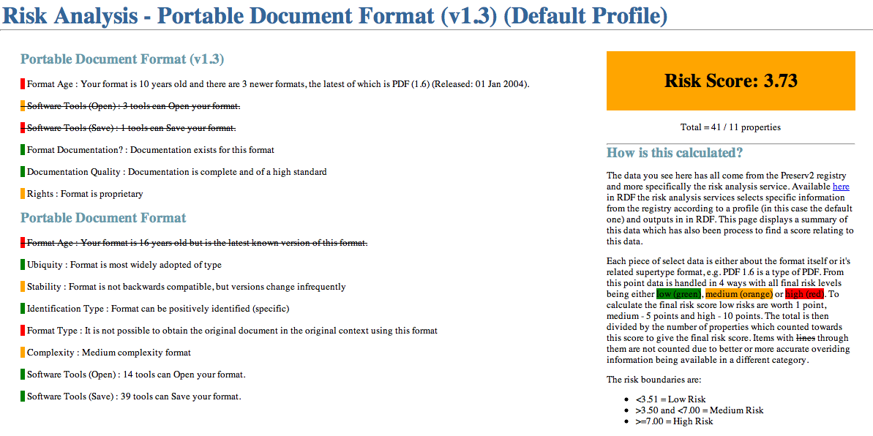
Example Output – PDF v1.3
http://p2-registry.ecs.soton.ac.uk

Slide 13
P2-Registry Futures
Import more data which people have created on the linked data web.
Currently 46,000 items of Information (mostly about PDF)
Have you got any?
http://preservation.eprints.org

Slide 14
EPrints 3.2
Desktop & Cloud Integration
Notes:
Welcome to the EPrints 3.2 5 minute demos
In this demo we are going to look at web based file uploading and the new architecture which has been built in eprints 3.2. The new architecture allows more flexability to perform processes on different types of files as they are uploaded.

Slide 15
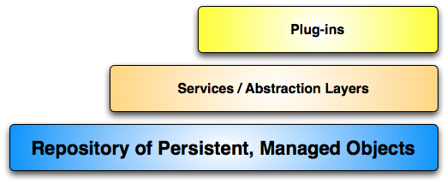
EPrints Structure
Everything builds on the core layer
Major part of v3.2 is strengthening the core and adding more abstraction layers
  Improved data model
  Enhanced data facilities
  Enhanced metadata facilities
  Improved programming & API
http://www.eprints.org

Slide 16
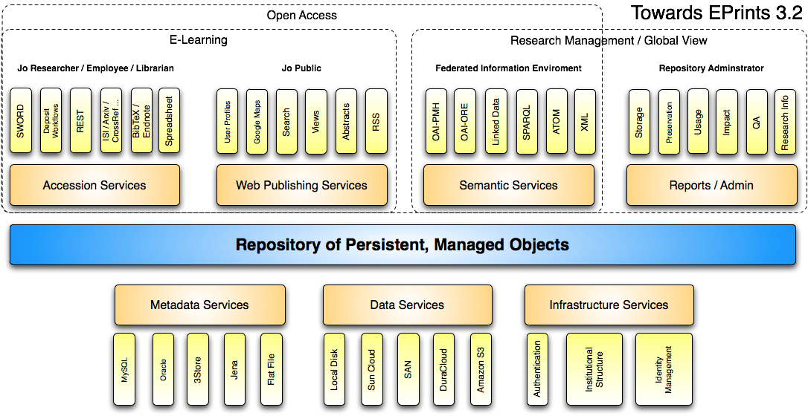
EPrints 3.2 Structure
http://www.eprints.org

Slide 17
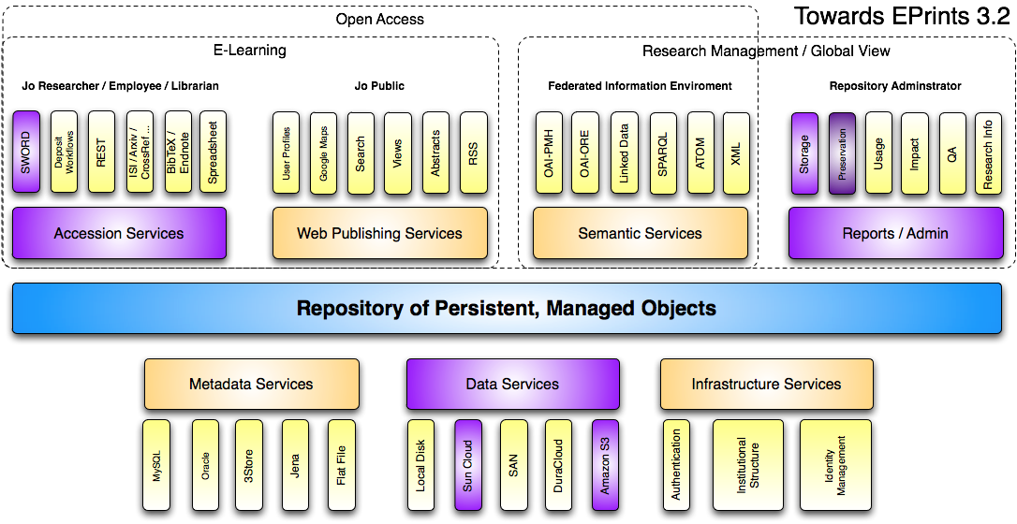
Presentation Focus
http://www.eprints.org

Slide 18
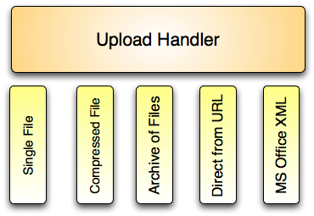
Desktop & Cloud Integration
Part 1: Desktop
Upload handler now has a Plug-in layer
http://www.eprints.org
Notes:
As many of you may know EPrints is already a very modular system allowing you to use plugins to perform different operations.
This is now true of the upload handler.
The upload handler in the past has already had the capability to handle the uncompressing of an archive of files as well as direct file upload and in Eprints 3.2 we saw the need to expand this capability to handle more types of files

Slide 19
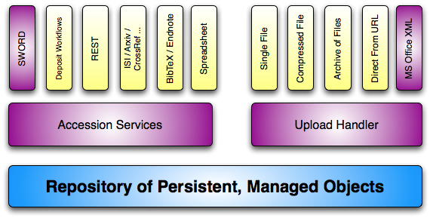
Desktop & Cloud Integration
Part 1: Desktop
Can be integrated with accession services
http://www.eprints.org
Notes:
As many of you may know EPrints is already a very modular system allowing you to use plugins to perform different operations.
This is now true of the upload handler.
The upload handler in the past has already had the capability to handle the uncompressing of an archive of files as well as direct file upload and in Eprints 3.2 we saw the need to expand this capability to handle more types of files

Slide 20
Desktop & Cloud Integration
Part 1: Desktop
EPrints 3.2
SWORD 2 Support
MS Office XML Upload Plug-in
Microsoft Office
Microsoft Article Authoring Add-in Tool
Dublin Core Metadata
SWORD 2 Support
http://www.eprints.org
Notes:
As many of you may know EPrints is already a very modular system allowing you to use plugins to perform different operations.
This is now true of the upload handler.
The upload handler in the past has already had the capability to handle the uncompressing of an archive of files as well as direct file upload and in Eprints 3.2 we saw the need to expand this capability to handle more types of files

Slide 21
Demo
Demo 1
1) Uploading Office 2007 Document into EPrints using Web Interface
2) Uploading directly from Word 2007 into EPrints
http://www.eprints.org
Notes:
So lets look at some demos. There are 3 cool plugins I’d like to show you including one to handle the new Microsoft Office formats which we are very excited about.

Slide 22
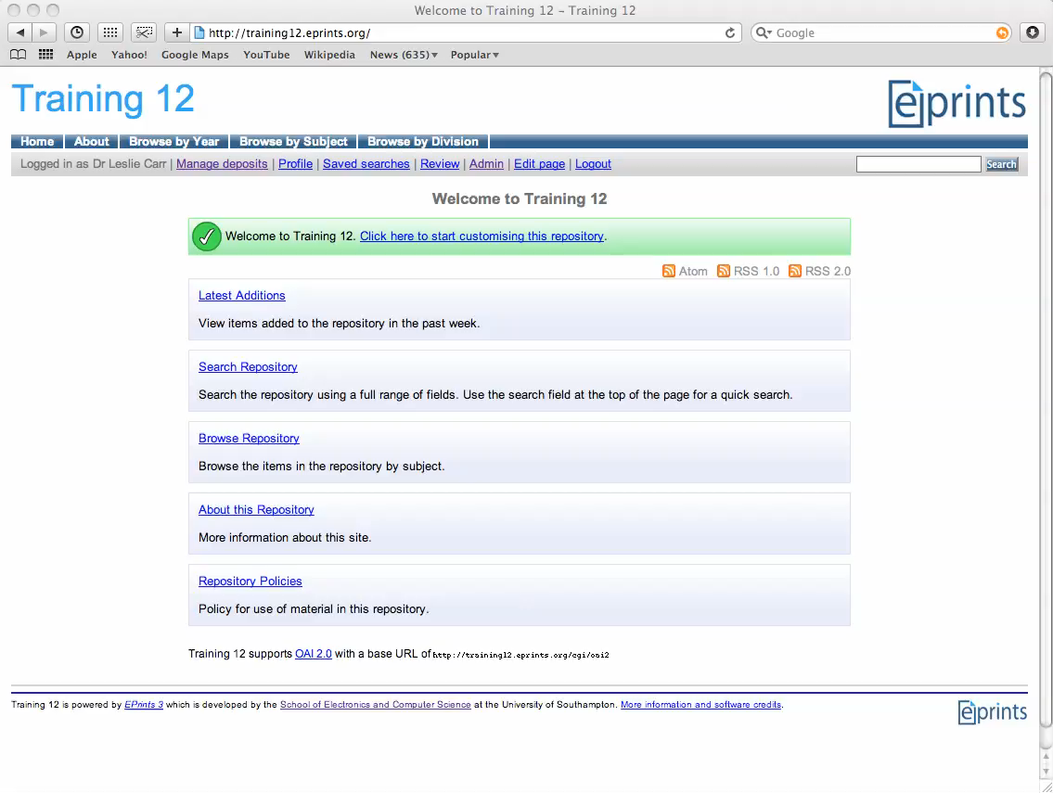

Slide 23
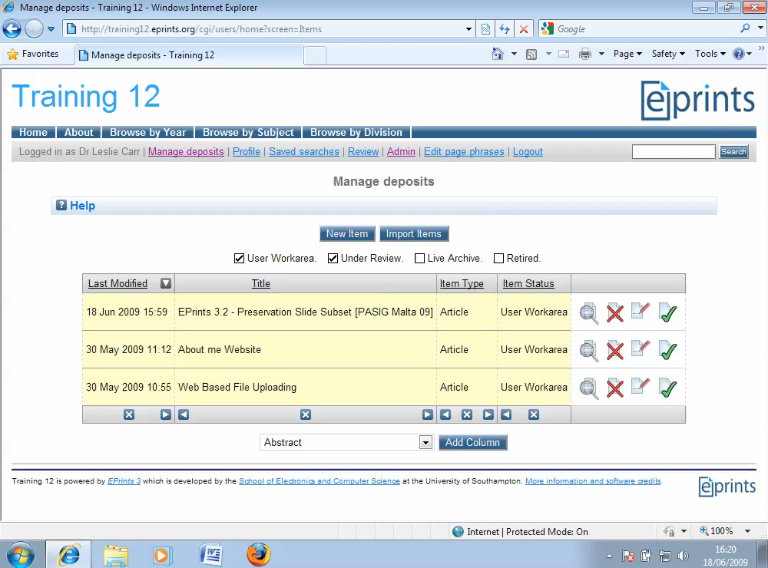

Slide 24

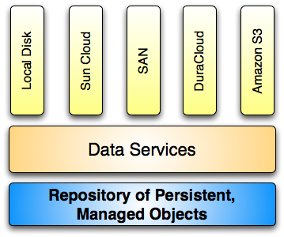
Desktop & Cloud Integration
Part 1I: Cloud – Hybrid Storage
Using a single storage platform or solution has drawbacks.
Cost vs. Speed vs. Reliability
If repositories are to provide good preservation then they need to utilize and be able to migrate to new platforms.
In this presentation we look at backing your repository with a Hybrid storage solution.
Gives you the power to utilize the benefits of each solution without losing control of your digital objects.
http://www.eprints.org
Notes:
As many of you may know EPrints is already a very modular system allowing you to use plugins to perform different operations.
This is now true of the upload handler.
The upload handler in the past has already had the capability to handle the uncompressing of an archive of files as well as direct file upload and in Eprints 3.2 we saw the need to expand this capability to handle more types of files

Slide 25
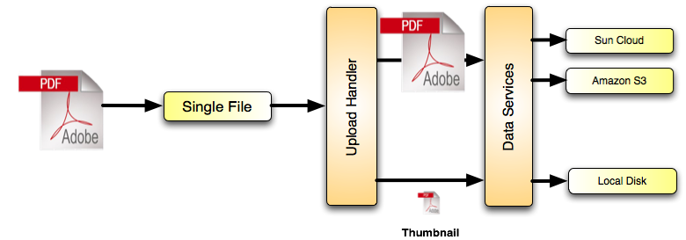
Desktop & Cloud Integration
Part 1I: Hybrid Storage Policies
http://www.eprints.org

Slide 26
Desktop & Cloud Integration
Part 1I: Hybrid Storage Policies
<choose>
<when test="datasetid = 'document'">
<choose>
<when test="$parent{relation_type} = ’http://eprints.org/relation/isVolatileVersionOf'">
<plugin name="Local"/>
</when>
<otherwise>
<plugin name="SunCSS"/>
<plugin name="AmazonS3"/>
</otherwise>
</choose>
</when>
<otherwise>
<plugin name="Local"/>
</otherwise>
</choose>
http://www.eprints.org

Slide 27
Demo
Demo 1I
1) Uploading a PDF into the cloud
1b) Managing your storage
http://www.eprints.org
Notes:
So lets look at some demos. There are 3 cool plugins I’d like to show you including one to handle the new Microsoft Office formats which we are very excited about.

Slide 28
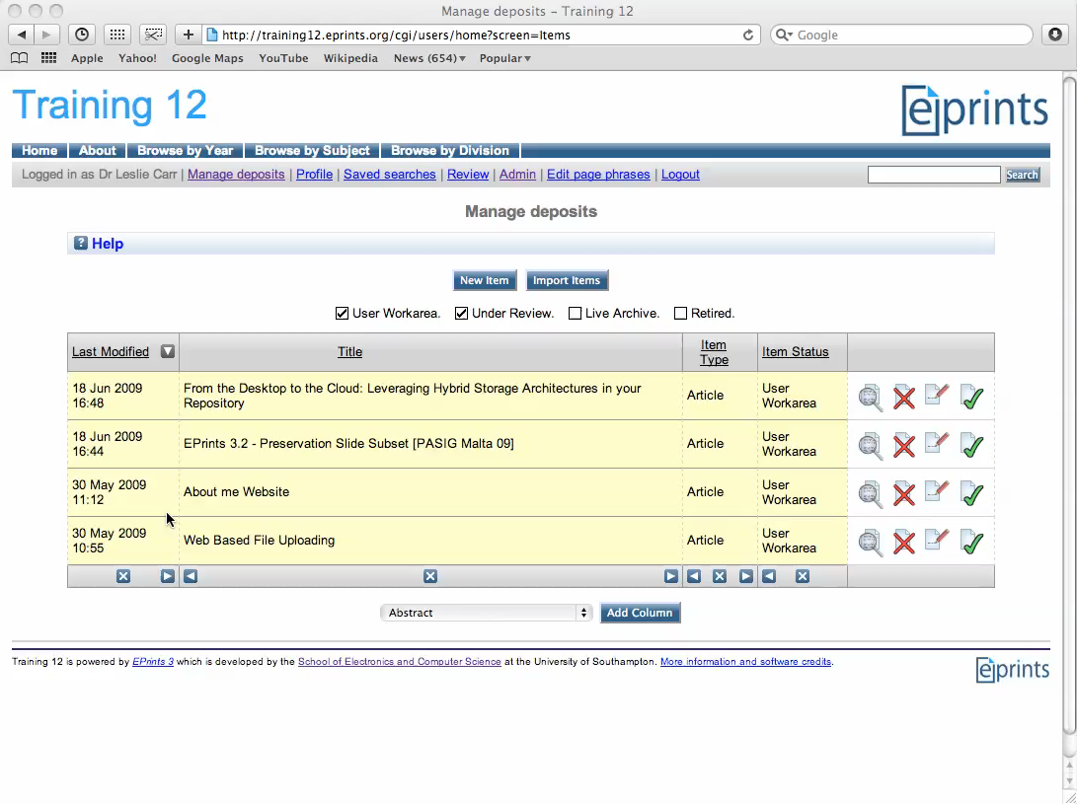

Slide 29
Desktop & Cloud Integration
Summary
Direct from desktop upload methods:
  MS Word 2007 + Article Add-in via SWORD
  FTP
  WebDav – Drag and drop into your repository
Storage Controller
  Local Plug-ins (Local Disk, Local Compressed)
  Local Archival Plug-ins (Honeycomb, NAS, SAN)
  Cloud Plug-ins (Amazon S3, SunCSS, Flickr)
http://www.eprints.org
Notes:
So lets look at some demos. There are 3 cool plugins I’d like to show you including one to handle the new Microsoft Office formats which we are very excited about.

Slide 30
Demo
Demo III
Direct Upload From Microsoft Word 2007 to the Cloud
http://www.eprints.org
Notes:
So lets look at some demos. There are 3 cool plugins I’d like to show you including one to handle the new Microsoft Office formats which we are very excited about.

Slide 31
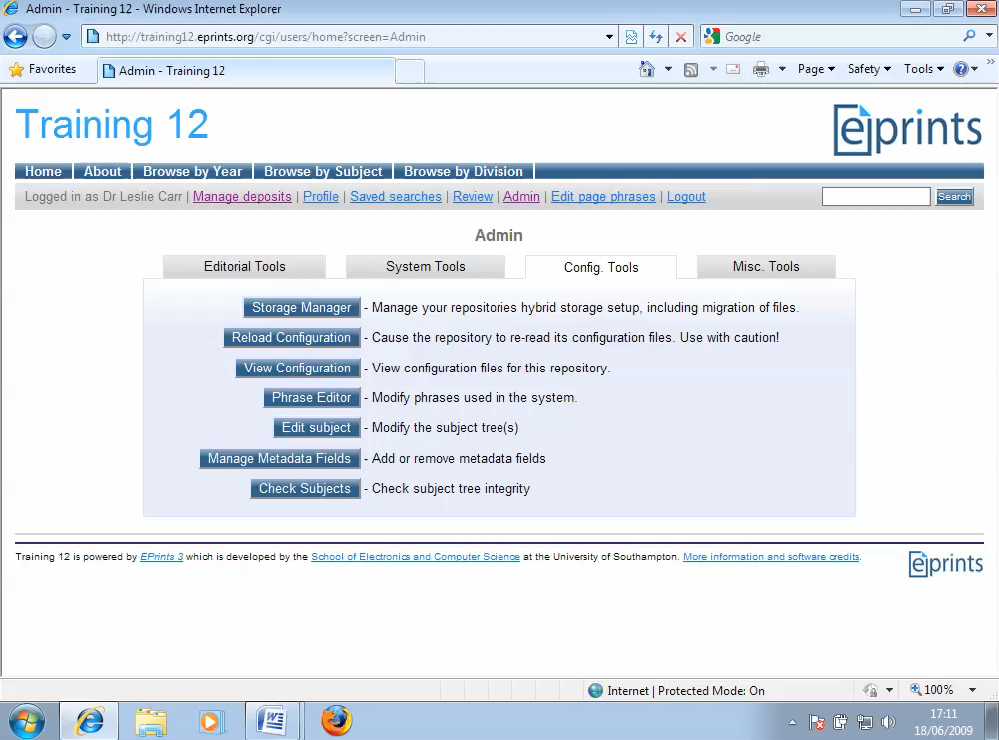

Slide 32
Thank-You
Qustions?
http://www.eprints.org
Notes:
So lets look at some demos. There are 3 cool plugins I’d like to show you including one to handle the new Microsoft Office formats which we are very excited about.

