Slide 1
The importance of having an institutional repository
Alma Swan
Key Perspectives Ltd
Truro, UK

Slide 2
Daniel Coit Gilman First President, Johns Hopkins University
Key Perspectives Ltd

Slide 3
University of Edinburgh Strategic Plan 2008-12
“The mission of our University is the creation, dissemination and curation of knowledge.”
Key Perspectives Ltd

Slide 4
New research approaches…
e-research (and ‘big’ research)
Collaborative ‘small’ research
Interdisciplinary research
Web 2.0 outputs becoming a norm
Early examples of institutional solutions
Key Perspectives Ltd

Slide 5
Research data
Increasingly the primary output in some fields
Key Perspectives Ltd

Slide 6
‘Atkins’ Report
“The primary access to the latest findings in a growing number of fields is through the Web, then through classic preprints and conferences, and lastly through refereed archival papers”.
NSF, 2005
Key Perspectives Ltd

Slide 7
Research data
Increasingly the primary output in some fields
New technologies to exploit them
Data have yet to be properly recognised – and rewarded - as a research output
Are increasingly the focus of attention from research funders
Key Perspectives Ltd

Slide 8
New technologies
Data-mining
Text-mining
Web 2.0 approaches
‘Wikiomics’
All these, along with the new research approaches…
… depend upon Open Access
Key Perspectives Ltd

Slide 9
Open Access
Immediate
Free (to use)
Free (of restrictions)
Access to the peer-reviewed literature (and data)
Not vanity publishing
Not a ‘stick anything up on the Web’ approach
Moving scholarly communication into the Web Age
Key Perspectives Ltd

Slide 10
‘Old’ paradigms
Use of proxy measures of an individual scholar’s merit is as good as it gets
It is a publisher’s responsibility to disseminate your work
The printed article is the format of record
Other scholars have time to search out what you want them to know
Key Perspectives Ltd

Slide 11
‘New’ paradigms
Rich, deep, broad metrics for measuring the contributions of individual scholars
Effective dissemination of your work is now in your hands (at last)
The digital format will be the format of record (is already in many areas)
Unless you routinely publish in Nature or Science, ‘getting it out there’ is up to you
Key Perspectives Ltd

Slide 12
Open Access: Who benefits?
Benefits to researchers themselves
Benefits to institutions
Benefits to national economies
Benefits to science and society
Key Perspectives Ltd

Slide 13
Open Access: how
Open Access repositories
Open Access journals (www.doaj.org)
Key Perspectives Ltd

Slide 14
Open Access repositories
Digital collections
Most usually institutional
Sometimes centralised (subject-based)
Interoperable
Form a network across the world
Create a global database of openly-accessible research
Key Perspectives Ltd

Slide 15
Where they are
Key Perspectives Ltd

Slide 16
Growth in numbers
Key Perspectives Ltd

Slide 17
What they contain
Key Perspectives Ltd

Slide 18
Why an institutional repository?
Fulfils a university’s mission to engender, encourage and disseminate scholarly work
Complete record of its intellectual effort
Permanent record of all digital output
Research management tool
‘Marketing’ tool for universities
Provides maximum Web impact for the institution
Key Perspectives Ltd

Slide 19
An institutional repository provides researchers with:
The means to disseminate their work, free, to the world
Secure storage (for completed work and for work-in-progress)
A location for supporting data that are unpublished
One-input-many outputs (CVs, publications)
Tool for research assessment
Personal marketing tool
Key Perspectives Ltd

Slide 20
But they have problems
Collecting content
‘Self-archiving’ rate is still low
Overall Open Access rate is 15-20%
Key Perspectives Ltd

Slide 21
A well-filled repository
Key Perspectives Ltd

Slide 22
And it gets used
Key Perspectives Ltd

Slide 23
Impact
Range = 36%-200%
(Data: Stevan Harnad and co-workers)
Key Perspectives Ltd

Slide 24
Lost citations, lost impact
Only around 15% of research is Open Access….
….. so 85% is not
….. and we are therefore losing 85% of the 50% increase in citations (conservative end of the range) that Open Access brings (= 42.5%)
Key Perspectives Ltd

Slide 25
So for institutions?
Key Perspectives Ltd

Slide 26
What this means to a university
200X: 2500 articles
Number of citations: 10000
If all had been OA, there would have been (42.5% more) 14250 citations, and ….
Since University X invests £200m in research per annum …
…this means lost impact worth £95m to the university in one year
Key Perspectives Ltd

Slide 27
The U.Southampton conundrum
The G-Factor (universitymetrics.com)
Key Perspectives Ltd

Slide 28
Key Perspectives Ltd

Slide 29
What about authors?
Key Perspectives Ltd

Slide 30
Impact
Range = 36%-200%
(Data: Stevan Harnad and co-workers)
Key Perspectives Ltd

Slide 31
An author’s own testimony on open access visibility
“Self-archiving in the PhilSci Archive has given instant world-wide visibility to my work. As a result, I was invited to submit papers to refereed international conferences/journals and got them accepted.”
Key Perspectives Ltd

Slide 32
What it means to a researcher
Key Perspectives Ltd

Slide 33
Key Perspectives Ltd

Slide 34
Ray Frost’s impact
Key Perspectives Ltd

Slide 35
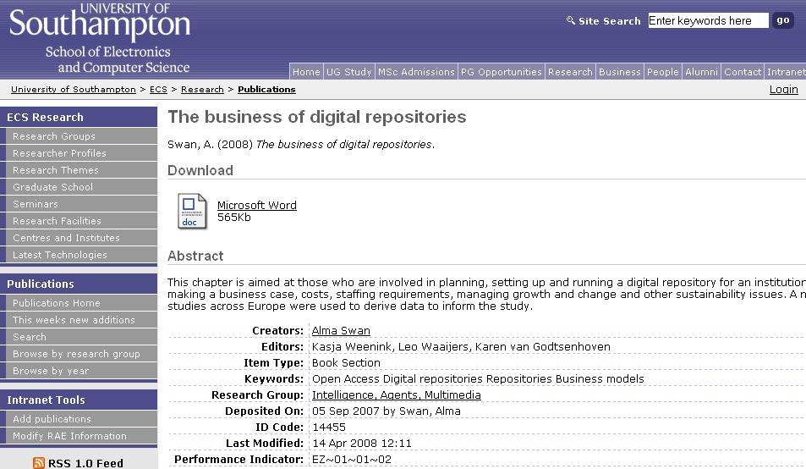
Key Perspectives Ltd
Notes:
35

Slide 36
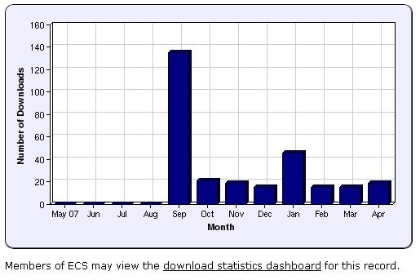
Key Perspectives Ltd
Notes:
36

Slide 37
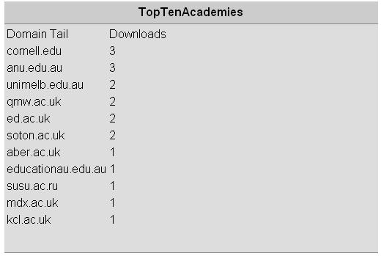
N.B. Downloads are a good predictor of eventual citations
Key Perspectives Ltd
Notes:
37

Slide 38
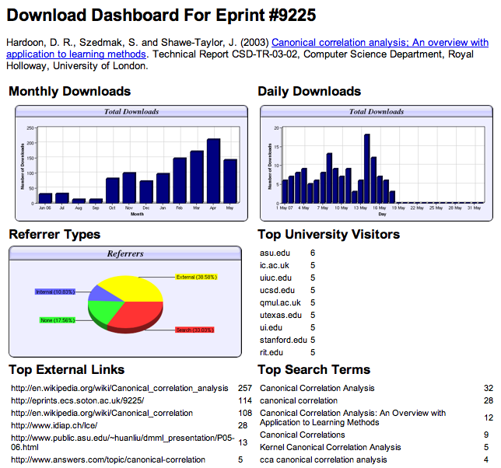

Slide 39
Download timelines
Key Perspectives Ltd

Slide 40
Referrers
Key Perspectives Ltd

Slide 41
Links and search terms
Key Perspectives Ltd

Slide 42
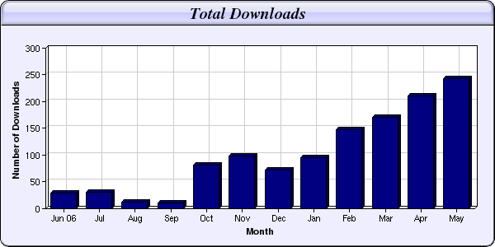
Every e-print tells a story…
Link placed on “Canonical correlation” page in Wikipedia
NIPS Workshop linked to this eprint from its web page
Key Perspectives Ltd

Slide 43
Why Open Access
Greater impact from scientific endeavour
More rapid and more efficient progress of science
Novel information-creation using new and advanced technologies
Better assessment, better monitoring, better management of science
Key Perspectives Ltd

Slide 44
New knowledge from old
Data-mining
Text-mining (semantic Web technologies)
UK: National Text-Mining Centre
Example: NeuroCommons (www.neurocommons.org)
Key Perspectives Ltd

Slide 45
Measure and manage research
Who is producing what?
Where is it being published / performed / installed?
How much impact it is having (by measuring citations and other things)?
Where are the upward trends?
Where are the downward trends?
How much collaborative work is being done?
With which other institutions?
Key Perspectives Ltd

Slide 46
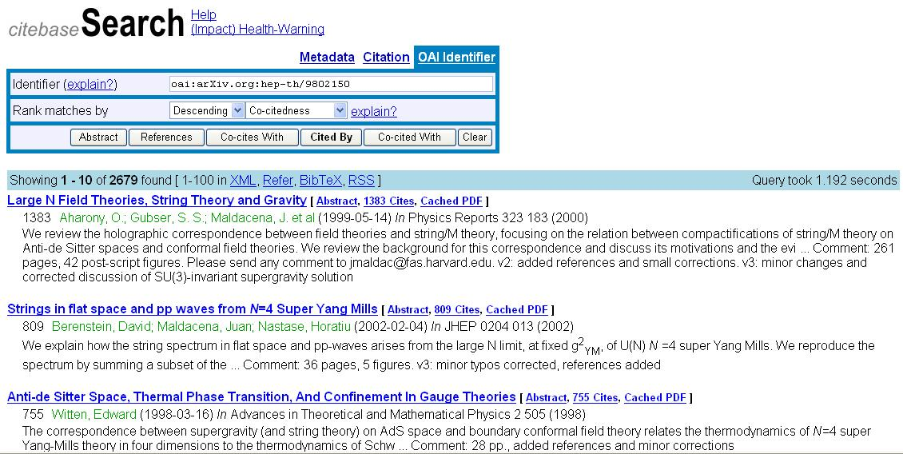
CiteBase
Key Perspectives Ltd

Slide 47
Key Perspectives Ltd

Slide 48
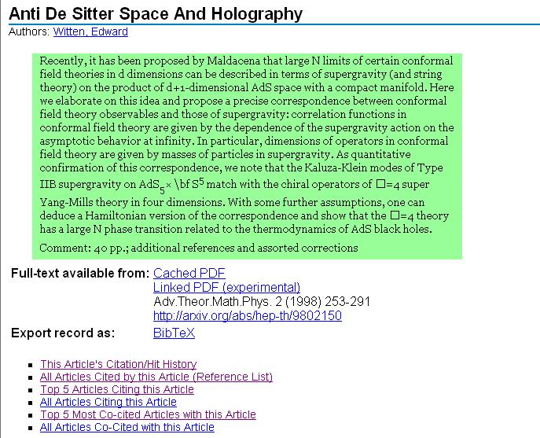
Key Perspectives Ltd

Slide 49
Key Perspectives Ltd

Slide 50
Finally, a solution to the researcher’s dilemma…
“My enemy isn’t plagiarism, it’s obscurity”
Key Perspectives Ltd

Slide 51
Thank you for listening
aswan@keyperspectives.co.uk
www.keyperspectives.co.uk
www.keyperspectives.com
Key Perspectives Ltd

