Slide 1
The Communication of Science and Technology in a Sustainable Future
Alma Swan, Key Perspectives Ltd, Truro, UK
World Association for Sustainable Development, Annual Conference Brighton, UK, 27-29 August 2008

Slide 2
Sustainable futures
“Assimilation of scientific and technological information is an essential precondition for progress in developing countries.” UNESCO, 1982
Health is a “prerequisite for security, economic growth, and sustainable futures” David Nabarro, WHO
Key Perspectives Ltd

Slide 3
The “10/90 gap”
Only 10% of resources are spent on 90% of health problems
The 90% of health problems is shouldered by developing countries
More research, and better research, is needed to close the gap
Research is a GLOBAL undertaking
“If I have seen further, it is by standing on the shoulders of giants.” Isaac Newton, 1676
Key Perspectives Ltd

Slide 4
Key Perspectives Ltd

Slide 5
The communication of science
Journals and books
Publish to communicate findings
‘Publish or perish’
Publish because the assessment system is based largely on publications (at the moment)
Where they publish is deemed to be significant (at the moment)
Key Perspectives Ltd

Slide 6
Science and technology journals
Approximately 24,000 (peer-reviewed)
Publishing around 1.6m articles per year
Mainly acquired via subscriptions
Can also purchase single articles
Value of the market: USD 50 billion p.a.
Key Perspectives Ltd

Slide 7
The problem I: price
The subscription price of journals ranges from $tens to many $000s
The $tens is almost entirely in the arts and humanities
S & T journals are expensive:
Neuroscience: $9,945
Tetrahedron: $17,969
Single articles cost typically $30 to download
Key Perspectives Ltd

Slide 8
The problem II: price inflation
Last 30 years
Average journal price has risen:
Over 6x US inflation rate
Over 2.5x rate of increase of US healthcare
Source: Lewis, 2008
Key Perspectives Ltd

Slide 9
The problem III: copyright rules!
Publishers assert rights over researchers’ articles
Guard those rights jealously, even to the detriment of the creator’s interests
Charge royalties for inclusion of articles in student course packs
Do not permit ‘free’ copies to circulate
Key Perspectives Ltd

Slide 10
The outcome …
… of both absolute cost and of inflation of that cost…
Even rich university libraries cannot afford to buy all the journals that their patrons need and want
University libraries that are not well-funded cannot afford even a reasonable core set of journals
Key Perspectives Ltd

Slide 11
Testimonies
“.. An [Indian] researcher is often unaware of the latest trends in science because hardly 10 percent of our libraries get the top journals.” A.S.Paintal, former Director General Indian Council for Medical Research
Health workers in the developing world are being “starved of the information that is the lifeblood of effective healthcare.” Neil Pakenham-Walsh, Coordinator Global Healthcare Information Network
Key Perspectives Ltd

Slide 12
World Health Organization survey, 2000
Researchers in developing countries ranked access to subscription-based journals as one of their most pressing problems
In countries with annual incomes of <US$1000 per capita, 56% of institutions surveyed had no current subscriptions to international journals, nor for the last 5 years
Key Perspectives Ltd

Slide 13
WHO’s HINARI and AGORA projects
Collaboration of >45 publishers: free or reduced-cost access to journals for developing countries
HINARI: health sciences
108 countries, 1043 institutions, 5000 journals
AGORA: agricultural sciences
108 countries, 1275 journals
Key Perspectives Ltd

Slide 14
The conditions
Per capita GDP < $1000 = free access at publishers’ discretion
Per capita GDP $1000-3000 = $1000 per year
Rules out China, Brazil, Indonesia and India anyway, because the GDP level is ‘too high’ or because there is a sales office in those countries
Key Perspectives Ltd

Slide 15
The new solution: “Open Access”
Enabled by the World Wide Web
Immediate
Free to use
Free of [copyright] restrictions
Access to the peer-reviewed literature
Worldwide, at any time
Greater visibility, greater impact
Key Perspectives Ltd

Slide 16
Impact
Range = 36%-200%
(Data: Stevan Harnad and co-workers)
Key Perspectives Ltd

Slide 17
Two routes to Open Access (OA)
Open Access journals
Open Access repositories
Key Perspectives Ltd

Slide 18
Open Access journals
Free to use (online)
Restriction-free
Different business models
3500+
Listed in the Directory of Open Access Journals (www.doaj.org)
Example: The Malaria Journal
Key Perspectives Ltd

Slide 19
Key Perspectives Ltd

Slide 20
Some special OAJ initiatives
Bioline International www.bioline.org.br/
Scielo (Scientific Electronic Library Online) www.scielo.br/
Key Perspectives Ltd

Slide 21
Bioline International: usage (c60 journals)
Key Perspectives Ltd

Slide 22
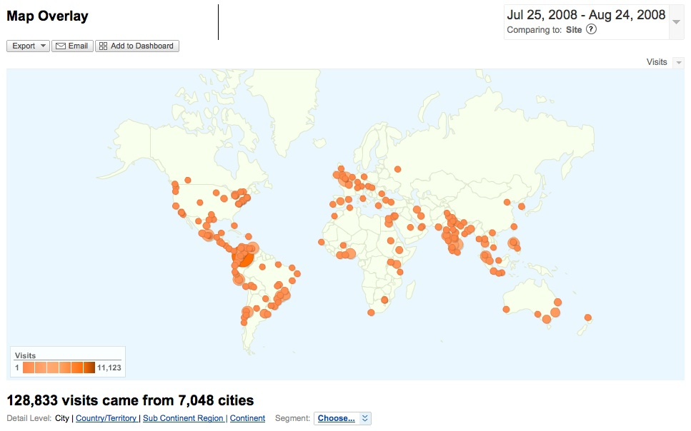
Bioline usage by city
Key Perspectives Ltd

Slide 23
Scielo: usage (200 journals)
Key Perspectives Ltd

Slide 24
Open Access repositories
Institutionally-based (universities, etc)
Collect copies of articles published by the institution’s researchers
Researchers themselves deposit the articles (or send them to the library for depositing by library staff)
Free to access and free of restrictions
Form a global database of current research, indexed by Google/Scholar
Key Perspectives Ltd

Slide 25
Key Perspectives Ltd

Slide 26
Key Perspectives Ltd

Slide 27
Usage
Key Perspectives Ltd

Slide 28
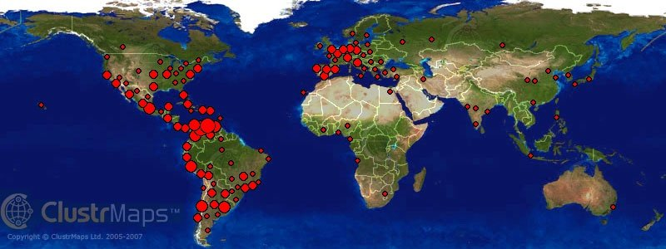
Usage map: repository of the Universidad do Los Andes, Venezuela
Key Perspectives Ltd

Slide 29
Open Access policies
UK: >90% of biomedical research now under an OA mandate
Australia: ARC and MRC
Canada: NRC, CIHR
USA: NIH
Europe: European Research Council
Plus universities around the world
N.B. Data
Key Perspectives Ltd

Slide 30
Sustainable development indicators (Kirsop, Arunachalam & Chan, 2007)
Relevance
Access and ease of use/search
Affordability
Usage
Capacity building and permanence
Key Perspectives Ltd

Slide 31
A two-way process, at last
Science is finally becoming a truly global endeavour
Promise of new collaborations
Science and technology are strengthened and more efficient when openly communicated
Key Perspectives Ltd

Slide 32
InterAcademy Panel to the UN on Millennium Development Goals
“Sustained progress in reducing poverty and related problems require strengthened institutions for science, technology and innovation throughout the world, including in each developing nation.”
Key Perspectives Ltd

Slide 33
Thank you for listening
OASIS
(Open Access to Scholarly Information Sourcebook)
aswan@keyperspectives.co.uk
www.keyperspectives.co.uk
www.keyperspectives.com
Key Perspectives Ltd

