Slide 1
The research data management workforce
Alma Swan
Key Perspectives Ltd
Truro, UK
The Data Imperative: Libraries and Research Data conference
Organised by the RLUK/SCONUL e-Research Task Force in association with the Oxford e-Research Centre and the Research Information Network
3 June 2009, Oxford, UK

Slide 2
A little background
Study commissioned by JISC
  Following up on two recommendations in the ‘Lyon report’
  Asked to look at the ‘supply of DS skills’
  Carried out in the first half of 2008 and published in summer 2008: http://www.jisc.ac.uk/publications/publications/dataskillscareersfinalreport.aspx
Study commissioned by RIN: how researchers ‘publish’ data
Key Perspectives Ltd

Slide 3
The roles NSF distinguishes
Data authors: people who produce digital data
Data managers: people who operate databases and are a ‘competent partner’ in data archiving and preservation
Data users: scientific, educational and professional communities
Data scientists: expert data handlers and managers
Key Perspectives Ltd

Slide 4
Our definitions
Data creators or data authors
Data scientists
Data managers
Data librarians
But:
  In practice these terms are not used precisely
  Role boundaries can be fuzzy
Key Perspectives Ltd

Slide 5
What data creators do
Key Perspectives Ltd

Slide 6
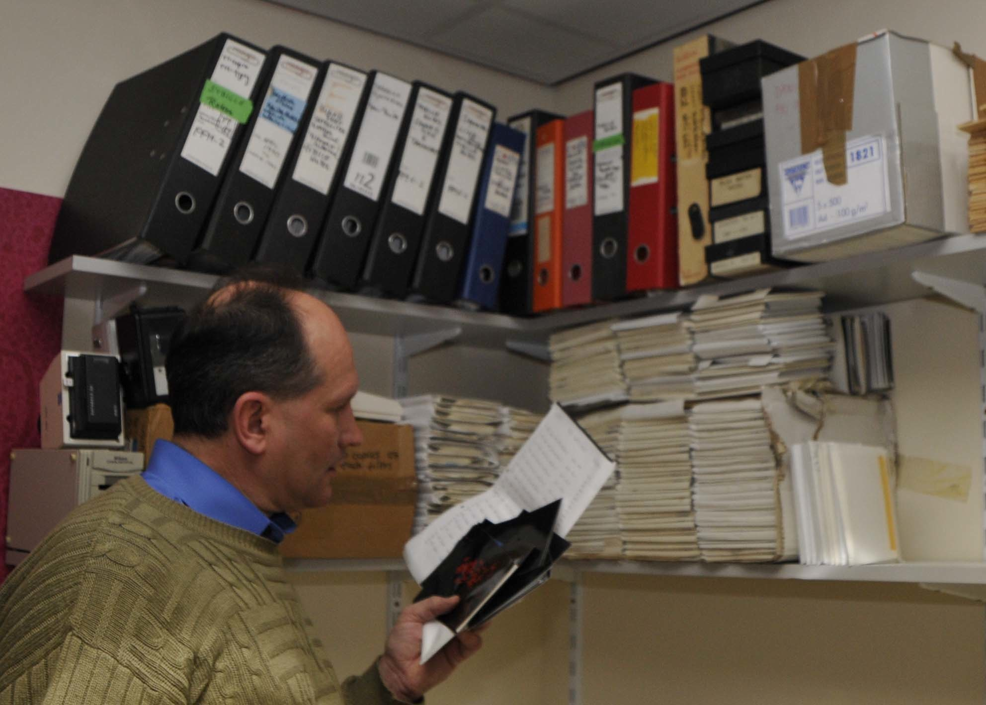
Key Perspectives Ltd

Slide 7
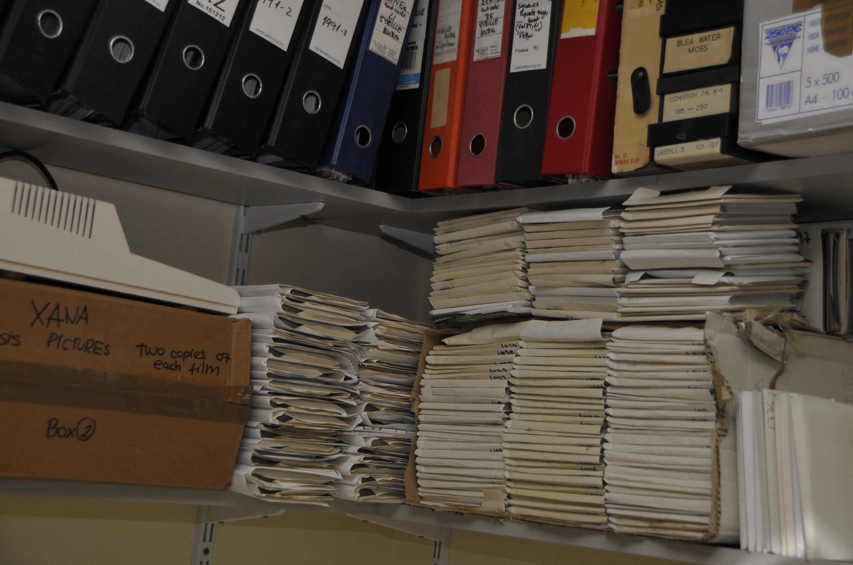
Key Perspectives Ltd

Slide 8
What data scientists do
Conceptualise the data aspects of the research project or programme
Aid in experimental design and planning (and execution, contributing their own insights)
Train researchers in using machines and software
Write (or help with) the data plan
Advise on funder requirements
Ensure research group conforms to good data practice and fulfils obligations
Preservation (depending on discipline or having a position in a data centre)
Key Perspectives Ltd

Slide 9
What data scientists do
Key Perspectives Ltd

Slide 10
Data managers
Skills in computational science
Experts in database technologies
Ensure systems in place for storage, curation and preservation
Data back-up and refreshing
Format migration
Liaise with data scientists (and researchers)
Data scientists often act as ‘translators’
Key Perspectives Ltd

Slide 11
What data managers do
Key Perspectives Ltd

Slide 12
Data librarians
Only a handful in the UK at present
Roles:
  Specific skills in data care, archiving and preservation
  Training researchers in data-awareness
  Transferring generic data management skills to researchers
Key Perspectives Ltd

Slide 13
What data librarians do
Key Perspectives Ltd

Slide 14
Back to the data scientists: careers
How did they get there?
  Typically by accident rather than design
  Assumed role within a research group
  Data centres: often a temporary intention morphs into permanence
What background do they have?
  Domain-related
  Computer science
  Information science
Key Perspectives Ltd

Slide 15
Qualifications
In-post people have domain-related or computer science training
New jobs increasingly require informatics skills
Informatics training is well-advanced in biology and chemistry
Majority of existing data scientists have a further degree
On-the-job CPD is commonplace
People skills are essential!
Key Perspectives Ltd

Slide 16
Training: data scientists
Data science is a rapidly-evolving area
Some have formal postgraduate training
On-the-job initial skilling (very important)
CPD:
  UKDA’s training course
  DCC’s Digital Curation 101
  Subject-specific events and workshops
  Short courses are the preferred model
Key Perspectives Ltd

Slide 17
Data librarians
Only a handful in the UK
Library schools not yet geared up for this training:
  Demand is low (because no established career path or grade)
  Lack of internships in US and work placements in UK
  Good subject-based first degree is required
This will change: formalising in the US, Canada and the UK
Key Perspectives Ltd

Slide 18
Future roles of the library
Train researchers to be more data-aware (anticipate increased level of data-related interactional learning and activity between library and research communities)
Adopt a data care role via repositories (DISC-UK DataShare project)
Developing a new professional strand of practice (and training) in the form of data librarianship
Key Perspectives Ltd

Slide 19
Pressing issues
Inform and educate researchers on data principles:
  Ownership
  What requirements already exist?
  What things are data?
  How can you manage them better?
  How can you deal with obstacles to that?
  Re-use
Provide facilities for care and attention
Key Perspectives Ltd

Slide 20
Open Access: articles
All seven Research Councils now have a mandatory OA policy
Details differ but the requirement is to make publications OA through some means within a certain (short) period of time
Other funders and institutions (and now governments) implementing similar policies
Increasing amount of freely available research summaries (journal articles)
Key Perspectives Ltd

Slide 21
Open Data: datasets
Recognition that research summaries (articles) are only partially informative and relatively useless
Research outputs in STM now almost all digital
* NERC Data Handbook
Key Perspectives Ltd

Slide 22
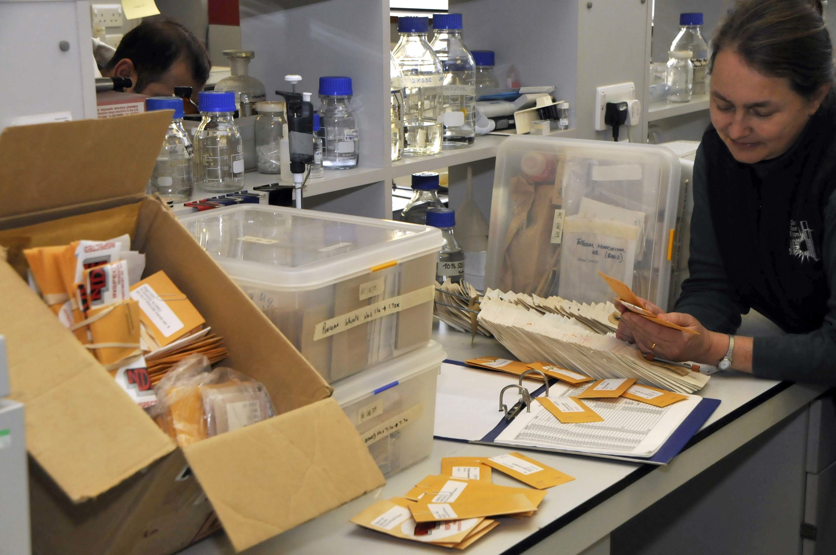
Key Perspectives Ltd

Slide 23
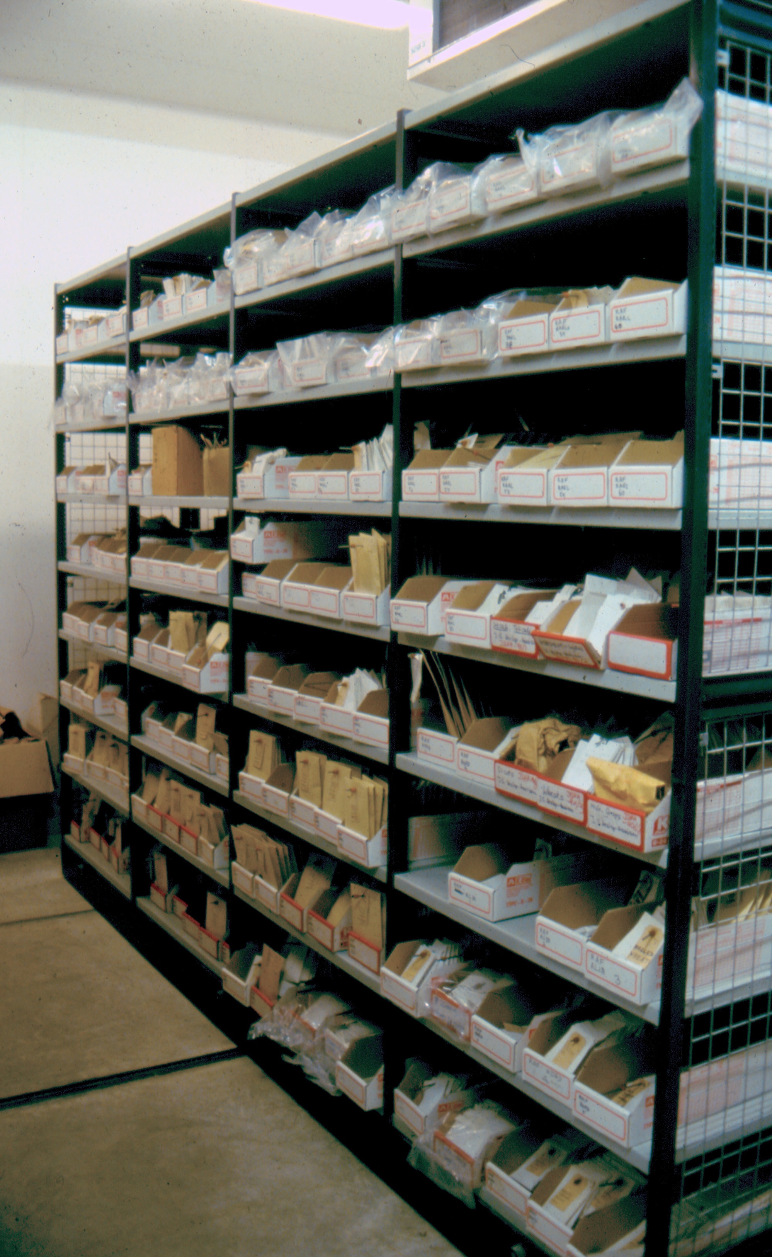
Key Perspectives Ltd

Slide 24
Open Data: datasets
Recognition that research summaries (articles) are only partially informative and relatively useless
Research outputs in STM now all digital
Datasets ‘are a resource in their own right’ *
Digital data have a vastly increased utility:
    Easily passed around
    More easily re-used
    Opportunities for educational or commercial exploitation
Data already becoming the primary outputs of research in some fields
* NERC Data Handbook
Key Perspectives Ltd

Slide 25
Current patterns
NERC and ESRC: first off the block – provide centralised national-level Data Centres
Later adopters : Delegate responsibility to the PI and institutions (the other RCs, with some sub-exceptions – e.g. Archaeology DS, Astronomy DCs)
Better than nothing
Good in disciplines where there are public databanks
Questionable merit in leaving institutions to take on the whole responsibility
Key Perspectives Ltd

Slide 26
The data management issues with which researchers need expert [library] help
Ownership
Sharing
Ease of re-use
Care
Key Perspectives Ltd

Slide 27
Ownership
Publishers do not claim ownership
Key Perspectives Ltd

Slide 28
… as a general principle, … the raw data outputs of research, should wherever possible be made freely accessible to other scholars
… best practice … is to separate supporting data from the article itself, and not to require any transfer of or ownership in such data or data sets as a condition of publication of the article in question
… it would be highly desirable, whenever feasible, to provide free access to that [sic] data, immediately or shortly after publication, whether the data is [sic] hosted on the publisher’s own site or elsewhere
ALPSP / STM Statement on databases, data sets and data accessibility, 2006
Key Perspectives Ltd

Slide 29
Ownership
Publishers do not claim ownership
Usually
Key Perspectives Ltd

Slide 30
Key Perspectives Ltd

Slide 31
Key Perspectives Ltd

Slide 32
Key Perspectives Ltd

Slide 33
Ownership
Publishers do not claim ownership
Usually
Funders may own data
Employers may own data
Several entities may share ownership
Creators frequently do not legally own the data they produce
Creators make many assumptions, and express little knowledge, about this
Key Perspectives Ltd

Slide 34
Ownership questions
Most data creators don’t know and don’t care
Ownership implies a duty of care
They may discard the data (even when they don’t own them)
They share, if that’s their thing
They may share before the data owner (e.g. funder) wishes them to
Or withhold, if they fear being exploited or just wish to stop others getting the use of their data
Key Perspectives Ltd

Slide 35
So what about sharing?
In some areas of research, journals play the role of enforcer/policeman
May require accession numbers (e.g. for molecular biology datasets in Genbank)
May require datasets themselves (e.g. chemical crystallography)
May even BE the data
These are likely to increase as publishers see providing research context (i.e. linking articles to underlying data) as another value-creating service
Key Perspectives Ltd

Slide 36
How helpful is this?
This is both helpful and not helpful:
  Helpful because metadata are relatively good
  Helpful because the system begins to create the linked web environment (limited semantics, but a start on the syntax)
  Especially unhelpful if the journals do not police their requirements
  Journal websites almost always store and share only flat files (mostly PDF)
Key Perspectives Ltd

Slide 37
Key Perspectives Ltd

Slide 38
Key Perspectives Ltd

Slide 39
Key Perspectives Ltd

Slide 40
Key Perspectives Ltd

Slide 41
The role of libraries in data management now: some urgent issues
Who else has the understanding to raise awareness in the research community of the urgency of the issue?
Do we leave the sharing and preservation of datasets to publishers?
What are the implications?
  Communication channels
  Facilities (repositories?)
Key Perspectives Ltd

Slide 42
Thank you for listening
aswan@keyperspectives.co.uk
www.keyperspectives.co.uk
www.keyperspectives.com
Key Perspectives Ltd

