Slide 1
Remember repositories? They were all the rage
Alma Swan
Key Perspectives Ltd
Truro, UK
SCONUL Annual Conference, Bournemouth, 10-12 June 2009

Slide 2
Overview
Where are repositories now?
Where can they go next?
What will happen after that?
Key Perspectives Ltd

Slide 3
Where are repositories now?

Slide 4
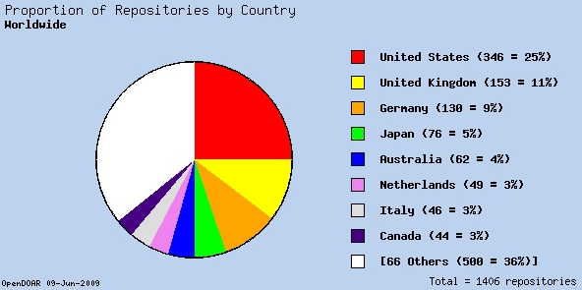
Numbers and places

Slide 5
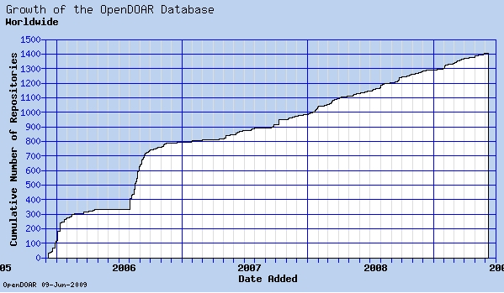
How they grow

Slide 6
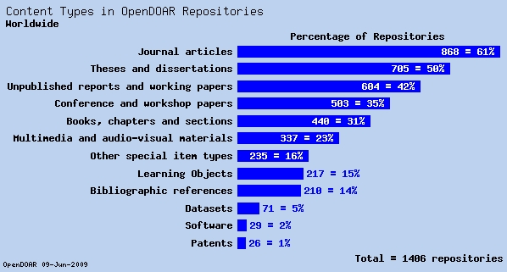
What they hold

Slide 7
How much of this stuff is there?
Research articles (full-text): 15%
Other types: generally less
Whose role is it to improve this?
The Library
Institutional strategists

Slide 8
The institutional strategists
Some have realised the strategic value of a repository
An empty one broadcasts a bad investment decision
A full one represents a valuable ROI
So far, 36 of them have understood this and done something about it

Slide 9
The mandates

Slide 10
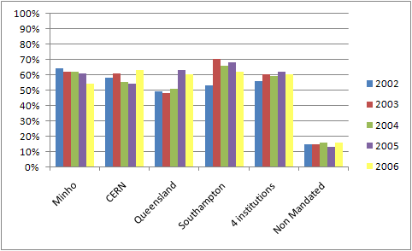
Do mandates make a difference?
Source: Gargouri & Harnad, 2009

Slide 11
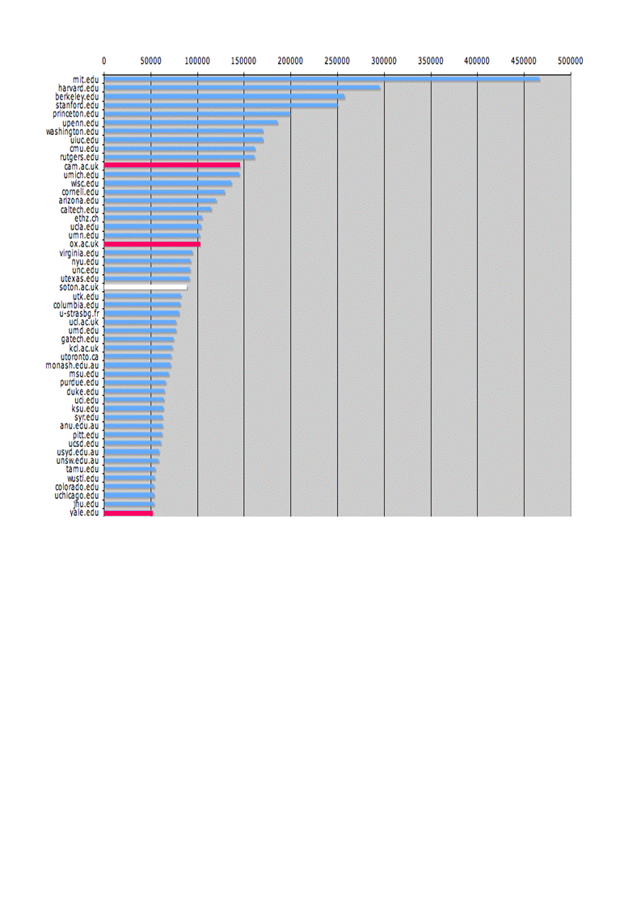
The U.Southampton conundrum
The G-Factor (universitymetrics.com)
Key Perspectives Ltd

Slide 12
Key Perspectives Ltd

Slide 13
The Library
With strategists: explain and exhort
Institutional mandate
The REF makes the IR core business for the instuitution
Align the institutional IP policy with the interests of the repository (author addendum; prior non-exclusive licence)
With researchers:
Guiding and advising
Providing practical assistance
Raising awareness

Slide 14
“Placing the reset button on the left on this form is a BAD IDEA!!!!!!!”
“The question is poorly posed.
…Don't you just hate trying to survey epidemiologists?!!”
Key Perspectives Ltd

Slide 15
“After answering this, I realise how contrary I am.”
How did you originally learn about self-archiving?
“From you today.”
Key Perspectives Ltd

Slide 16
“Re questions 9 and 10: Have been suffering from a faulty hip, waiting for an operation. Am now recovering from same and hoping to be much more active in future.”
Key Perspectives Ltd

Slide 17
“This is a long comment so I beg your indulgence reading it to the bitter end – because I believe I have a more basic problem than the one you ask about…..”
Key Perspectives Ltd

Slide 18
“I just want to establish a relationship with you.”
Key Perspectives Ltd

Slide 19
“My understanding stems from other sources. Unfortunately, nobody in key positions at our school understands it.”

Slide 20
“It might have been promoted, but not so vigorously that I have noticed”

Slide 21
“My library doesn't seem to be aware of anything like Open Access, they're still living in the 20th century”

Slide 22
The communication gap

Slide 23
However…
40% of library catalogues do not list OA journals from the DOAJ
40% of library websites do not:
Provide clear and obvious links to the IR
Provide information on copyright relating to the use of the IR
Point to the RoMEO database
Three-quarters of researchers do not know if they have an IR
And the problem is the 15%

Slide 24
The repository and the researcher
Key Perspectives Ltd

Slide 25
Key Perspectives Ltd

Slide 26
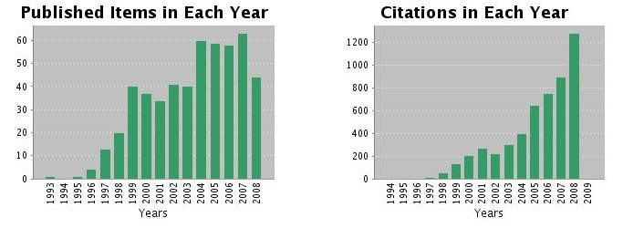
Ray Frost’s impact
Key Perspectives Ltd

Slide 27
Advice and assistance
RoMEO
Managing rights
Deposit
Data

Slide 28
Where can repositories go next?

Slide 29
What they hold

Slide 30
Open Data: datasets
Recognition that research summaries (articles) are only partially informative and relatively useless
Research outputs in STM now all digital
Datasets ‘are a resource in their own right’ *
Digital data have a vastly increased utility:
Easily passed around
More easily re-used
Opportunities for educational or commercial exploitation
Data already becoming the primary outputs of research in some fields
* NERC Data Handbook
Key Perspectives Ltd

Slide 31
Current patterns
NERC and ESRC: first off the block – provide centralised national-level Data Centres
Later adopters : Delegate responsibility to the PI and institutions (with some exceptions)
Better than nothing
Good in disciplines where there are public databanks
Questionable merit in leaving institutions to take on the whole responsibility
Key Perspectives Ltd

Slide 32
Data librarianship
Librarians with specialist skills in digital data management
Starting to formalise and emerge as a new career path
Library schools developing their curricula accordingly
Transformative factor in scholarly communication (and in institutional strategic thinking)

Slide 33
Two other transformative factors that loom large
e-books:
Promise of Open Access for monographs
The give-way literature will extend to books
Already publishing models being developed to accommodate OA to academic books (e.g. university presses; Bookboon)
Outside formal book publishing things are changing too:
“People I know who are writing books these days are just putting them up on the Web without bothering to get them published in the traditional way”
Open Educational Resources

Slide 34
Joining things up on campus
The institutional repository may in reality be a set of repositories
Documents, data, images
Departmental, group, personal

Slide 35
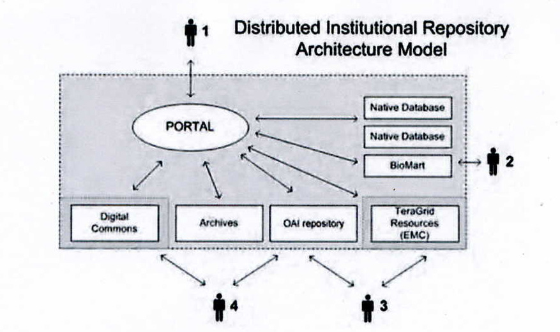
Purdue University’s model
Key Perspectives Ltd

Slide 36
Oxford DAMS: Digital Asset Management System
Users
ORA access
Access to
data collection
Application
Application
Application
FEDORA
Digital object management
ORA, data collection
other collections
FEDORA
Digital object management
Other collections
FEDORA
Digital object management
Other collections
Storage layer: Honeycomb technologies
Source: Sally Rumsey

Slide 37
Joining things up on campus
The institutional repository may in reality be a set of repositories
Documents, data, images
Departmental, group, personal
Other campus profiling services

Slide 38
What will happen after that?

Slide 39
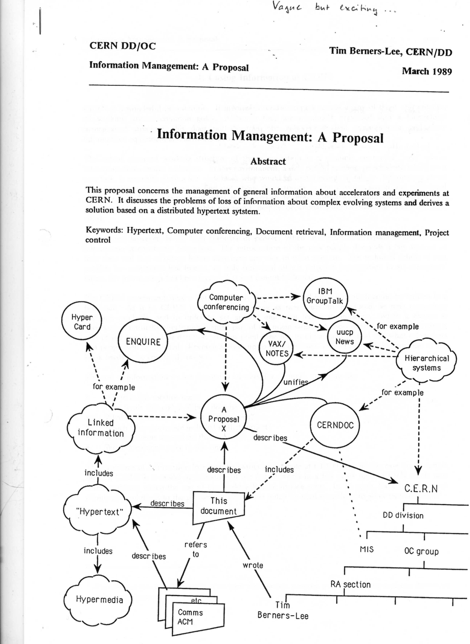

Slide 40
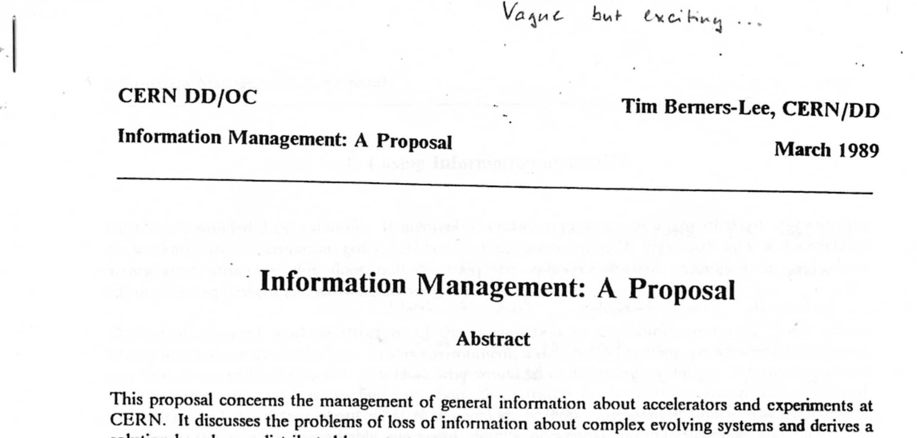

Slide 41
The Web, the Web, the Web
Linking and contextualising
Not just

Slide 42
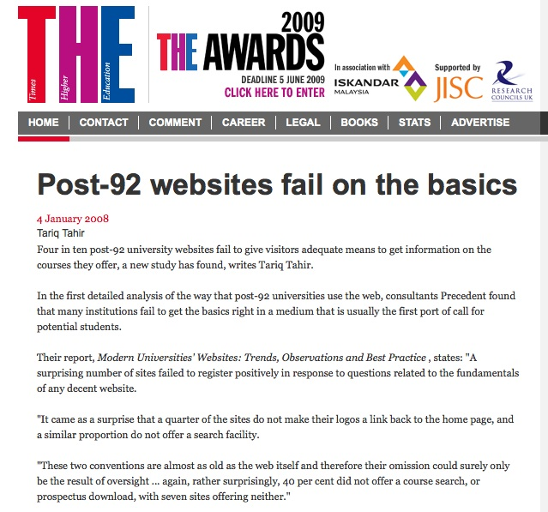

Slide 43

What about PDF?
John Wilbanks (Science Commons):
“Scraping is the right word, because having to work with PDF is really scraping the bottom of the barrel.”
Key Perspectives Ltd

Slide 44
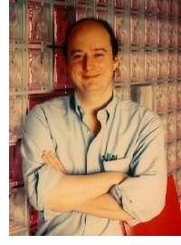
What about PDF?
Clifford Lynch
(Coalition for Networked Information):
“PDF is evil”
Key Perspectives Ltd

Slide 45

What about PDF?
Peter Murray-Rust (Cambridge):
“Getting to XML from PDF is like starting with the burger and trying to get back to the cow.”
Key Perspectives Ltd

Slide 46
The web will be "the principal battlefield" in the competition for students
James Soutar
Senior consultant
Precedent

Slide 47
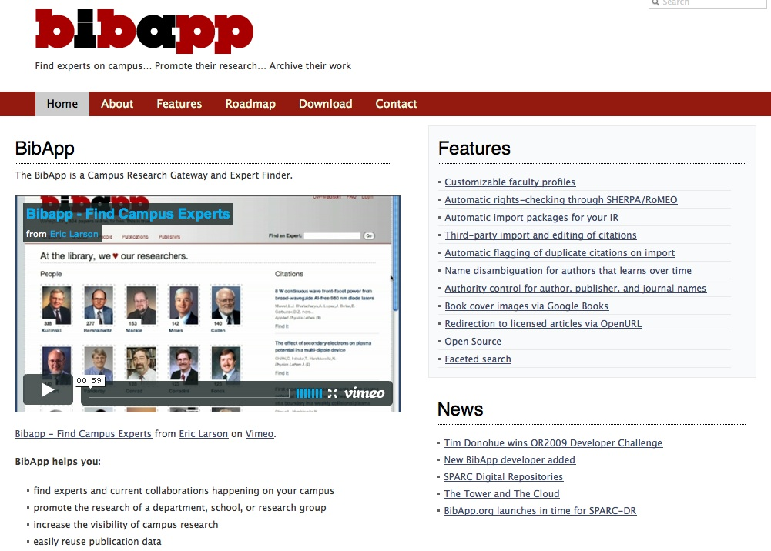

Slide 48
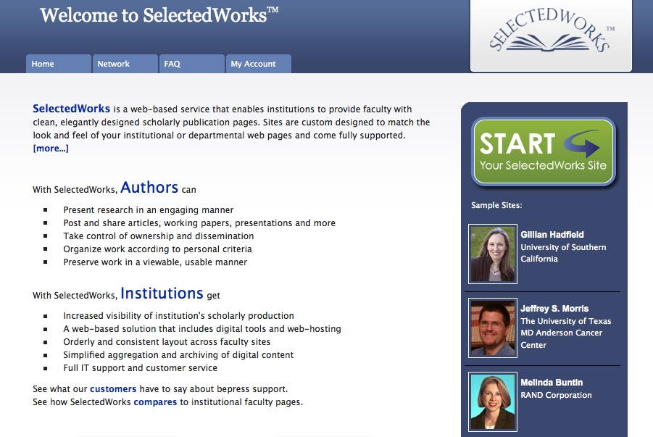

Slide 49
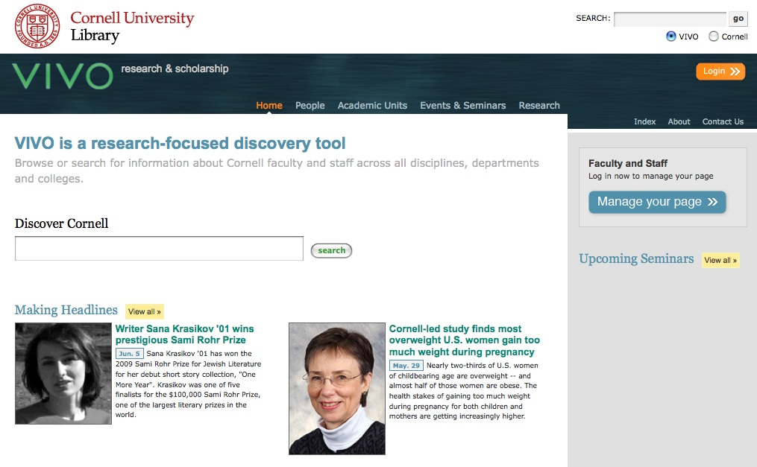

Slide 50
Text-mining
Named entities
Acronyms
Facts

Slide 51
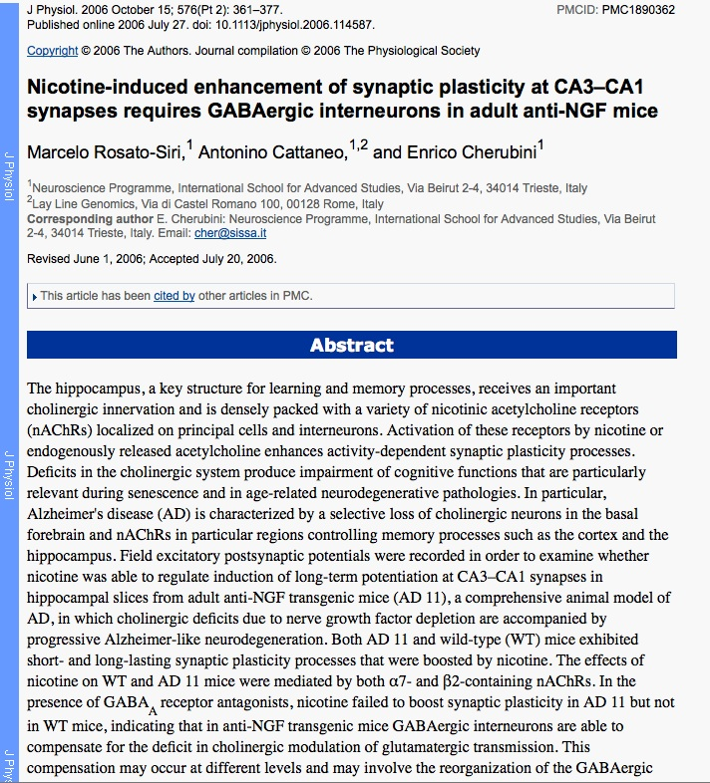

Slide 55
Text-mining
Named entities
Acronyms
Facts
Relationships
Semantic technologies retrieve facts and perform semantic searches across the literature
Data-mining technologies

Slide 56
Thank you for listening
aswan@keyperspectives.co.uk
www.keyperspectives.co.uk
www.keyperspectives.com
Key Perspectives Ltd

Slide 57
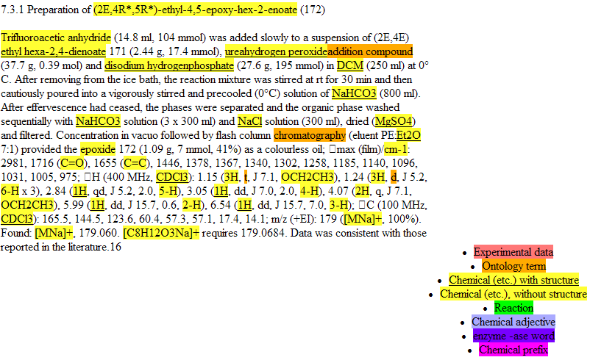

Slide 58
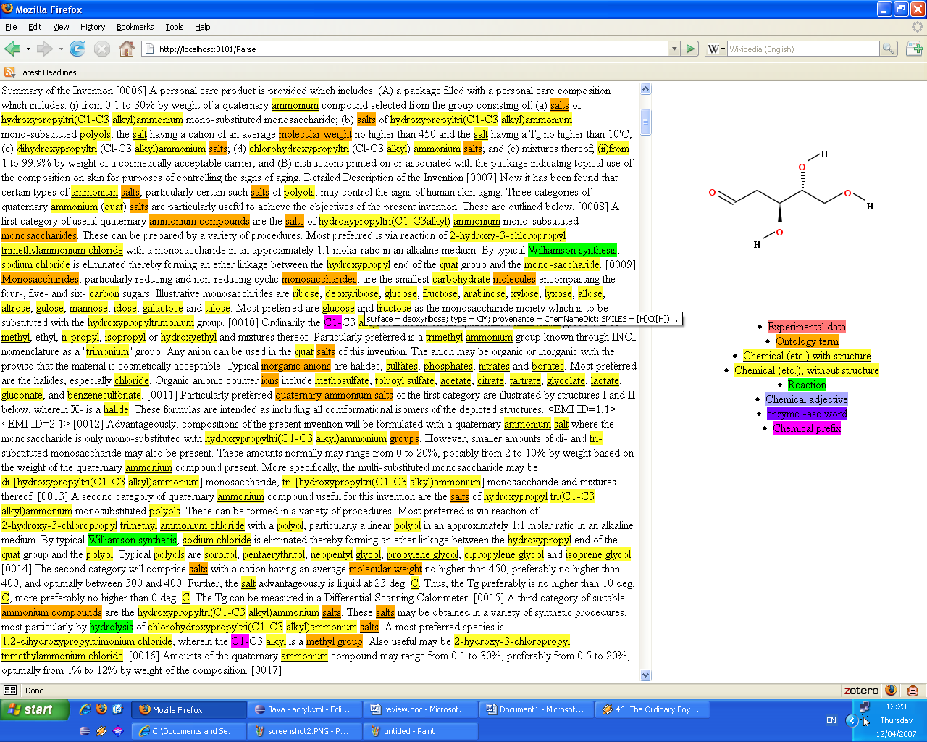

Slide 59

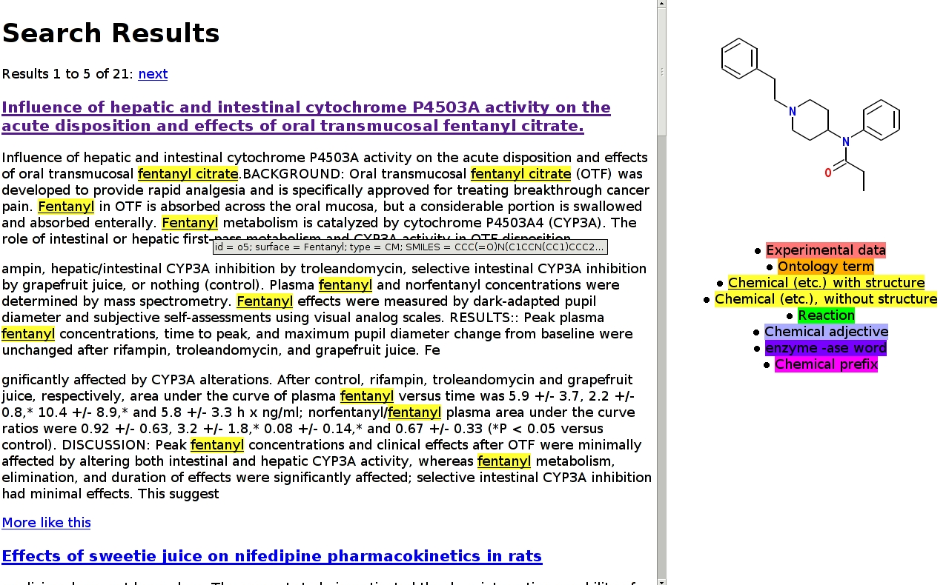

Slide 60


(A) Preparation of poly(ethylene glycol) (PEG) macroinitiator
Monomethoxy poly(ethylene glycol), MW = 5000, ex Aldrich (50g, 0.01 moles) was dissolved in anhydrous toluene (250 ml) in a 2-necked round bottom flask fitted with a suba seal and calcium chloride guard tube. Polymer-bound 4-(dimethylamino)pyridine (2g, 1.25 mmol N/g ), triethylamine (2.02g, 0.02 moles) and a magnetic stirrer bar were added to the PEG solution. 2-Bromoisobutyryl bromide (4.6g, 0.02 moles) was added dropwise via a syringe through the suba seal, which caused the initially clear solution to turn to a milky suspension. After stirring at ambient temperature overnight, the reaction mixture was filtered through a bed of silica to remove insolubles. The filtrate was evaporated to about one third of its original volume, then added to petroleum ether and the precipitated product collected on a filter. After drying overnight under vacuo the product was obtained as a white solid.
Characterisation:
IR : 1734 cm-1 (s, saturated ester carbonyl) NMR (1H-CDCl3) (ppm) : 1.94 (d, ester CH3); 3.38 (s, methoxy CH3); 3.64 (s, PEG CH2); 4.32 (m, CH2-O-CO). [BR]
Reagents
Quantities
Actions
Solvents

Slide 61
Reactant
Amount
Dissolve
Solvent
Amount
Reactant
Reactant
Amount
Reactant
Amount
Add
Reactant
Reactant
Amount
Add
Stir
Stir
Filter
Evaporate
Add
Solvent
A
Filter
Dry
Reagents
Quantities
Actions
Solvents

Slide 62
Item on the BBC news website: 4 links
Researcher’s home page:
Bibliography 3 years out of date and with no information about the project
No links to full-text papers, the ECS repository, his research group, PhD opportunities, the School, the University…
The project website: only link is to EU Information Society pages
The School’s home page
The University’s home page
Key Perspectives Ltd

Slide 63
Google on the author’s name…
Official School personal information page, with links to projects and papers
Project link goes to School projects database …
… where it ends up at an internal project page hosted by one of the other project partners and needing password access
Key Perspectives Ltd

Slide 64
Computer scientists’ web presence
ONE THIRD of ECS researchers have no working home page
20% of professors in MIT’s Department of Computer Science lack a home page
Key Perspectives Ltd

Slide 65
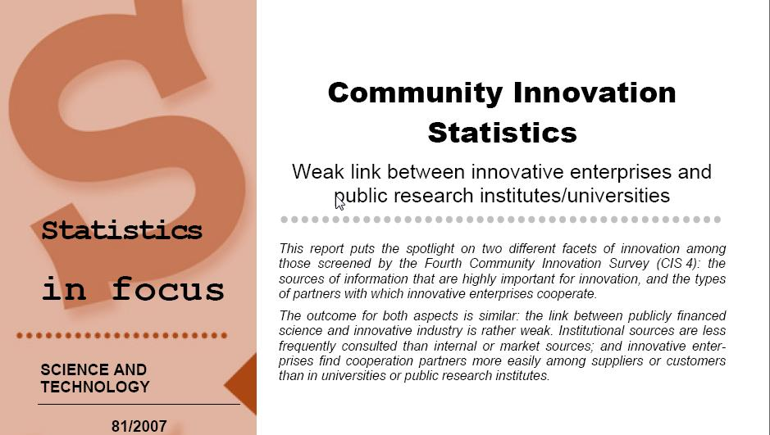
EU CIS studies
Key Perspectives Ltd

Slide 66
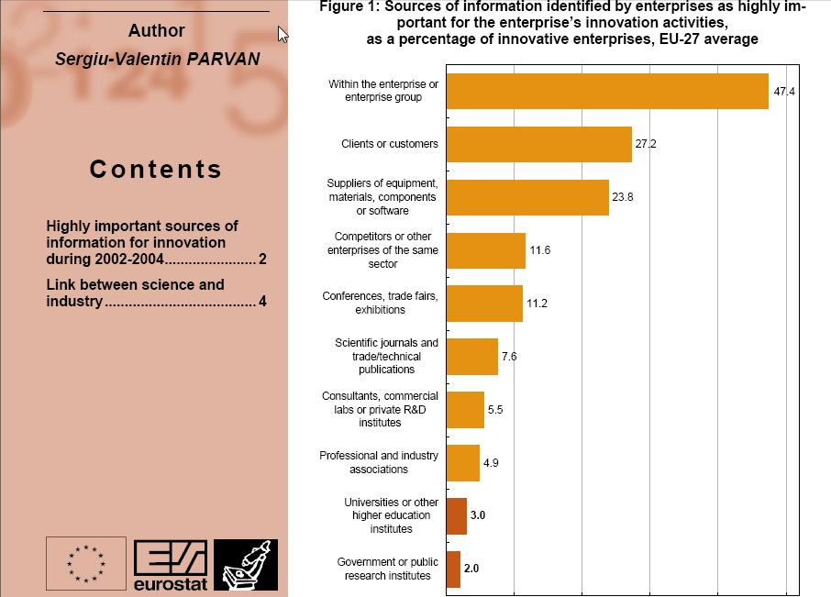
Key Perspectives Ltd

Slide 67
“Institutional sources are less frequently consulted than internal or market sources; and innovative enterprises find cooperation partners more easily among suppliers or customers than in universities or public research institutes.”
Key Perspectives Ltd

