Slide 1
Scholarly communication – international developments: Why open scholarship is taking root
Alma Swan
Enabling Open Scholarship
And
Key Perspectives Ltd, Truro, UK

Slide 2
Development areas
Awareness and uptake of Open Access
Policies
Visibility and impact
Infrastructure
Economics

Slide 3
Policies
Cover articles and datasets
National-level funder policies
International-level funder policies (ERC)
Important current consultations:
Office of Science & Technology Policy (White House)
European Commission – “EU 2020”

Slide 4
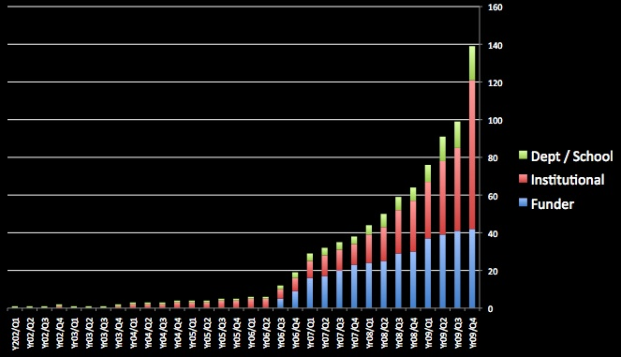
Policies

Slide 5
Things covered by policies
Articles and conference papers
Theses are increasingly being addressed
Humanities are NOT being left behind
Datasets are now being treated as very important (“CC0”)

Slide 6
Policy types

Slide 7
Visibility
Best evidenced by usage
e-Scholarship (University of California): 9 million views since 2002 (31,000 items)
School of Electronics & Computer Science (University of Southampton): 30,000 downloads per month (c18,000 items)
ORBi (University of Liege): 170,000 downloads in December 2009 (14,000 items)

Slide 8
Open Access citation impact
Range = 36%-200%
(Data: Stevan Harnad and co-workers)

Slide 9
Queensland University of Technology
EPrints repository
Mandatory policy since 2004
14,269 items, of which almost 9000 are full-text, OA
Further 1000 in embargo area
2088 active depositors

Slide 10
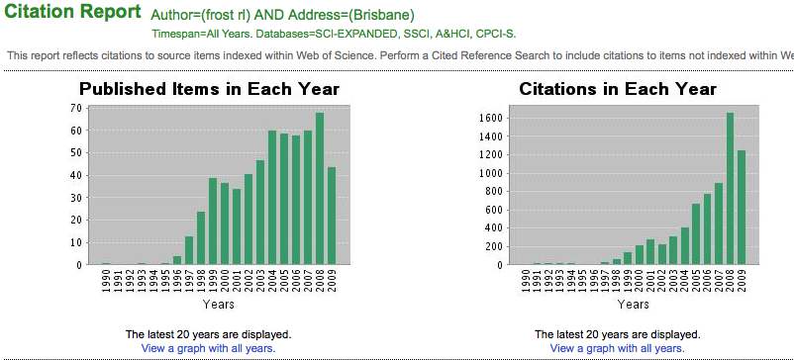
Ray Frost’s impact

Slide 11
The U.Southampton conundrum
The G-Factor (universitymetrics.com)

Slide 13
Infrastructures
Repository network
c1500 worldwide; growing at 1 per day
Mainly institutional
Some centralised (thematic; e.g. PubMed Central)
Interoperable
Form a network across the world
Create a global database of openly-accessible research

Slide 14
An institutional repository …
Fulfils a university’s mission to engender, encourage and disseminate scholarly work
Complete record of its intellectual effort
Permanent record of all digital output
Research management tool
Marketing tool for universities
Provides maximum Web impact for the institution

Slide 15
Interoperability
e-science infrastructures (GEANT)
Repository infrastructures:
Deposit (e.g. SWORD)
Discovery (metadata: e.g. CERIF)
Re-use (XML)
Preserve e.g. PLANETS (Preservation and Long-Term Access through Networked Services) Project http://www.planets-project.eu/
Key Perspectives Ltd

Slide 16
Repository services
National harvesters/portals for OA content
Scielo (journals)
RCAAP (Portugal) http://www.rcaap.pt/about_en.jsp
Recolecta (Spain)http://search.recolecta.driver.research-infrastructures.eu/
PROW? (Polish Research Online to the World)
Subject-based harvesting services
Economists Online
Coming up:
Citation analysis services
Identifier services

Slide 17
Economics
John Houghton’s studies:
Australia
UK
Netherlands
Denmark
New UK study at institution-level (publishing February 2010)
Key Perspectives Ltd

Slide 18
Economic benefits from Open Access
Houghton: National savings with Open Access:
UK: €731m per annum
Denmark: €111m per annum
Netherlands: €211m per annum
Swan: Institutional savings: €0.5m - €2m per annum

Slide 19
Thank you
aswan@keyperspectives.co.uk
www.openscholarship.org

Slide 20
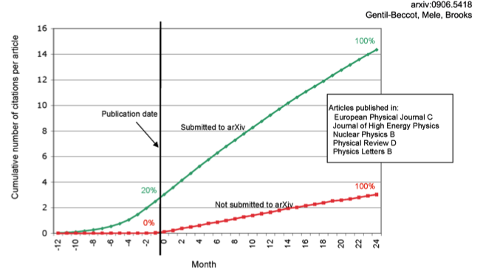
The early bird …
Key Perspectives Ltd

Slide 21
Impact
Gentil-Beccot, Mele and Brooks (2009)
“Immense Open Access advantage” for papers deposited in arXiv before formal publication
“Do not detect any citation advantage from publication in Open Access journals in high-energy physics.”
Key Perspectives Ltd

Slide 22
Total Research Income: QUT and sector
Data: Tom Cochrane
Deputy Vice-Chancellor, QUT
Key Perspectives Ltd

Slide 23
Humanities are OA too
Humanities journal articles are covered by mandates
New platforms appearing for humanities outputs
Open Humanities Press
New business models are being explored for books:
US university presses
OAPEN Project (www.oapen.org)
Commercial publishers (Bloomsbury Academic)
Key Perspectives Ltd

