Slide 1
#depositmo Interactive Multi-Submission Deposit Workflows for Desktop Applications
David Tarrant
davetaz@ecs.soton.ac.uk
Electronics and Computer Science

Slide 2
In order to get more items into our repositories we need to get closer to the researchers workflow (and support this)

Slide 3
Secondly, there needs to be an incentive for the researcher to use the service

Slide 4
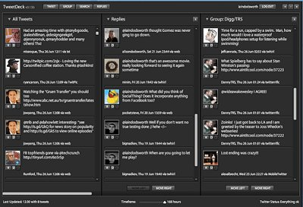
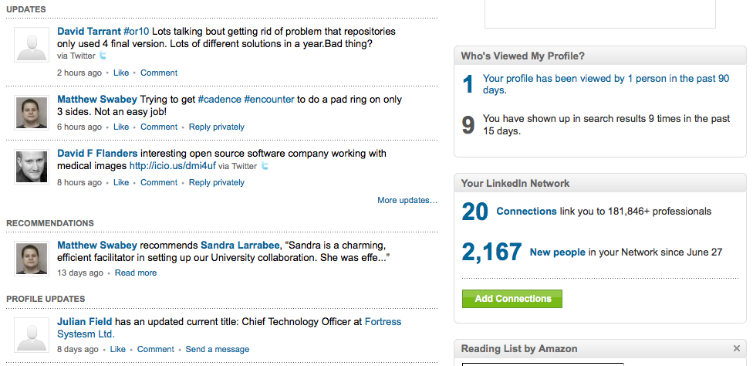
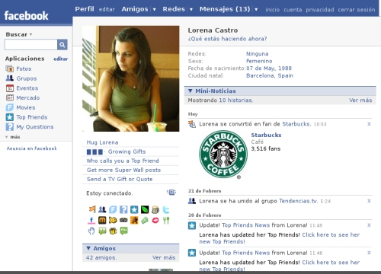
Preferred Environments

Slide 5
Preferred Environments

Slide 6
SWORD
Simple
A big success!

Slide 7
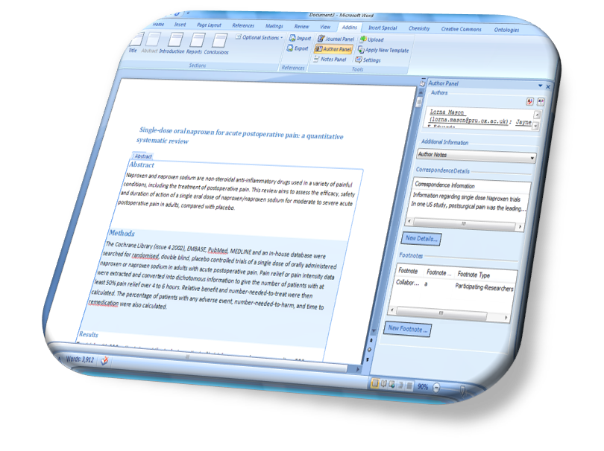
Microsoft Author-Addin
SWORD advocated by Microsoft through their Author Add-In tool.
Beta 2 – Single repository SWORD deposit
Beta 3 – Multi-repository SWORD deposit
Works on Office 2007/2010
http://research.microsoft.com/authoring

Slide 8
The Problem with SWORD
Loads work onto the repository editors
Users are disconnected from their submissions.
No feedback loop
No incentive
No guideline for what the receipt means.

Slide 9
Demand & Incentive
Many repositories want a copy
Green/Gold OA
Multi-submission is “even more” time consuming
Each have different workflows and metadata schemas

Slide 10
DepositMO
“Changing the culture, embedding deposit into the natural everyday workflow of researchers and lecturers”

Slide 11
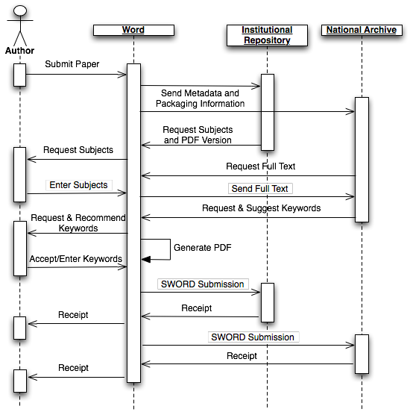

Slide 12
Office as a (client side) Service
Fonts!
User “saves” to the repository
Repository requests a PDF version (fonts embedded)
Client supplies the PDF (autonomously)

Slide 13
Office as a (client side) Service
Repository requires key words.
Repository asks for full text, does a key word extraction
Repository client for keywords and sends the ones it has found
Client gets a dialogue to allow them to verify and enter more keywords

Slide 14
SWORD + REST
Save first version to repository
When done, hit publish / submit.
Shows you on the desktop state of publication, e.g. open doc in word, author bar tells you state in all repositories.

Slide 15
SWORD Receipt
Use the receipt as a URL for the publication from where you can obtain the following:
Status of publication
Number of downloads
Number of citations
Same URL for correction, deletion and other RESTFUL operations.
Fits well with work already in progress

Slide 16
Project Deliverables – Technical
Interaction Specification
Simple REST XML/RDF based
Extensible for new clients (e.g. Open Office)
New Author Add-in supporting spec
Repository Integration
EPrints & DSpace
Desktop integration (extending existing tools where possible)

Slide 17
Project Deliverables – Training
Southampton and Edinburgh to build this into the campus workstations and provide desktop training.
Project to train the trainers (17 currently)

Slide 18
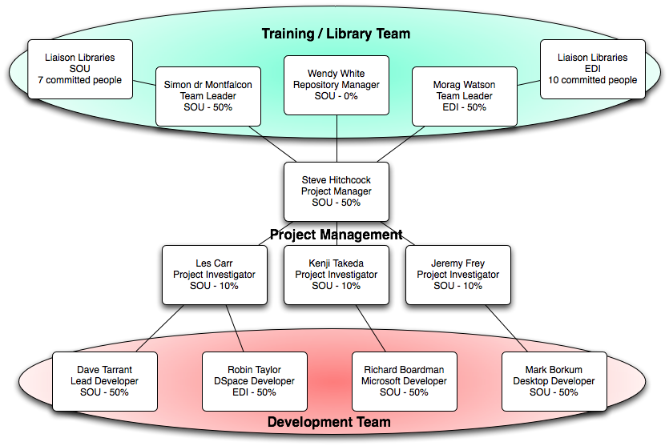
The Team

Slide 19
In order to get more items into our repositories we need to get closer to the researchers workflow (and support this)

Slide 20
Secondly, there needs to be an incentive for the researcher to use the service
Closing the feedback loop
Extensible Opportunities

Slide 21
#depositmo http://blogs.ecs.soton.ac.uk/depositmo
David Tarrant
davetaz@ecs.soton.ac.uk
Electronics and Computer Science

