Slide 1
Open access what’s in it for YOU?
Alma Swan
Key Perspectives Ltd
Truro, UK
Open Access Day, Aarhus University, Aarhus, Denmark, 22 February 2010

Slide 2
Some context
Key Perspectives Ltd

Slide 3
Key Perspectives Ltd

Slide 4
The system is broken
WHO survey (2000):
56% of research-based institutions in lower-income countries had NO current subscriptions to research journals
Nor had they for the previous 5 years
We will never close the “10/90 gap” unless we change the system
Publicly-funded research should be freely available to the ‘public’
Key Perspectives Ltd

Slide 5
Old paradigms of research dissemination
Use of proxy measures of an individual scholar’s merit is as good as it gets
The responsibility for disseminating your work rests with the publisher
The printed article is the format of record
Other scholars have time to search out what you want them to know
Key Perspectives Ltd

Slide 6
New paradigms of research dissemination
Rich, deep, broad metrics for measuring the contributions of individual scholars
Effective dissemination of your work is now in your hands (at last)
The digital format will be the format of record (is already in many areas)
Unless you routinely publish in Nature or Science, ‘getting it out there’ is up to you
Key Perspectives Ltd

Slide 7
Open Access
Immediate
Free (to use)
Free (of restrictions)
Access to the peer-reviewed literature (and data)
Not vanity publishing
Not a ‘stick anything up on the Web’ approach
Moving scholarly communication into the Web Age
Key Perspectives Ltd

Slide 8
Open Access – Why?
Science moves faster and more efficiently
Greater visibility and impact
Better monitoring, assessment and evaluation of research
Enables new semantic technologies (text-mining and data-mining)
Key Perspectives Ltd

Slide 9
Open Access: Who benefits?
Benefits to researchers themselves
Benefits to institutions
Benefits to national economies
Benefits to science and society
Key Perspectives Ltd

Slide 10
Open Access: how
Open Access journals (www.doaj.org)
Open Access repositories
Open Access monographs
Key Perspectives Ltd

Slide 11
Open Access journals
Content available free of charge online
In many cases, free of restrictions on use too
Some charge at the ‘front end’
More than half do not levy a charge at all
Around 4700 of them
Listed in the Directory of Open Access Journals (DOAJ)
Key Perspectives Ltd

Slide 12
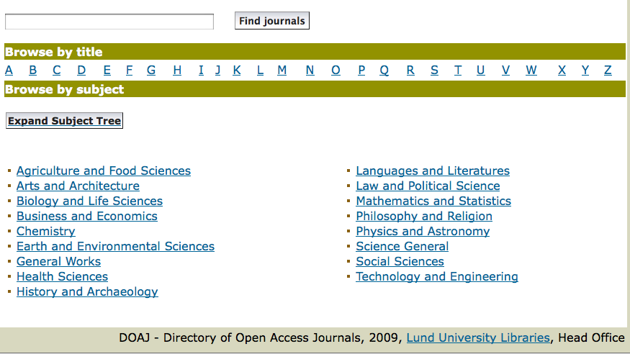
DOAJ categories
Key Perspectives Ltd

Slide 13
Open Access repositories
Digital collections
Most usually institutional
Sometimes centralised (subject-based)
Interoperable
Form a network across the world
Create a global database of openly-accessible research
Currently >1400
Key Perspectives Ltd

Slide 14
Where repositories are
Total at September 2009: 1422
Key Perspectives Ltd

Slide 15
What they contain
Key Perspectives Ltd

Slide 16
How to make your work Open Access through a repository
Prepare your paper and submit it to your journal of choice for peer review
Make any changes required as a result of the peer review process
Submit the final version to the journal
Deposit that same final version to your repository through the normal deposit procedure that applies in your institution
N.B. Your repository staff may check journal copyright conditions on your behalf, or you may do so yourself using the SHERPA RoMEO service at http://www.sherpa.ac.uk/romeo/
Key Perspectives Ltd

Slide 17
What’s in it for authors?
Key Perspectives Ltd

Slide 18
A well-filled repository
Key Perspectives Ltd

Slide 19
And it gets used
Key Perspectives Ltd

Slide 20
Impact
Range = 36%-200%
(Data: Stevan Harnad and co-workers)
Key Perspectives Ltd

Slide 21
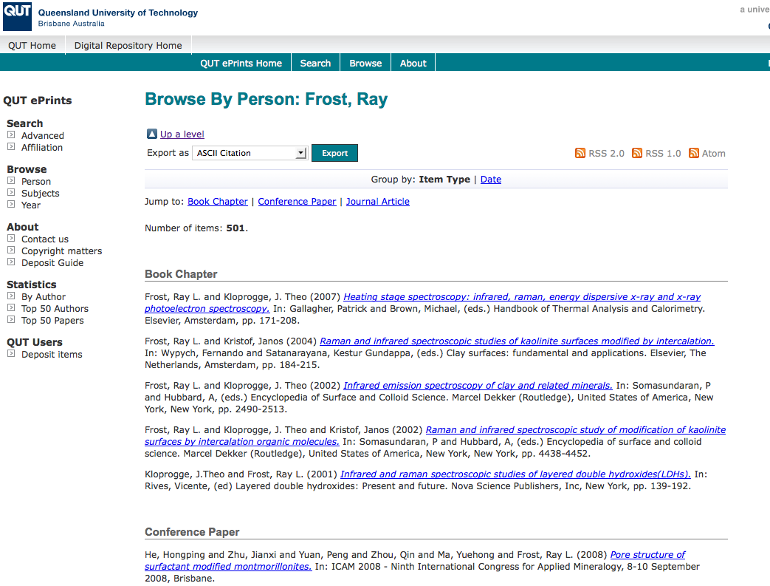
What OA means to a researcher
OpenScholarship.org

Slide 22
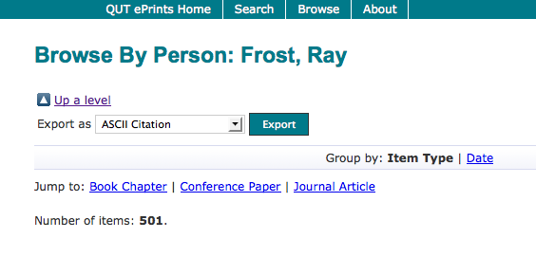
OpenScholarship.org

Slide 23
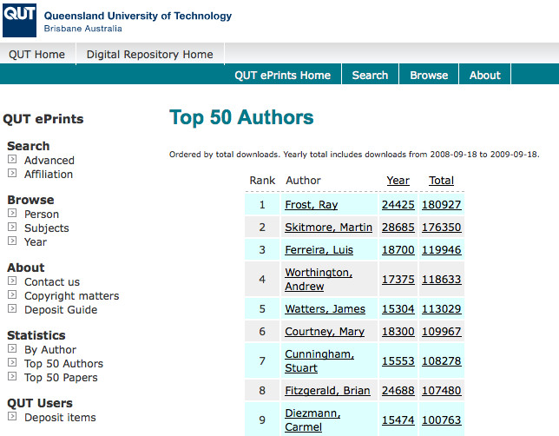
OpenScholarship.org

Slide 24
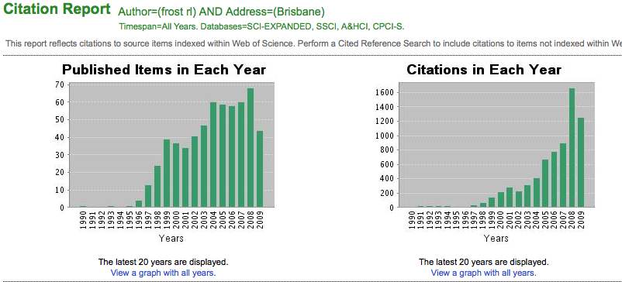
Ray Frost’s impact
OpenScholarship.org

Slide 25
Martin Skitmore (Urban Design)
Key Perspectives Ltd

Slide 26
Luis Ferreira (Civil Engineering)
Key Perspectives Ltd

Slide 27
Andrew Worthington (Economics & Finance)
Key Perspectives Ltd

Slide 28
Binh Pham (Information technology)
Key Perspectives Ltd

Slide 29
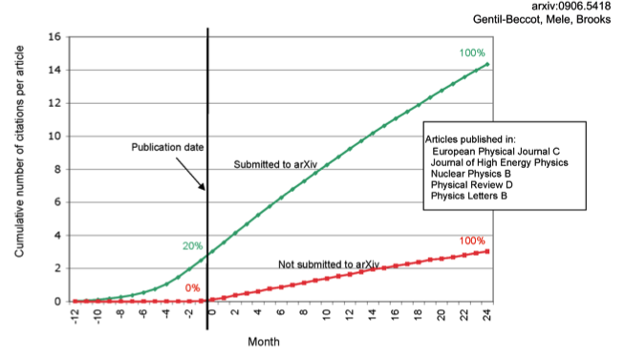
The early bird …
Key Perspectives Ltd

Slide 30
Engineering
Citations
Data: Gargouri & Harnad, 2010
Key Perspectives Ltd

Slide 31
Clinical medicine
Citations
Data: Gargouri & Harnad, 2010
Key Perspectives Ltd

Slide 32
Social science
Citations
Data: Gargouri & Harnad, 2010
Key Perspectives Ltd

Slide 33
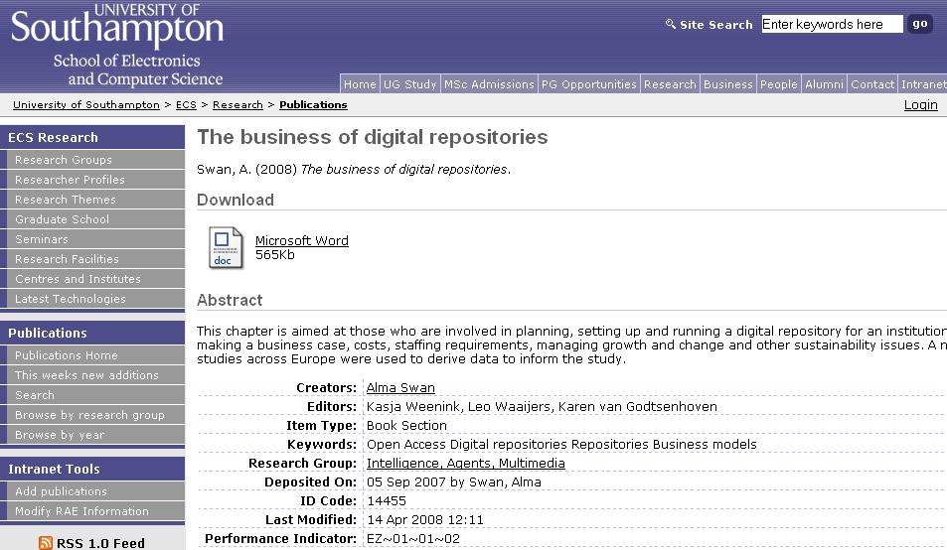
Key Perspectives Ltd
Notes:
33

Slide 34
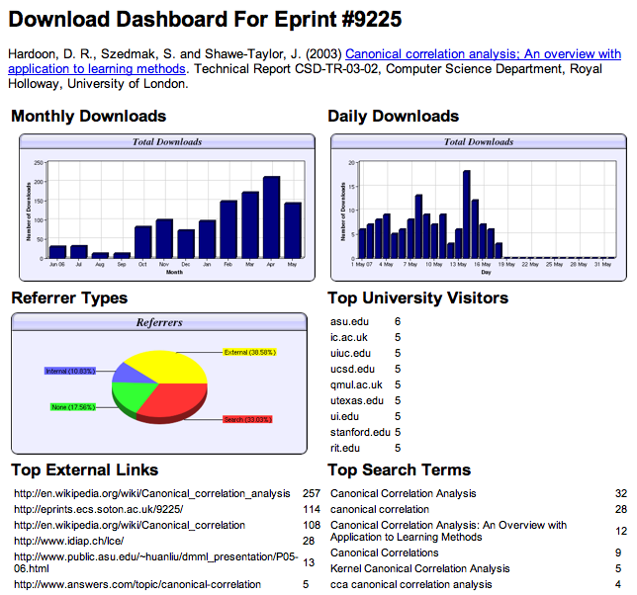

Slide 35
Download timelines
Key Perspectives Ltd

Slide 36
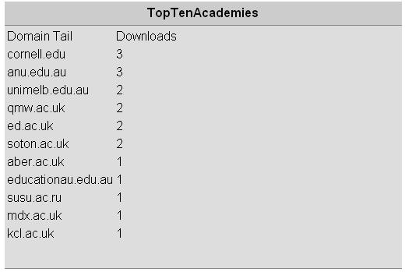
N.B. Downloads are a good predictor of eventual citations
Key Perspectives Ltd
Notes:
36

Slide 37
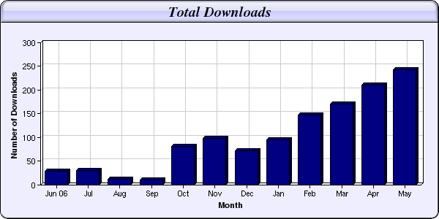
Every e-print tells a story…
Link placed on “Canonical correlation” page in Wikipedia
NIPS Workshop linked to this eprint from its web page
Key Perspectives Ltd

Slide 38
Professor Martin Skitmore School of Urban Design, QUT
“There is no doubt in my mind that ePrints will have improved things – especially in developing countries such as Malaysia … many more access my papers who wouldn’t have thought of contacting me personally in the ‘old’ days.
While this may … increase … citations, the most important thing … is that at least these people can find out more about what others have done…”
Key Perspectives Ltd

Slide 39
Dr Belinda Luke Senior Lecturer, Accountancy, QUT
“One thing it has done is make students aware of what I’m doing outside the classroom. This is important because both undergrad and postgrad students often don’t understand what we do beside teach them.”
Key Perspectives Ltd

Slide 40
EU CIS studies
Key Perspectives Ltd

Slide 41
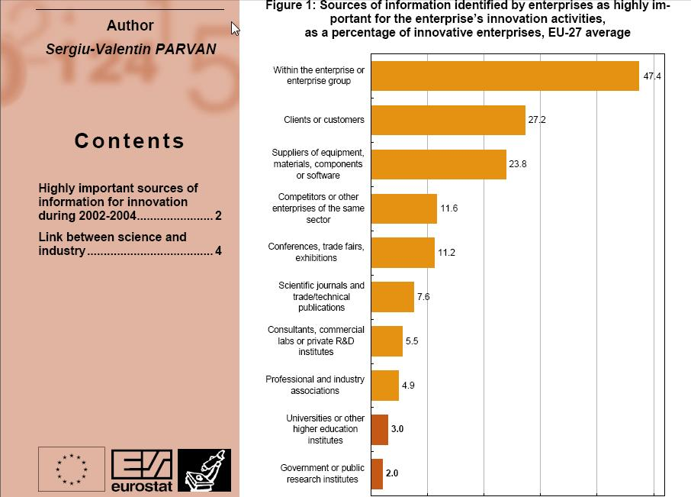
Key Perspectives Ltd

Slide 42
Dr Evonne Miller Senior Lecturer, Design, QUT
“Just last week, the General Manager of Sustainable Development from an Australian rural industry called me–based on reading one of my research papers in ePrints. He loved what he read –which he thought was the most clear approach he’d seen on quantifying social impact –and we are now in discussion about how we can help them measure their industry’s social impacts.”
Key Perspectives Ltd

Slide 43
Total Research Income: QUT and sector
Data: Tom Cochrane
Deputy Vice-Chancellor, QUT
Key Perspectives Ltd

Slide 44
For institutions?
Key Perspectives Ltd

Slide 45
Why an institutional repository?
Fulfils a university’s mission to engender, encourage and disseminate scholarly work
Complete record of its intellectual effort
Permanent record of all digital output
Research management tool
‘Marketing’ tool for universities
Provides maximum Web impact for the institution
Key Perspectives Ltd

Slide 46
The U.Southampton conundrum
The G-Factor (universitymetrics.com)
Key Perspectives Ltd

Slide 47
Key Perspectives Ltd

Slide 48
An author’s own testimony on open access visibility
“Self-archiving in the PhilSci Archive has given instant world-wide visibility to my work. As a result, I was invited to submit papers to refereed international conferences/journals and got them accepted.”
Key Perspectives Ltd

Slide 49
Impact
Range = 36%-200%
(Data: Stevan Harnad and co-workers)
Key Perspectives Ltd

Slide 50
Lost citations, lost impact
Say, Open Access brings 50% more citations
Only around 15% of research is Open Access
….. so 85% is not
University X is therefore losing 85% of the 50% increase in citations (conservative end of the range) that Open Access brings (= 42.5%)
Key Perspectives Ltd

Slide 51
What lack of Open Access means to a university (the University of Aarhus)
Articles: 6180 articles 2005-2009 (5 years)
Number of citations: 32,027
If all had been OA, there would have been (42.5% more) 45,619 citations, and ….
Say, the University invests €100m in research per annum (€500m over the period)…
…this means lost impact worth €212.5m to the university in that period
Key Perspectives Ltd

Slide 52
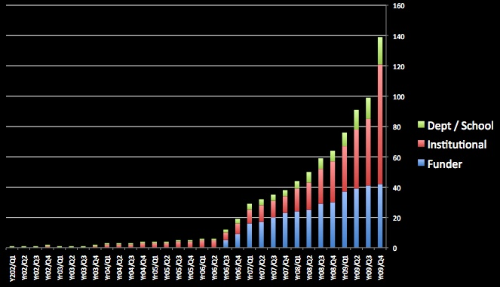
Open Access policies
Key Perspectives Ltd

Slide 53
Daniel Coit Gilman First President, Johns Hopkins University
It is one of the noblest duties of a university to advance knowledge and to diffuse it, not merely among those who can attend the daily lectures, but far and wide.
Key Perspectives Ltd

Slide 54
University of Edinburgh Strategic Plan 2008-12
“The mission of our University is the creation, dissemination and curation of knowledge.”
Key Perspectives Ltd

Slide 55
Resources
1. General, comprehensive resource on Open Access:
OASIS
(Open Access Scholarly Information Sourcebook)
www.openoasis.org
Resource for policymakers, institutional managers:
EOS
(Enabling Open Scholarship)
www.openscholarship.org
Key Perspectives Ltd

Slide 56
Thank you for listening
aswan@keyperspectives.co.uk
www.keyperspectives.co.uk
www.openoasis.org
Key Perspectives Ltd

