Slide 1
Me and my impact: what can this repository thing do to help?
Alma Swan
Key Perspectives Ltd
Truro, UK
University of Huddersfield OA event, 17 March 2010

Slide 2
Some context
Key Perspectives Ltd

Slide 3
Open Access
Immediate
Free (to use)
Free (of restrictions)
Access to the peer-reviewed literature (and data)
Not vanity publishing
Not a ‘stick anything up on the Web’ approach
Moving scholarly communication into the Web Age
Key Perspectives Ltd

Slide 4
Open Access – Why?
Science moves faster and more efficiently
Greater visibility and impact
Better monitoring, assessment and evaluation of research
Enables new semantic technologies (text-mining and data-mining)
Key Perspectives Ltd

Slide 5
Open Access: how
Open Access journals (www.doaj.org)
Open Access repositories
Open Access monographs
Key Perspectives Ltd

Slide 6
Open Access journals
Content available free of charge online
In many cases, free of restrictions on use too
Some charge at the ‘front end’
More than half do not levy a charge at all
Around 4700 of them
Listed in the Directory of Open Access Journals (DOAJ)
Key Perspectives Ltd

Slide 7
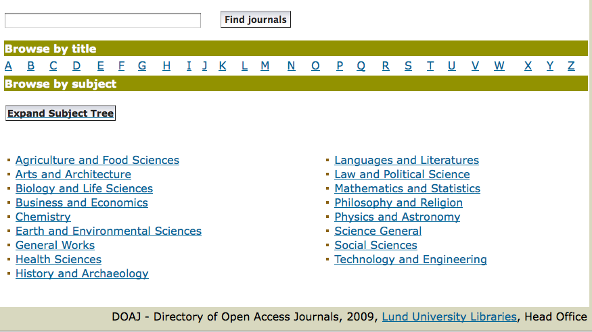
DOAJ categories
Key Perspectives Ltd

Slide 8
Open Access repositories
Digital collections
Most usually institutional
Sometimes centralised (subject-based)
Interoperable
Form a network across the world
Create a global database of openly-accessible research
Currently >1400
Key Perspectives Ltd

Slide 9
Where repositories are
Total at September 2009: 1422
Key Perspectives Ltd

Slide 10
What they contain
Key Perspectives Ltd

Slide 11
Key Perspectives Ltd

Slide 12
How to make your work
Open Access through a repository
Prepare your paper and submit it to your journal of choice for peer review
Make any changes required as a result of the peer review process
Submit the final version to the journal
Deposit that same final version to your repository through the normal deposit procedure that applies in your institution
N.B. Your repository staff may check journal copyright conditions on your behalf, or you may do so yourself using the SHERPA RoMEO service at http://www.sherpa.ac.uk/romeo/
Key Perspectives Ltd

Slide 13
Key Perspectives Ltd

Slide 14
What’s in it for authors?
Key Perspectives Ltd

Slide 15
An author’s own testimony on open access visibility
“Self-archiving in the PhilSci Archive has given instant world-wide visibility to my work. As a result, I was invited to submit papers to refereed international conferences/journals and got them accepted.”
Key Perspectives Ltd

Slide 16
A well-filled repository
Key Perspectives Ltd

Slide 17
And it gets used
Key Perspectives Ltd

Slide 18
Professor Martin Skitmore
School of Urban Design, QUT
“There is no doubt in my mind that ePrints will have improved things – especially in developing countries such as Malaysia … many more access my papers who wouldn’t have thought of contacting me personally in the ‘old’ days.
While this may … increase … citations, the most important thing … is that at least these people can find out more about what others have done…”
Key Perspectives Ltd

Slide 19
Impact
Range = 36%-200%
(Data: Stevan Harnad and co-workers)
Key Perspectives Ltd

Slide 20
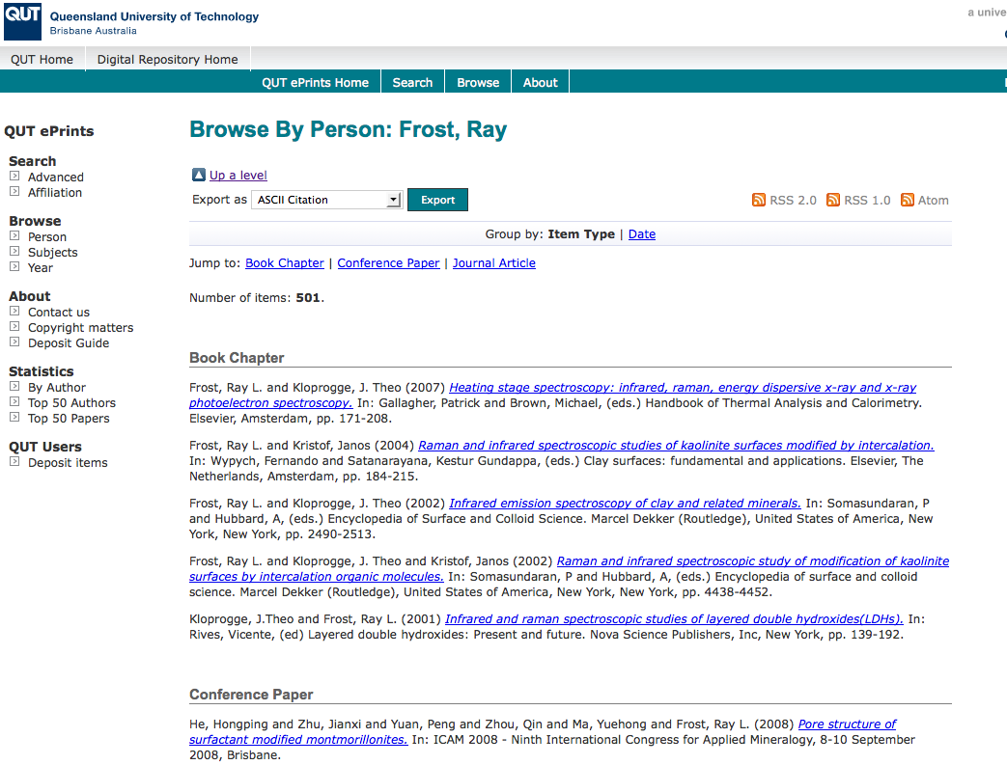
What OA means to a researcher
Key Perspectives Ltd

Slide 21
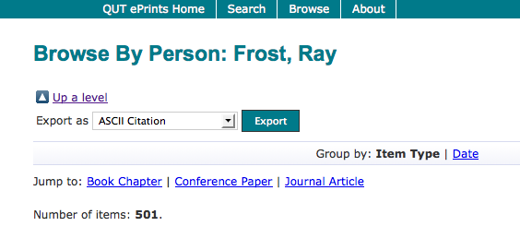
Key Perspectives Ltd

Slide 22
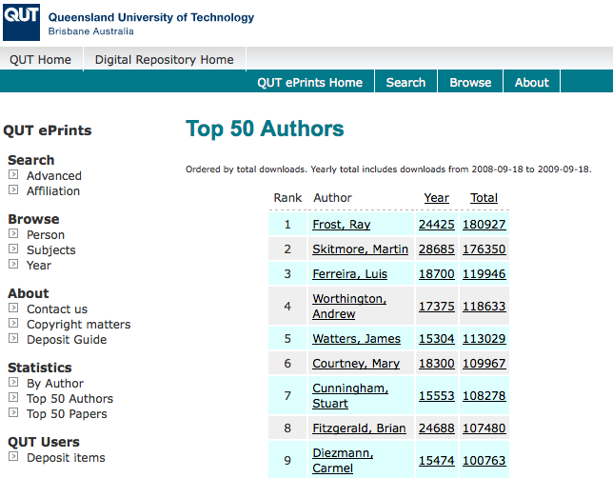
Key Perspectives Ltd

Slide 23
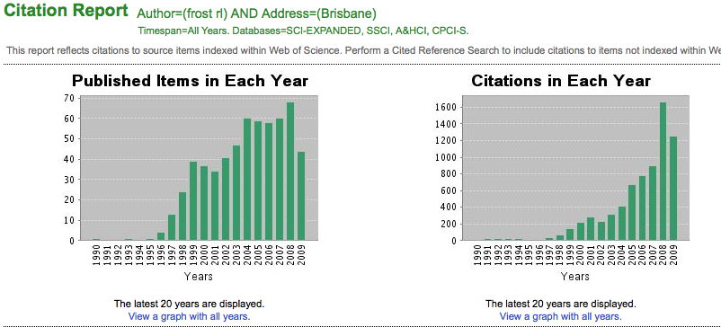
Ray Frost’s impact
Key Perspectives Ltd

Slide 24
Key Perspectives Ltd

Slide 25
Liam Blunt
(Computing & Engineering)
Key Perspectives Ltd

Slide 26
Key Perspectives Ltd

Slide 27
Lindsay Harding
(Applied Sciences)
Key Perspectives Ltd

Slide 28
And for individual scientists….
Diamond, A M (1986) What is a citation worth? J. Human Resources 21, 200 (www.garfield.library.upenn.edu/essays/v11p354y1988.pdf)
Marginal value of one citation is 50-1300 USD (depending on field and number of citations: an increase from 0 to 1 citation is worth more than from 30-31 citations)
Update for inflation (170%) = 86-2227 USD (say, $1000)
Convert to sterling = £700
Now let’s look at Lindsay’s situation….
Key Perspectives Ltd

Slide 29
Lindsay Harding
(Applied Sciences)
530 citations
Would have been 42.5% lower without OA = 464 citations
Lindsay has gained 66 citations
Each citation is worth £700
Lindsay is richer by = £46,200!
Key Perspectives Ltd

Slide 30
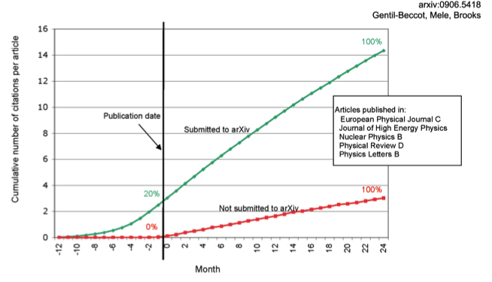
The early bird …
Key Perspectives Ltd

Slide 31
Engineering
Citations
Data: Gargouri & Harnad, 2010
Key Perspectives Ltd

Slide 32
Clinical medicine
Citations
Data: Gargouri & Harnad, 2010
Key Perspectives Ltd

Slide 33
Social science
Citations
Data: Gargouri & Harnad, 2010
Key Perspectives Ltd

Slide 34
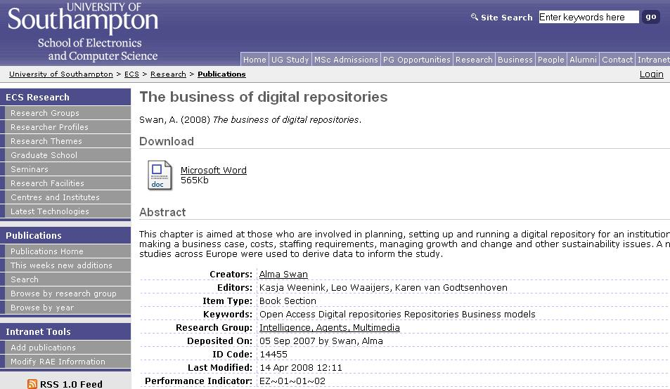
Key Perspectives Ltd
Notes:
34

Slide 35
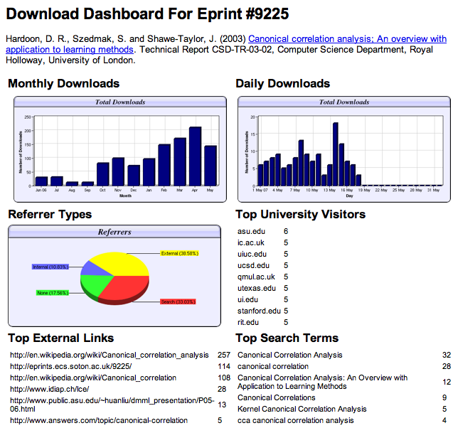

Slide 36
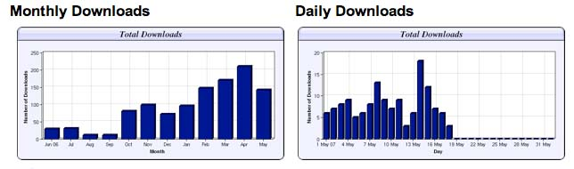
Download timelines
Key Perspectives Ltd

Slide 37
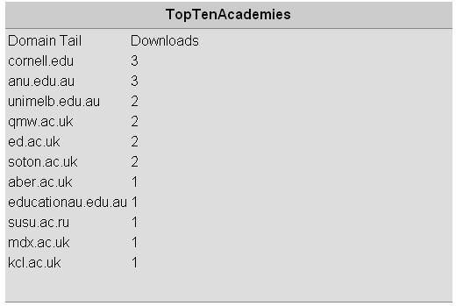
N.B. Downloads are a good predictor of eventual citations
Key Perspectives Ltd
Notes:
37

Slide 38
Dr Belinda Luke
Senior Lecturer, Accountancy, QUT
“One thing it has done is make students aware of what I’m doing outside the classroom. This is important because both undergrad and postgrad students often don’t understand what we do beside teach them.”
Key Perspectives Ltd

Slide 39
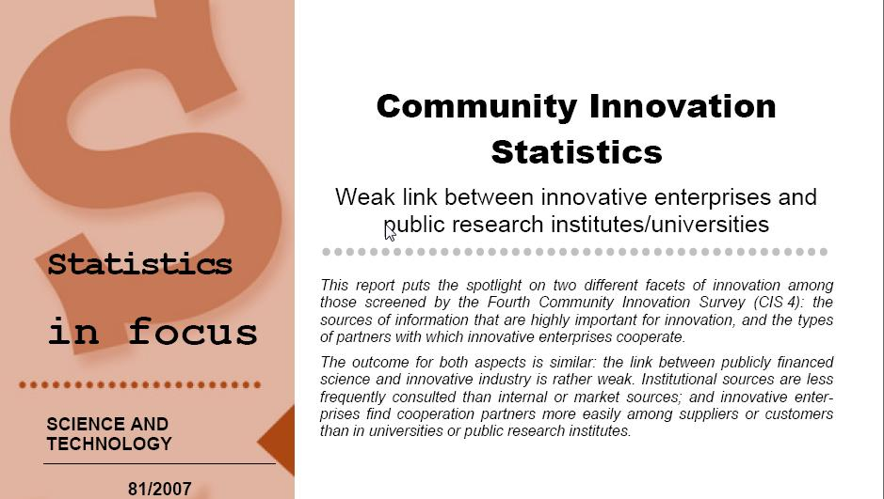
EU CIS studies
Key Perspectives Ltd

Slide 40
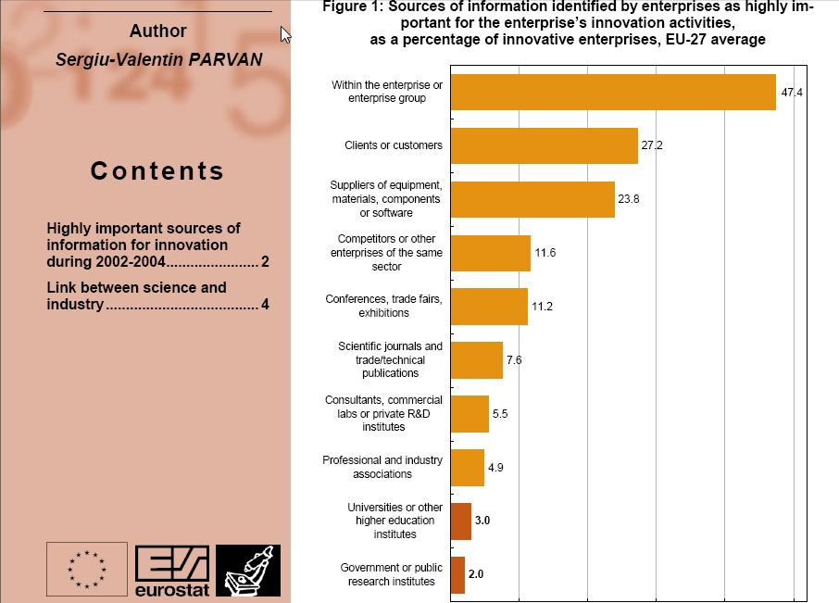
Key Perspectives Ltd

Slide 41
Total Research Income: QUT and sector
Data: Tom Cochrane
Deputy Vice-Chancellor, QUT
Key Perspectives Ltd

Slide 42
Dr Evonne Miller
Senior Lecturer, Design, QUT
“Just last week, the General Manager of Sustainable Development from an Australian rural industry called me – based on reading one of my research papers in ePrints.
He loved what he read ..... and we are now in discussion about how we can help them measure their industry’s social impacts.”
Key Perspectives Ltd

Slide 43
For institutions?
Key Perspectives Ltd

Slide 44
Why an institutional repository?
Fulfils a university’s mission to engender, encourage and disseminate scholarly work
Complete record of its intellectual effort
Permanent record of all digital output
Research management tool
‘Marketing’ tool for universities
Provides maximum Web impact for the institution
Key Perspectives Ltd

Slide 45
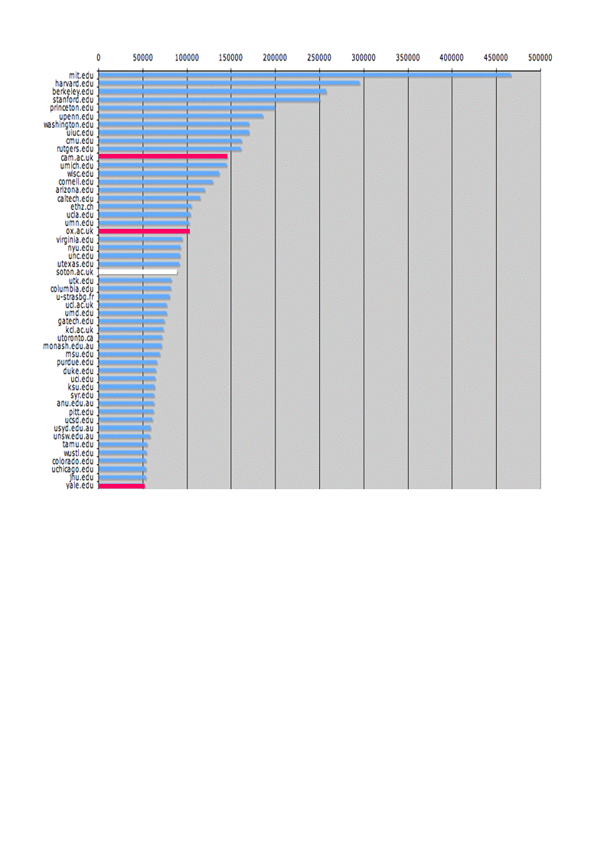
The U.Southampton conundrum
The G-Factor (universitymetrics.com)
Key Perspectives Ltd

Slide 46
Key Perspectives Ltd

Slide 47
Impact
Range = 36%-200%
(Data: Stevan Harnad and co-workers)
Key Perspectives Ltd

Slide 48
Lost citations, lost impact
Say, Open Access brings 50% more citations
Only around 15% of research is Open Access
….. so 85% is not
The University of Huddersfield is therefore losing 85% of the 50% increase in citations (conservative end of the range) that Open Access brings (= 42.5%)
Key Perspectives Ltd

Slide 49
What lack of Open Access means to Huddersfield University
Articles: 1805 articles (5 years)
Number of citations: 10,149
If all had been OA, there would have been (42.5% more) 11590 citations, and ….
Say, the University invests £50m in research per annum (€500m over the period)…
…this means lost impact worth £21.25m to the university in that period
Key Perspectives Ltd

Slide 50
Daniel Coit Gilman
First President, Johns Hopkins University
It is one of the noblest duties of a university to advance knowledge and to diffuse it, not merely among those who can attend the daily lectures, but far and wide.
Key Perspectives Ltd

Slide 51
Huddersfield: Nice, but not enough...
We welcome contributions...”
“For the benefit of you, the University and research, we require...”
Key Perspectives Ltd

Slide 52
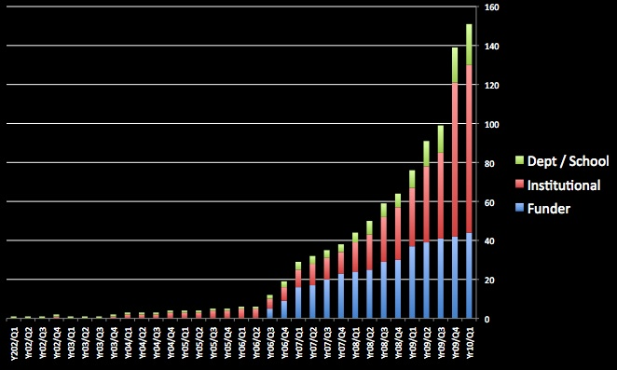
Open Access mandatory policies
Key Perspectives Ltd

Slide 53
University of Edinburgh
Strategic Plan 2008-12
“The mission of our University is the creation, dissemination and curation of knowledge.”
Key Perspectives Ltd

Slide 54
Resources
1. General, comprehensive resource on Open Access:
OASIS
(Open Access Scholarly Information Sourcebook)
www.openoasis.org
Resource for policymakers, institutional managers:
EOS
(Enabling Open Scholarship)
www.openscholarship.org
Key Perspectives Ltd

Slide 55
Thank you for listening
aswan@keyperspectives.co.uk
www.keyperspectives.co.uk
www.openoasis.org
Key Perspectives Ltd

