Slide 1
Open Access repositories – what they can do for researchers, universities and Austria
Alma Swan
Key Perspectives Ltd
Truro, UK
Austrian OA Day, Vienna, 25 March 2010

Slide 2
Some context
Key Perspectives Ltd

Slide 3
Open Access
Immediate
Free (to use)
Free (of restrictions)
Access to the peer-reviewed literature (and data)
Not vanity publishing
Not a ‘stick anything up on the Web’ approach
Moving scholarly communication into the Web Age
Key Perspectives Ltd

Slide 4
Open Access: how
Open Access journals (www.doaj.org)
Open Access repositories
Open Access monographs
Key Perspectives Ltd

Slide 5
Open Access repositories
Digital collections
Most usually institutional
Sometimes centralised (subject-based)
Interoperable
Form a network across the world
Create a global database of openly-accessible research
Currently >1600
Key Perspectives Ltd

Slide 6
Where repositories are
Total at March 2010: 1625
Key Perspectives Ltd

Slide 7
How to make your work Open Access through a repository
Prepare your paper and submit it to your journal of choice for peer review
Make any changes required as a result of the peer review process
Submit the final version to the journal
Deposit that same final version to your repository through the normal deposit procedure that applies in your institution
N.B. Your repository staff may check journal copyright conditions on your behalf, or you may do so yourself using the SHERPA RoMEO service at http://www.sherpa.ac.uk/romeo/
Key Perspectives Ltd

Slide 8
What’s in it for authors?
Key Perspectives Ltd

Slide 9
An author’s own testimony on open access visibility
“Self-archiving in the PhilSci Archive has given instant world-wide visibility to my work. As a result, I was invited to submit papers to refereed international conferences/journals and got them accepted.”
Key Perspectives Ltd

Slide 10
A well-filled repository
Key Perspectives Ltd

Slide 11
And it gets used
Key Perspectives Ltd

Slide 12
Professor Martin Skitmore School of Urban Design, QUT
“There is no doubt in my mind that ePrints will have improved things – especially in developing countries such as Malaysia … many more access my papers who wouldn’t have thought of contacting me personally in the ‘old’ days.
While this may … increase … citations, the most important thing … is that at least these people can find out more about what others have done…”
Key Perspectives Ltd

Slide 13
Impact
Range = 36%-200%
(Data: Stevan Harnad and co-workers)
Key Perspectives Ltd

Slide 14
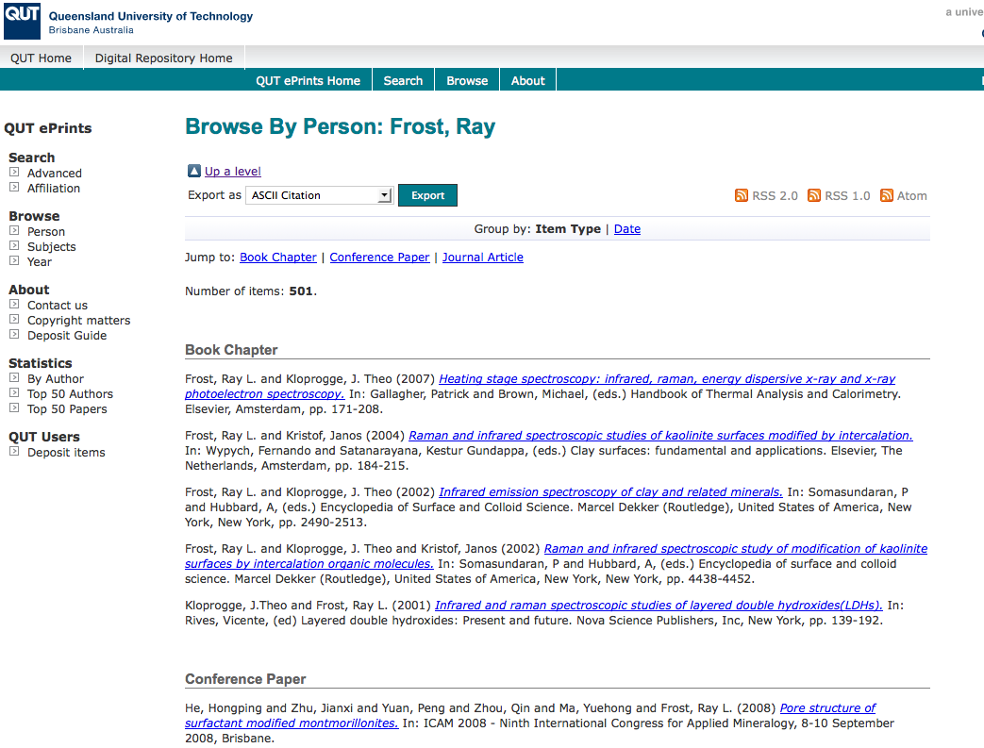
What OA means to a researcher
Key Perspectives Ltd

Slide 15
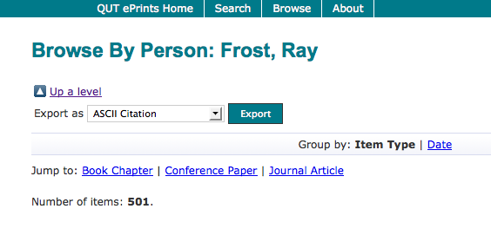
Key Perspectives Ltd

Slide 16
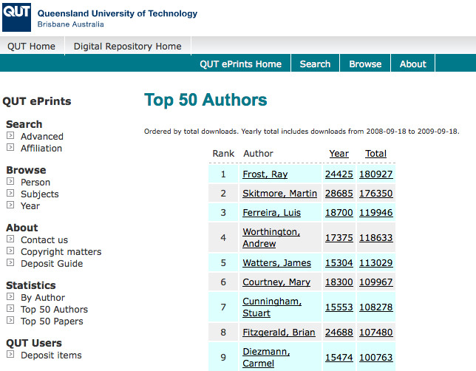
Key Perspectives Ltd

Slide 17
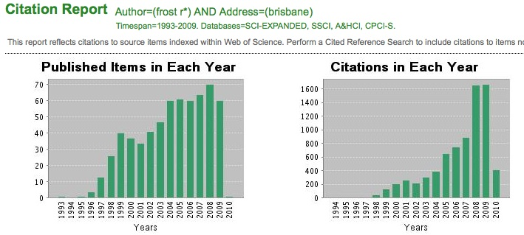
Ray Frost’s impact
Key Perspectives Ltd

Slide 18
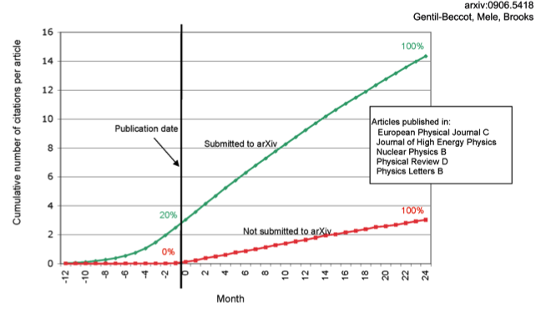
The early bird …
Key Perspectives Ltd

Slide 19
Engineering
Citations
Data: Gargouri & Harnad, 2010
Key Perspectives Ltd

Slide 20
Clinical medicine
Citations
Data: Gargouri & Harnad, 2010
Key Perspectives Ltd

Slide 21
Social science
Citations
Data: Gargouri & Harnad, 2010
Key Perspectives Ltd

Slide 22
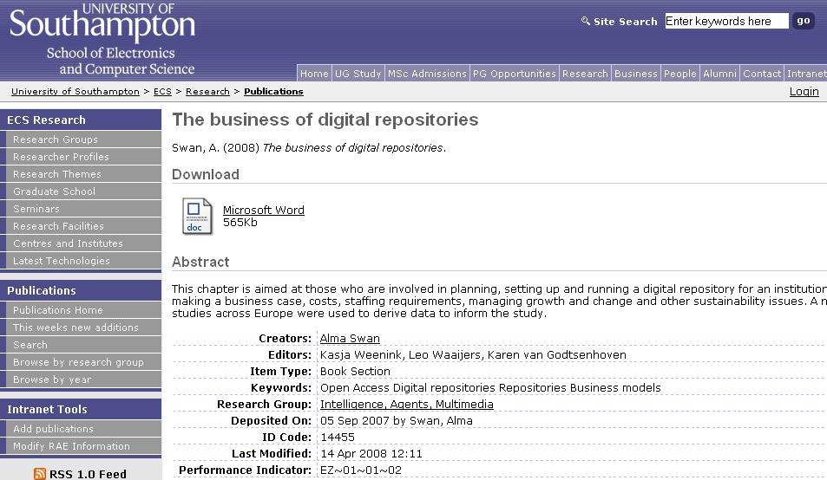
Key Perspectives Ltd
Notes:
22

Slide 23
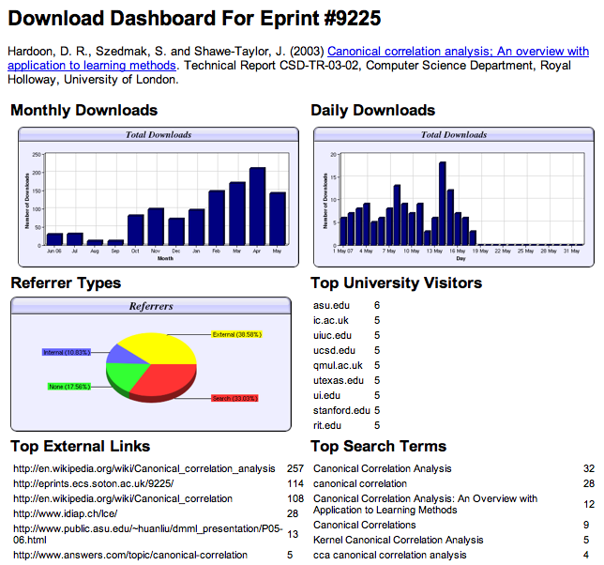

Slide 24
Download timelines
Key Perspectives Ltd

Slide 25
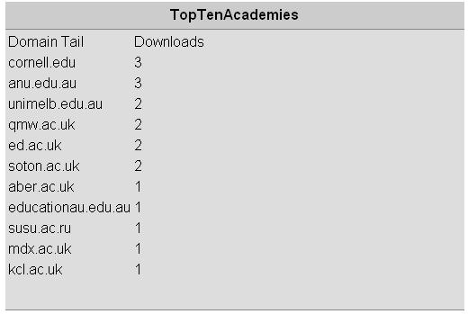
N.B. Downloads are a good predictor of eventual citations
Key Perspectives Ltd
Notes:
25

Slide 26
EU CIS studies
Key Perspectives Ltd

Slide 27
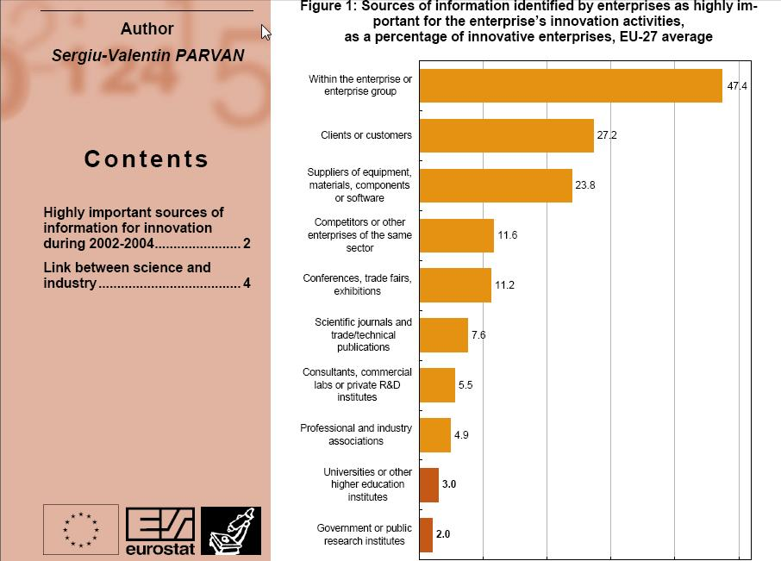
Key Perspectives Ltd

Slide 28
Total Research Income: QUT and sector
Data: Tom Cochrane
Deputy Vice-Chancellor, QUT
Key Perspectives Ltd

Slide 29
Dr Evonne Miller Senior Lecturer, Design, QUT
“Just last week, the General Manager of Sustainable Development from an Australian rural industry called me – based on reading one of my research papers in ePrints.
He loved what he read ..... and we are now in discussion about how we can help them measure their industry’s social impacts.”
Key Perspectives Ltd

Slide 30
For institutions?
Key Perspectives Ltd

Slide 31
Why an institutional repository?
Fulfils a university’s mission to engender, encourage and disseminate scholarly work
Complete record of its intellectual effort
Permanent record of all digital output
Research management tool
‘Marketing’ tool for universities
Provides maximum Web impact for the institution
Key Perspectives Ltd

Slide 32
The U.Southampton conundrum
The G-Factor (universitymetrics.com)
Key Perspectives Ltd

Slide 33
Key Perspectives Ltd

Slide 34
Impact
Range = 36%-200%
(Data: Stevan Harnad and co-workers)
Key Perspectives Ltd

Slide 35
What lack of Open Access means to the University of Vienna
Articles in 2009: 4396 articles
Number of citations: 4084
If all had been OA, there would have been (50% more) 6126 citations, and ….
Say, the University invests €100m in research per annum …
…this means lost impact worth €50m to the university in that period
Key Perspectives Ltd

Slide 36
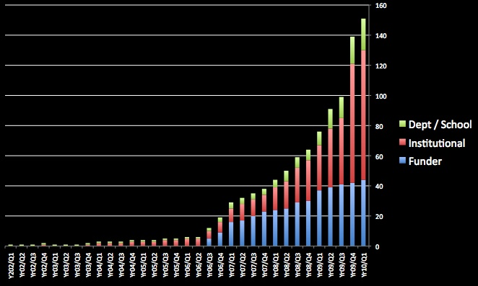
Open Access mandatory policies
Key Perspectives Ltd

Slide 37
Daniel Coit Gilman First President, Johns Hopkins University
It is one of the noblest duties of a university to advance knowledge and to diffuse it, not merely among those who can attend the daily lectures, but far and wide.
Key Perspectives Ltd

Slide 38
University of Edinburgh Strategic Plan 2008-12
“The mission of our University is the creation, dissemination and curation of knowledge.”
Key Perspectives Ltd

Slide 39
Resources
1. General, comprehensive resource on Open Access:
OASIS
(Open Access Scholarly Information Sourcebook)
www.openoasis.org
2. Resource for policymakers, institutional managers:
EOS
(Enabling Open Scholarship)
www.openscholarship.org
Key Perspectives Ltd

Slide 40
Thank you for listening
aswan@keyperspectives.co.uk
www.keyperspectives.co.uk
www.openoasis.org
Key Perspectives Ltd

