Slide 1
Making it Rich and Personal meeting institutional challenges from next generation learning environments
Su White, Hugh Davis, Debra Morris, Peter Hancock
saw@ecs.soton.ac.uk
http://www.ecs.soton.ac.uk/people/saw PLE_BCN 7th July 2010
This presentation and the paper
http://eprints.ecs.soton.ac.uk/21327
Notes:
The understanding that personal learning environments provide a more realistic and workable perspective of learners’ interactions with and use of technology has gained widespread acceptance across many of the communities interested in learning and teaching technologies within higher education.
However in universities the service which normally purchases and deploys technology infrastructure is typically, and understandable, risk-averse, the more so, because the consequences of expensive decisions about infrastructure will stay with the organisations for many years. Furthermore across the broader academic community the awareness of and familiarity with technologies in support of learning may be varied. In this context work to innovate the learning environment will require considerable team effort and collective commitment.
This paper presents a case study account of institutional processes harnessed to establish a universal personal learning environment fit for the 21st century. The challenges encountered were consequential of our working definition of a learning environment which went beyond simple implementation – in our experience the requirements became summarised as ‘its more than a system, it’s a mindset’. As well as deploying technology ‘fit for purpose’ we were seeking to create an environment which could play an integral and catalytic part in the university’s role of enabling transformative education.
Our ambitions and aspirations derive from evidence in the literature, for example, van Harmelen on personal learning environments (2006), Downes on e-learning 2.0 (2005) and the recent report by Bradwell for Demos on the Edgeless University (2009).
We have also drawn on evidence of our recent and current performance; gauged by institutional benchmarking and an extensive student survey. The paper will present and analyse this qualitative and quantitative data. We will provide an account and analysis of our progress to achieve change, the methods we used, problems encountered and the decisions we made on the way.
Dr Su White is based in the Learning Societies Lab, in Electronics and Computer Science at the University of Southampton. Su’s research interests include the impact of emerging technologies on Higher Education. Su is a part of the curriculum innovation project southampton learning environment team and a member of the university’s TEL-SIG.
I will not spend an equal amount of time on each slide, some slides are meant to quickly convey images/ideas.

Slide 2
Links and tags and badge
Basic details and links to publications
http://www.ecs.soton.ac.uk/research/projects/749
Curriculum innovation programme
http://www.soton.ac.uk/cip/environment/index.html
Project Blog
http://blogs.ecs.soton.ac.uk/sle/
This presentation and the paper
http://eprints.ecs.soton.ac.uk/21327
Notes:
A rather bad pic of my hand made badge (it’s a label/tag) with mind map and links ☺
Plus links to formal info on the SLE which may grow with time if you are following this project

Slide 3
The shape of this talk
1 – intro
4 –future and conclusions?
2 – context(s)
3 experience
Notes:
Plan for the order of presentation
Context and current practice – the way the world is – a sneak of how I will be talking about things

Slide 4
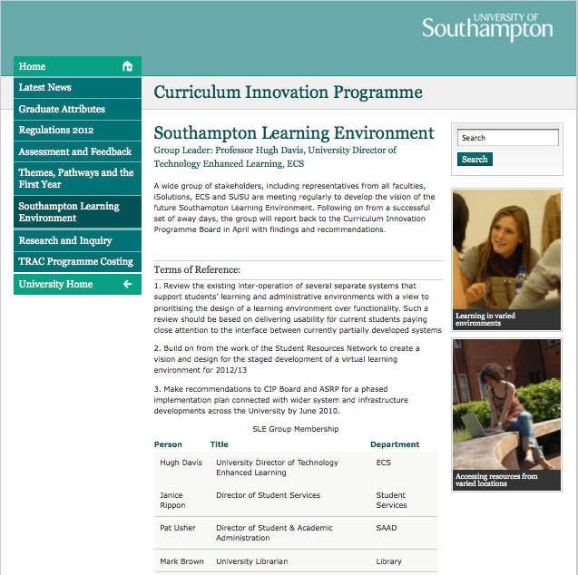
Who we are
Hugh Davis Head of technology enhanced learning
Pete Hancock: Director of ’IT services’
Debra Morris
Librarian leads on e-learning
Su White Academic researches institutional change
And a host of others….
Kenji Takeda, Heidi Solheim, Janice Rippon, Pat Usher, Mark Brown, Fiona Grindey, Marcus Grace, Trevor Bryant, Alex Furr, Vicky Wright, Dave Martin, Jamie Ings , Ash Browning, John Isger
Patron/Sponsor PVC Humphris
Notes:
The extent of the project

Slide 5
Its been a long while in the making
A journey and some observations…
Microcosm (1990s)
Campus Wide Structure for Multimedia Learning (TLTP Scholar)
WWW, Blackboard, QuestionMark, SUSSED (portal)
Staff Use and Attitude Surveys
Audits
Benchmarking (EMM carpet)
Student Survey
Enhancement Academy
EMM carpet
We have organisational knowledge
And we have ECS and LSL
Notes:
Investment before we knew it, also complemented by strength of ECS, LSL

Slide 6
Feedback as driver
Almost 1000 responses, across institution
One example from many
Notes:
What we learnt from the student survey
And how we plan to continue to learn – modified delphi

Slide 7
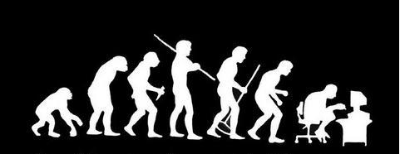
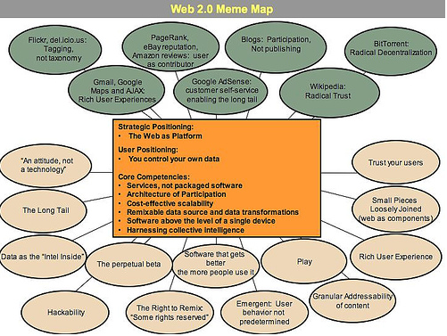
use and understanding
Notes:
Technological innovation alongside

Slide 8
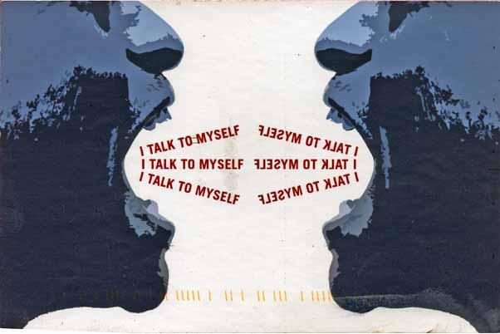
A computing service…
Pathologically risk averse
new ideas mean its time for some negotiation ☺
We are talking
about major culture change
Notes:
Working with the computing service we are talking culture change

Slide 9
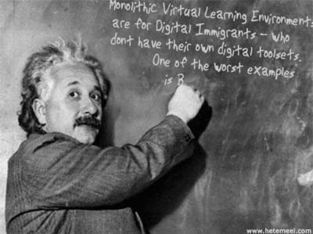
(above image thanks to Dave Millard from a generator at http://generator.kitt.net/)
Notes:
And its not just the computing service who have got to change
Coming back to the concept of a negotiated meaning of understanding

Slide 10
Rich Learning Environments
A model aligned to our situation
Notes:
These are the concepts we are using to underpin our negotiation
They are familiar
They map to our existing practices
We are talking about a rich learning environment
We are talking about a holistic view

Slide 11
Rich Learning Environment
In a Rich Learning Environment social space is the underlying fabric Social space incorporates communication and community Social space intersects personal and institutional space
Notes:
This is why it is a rich learning environment
Its more than just personal – but of course as every individual will view it and tailor it to their need it will be personal
Metaphors – city – got bogged down in sewers! anecdote

Slide 12
Southampton Learning Environment
Notes:
Here is another way of looking at the same environment
And the Computing person was able to map it to their understnding of how they currently go about provision

Slide 13
How do you model complexity?
External Sources
HERO
UCAS
Elsevier
Blackwells
HESA
HEFCE
UUK
Russell Group
HEA
THES
Guardian
Open Courseware
Registry
Student loans company
Sustrans
Data.gov
IET
ACM
BCS
IEEE
GMC
GTC
Open Street Map
Ordnance Survey
Mimas
ePrints
EdShare
Indicative activities Explore web site
Book open day
Investigate current admissions tariff
Compare five potential UCAS choices
Review league table performance
Change mind about study options at last minute
Examine HERO institutional profile
Find out who teaches in a department
Check out the dates of the next academic year
Consult the regulations regarding academic integrity
Download timetable
Make appointment with mentoring service
Make travel arrangements
Reserve a library book
Find journal articles and put into collection
Book a meeting room
Select options
Review transcript
Construct learning portfolio
Create online CV
Submit a mitigating circumstances request
Review current marks profile
Identify tutor for failing student
Check marks profile of potential project student
Review institutional software portfolio
Actors
Student
Part-time Student
Work-placement Student
Recent graduate
Retake student
Alumna
PSB
Prospective Student
Tutor
Graduate Teaching Assistant
Lab technician
Part time tutor
Teacher
Researcher
Administrator
Librarian
Learning technologist
Media Assistant
IT support
Invigilator
Doctor
Counsellor
Senior tutor
These lists are not in any way complete
Notes:
The lists tasks, data sources, and actors are not complete, but are indicative

Slide 14
We want to climb over the walls…
ECS
Library
Student
services
facebook
Student Union
admin
Adapted from one used by tbl, originally from the economist I think
Notes:
We have our own walls to climb over too – he he ;-) the original slide refers to facebook, bebo, linkedin etc. Students may want to have interconnectivity with external apps, actors in our systems may want to share data from internal info with external apps, but whatever else we certainly need to be able to share and reuse data from and between our internal apps, using a web2.0 approach using the web as a platform, exposing our data and devising services to enable apps to communicate is essential

Slide 15
Our educational position: student-centred research-led learning
Authentic learning
Situated Learning
21st century world-ware
Accommodating diversity caused by disciplinary differences
Meeting the needs of our learners
Acquiring/mastering Skills, knowledge and understanding
Meeting the needs of our academics
Making the administration work for the teachers, administrators and the students!!
Learning experiences for the thought leaders and decision makers of tomorrow
Ethical decision makers and global leaders
Notes:
We have had lots of discussion about values and principles
The rich learning environment needs to be constructively aligned (ala biggs) to all our objectives

Slide 16
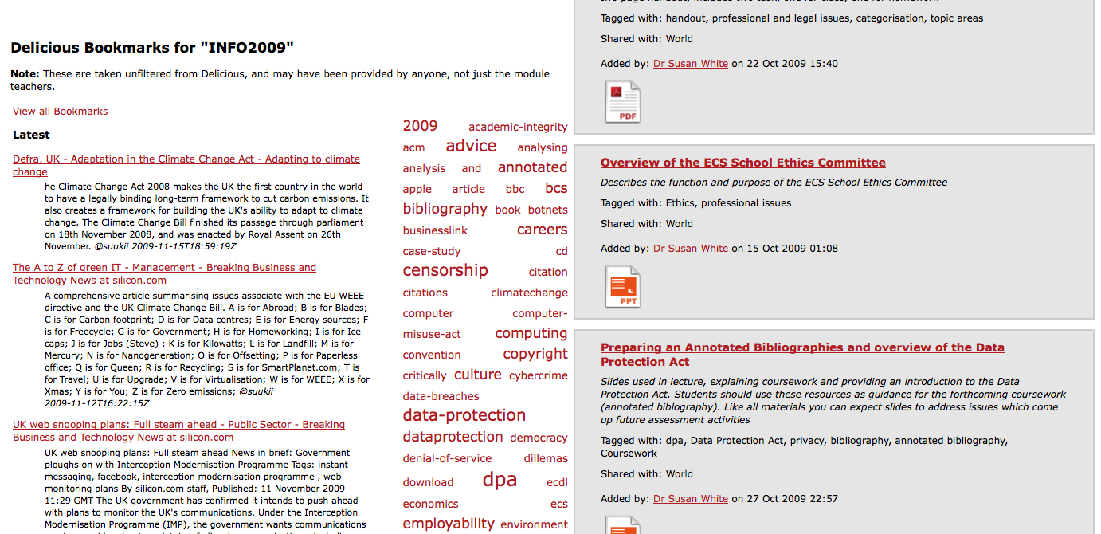
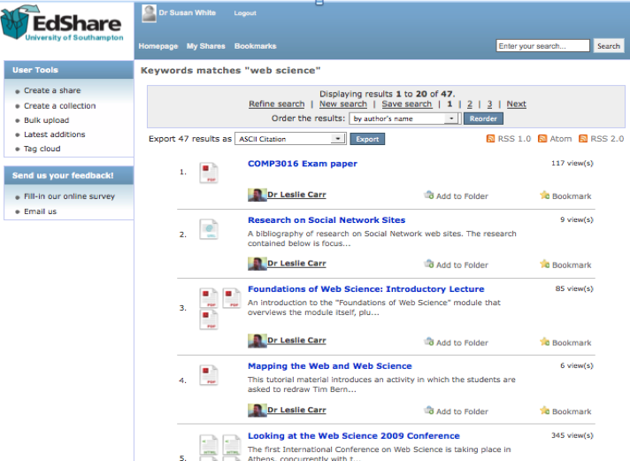
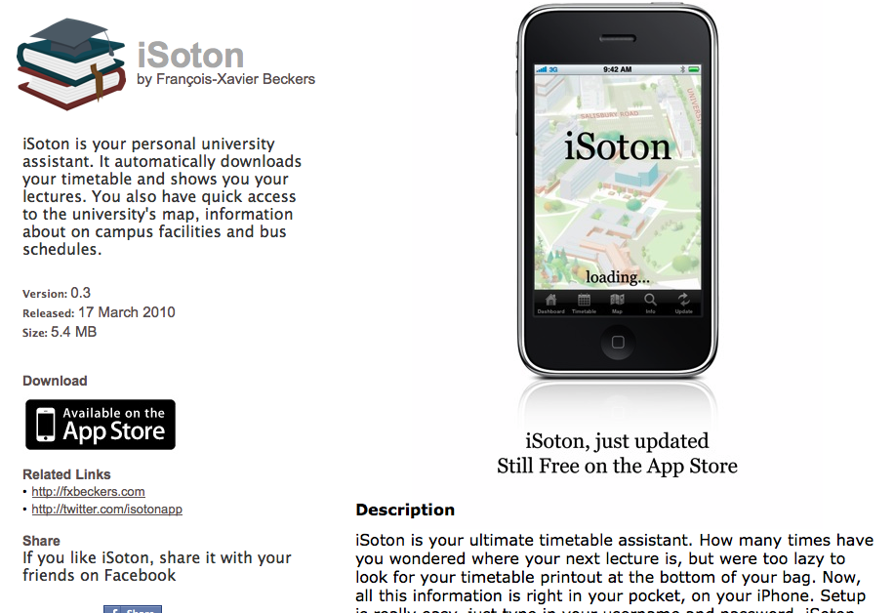
Example collected aspects
Incorporated principles
Aggregation
Personalisation
Customisation
Linked data
Open data
Web 2.0 world
Notes:
We have proof of concept developments which are home grown demonstrators
We also seek to learn from the achievement of others

Slide 17
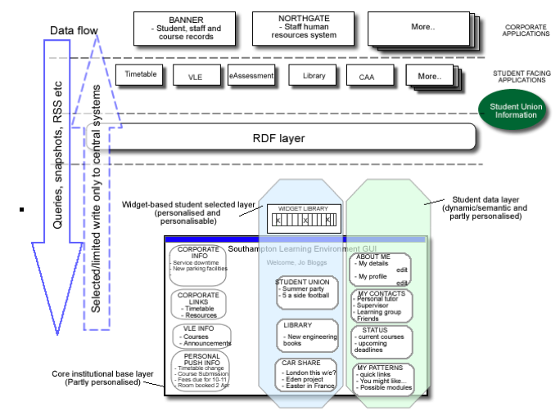
Notes:
We seek funding from lots of places, here is the technical (back on an envelope translated into system diagram) which was used to underpin a recently successful JISC bid
We have also got student interns, project students and masters students working on proof of concept apps (and as shown, some students just go and do it!)

Slide 18
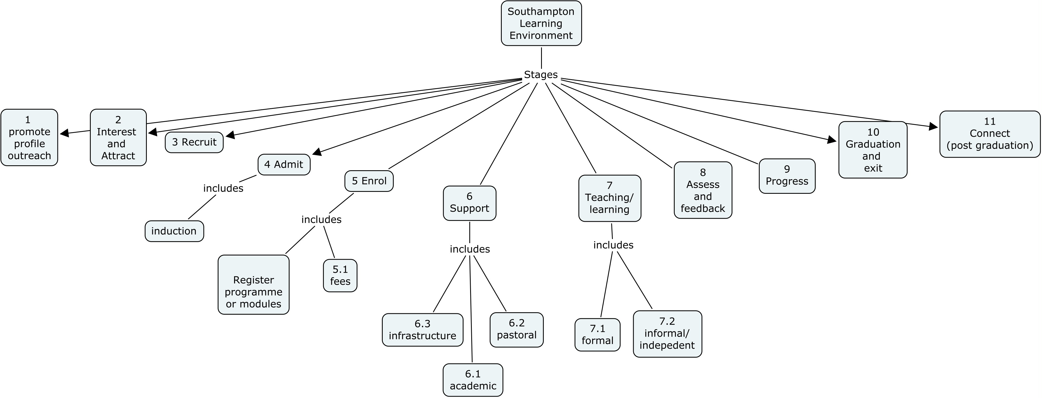
Meeting, talking, making, talking
SLE group meetings
CIP boards
TEL-SIG
Coffee room discussions
Making and using our tools
Notes:
Some of the output from meetings
Post-its, flip charts, talk, slides, videos – need links for future – go see the blog site

Slide 19
We found
We said
SLE group meetings
CIP boards
TEL-SIG
Coffee room discussions
Making and using our tools
Led by colleagues with commitment, knowledge (and backup teams)
Massive investment in term of time
Technical vision which has been sold to the institution
But we will still have to do a great deal of work
Our strongest card is the range of folk we have involved and high level commitment
Drip funding internal and external to help and develop
Proof of concept development
Successful negotiation requires compromise between formal approaches and the informal and personal
Trust
Notes:
You can frame this formally against the literature on innovation
We have multi role teams, working collaboratively but as with learning this is about time on task and personal investment

Slide 20
Thank You ☺
Su White
Learning Societies Lab
Electronics and Computer Science
University of Southampton
saw@ecs.soton.ac.uk
http://www.ecs.soton.ac.uk/~saw/
http://twitter.com/suukii
http://delicious.com/suukii
http://shirleyknot.blogspot.com/

Slide 21
Creative commons attribution non-commercial share alike

Slide 22
Selected references
Attwell, G. (2007). "Personal Learning Environments – the future of eLearning? eLearning papers Vol. 2, http://www.elearningpapers.eu/index.php? last accessed June 2010." E-Learning Papers 2(1).
Bradwell, P. (2009). The Edgeless University: Why higher education must embrace technology. London, Demos.
Conole, G., M. d. Laat, et al. (2006). JISC LXP student experiences of technologies final report. Bristol, HEFCE.
Downes, S. (2005). "E-learning 2.0 " eLearn 2005(10 http://www.elearnmag.org/subpage.cfm?article=29-1&section=articles last accessed June 2010).
Gaver, W. W. (1991). Technology affordances. Proceedings of the SIGCHI conference on Human factors in computing systems: Reaching through technology, New Orleans, ACM Press.
Gaver, W. W. (1996). "Situating Action ii: Affordances for interaction: The social is material for design." Ecological Psychology 8: 111-130.
JISC (2007). A report on the JISC CETIS PLE project. available online at http://wiki.cetis.ac.uk/Ple/Report last accessed Jume 2010.
Jonassen, D. H., T. Mayes, et al. (1993). A manifesto for a constructivist approach to uses of technology in higher education. Designing environments for constructive learning. T. M. Duffy, J. Lowyck and D. H. Jonassen. Heidelberg, Springer-Verlag.: 231-247.
Marshall, S. and G. Mitchell (2006). Assessing sector e-learning capability with an e-learning maturity model. ALT-C Association for Learning Technologies Conference, Edinburgh, UK.
O'Reilly, T. (2005). "What Is Web 2.0 – Design Patterns and Business Models for the Next Generation of Software http://oreilly.com/web2/archive/what-is-web-20.html."
O'Reilly, T. ( 2007). "What is Web 2.0: Design Patterns and Business Models for the Next Generation of Software http://papers.ssrn.com/sol3/papers.cfm?abstract_id=1008839 last accessed June 2010." Communications & Strategies 1(First Quarter 2007): 17.
Olivier, B. and O. Liber (2002). Lifelong learning: the need for portable personal learning environments and supporting interoperability standards SSGRR 2002w International Conference on Advances in Infrastructure for Electronic Business, Education, Science and Medicine on the Internet, L'Aquilla, Italy http://ssgrr2002w.atspace.com/papers/14.pdf last accessed June 2010.
Shirky, C. (2003). A group is its own worst enemy. Clay Shirky's Writings About the Internet: Economics & Culture, Media & Community, Open Source, shirkey.com. 2010 http://www.shirky.com/writings/group_enemy.html last accessed June 2010.
Tiropanis, T., H. Davis, et al. (2009). Semantic Technologies in Learning and Teaching (SemTech) - JISC Report. Bristol.
Van Harmelen, M. (2006). Personal Learning Environments. 6th International Conference on Advanced Learning Technologies (ICALT'06). Kerkrade, Netherlands, IEEE.
Wenger, E. (1998). Communities of Practice: Learning, Meaning and Identity, Cambridge University Press.
White, S. (1993). Scholar - A campus wide structure for Multimedia Learning. AETT Annual Conference: Designing for Learning, Jordanhill Campus, University of Strathclyde, Glasgow, Kogan Page.
White, S. and H. C. Davis (2008). eMM Benchmarking at Southampton:the carpet, observations and reflections. Technical Report LSL-EL-0108, ECS, University of Southampton.
White, S. A. (2006). Higher Education and Learning Technologies: An Organisational Perspective. Electronics and Computer Science. Southampton, UK, University of Southampton. PhD.
/
Notes:
Time flies. It's actually almost 20 years ago when I wanted to reframe the way we use information, the way we work together -- I invented the World Wide Web. Now, 20 years on, at TED, I want to ask your help in a new reframing.
So, going back to 1989, I wrote a memo suggesting the global hypertext system. Nobody really did anything with it, pretty much. But, 18 months later -- this is how innovation happens -- 18 months later, my boss said I could do it on the side, as a sort of a play project, kick the tires of a new computer we'd got. And so he gave me the time to code it up. So I basically roughed out what HTML should look like, hypertext protocol -- HTTP -- the idea of URLs -- these names for things which started with HTTP. I wrote the code and put it out there.
Why did I do it? Well, it was basically frustration. I was frustrated -- I was working as a software engineer in this huge, very exciting lab, lots of people coming from all over the world. They brought all sorts of different computers with them. They had all sorts of different data formats. All sorts, all kinds of documentation systems. So that, in all that diversity, if I wanted to figure out how to build something out of a bit of this and a bit of this, everything I looked into, I had to connect to some new machine, I had to learn to run some new program, I would find the information I wanted in some new data format. And these were all incompatible. It was just very frustrating. The frustration was all this unlocked potential.
In fact, on all these discs there were documents. So if you just imagined them all being part of some big, virtual documentation system in the sky, say on the Internet, then life would be so much easier. Well, once you've had an idea like that it kind of gets under your skin and even if people don't read your memo -- actually he did, it was found after he died, his copy. He had written, "Vague, but exciting," in pencil, in the corner.
(Laughter)
But in general it was difficult -- it was really difficult to explain what the web was like. It's difficult to explain to people now that it was difficult then. But then -- OK, when TED started, there was no web so things like click didn't have the same meaning. I can show somebody a piece of hypertext, a page which has got links, and we click on the link and bing -- there'll be another hypertext page. Not impressive. You know, we've seen that -- we've got things on hypertext on CD-ROMs. What was difficult was to get them to imagine So, imagine that that link could have gone to virtually any document you could imagine. Alright, that is the leap that was very difficult for people to make. Well, some people did. Though yeah, it was difficult to explain, but there was a grassroots movement. And that is what has made it most fun. That has been the most exciting thing, not the technology, not the things people have done with it, but actually the community, the spirit of all these people getting together, sending emails. That's what it was like then.
Do you know what? It's funny, but right now it's kind of like that again. I asked everybody, more or less, to put their documents -- I said, "Could you put your documents on this web thing?" And, you did. Thanks. It's been a blast, hasn't it? I mean, it has been quite interesting because we've found out that the things that happen with the web really sort of blow us away. They're much more than we'd originally imagined when we put together the initial website that we started off with. Now, I want you to put your data on the web. Turns out that there is still huge unlocked potential. There is still a huge frustration that people have because we haven't got data on the web as data.
What do you mean data? What's the difference -- documents, data? Documents you read, OK? More or less, you read them, you can follow links from them, and that's it. Data -- you can do all kinds of stuff with a computer. Who was here or has otherwise seen Hans Rosling's talk? One of the great -- yes a lot of people have seen it -- one of the great TED Talks. Hans put up this presentation in which he showed, for various different countries, in various different colors -- he showed income levels on one axis and he showed infant mortality, and he shot this thing animated through time. So, he'd taken this data and made a presentation which just shattered a lot of myths that people had about the economics in the developing world.
He put up a slide a little bit like this. It had underground all the data OK, data is brown and boxy and boring, and that's how we think of it, isn't it? Because data you can't naturally use by itself But in fact, data drives a huge amount of what happens in our lives and it happen because somebody takes that data and does something with it. In this case, Hans had put the data together he had found it from all kinds of United Nations websites and things. He had put it together, combined it into something more interesting than the original pieces and then he'd put it into this software, which I think his son developed, originally, and produces this wonderful presentation. And Hans made a point of saying, "Look, it's really important to have a lot of data." And I was happy to see that at the party last night that he was still saying, very forcibly, "It's really important to have a lot of data."
So I want us now to think about not just two pieces of data being connected, or six like he did, but I want to think about a world where everybody has put data on the web and so virtually everything you can imagine is on the web. and then calling that linked data. The technology is linked data, and it's extremely simple. If you want to put something on the web there are three rules: first thing is that those HTTP names -- those things that start with "http:" -- we're using them not just for documents now, we're using them for things that the documents are about. We're using them for people, we're using them for places, we're using them for your products, we're using them for events. All kinds of conceptual things, they have names now that start with HTTP.
Second rule, if I take one of these HTTP names and I look it up and I do the web thing with it and I fetch the data using the HTTP protocol from the web, I will get back some data in a standard format which is kind of useful data that somebody might like to know about that thing, about that event. Who's at the event? Whatever it is about that person, where they were born, things like that. So the second rule is I get important information back.
Third rule is that when I get back that information it's not just got somebody's height and weight and when they were born, it's got relationships. Data is relationships. Interestingly, data is relationships. This person was born in Berlin, Berlin is Germany. And when it has relationships, whenever it expresses a relationship then the other thing that it's related to is given one of those names that starts HTTP. So, I can go ahead and look that thing up. So I look up a person -- I can look up then the city where they were born I can look up the region it's in, and the town it's in, and the population of it, and so on. So I can browse this stuff.
So that's it, really. That is linked data. I wrote an article entitled "Linked Data" a couple of years ago and soon after that, things started to happen. The idea of linked data is that we get lots and lots and lots of these boxes that Hans had, and we get lots and lots and lots of things sprouting. It's not just a whole lot of other plants. It's not just a root supplying a plant, but for each of those plants, whatever it is -- a presentation, an analysis, somebody's looking for patterns in the data -- they get to look at all the data and they get it connected together, And the really important thing about data is the more things you have to connect together, the more powerful it is.
So, linked data. The meme went out there. And, pretty soon Chris Bizer at the Freie Universitat in Berlin who was one of the first people to put interesting things up, he noticed that Wikipedia -- you know Wikipedia, the online encyclopedia with lots and lots of interesting documents in it. Well, in those documents, there are little squares, little boxes. And in most information boxes, there's data. So he wrote a program to take the data, extract it from Wikipedia, and put it into a blob of linked data on the web, which he called dbpedia. Dbpedia is represented by the blue blob in the middle of this slide and if you actually go and look up Berlin, you'll find that there are other blobs of data which also have stuff about Berlin, and they're linked together. So if you pull the data from dbpedia about Berlin, you'll end up pulling up these other things as well. And the exciting thing is it's starting to grow. This is just the grassroots stuff again, OK?
Let's think about data for a bit. Data comes in fact in lots and lots of different forms Think of the diversity of the web, it's a really important thing that the web allows you to put all kinds of data up there. So it is with data. I could talk about all kinds of data. We could talk about government data, enterprise data is really important, there's scientific data, there's personal data, there's weather data, there's about events, there's data about talks, and there's news and all kinds of stuff. I'm just going to mention a few of them so that you get the idea of the diversity of it, so that you also see how much unlocked potential.
Let's start with government data. Barack Obama said, in a speech, that he -- American government data would be available on the Internet in accessible formats. And I hope that they will put it up as linked data. That's important. Why is it important? Not just for transparency, yeah transparency in government is important, but that data -- this is the data from all the government departments Think about how much of that data is about how life is lived in America. It's actual useful. It's got value. I can use it in my company. I could use it as a kid to do my homework. So we're talking about making the world run better by making this data available.
In fact if you're responsible -- if you know about some data in a government department, often you find that these people, they're very tempted to keep it -- Hans calls it database hugging. You hug your database, you don't want to let it go until you've made a beautiful website for it. Well, I'd like to suggest that rather -- yes, make a beautiful website, who am I to say don't make a beautiful website? Make a beautiful website, but first give us the unadulterated data, we want the data. We want unadulterated data. OK, we have to ask for raw data now. And I'm going to ask you to practice that, OK? Say "raw."
Audience: Raw.
Tim Berners-Lee: Can you say "data"?
Audience: Data.
TBL: Can you say "now"?
Audience: Now!
TBL: Alright, raw data now!
Audience: Raw data now!
Practice that. It's important because you have no idea the number of excuses people come up with to hang onto their data and not give it to you, even though you've paid for it as a taxpayer. And it's not just America. It's all over the world. And it's not just governments, of course -- it's enterprises as well.
So I'm just going to mention a few other thoughts on data. Here we are at TED, and all the time we are very conscious of the huge challenges that human society has right now -- curing cancer, understanding the brain for Alzheimer's, understanding the economy to make it a little bit more stable, understanding how the world works. The people who are going to solve those -- the scientists -- they have half-formed ideas in their head, they try to communicate those over the web. But a lot of the state of knowledge of the human race at the moment is on databases, often sitting in their computers, and actually, currently not shared.
In fact, I'll just go into one area -- if you're looking at Alzheimer's, for example, drug discovery -- there is a whole lot of linked data which is just coming out because scientists in that field realize this is a great way of getting out of those silos, because they had their genomics data in one database in one building, and they had their protein data in another. Now, they are sticking it onto it -- linked data -- and now they can ask the sort of question, that you probably wouldn't ask, I wouldn't ask -- they would. What proteins are involved in signal transduction and also related to pyramidal neurons? Well, you take that mouthful and you put it into Google. Of course, there's no page on the web which has answered that question because nobody has asked that question before. You get 223,000 hits -- no results you can use. You ask the linked data -- which they've now put together -- 32 hits, each of which is a protein which has those properties and you can look at. The power of being able to ask those questions, as a scientist -- questions which actually bridge across different disciplines -- is really a complete C-change. It's very very important. Scientists are totally stymied at the moment -- the power of the data that other scientists have collected is locked up and we need to get it unlocked so we can tackle those huge problems.
Now if I go on like this, you'll think that all the data comes from huge institutions and has nothing to do with you. But, that's not true. In fact, data is about our lives. You just -- you log on to your social networking site, your favorite one, you say, "This is my friend." Bing! Relationship. Data. You say, "This photograph, it's about -- it depicts this person. " Bing! That's data. Data, data, data. Every time you do things on the social networking site, the social networking site is taking data and using it -- re-purposing it -- and using it to make other people's lives more interesting on the site. But, when you go to another linked data site -- and let's say this is one about travel, and you say, "I want to send this photo to all the people in that group," you can't get over the walls. The Economist wrote an article about it, and lots of people have blogged about it -- tremendous frustration. The way to break down the silos is to get inter-operability between social networking sites. We need to do that with linked data.
One last type of data I'll talk about, maybe it's the most exciting. Before I came down here, I looked it up on OpenStreetMap The OpenStreetMap's a map, but it's also a Wiki. Zoom in and that square thing is a theater -- which we're in right now -- The Terrace Theater. It didn't have a name on it. So I could go into edit mode, I could select the theater, I could add down at the bottom the name, and I could save it back. And now if you go back to the OpenStreetMap. org, and you find this place, you will find that The Terrace Theater has got a name. I did that. Me! I did that to the map. I just did that! I put that up on there. Hey, you know what? If I -- that street map is all about everybody doing their bit and it creates an incredible resource because everybody else does theirs. And that is what linked data is all about. It's about people doing their bit to produce a little bit, and it all connecting. That's how linked data works. You do your bit. Everybody else does theirs. You may not have lots of data which you have yourself to put on there but you know to demand it. And we've practiced that.
So, linked data -- it's huge. I've only told you a very small number of things There are data in every aspect of our lives, every aspect of work and pleasure, and it's not just about the number of places where data comes, it's about connecting it together. And when you connect data together, you get power in a way that doesn't happen just with the web, with documents. You get this really huge power out of it. So, we're at the stage now where we have to do this -- the people who think it's a great idea. And all the people -- and I think there's a lot of people at TED who do things because -- even though there's not an immediate return on the investment because it will only really pay off when everybody else has done it -- they'll do it because they're the sort of person who just does things which would be good if everybody else did them. OK, so it's called linked data. I want you to make it. I want you to demand it. And I think it's an idea worth spreading.
Thanks.
(Applause)

