Slide 1
Open Access repositories
Alma Swan
Key Perspectives Ltd, Truro, UK and
EPrints, School of Electronics & Computer Science, University of Southampton, UK
Biodiversity International Conference, Rome, 7 July 2010

Slide 2
Open Access repositories
Digital collections
Most usually institutional
Sometimes centralised (subject-based)
Interoperable
Form a network across the world
Create a global database of openly-accessible research
Currently >1600
Key Perspectives Ltd

Slide 3
Where repositories are
Total at March 2010: 1625
Key Perspectives Ltd

Slide 4
What they contain
Key Perspectives Ltd

Slide 5
A well-filled repository
Key Perspectives Ltd

Slide 6
And it gets used
Key Perspectives Ltd

Slide 7
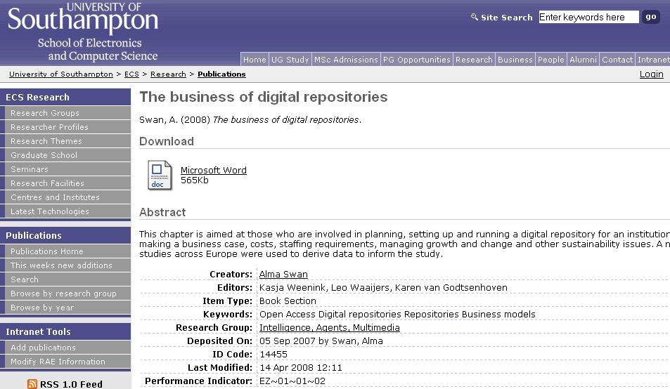
Key Perspectives Ltd
Notes:
7

Slide 8
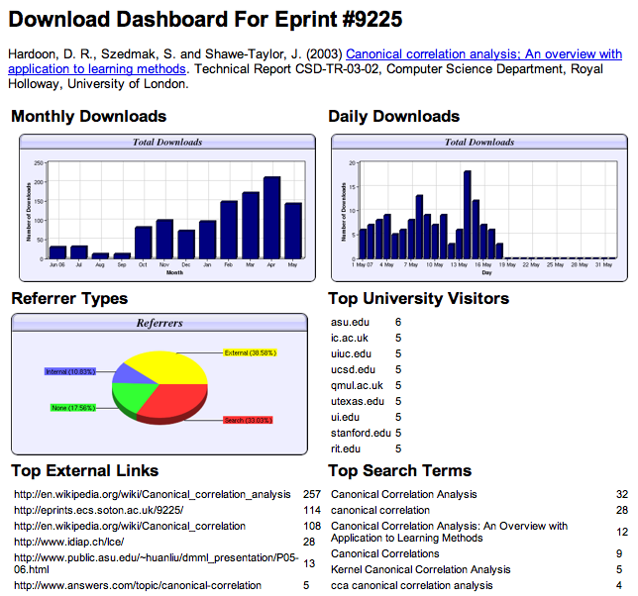

Slide 9
Download timelines
Key Perspectives Ltd

Slide 10
Referrers
Key Perspectives Ltd

Slide 11
Links and search terms
Key Perspectives Ltd

Slide 12
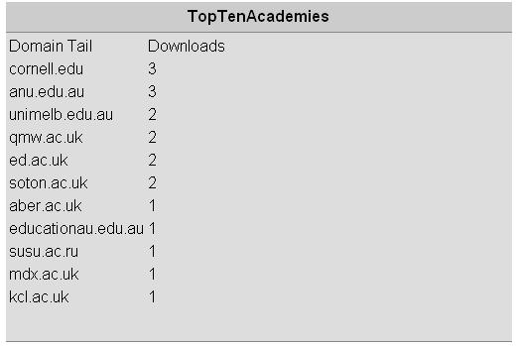
N.B. Downloads are a good predictor of eventual citations
Key Perspectives Ltd
Notes:
12

Slide 13
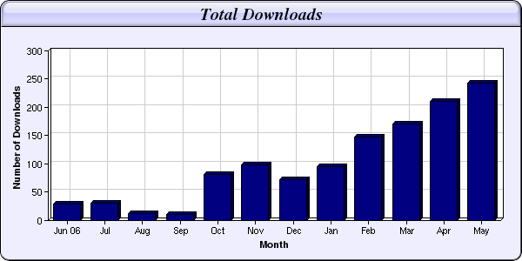
Every e-print tells a story…
Link placed on “Canonical correlation” page in Wikipedia
NIPS Workshop linked to this eprint from its web page
Key Perspectives Ltd

Slide 14
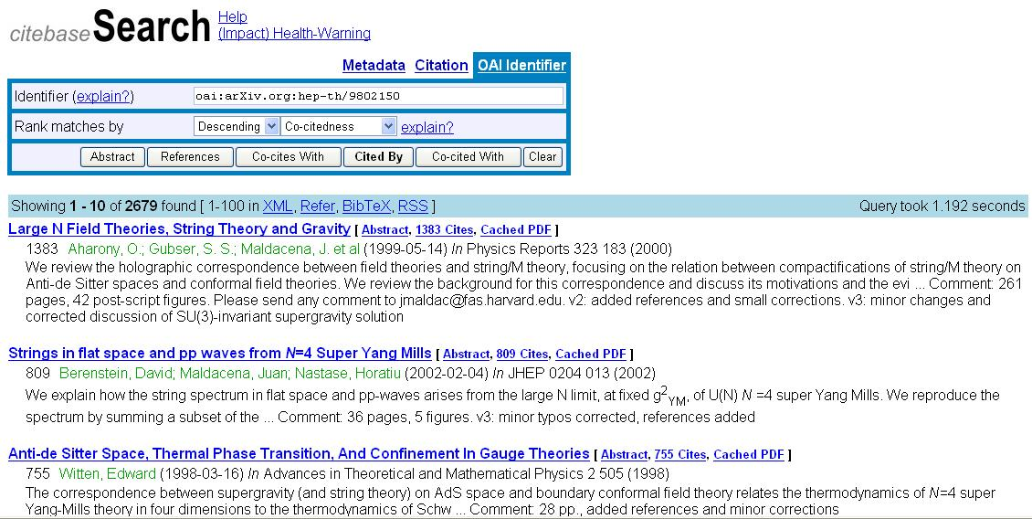
CiteBase
Key Perspectives Ltd

Slide 15
Key Perspectives Ltd

Slide 16
Business issues
Clear mission for the repository
Assess resources: human, financial, temporal
What can you do in-house? What might you need/want to outsource?
Who do you need to persuade?
Build a business case:
Cost/benefit
Trends analysis and competitor appraisal
Champion if possible
Key Perspectives Ltd

Slide 17
EPrints Services
Open source software, free to download: works out of the box
Training courses
Repository build
Repository build-and-host
Hosting
Bespoke consultancy
Key Perspectives Ltd

Slide 18
Resources
1. General, comprehensive resource on Open Access:
OASIS
(Open Access Scholarly Information Sourcebook)
www.openoasis.org
2. Resource for policymakers, institutional managers:
EOS
(Enabling Open Scholarship)
www.openscholarship.org
Key Perspectives Ltd

Slide 19
Thank you for listening
aswan@keyperspectives.co.uk
www.keyperspectives.co.uk
www.keyperspectives.com
Key Perspectives Ltd

