Slide 1
Economic modelling of Open access for individual institutions
Alma Swan
Key Perspectives Ltd
Truro, UK

Slide 2
Economic implications of OA for the UK
John Houghton and colleagues (2009)
Identified the activities in the scholarly communication system
Attached costs to each, and thus to the system
Modelled the economic benefits of 3 new, alternative scholcomm scenarios
Key Perspectives Ltd

Slide 3
Scholarly communication process
Key Perspectives Ltd

Slide 4
‘Houghton Model’
Available to download online
Anyone can use their own data to populate it
Models three alternative Open Access communication scenarios (plus other scholarly communication-related issues)
Key Perspectives Ltd

Slide 5
Three scholarly communication scenarios
Self-archiving in repositories (‘Green’ Open Access)
  In parallel with subscription journals
  Instead of subscription journals, via repositories with overlay services
Open Access journals (‘Gold’ Open Access publishing)
Key Perspectives Ltd

Slide 6
Rationales and assumptions
Obvious direct cost savings (subscriptions, ILL, PPV)
Open Access makes it easier to find and retrieve the material a researcher needs to:
  READ
  WRITE papers
  Carry out PEER REVIEW work
Open Access obviates the need to spend time seeking permissions or dealing with copyright and licensing issues
etc
Key Perspectives Ltd

Slide 7
The national picture
(Houghton et al, 2009)
Overall cost of scholarly communication in the UK is £5 billion per annum
Savings from moving from subscription journal publishing to Open Access journal publishing: £80m per annum
Savings from moving from subscription journal publishing to Open Access provided through university repositories: £115m per annum
Key Perspectives Ltd

Slide 8
Universities differ
Do things differently in libraries
Buy journals in different ways
Run more or less elaborate repositories
Employ different numbers of people
Pay people different salaries
Key Perspectives Ltd

Slide 9
Data required: research-related
Research income per annum (institution)
Number of researchers
Average researcher salary
Publications per annum (institution)
Time spent reading and writing articles
Time spent serving as editors and on editorial boards
Time spent peer reviewing articles
Key Perspectives Ltd

Slide 10
Data required: library-related
Number of subscriptions:
  Print-only
  Electronic-only
  Dual mode
Cost of subscriptions
Handling time for journals/books
Key Perspectives Ltd

Slide 11
Data required: Repository-related data
Operational cost of repository per annum
Time taken to deposit
Average salary of depositor
Number of items produced by the institution per annum
Key Perspectives Ltd

Slide 12
Savings from OA via repositories
£ per annum
Key Perspectives Ltd

Slide 13
Savings from OA via OA journals
Key Perspectives Ltd

Slide 14
University UK:
Annual savings from OA
£ per annum
Key Perspectives Ltd

Slide 15
University UK:
Savings per annum: OA via repositories
£ per annum
Key Perspectives Ltd

Slide 16
University UK:
Savings per annum: OA journals
£ per annum
Key Perspectives Ltd

Slide 17
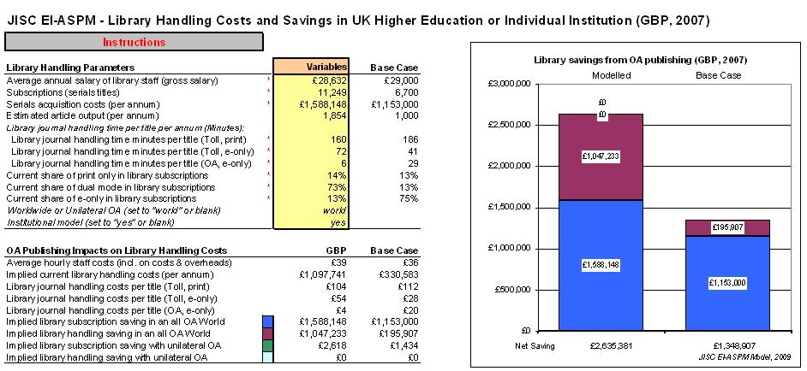
Key Perspectives Ltd

Slide 18
Worksheet 1: modelling data
Key Perspectives Ltd

Slide 19
Worksheet 2: Data for chart
Key Perspectives Ltd

Slide 20
Key Perspectives Ltd

Slide 21
aswan@keyperspectives.co.uk
www.keyperspectives.co.uk
www.openscholarship.org
www.openoasis.org
Key Perspectives Ltd

