Slide 1
Costs and benefits of Open Access to universities and nations: some economic considerations and building the business case
Alma Swan
OASIS
(Open Access Scholarly Information Sourcebook)
www.openoasis.org
www.openOASIS.org

Slide 2
Building a business case
Senior management objectives for research:
Visibility
Foundation for others’ use
Impact should be as great as possible
Not at ANY cost
But managers do cost/benefit analyses in decision-making
Your business case must speak to this
This talk is about the economic argument
You should complement this with the evidence about usage and impact
www.openOASIS.org

Slide 3
Economic implications of OA
John Houghton and colleagues (2009)
Identified the activities in the scholarly communication system
Attached costs to each, and thus to the system
Modelled the economic benefits of new, alternative scholcomm scenarios
Australia, UK, Netherlands, Denmark and US federal agencies
Individual universities (Swan, 2010)
www.openOASIS.org

Slide 4
Scholarly communication process
www.openOASIS.org

Slide 5
The scholarly communication process (Björk, 2007)
Fund R&D and communication
Perform research and communicate results
Publish scientific/scholarly works
Facilitate dissemination, retrieval and preservation
Study publications and apply knowledge
www.openOASIS.org

Slide 6
‘Houghton Model’
Available to download online
Anyone can use their own data to populate it
Models three alternative Open Access communication scenarios (plus other scholarly communication-related issues)
www.openOASIS.org

Slide 7
Three scholarly communication scenarios
Self-archiving in repositories (‘Green’ Open Access)
In parallel with subscription journals
Instead of subscription journals, via repositories with overlay services
Open Access journals (‘Gold’ Open Access publishing)
www.openOASIS.org

Slide 8
Rationales and assumptions
Obvious direct cost savings (subscriptions, ILL, PPV)
Open Access makes it easier to find and retrieve the material a researcher needs to:
READ
WRITE papers
Carry out PEER REVIEW work
Open Access obviates the need to spend time seeking permissions or dealing with copyright and licensing issues
etc (no duplication, blind alleys …)
www.openOASIS.org

Slide 9
National pictures (Houghton et al, 2009, 2010)
Annual € savings from moving to: | UK | Netherlands | Denmark | US federal agencies
OA journals (‘Gold’ OA) | 480 million | 133 million | 70 million | Value of benefit amounts to some 4x to 25x the cost
OA repositories with subscriptions (‘Green’ OA) | 125 million | 50 million | 30 million
OA repositories with overlay services | Circa 480 million | Circa 133 million | Circa 70 million
www.openOASIS.org

Slide 10
Individual universities
Results reported for 4 institutions with research income varying from 2 million GBP to 200 million GBP p.a. (Swan, 2010)
2 further institutions modelled by request
Series of workshops around UK: further c20-25 universities modelled
Why do each university separately?
www.openOASIS.org

Slide 11
Universities differ
Do things differently in libraries
Buy journals in different ways
Run more or less elaborate repositories
Employ different numbers of people
Pay people different salaries
www.openOASIS.org

Slide 12
Savings from OA via repositories
GBP per annum
www.openOASIS.org

Slide 13
Savings from OA via OA journals
www.openOASIS.org

Slide 14
University UK: Annual savings from OA
£ per annum
www.openOASIS.org

Slide 15
University UK: Savings per annum: OA via repositories
£ per annum
www.openOASIS.org

Slide 16
University UK: Savings per annum: OA journals
£ per annum
www.openOASIS.org

Slide 17
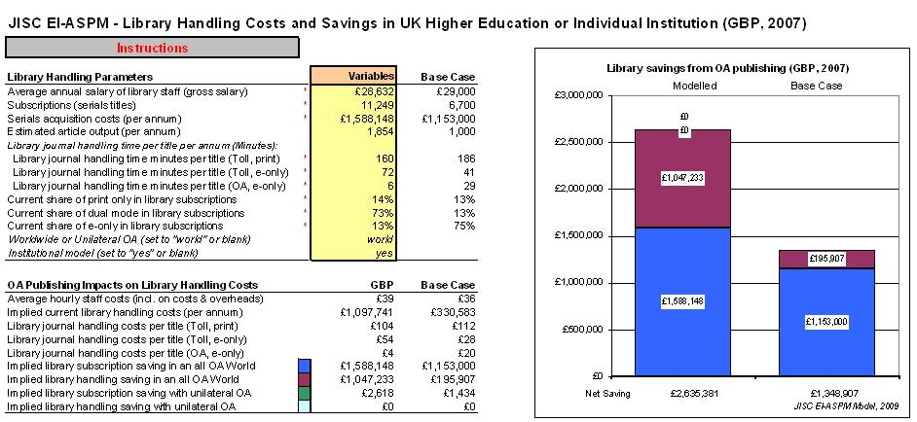
The online model
www.openOASIS.org

Slide 18
www.openOASIS.org

Slide 19
Data required: research-related
Research income per annum (institution)
Number of researchers
Average researcher salary
Publications per annum (institution)
Time spent reading and writing articles
Percentage of researchers serving as editors and on editorial boards
Time spent peer reviewing articles
www.openOASIS.org

Slide 20
Data required: library-related
Number of subscriptions:
Print-only
Electronic-only
Dual mode
Cost of subscriptions
Handling time for journals/books
Average librarian salary
www.openOASIS.org

Slide 21
Data required: Repository-related data
Operational cost of repository per annum
Time taken to deposit
Average salary of depositor
Number of items produced by the institution per annum
www.openOASIS.org

Slide 22
OA Week 2010 offer from OASIS
We will model the benefits for your university
www.openOASIS.org

Slide 23
www.openOASIS.org

Slide 24
OA Week 2010 offer from OASIS
We will model the benefits for your university
But you must provide me with the data needed
We can use default data for certain items
Caveat: default data may not give an absolutely true picture for your institution
www.openOASIS.org

Slide 25
Your side of the bargain …
Quid pro quo: I can use your data (anonymised) to provide examples and to illustrate the principles of the modelling
Conditions:
You provide monetary values all in EUROS
You use this as part of your business case to your institution’s senior management
OASIS shortly to release a paper on economic and other benefits of OA specifically aimed at institutional managers (from EOS: www.openscholarship.org)
www.openOASIS.org

Slide 26
Data required: research-related
Research income per annum (institution)
Number of researchers
Average researcher salary
Publications per annum (institution)
Time spent reading and writing articles
Time spent peer reviewing articles
Percentage of researchers serving as editors and on editorial boards
www.openOASIS.org

Slide 27
Data required: library-related
Number of subscriptions:
Print-only
Electronic-only
Dual mode
Cost of subscriptions
Handling time for journals/books
Average librarian’s salary
www.openOASIS.org

Slide 28
Data required: Repository-related data
Operational cost of repository per annum
Time taken to deposit
Average salary of depositor
Number of items produced by the institution per annum
N.B. If you have no IR, then we can use default values throughout here
www.openOASIS.org

Slide 29
a.swan@talk21.com
www.openoasis.org
www.openscholarship.org
www.keyperspectives.co.uk
www.openOASIS.org

