Slide 1
Open Access to research
Alma Swan
Key Perspectives Ltd
Truro, UK
Open Society Institute Global Supplementary Grant Program Conference, Cambridge UK, 7-9 April 2010

Slide 2
Some context

Slide 3
Why researchers publish their work
Key Perspectives Ltd

Slide 4
The ‘traditional’ system of scholarly communication
Based on print-on-paper
Old business models had to account for dissemination costs of a physical (often heavy) thing (journal issue, book)
... and account for unsold copies
... and for printing those things, etc
The basic model is to charge for access
In the Web Age, access should be free, and new business models should develop to enable that
Key Perspectives Ltd

Slide 5
Key Perspectives Ltd

Slide 6
The system is broken
WHO survey (2000):
56% of research-based institutions in lower-income countries had NO current subscriptions to research journals
Nor had they for the previous 5 years
We will never close the “10/90 gap” unless we change the system
Publicly-funded research should be freely available to the ‘public’
Key Perspectives Ltd

Slide 7
The solution:
Open Access
Key Perspectives Ltd

Slide 8
Open Access
Immediate
Free (to use)
Free (of restrictions)
Access to the peer-reviewed literature (and data)
Not vanity publishing
Not a ‘stick anything up on the Web’ approach
Moving scholarly communication into the Web Age
Key Perspectives Ltd

Slide 9
Open Access: Who benefits?
Researchers
Institutions
National economies
Science and society
Key Perspectives Ltd

Slide 10
Why Open Access
Greater impact from scientific endeavour
More rapid and more efficient progress of science
Novel information-creation using new and advanced technologies
Better assessment, better monitoring, better management of science
Key Perspectives Ltd

Slide 11
Open Access: how
Open Access journals (www.doaj.org)
Open Access repositories
Open Access monographs
Key Perspectives Ltd

Slide 12
Open Access journals
Content available free of charge online
In many cases, free of restrictions on use too
Some charge at the ‘front end’
More than half do not levy a charge at all
Around 4700 of them
Listed in the Directory of Open Access Journals (DOAJ)
Key Perspectives Ltd

Slide 13
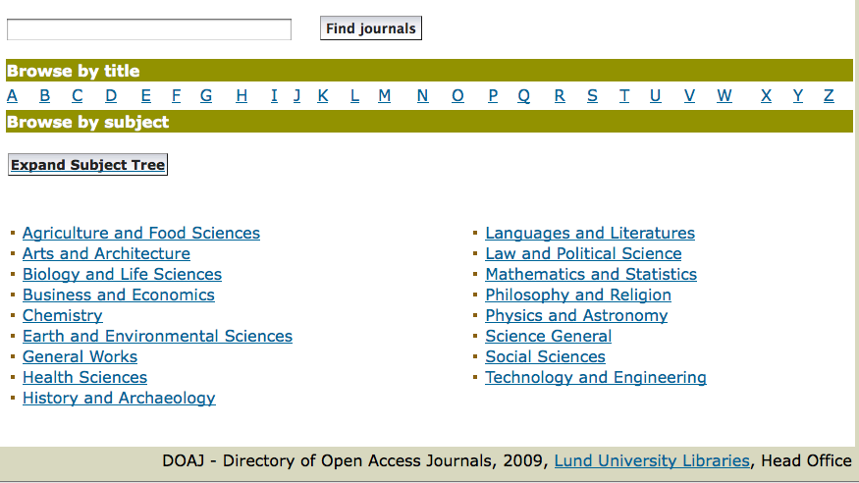
DOAJ categories
Key Perspectives Ltd

Slide 14
Open Access repositories
Digital collections
Most usually institutional
Sometimes centralised (subject-based)
Interoperable
Form a network across the world
Create a global database of openly-accessible research
Currently >1400
Key Perspectives Ltd

Slide 15
Where repositories are
Total at September 2009: 1422
Key Perspectives Ltd

Slide 16

CERN
Key Perspectives Ltd

Slide 17
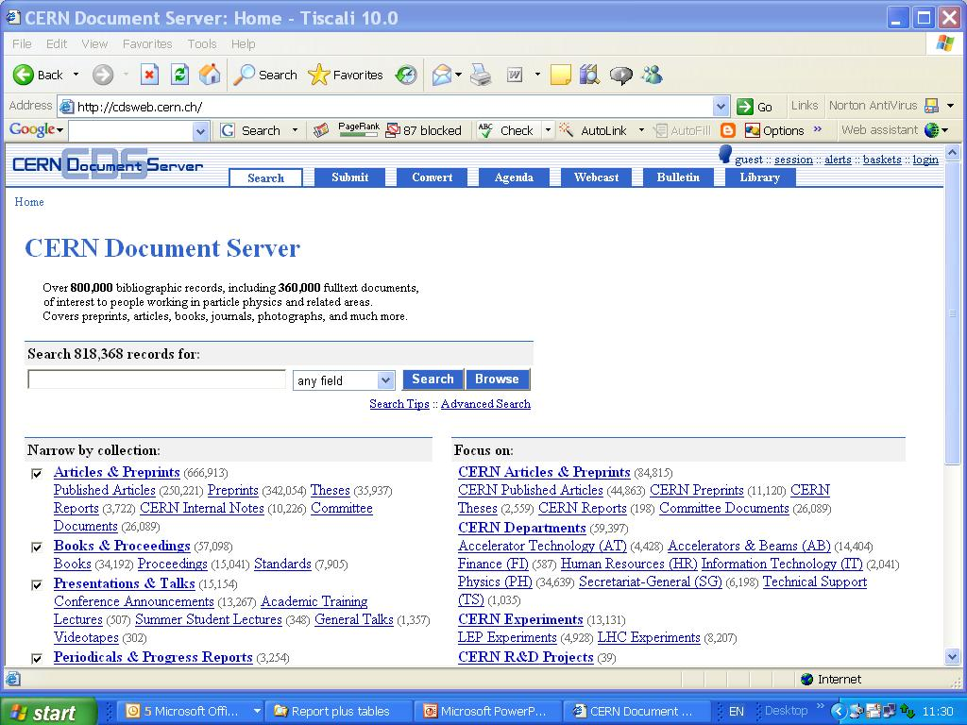
Key Perspectives Ltd

Slide 18
What they contain
Key Perspectives Ltd

Slide 19
A well-filled repository
Key Perspectives Ltd

Slide 20
And it gets used
Key Perspectives Ltd

Slide 21
Visibility: an author’s testimony
“Self-archiving in the PhilSci Archive has given instant world-wide visibility to my work. As a result, I was invited to submit papers to refereed international conferences/journals and got them accepted.”
Key Perspectives Ltd

Slide 22
An institutional repository provides researchers with:
The means to disseminate their work, free, to the world
Secure storage (for completed work and for work-in-progress)
A location for supporting data that are unpublished
One-input-many outputs (CVs, publications)
Tool for research assessment
Personal marketing tool
The route to maximal visibility and impact for their work
Key Perspectives Ltd

Slide 23
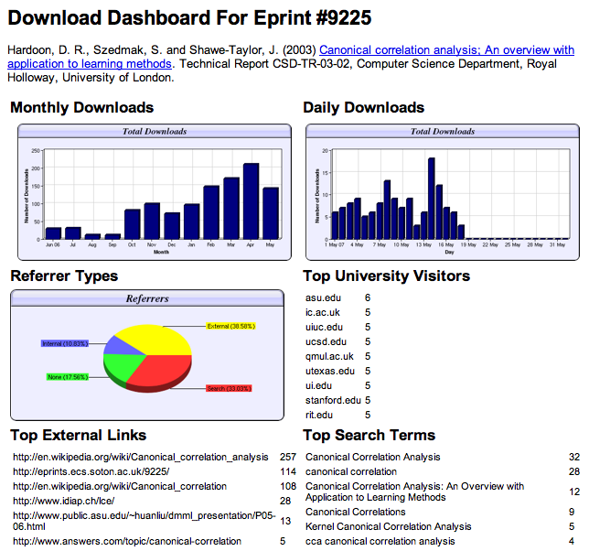

Slide 24
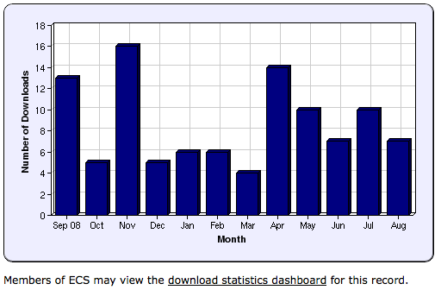
Key Perspectives Ltd
Notes:
24

Slide 25
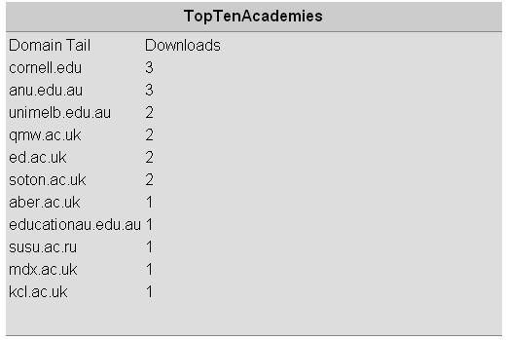
N.B. Downloads are a good predictor of eventual citations
Key Perspectives Ltd
Notes:
25

Slide 26
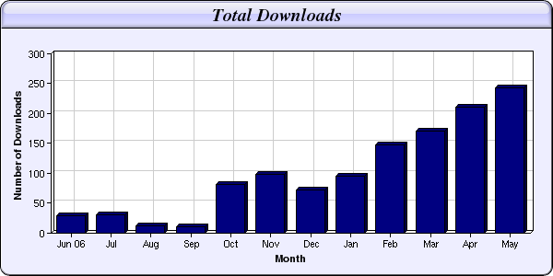
Every e-print tells a story…
Link placed on “Canonical correlation” page in Wikipedia
NIPS Workshop linked to this eprint from its web page
Key Perspectives Ltd

Slide 27
Impact
Range = 36%-200%
(Data: Stevan Harnad and co-workers)
Key Perspectives Ltd

Slide 28
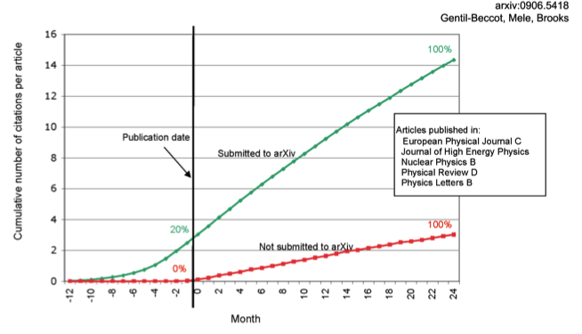
The early bird …
Key Perspectives Ltd

Slide 29
Engineering
Citations
Data: Gargouri & Harnad, 2010
Key Perspectives Ltd

Slide 30
Clinical medicine
Citations
Data: Gargouri & Harnad, 2010
Key Perspectives Ltd

Slide 31
Social science
Citations
Data: Gargouri & Harnad, 2010
Key Perspectives Ltd

Slide 32
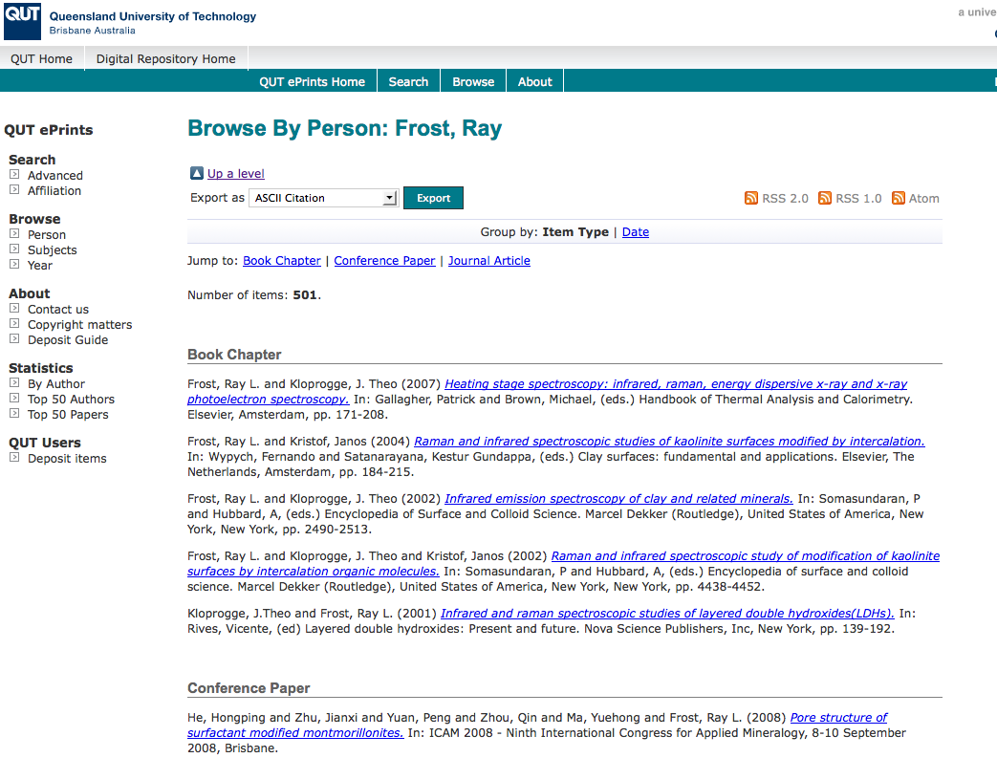
What OA means to a researcher
OpenScholarship.org

Slide 33
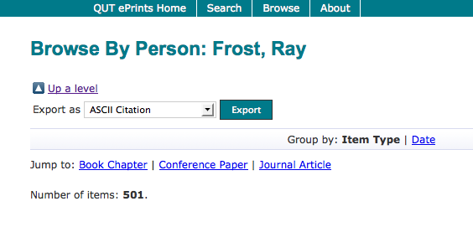
Key Perspectives Ltd

Slide 34
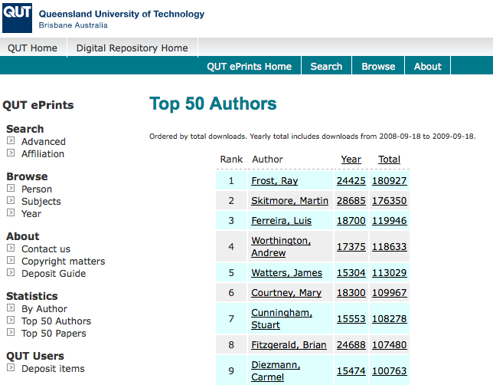
Key Perspectives Ltd

Slide 35
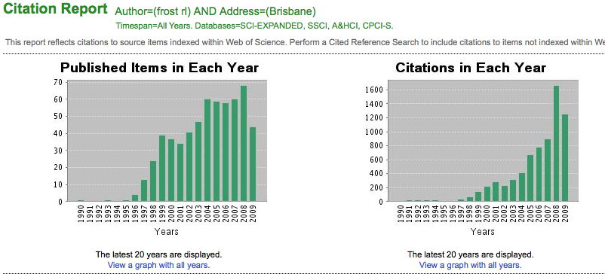
Ray Frost’s impact
Key Perspectives Ltd

Slide 36
Martin Skitmore
(Urban Design)
Key Perspectives Ltd

Slide 37
Luis Ferreira
(Civil Engineering)
Key Perspectives Ltd

Slide 38
Andrew Worthington
(Economics & Finance)
Key Perspectives Ltd

Slide 39
Binh Pham
(Information technology)
Key Perspectives Ltd

Slide 40
How to make your work
Open Access through a repository
Prepare your paper and submit it to your journal of choice for peer review
Make any changes required as a result of the peer review process
Submit the final version to the journal
Deposit that same final version to your repository through the normal deposit procedure that applies in your institution
N.B. Your repository staff may check journal copyright conditions on your behalf, or you may do so yourself using the SHERPA RoMEO service at http://www.sherpa.ac.uk/romeo/
Key Perspectives Ltd

Slide 41
Publisher permissions
Key Perspectives Ltd

Slide 42
Publisher permissions
Key Perspectives Ltd

Slide 43
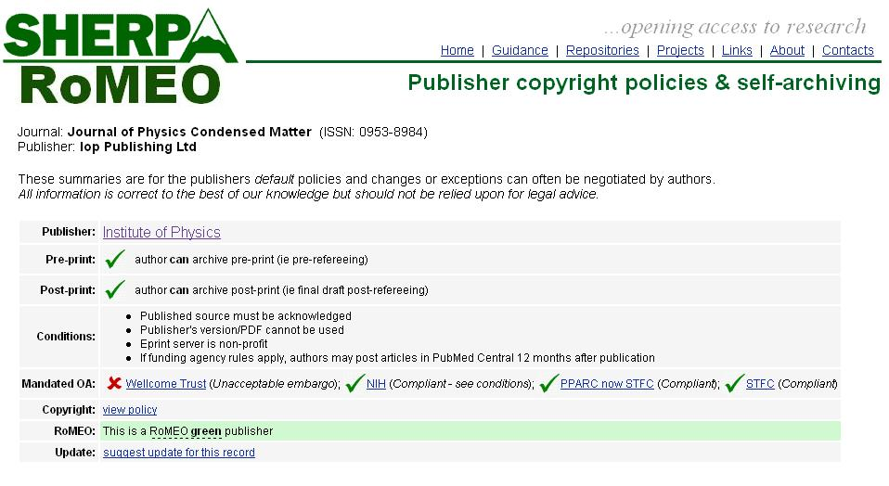
Key Perspectives Ltd

Slide 44
Where?
In your university’s repository
In The Depot if your university does not have a repository
http://www.depot.edina.ac.uk/
Repository space for those without an institutional repository
A re-direct service to a more appropriate resource if available
Key Perspectives Ltd

Slide 45
An institutional repository …
Fulfils a university’s mission to engender, encourage and disseminate scholarly work
Complete record of its intellectual effort
Permanent record of all digital output
Research management tool
Marketing tool for universities
Provides maximum Web impact for the institution
Key Perspectives Ltd

Slide 46
Open Access policies
Key Perspectives Ltd

Slide 47
Daniel Coit Gilman
First President, Johns Hopkins University
It is one of the noblest duties of a university to advance knowledge and to diffuse it, not merely among those who can attend the daily lectures, but far and wide.
Key Perspectives Ltd

Slide 48
Thank you for listening
aswan@keyperspectives.co.uk
www.keyperspectives.co.uk
www.openoasis.org
Key Perspectives Ltd

