Slide 1
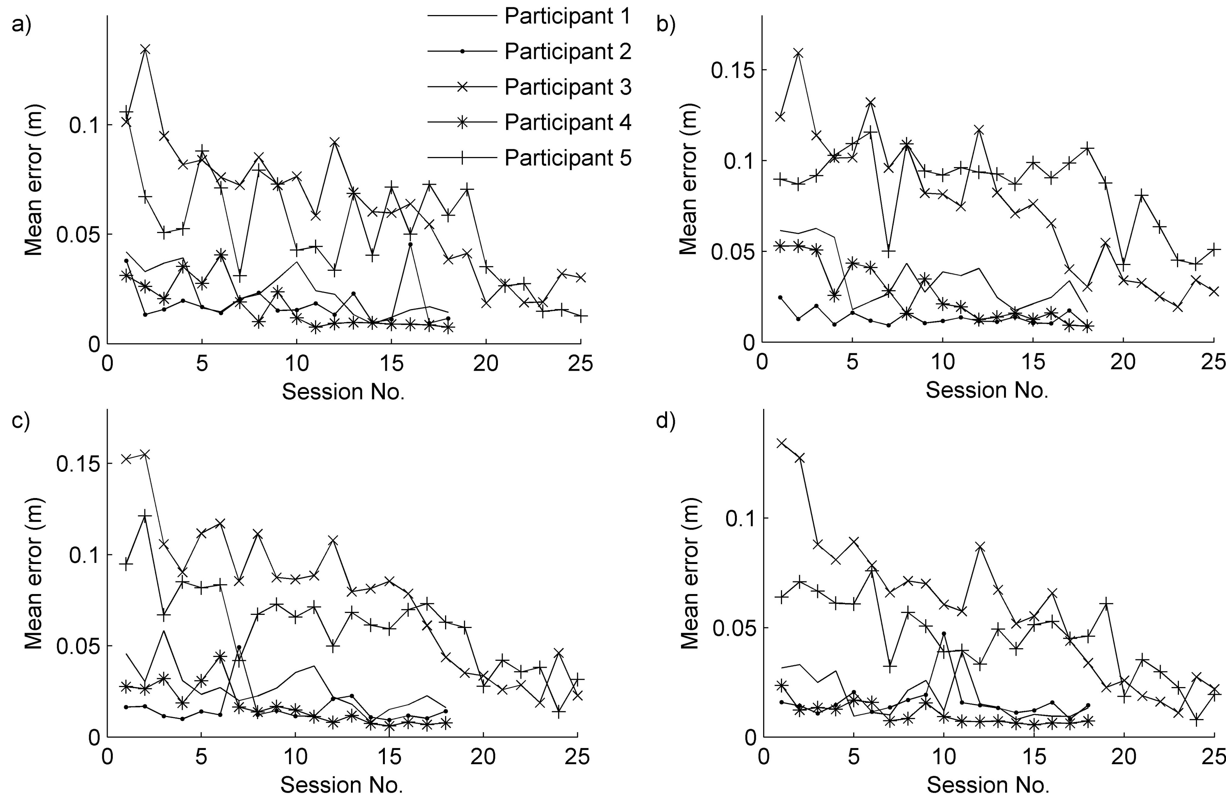



Stroke Rehabilitation using Learning Control Mediated by Electrical Stimulation
Meadmore K L¹, Hughes A-M², Cai Z¹, Tong D¹, Freeman C T¹, Burridge J H², Rogers E¹
¹School of Electronics and Computer Science, ² School of Health Sciences, University of Southampton, UK, SO17 1BJ
Introduction
Many people have problems with using their arm after a stroke, which can affect their ability to perform activities like reaching out to pick an object up. In recent years, use of robots and electrical stimulation (ES) of muscles have been used to help with these problems.^{1, 2, 3} Effectiveness improves when ES is associated with a voluntary attempt to move the limb².
We have developed a new system which uses ES and robot technologies in conjunction with a technique called “Iterative Learning Control” (ILC) to help people recover movement in their arm^{4, 5}. Our system i) controls the applied ES so that the performance of a task improves with repeated attempts, and ii) encourages and supports voluntary effort by the participant, supplying just enough ES to achieve the movement.
The aim of the study reported below was to investigate whether ILC mediated by ES can facilitate reaching movements in participants with stroke.
Results
Changes in Unassisted Tracking Performance: As shown in Figure 1, for each participant the change in tracking error decreased over time.
Figure 1. Mean changes in error in unassisted tracking task
Table 3. Slopes for changes in mean error scores
Clinical Outcomes: A significant improvement was found for the FMA (see Table 4); however, as the difference did not reach a change of 10%, the improvement was not clinically relevant. There was no difference in baseline and post-treatment scores for the ARAT (see Table 4).
Table 4 Clinical scores at pre- and post-treatment sessions
Method
Participants: 5 hemiparetic participants, at least 6 months after stroke, with reduced upper limb function.
Table 1. Participant characteristics.
Design and Procedure: Participants attended two pre-treatment assessment sessions, 18 (or 25) treatment sessions and one post-treatment assessment session. This was conducted over a 6 week period.
Tracking Tasks: Participants held a pillar attached to an elliptical disk located directly above the hand. A target area defined by a circle of LEDS with a central crosshair was marked on the disk. A red dot was projected onto the disk and participants were asked to move their arm to track the slowing moving dot of light by keeping the dot within the circle of LEDs, and as close to the cross hair as possible. To reinforce good performance and indicate error the LEDs changed colour.
Green = error < 25 mm; Amber = error 25-50 mm; Red = error > 50 mm
There were 27 different trajectories that could be tracked. These were made up made up of 1 of 3 angles, 1 of 3 lengths and 1 of 3 durations that differed in difficulty:
Table 2. Variables making the 27 tracking trajectories
Assessments: For the 2 pre- and 1 post-treatment assessments, participants completed two clinical tests:
1. Action Research Arm Test (ARAT) 2. Fugl-Meyer Assessment (FMA)
At the beginning and end of each treatment session, participants were required to complete four unassisted (i.e., without any ES) tracking tasks:
T1SS 2. T1MS 3. T2SS 4. T2MS
Treatment Sessions: The participants’ arm was supported by the robot and ES was applied to the triceps brachii muscle. The same tracking task was attempted 6 times, with a rest period of 15 seconds. During each rest period, the arm was returned to the starting position, and ILC was used to compute the amount of ES (amplitude and timing) to be applied to the muscle by incorporating data from previous trials of the task. The treatment sessions lasted about 1 hour and the number of tracking tasks was limited only by fatigue.
Mean Age (range) | Gender M:F | Time from Stroke (range) | Stroke type (infraction: Hemorrhage) | Side of Hemiparesis (L:R)
52 years (38-77) | 3:2 | 4 years (.7-8.4) | 2:2* *1 = unknown | 2:3
Thus, participants improved in tracking performance over time. This was statistically significant in 3 of the 4 tracking tasks assessed (see Table 3).
Trajectory | Mean slope | p - value (95% CI)
a = T1SS | -3.302 | .03 (-0.0033, -0.0003) *
b = T1MS | -3.165 | .03 (.0044, -.0000) *
c = T2SS | -2.270 | .05 (-.0043, -.0000) *
d = T2MS | -2.821 | .09 (-.00035, .0003)
Test | Pre-treatment Mean (SD) | Post-treatment Mean (SD) | Change (SD) | p - value (95% CI)
ARAT | 4.00 (1.46) | 3.40 (0.55) | -0.60 (1.19) | .32 (.88, -2.08)
FMA | 12.90 (3.36) | 15.40 (4.28) | 2.50 (1.58) | .02 (4.46, 0.54)
Angle | Length | Duration
T1 (20º internal rotation) | Short (S: 80% of max reach) | Slow (S: 15 s)
T2 (midline) | Medium (M: 90% of max reach) | Medium (M: 10 s)
T3 (20º external rotation) | Long (L: 99% of max reach) | Fast (F: 5 s)
Conclusions
Using ILC in conjunction with ES, we found significant changes in unassisted tracking performance and FMA. Furthermore, in the current study, we found the greatest improvements were made by participants with the lowest baseline FMA scores. Thus, these results suggest that ILC mediated by ES can facilitate reaching movements in participants with stroke.
Future Directions: Extension to 3D
To maximise its potential for rehabilitation, the technology has been extended to assist 3D arm movements. This involved substantial extension to the underlying dynamic model of the system and to the ILC schemes used to provide the precise tracking control.
Using the (Stimulation Assisted by Iterative Learning) system, participants track a moving ball along a 3D trajectory. The task is displayed using custom-made virtual reality software, and is participant-specific. A mechanical robotic unweighing system is used to support the participant’s arm and ES is applied to their anterior deltoid and triceps muscles. Again, as in the current study, the ES control scheme simultaneously provides assistive stimulation to enable accurate completion of the movement task.
Trials using this system are about to commence.
References:
1. J. R. De Kroon, J. H. van der Lee, M. J. Izerman, and G. J. Lankhorst. Therapeutic electrical stimulation to improve motor control and functional abilities of the upper extremity after stroke: a systematic review. Clin Rehabil, 16:350–360, 2002.
2. J. H. Burridge and M. Ladouceur. Clinical and therapeutic applications of neuromuscular stimulation: A review of current use and speculation into future developments. Neuromodulation, 4(4):147–154, 2001.
3. R. A. Schmidt and T. D. Lee. Motor control and learning: a behavioral emphasis. Human Kinetics Publishers, 3rd edition, 1998. Part 3: Motor Learning, pp. 261-285.
4. Freeman, C. T., Hughes, A. -M., Burridge, J. H., Chappell, P. H., Lewin, P. L. & Rogers, E. 2009b, “Iterative Learning Control of FES Applied to the Upper Extremity for Stroke Rehabilitation”, Control Engineering Practice, vol. 17, no. 3, pp. 368-381.
5. Hughes, A. M., Freeman, C. T., Burridge, J. H., Chappell, P. H., Lewin, P. L. & Rogers, E. 2009 “Feasibility of iterative learning control mediated by functional electrical stimulation for reaching after stroke”, J. Neurorehab. Neural Repair, vol. 23 (6). 559–568.

