Slide 1
The Open Access alternative: scenarios, advantages, costs and benefits
Alma Swan
Convenor
Enabling Open Scholarship
International Conference: Open Access and Open Knowledge: advantages for Researchers, Torino, Italy, 18 October 2010

Slide 2
Some context

Slide 3
Old paradigms of research dissemination
Use of proxy measures of an individual scholar’s merit is as good as it gets
The responsibility for disseminating your work rests with the publisher
The printed article is the format of record
Other scholars have time to search out what you want them to know

Slide 4
New paradigms of research dissemination
Rich, deep, broad metrics for measuring the contributions of individual scholars
Effective dissemination of your work is now in your hands (at last)
The digital format will be the format of record (is already in many areas)
Unless you routinely publish in Nature or Science, ‘getting it out there’ is up to you

Slide 5
Open Access
Immediate
Free (to use)
Free (of restrictions)
Access to the peer-reviewed literature (and data)
Not vanity publishing
Not a ‘stick anything up on the Web’ approach
Moving scholarly communication into the Web Age

Slide 6
Open Access – Why?
Research moves faster and more efficiently
Greater visibility and impact
Better monitoring, assessment and evaluation of research
Enables new semantic technologies (text-mining and data-mining)
Publicly-funded research should be freely available to the ‘public’

Slide 7
Open Access: how
Open Access journals (www.doaj.org)
Open Access repositories
Open Access monographs

Slide 8
Open Access journals
Content available free of charge online
In many cases, free of restrictions on use too
Some charge at the ‘front end’
More than half do not levy a charge at all
Around 5500 of them
Listed in the Directory of Open Access Journals (DOAJ)

Slide 9
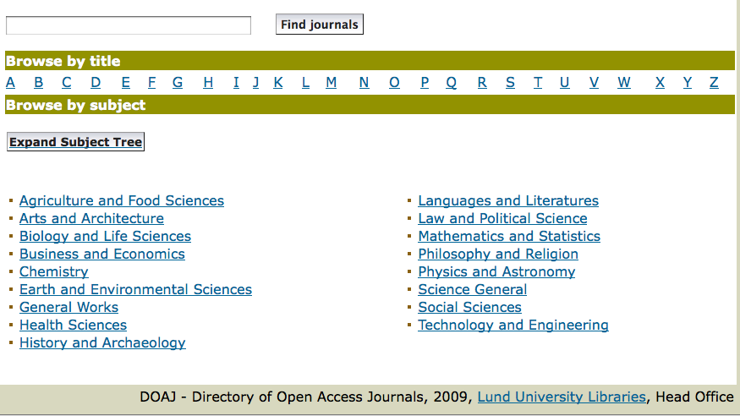
DOAJ categories

Slide 10
Open Access repositories
Digital collections
Most usually institutional
Sometimes centralised (subject-based)
Interoperable
Form a network across the world
Create a global database of openly-accessible research
Currently c1750

Slide 11
Where repositories are
Total at October 2010: 1750

Slide 12
What they contain

Slide 13
What’s in it for authors?

Slide 14
Author advantages from Open Access
Visibility
Usage
Impact
Personal profiling and marketing
Research advantages

Slide 15
Visibility

Slide 16
An author’s own testimony on open access visibility
“Self-archiving in the PhilSci Archive has given instant world-wide visibility to my work. As a result, I was invited to submit papers to refereed international conferences/journals and got them accepted.”

Slide 17
Usage

Slide 18
A well-filled repository

Slide 19
And it gets used

Slide 20
Professor Martin Skitmore School of Urban Design, QUT
“There is no doubt in my mind that ePrints will have improved things – especially in developing countries such as Malaysia … many more access my papers who wouldn’t have thought of contacting me personally in the ‘old’ days.
While this may … increase … citations, the most important thing … is that at least these people can find out more about what others have done…”

Slide 21
Impact

Slide 22
Impact
Range = 36%-200%
(Data: Stevan Harnad and co-workers)

Slide 23
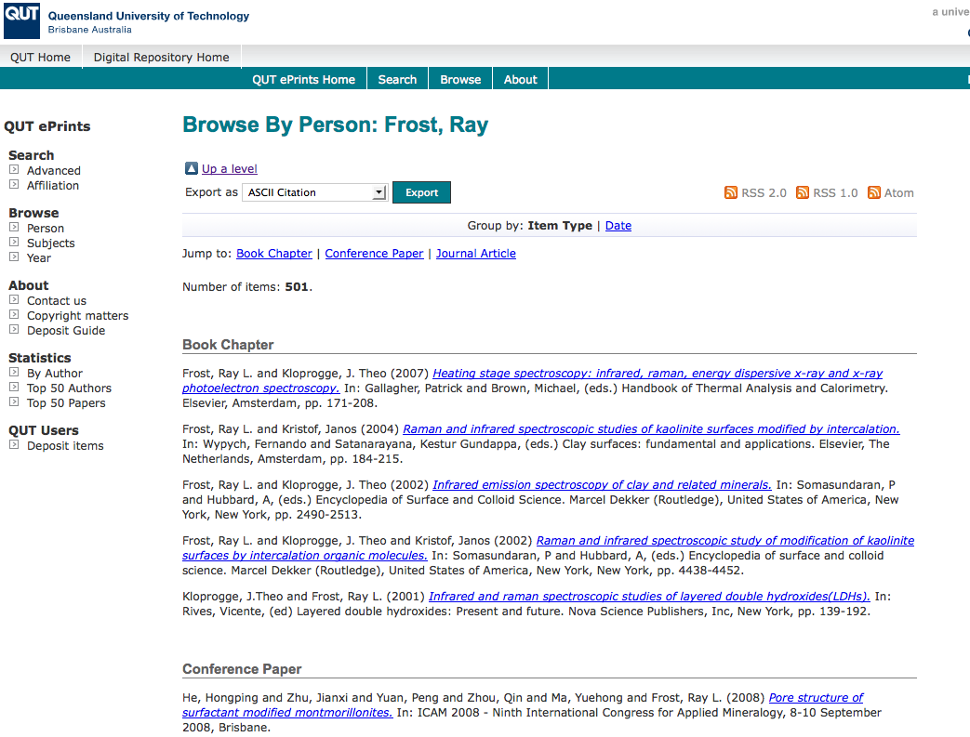
What OA means to a researcher

Slide 24
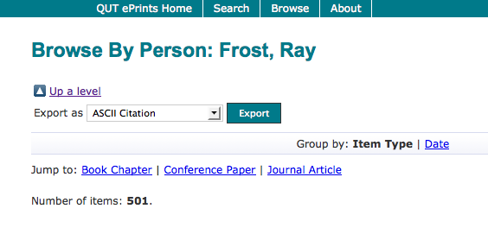

Slide 25
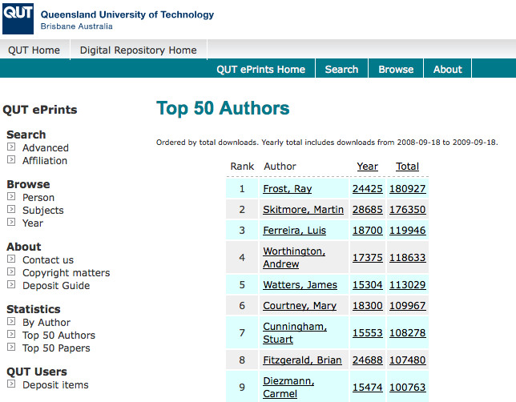

Slide 26
Top authors (by download)

Slide 27
Ray Frost’s impact

Slide 28
Top authors (by download)

Slide 29
Martin Skitmore (Urban Design)

Slide 30
Engineering
Citations
Data: Gargouri & Harnad, 2010

Slide 31
Clinical medicine
Citations
Data: Gargouri & Harnad, 2010

Slide 32
Social science
Citations
Data: Gargouri & Harnad, 2010

Slide 33
Profiling and marketing

Slide 34
Notes:
34

Slide 35
Download timeline

Slide 38
Research advantages

Slide 39
EU CIS studies

Slide 40
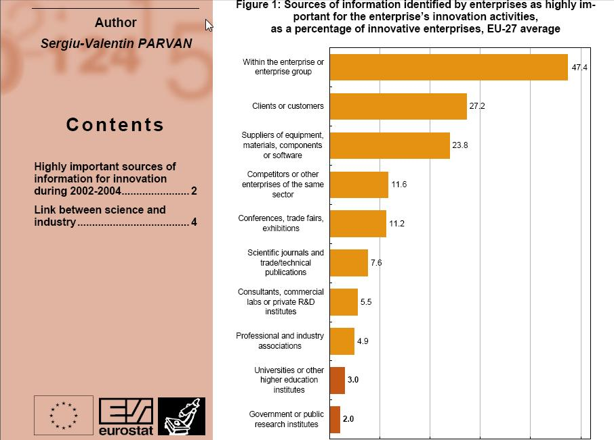

Slide 41
For institutions?

Slide 42
Institutional advantages from Open Access
Visibility
Usage
Impact
Institutional profiling and marketing
Research advantages

Slide 43
Why an institutional repository?
Fulfils a university’s mission to engender, encourage and disseminate scholarly work
Complete record of its intellectual effort
Permanent record of all digital output
Research management tool
‘Marketing’ tool for universities
Provides maximum Web impact for the institution

Slide 44
The U.Southampton conundrum
The G-Factor (universitymetrics.com)

Slide 46
Webometrics

Slide 47
Total Research Income: QUT and sector
Data: Tom Cochrane, Deputy Vice-Chancellor, QUT

Slide 48
Total Research Income: QUT and sector
Data: Tom Cochrane, Deputy Vice-Chancellor, QUT

Slide 49
Dr Evonne Miller Senior Lecturer, Design, QUT
“Just last week, the General Manager of Sustainable Development from an Australian rural industry called me – based on reading one of my research papers in ePrints.
He loved what he read ..... and we are now in discussion about how we can help them measure their industry’s social impacts.”

Slide 50
Daniel Coit Gilman First President, Johns Hopkins University
It is one of the noblest duties of a university to advance knowledge and to diffuse it, not merely among those who can attend the daily lectures, but far and wide.

Slide 51
University of Edinburgh Strategic Plan 2008-12
“The mission of our University is the creation, dissemination and curation of knowledge.”

Slide 52
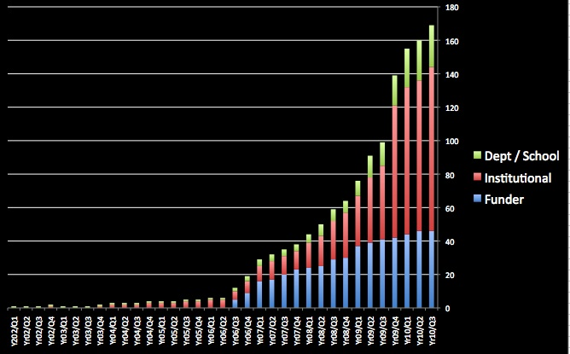
Open Access mandatory policies

Slide 53
Resources
General, comprehensive resource on Open Access:
OASIS
(Open Access Scholarly Information Sourcebook)
www.openoasis.org
For policymakers, institutional managers:
EOS
(Enabling Open Scholarship)
www.openscholarship.org

Slide 54
Thank you for listening
aswan@keyperspectives.co.uk
www.keyperspectives.co.uk
www.openoasis.org

