Slide 1
The ‘whys’ of Open Access: efficiency and impact
Alma Swan
Enabling Open Scholarship
And
Key Perspectives Ltd
JISC Conference: The Future of Research? London, UK, 18-19 October 2010

Slide 2
Efficiencies

Slide 3
Efficiencies from Open Access
Obvious direct cost savings (subscriptions, ILL, PPV)
Open Access makes it easier to find and retrieve the material a researcher needs to:
READ
WRITE papers
Carry out PEER REVIEW work
Open Access obviates the need to spend time seeking permissions or dealing with copyright and licensing issues
No duplication, blind alleys, etc …

Slide 4
Three new scholarly communication scenarios
Self-archiving in repositories (‘Green’ Open Access)
In parallel with subscription journals
Instead of subscription journals, via repositories with overlay services
Open Access journals (‘Gold’ Open Access publishing)

Slide 5
University UK: Annual savings from OA
GBP per annum

Slide 6
Savings from OA via repositories
GBP per annum

Slide 7
Savings from OA via OA journals
GBP per annum

Slide 8
Societal value

Slide 9
Impact: visibility, usage and academic impact

Slide 10
Visibility and usage
Visibility comes through Web search engines
Best evidenced by usage
e-Scholarship (University of California): 11.4 million views since 2002 (36,500 items)
School of Electronics & Computer Science (University of Southampton): 30,000 downloads per month (5,500 full-text items)
ORBi (University of Liege): 129,000 downloads since September 2009 (31,000 full-text items)

Slide 12
Open Access citation impact
Range = 36%-200%
(Data: Stevan Harnad and co-workers)

Slide 13
Engineering
Citations
Data: Gargouri & Harnad, 2010

Slide 14
Clinical medicine
Citations
Data: Gargouri & Harnad, 2010

Slide 15
Social science
Citations
Data: Gargouri & Harnad, 2010

Slide 16
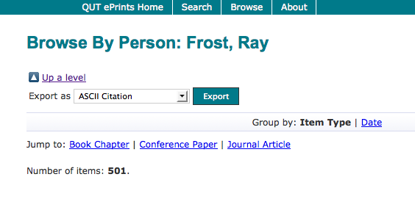
What OA means to a researcher

Slide 17
Top authors (by download)

Slide 18
Ray Frost’s impact

Slide 19
Top authors (by download)

Slide 20
Martin Skitmore (Urban Design)

Slide 21
Impact: Enabling innovation

Slide 22
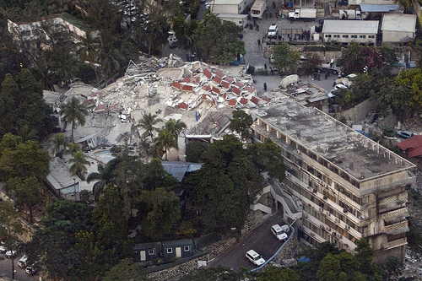
Photos: UNDP

Slide 23
EU CIS studies

Slide 24
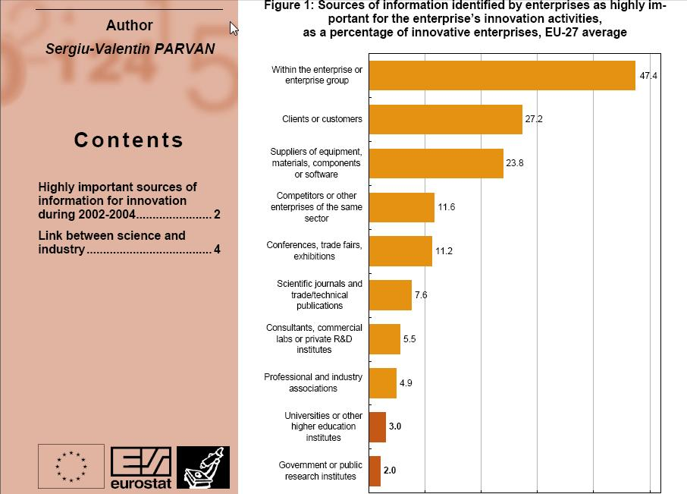

Slide 25
“With a small oncology company … it is imperative that I have access to the literature. But small companies do not have the "deep pockets" necessary...
The for-profit journal publishers have effectively barred access to key scientific information except to those who can afford their outrageous fees.
Much of the most innovative work is being done at companies like mine that cannot afford to pay $30+ per paper or pay per-search charges in abstracts or journal collections.”
Terence Dolak, SDR Pharmaceuticals, Andover, NJ, USA

Slide 26
“We submitted a patent application .... the patent authorities that stated that [some of this] was known and published [in] a scientific paper.
This came approximately at the same time as we were about to close a financing round. As a consequence our closing was delayed .... In this period we were really broke and we could not afford to do any experiments. New experiments were essential .... otherwise we would have to withdraw four other patent applications we had filed.
The lesson is that if we had had access to the scientific paper then we would have been in a much better position.”
CEO, small pharmaceutical company, Denmark

Slide 27
Dr Evonne Miller Senior Lecturer, Design, QUT
“Just last week, the General Manager of Sustainable Development from an Australian rural industry called me – based on reading one of my research papers in ePrints.
He loved what he read ..... and we are now in discussion about how we can help them measure their industry’s social impacts.”

Slide 28
Total Research Income: QUT and sector
Data: Tom Cochrane, Deputy Vice-Chancellor, QUT

Slide 29
Thank you
aswan@talk21.com
www.openscholarship.org

