Slide 1
Visibility, usage, impact, economic benefits – the significance of open archives for research and elsewhere
Alma Swan
Convenor
Enabling Open Scholarship
The Significance of Open Archives for Research Conference
Uppsala, Sweden, 16/17 November 2010

Slide 2
Open Access – Why?
Research moves faster and more efficiently
Greater visibility and impact
Better monitoring, assessment and evaluation of research
Enables new semantic technologies (text-mining and data-mining)
Publicly-funded research should be freely available to the ‘public’

Slide 3
Open Access repositories
Digital collections
Most usually institutional
Sometimes centralised (subject-based)
Interoperable
Form a network across the world
Create a global database of openly-accessible research
Currently c1750

Slide 4
Where repositories are
Total at October 2010: 1750

Slide 5
What’s in it for authors?

Slide 6
Author advantages from Open Access
Visibility
Usage
Impact
Personal profiling and marketing
Research advantages

Slide 7
Visibility

Slide 8
An author’s own testimony on open access visibility
“Self-archiving in the PhilSci Archive has given instant world-wide visibility to my work. As a result, I was invited to submit papers to refereed international conferences/journals and got them accepted.”

Slide 9
Usage

Slide 10
A well-filled repository

Slide 11
And it gets used

Slide 12
Professor Martin Skitmore School of Urban Design, QUT
“There is no doubt in my mind that ePrints will have improved things – especially in developing countries such as Malaysia … many more access my papers who wouldn’t have thought of contacting me personally in the ‘old’ days.
While this may … increase … citations, the most important thing … is that at least these people can find out more about what others have done…”

Slide 13
Impact

Slide 14
Impact
Range = 36%-200%
(Data: Stevan Harnad and co-workers)

Slide 15
Engineering
Citations
Data: Gargouri & Harnad, 2010

Slide 16
Clinical medicine
Citations
Data: Gargouri & Harnad, 2010

Slide 17
Social science
Citations
Data: Gargouri & Harnad, 2010

Slide 18
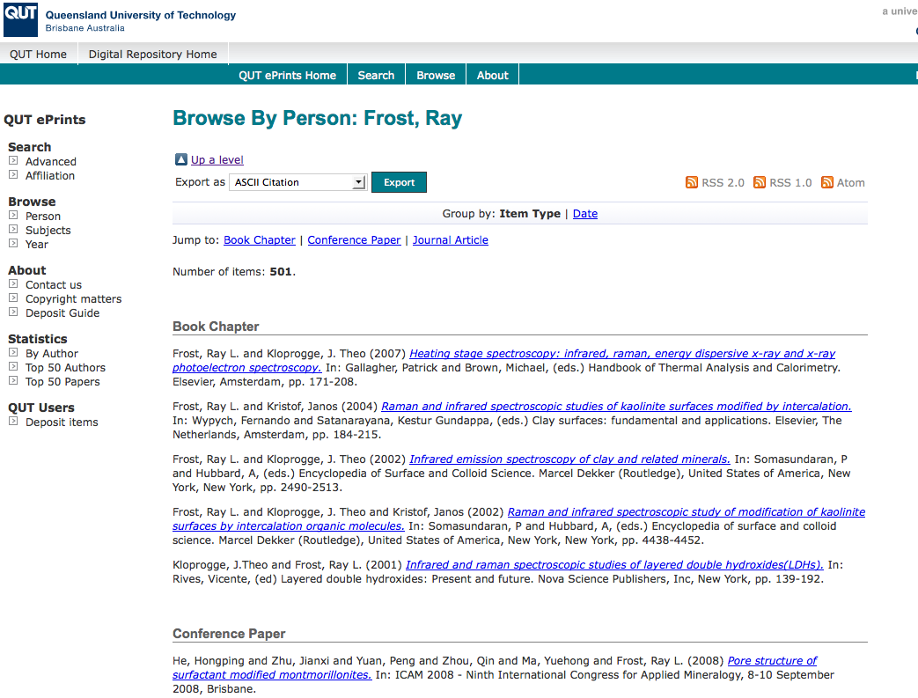
What OA means to a researcher

Slide 19
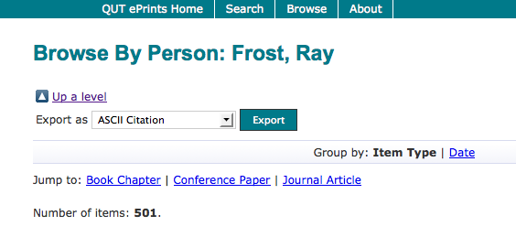

Slide 20
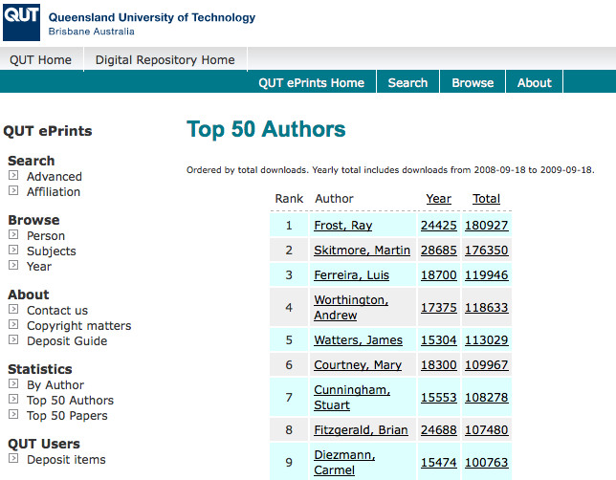

Slide 21
Top authors (by download)

Slide 22
Ray Frost’s impact

Slide 23
Top authors (by download)

Slide 24
Martin Skitmore (Urban Design)

Slide 25
Profiling and marketing

Slide 26
Notes:
26

Slide 27
Download timeline

Slide 29
Research advantages

Slide 30
EU CIS studies

Slide 31
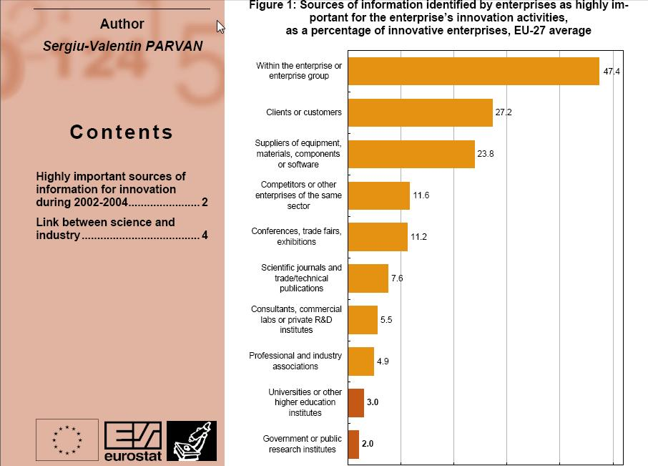

Slide 32
For institutions?

Slide 33
The U.Southampton conundrum
The G-Factor (universitymetrics.com)

Slide 35
Webometrics

Slide 36
Total Research Income: QUT and sector
Data: Tom Cochrane, Deputy Vice-Chancellor, QUT

Slide 37
Dr Evonne Miller Senior Lecturer, Design, QUT
“Just last week, the General Manager of Sustainable Development from an Australian rural industry called me – based on reading one of my research papers in ePrints.
He loved what he read ..... and we are now in discussion about how we can help them measure their industry’s social impacts.”

Slide 38
Resources
General, comprehensive resource on Open Access:
OASIS
(Open Access Scholarly Information Sourcebook)
www.openoasis.org
For policymakers, institutional managers:
EOS
(Enabling Open Scholarship)
www.openscholarship.org

Slide 39
Thank you for listening
aswan@keyperspectives.co.uk
www.keyperspectives.co.uk
www.openoasis.org

