Slide 1
The Benefits of Open Access – to authors, institutions and nations
Alma Swan
Convenor
Enabling Open Scholarship
Mötesplats Open Access / Meeting Place Open Access, Lund, 24-25 November 2010

Slide 2
Some context

Slide 3
Open Access
Immediate
Free (to use)
Free (of restrictions)
Access to the peer-reviewed literature (and data)
Not vanity publishing
Not a ‘stick anything up on the Web’ approach
Moving scholarly communication into the Web Age

Slide 4
Open Access – Why?
Research moves faster and more efficiently
Greater visibility and impact
Better monitoring, assessment and evaluation of research
Enables new semantic technologies (text-mining and data-mining)
Publicly-funded research should be freely available to the ‘public’

Slide 5
Open Access: how
Open Access journals (www.doaj.org)
Open Access repositories
Open Access monographs

Slide 6
Open Access journals
Content available free of charge online
In many cases, free of restrictions on use too
Some charge at the ‘front end’
More than half do not levy a charge at all
Around 5750 of them
Listed in the Directory of Open Access Journals (DOAJ)

Slide 7
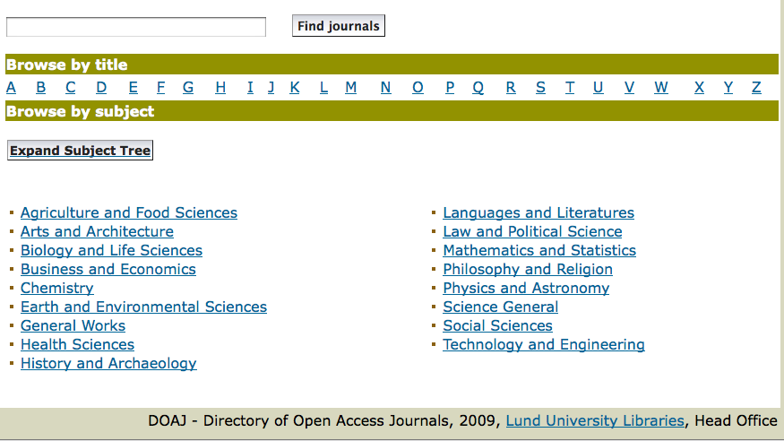
DOAJ categories

Slide 8
Open Access repositories
Digital collections
Most usually institutional
Sometimes centralised (subject-based)
Interoperable
Form a network across the world
Create a global database of openly-accessible research
Currently c1750

Slide 9
Where repositories are
Total at October 2010: 1750

Slide 10
What they contain

Slide 11
What’s in it for authors?

Slide 12
Author advantages from Open Access
Visibility
Usage
Impact
Personal profiling and marketing

Slide 13
Visibility

Slide 14
An author’s own testimony on open access visibility
“Self-archiving in the PhilSci Archive has given instant world-wide visibility to my work. As a result, I was invited to submit papers to refereed international conferences/journals and got them accepted.”

Slide 15
Professor Martin Skitmore School of Urban Design, QUT
“There is no doubt in my mind that ePrints [his university repository] will have improved things – especially in developing countries such as Malaysia … many more access my papers who wouldn’t have thought of contacting me personally in the ‘old’ days.
While this may … increase … citations, the most important thing … is that at least these people can find out more about what others have done…”

Slide 16
Usage

Slide 17
A well-filled repository

Slide 18
And it gets used

Slide 19
Impact

Slide 20
Impact
Range = 36%-200%
(Data: Stevan Harnad and co-workers)

Slide 21
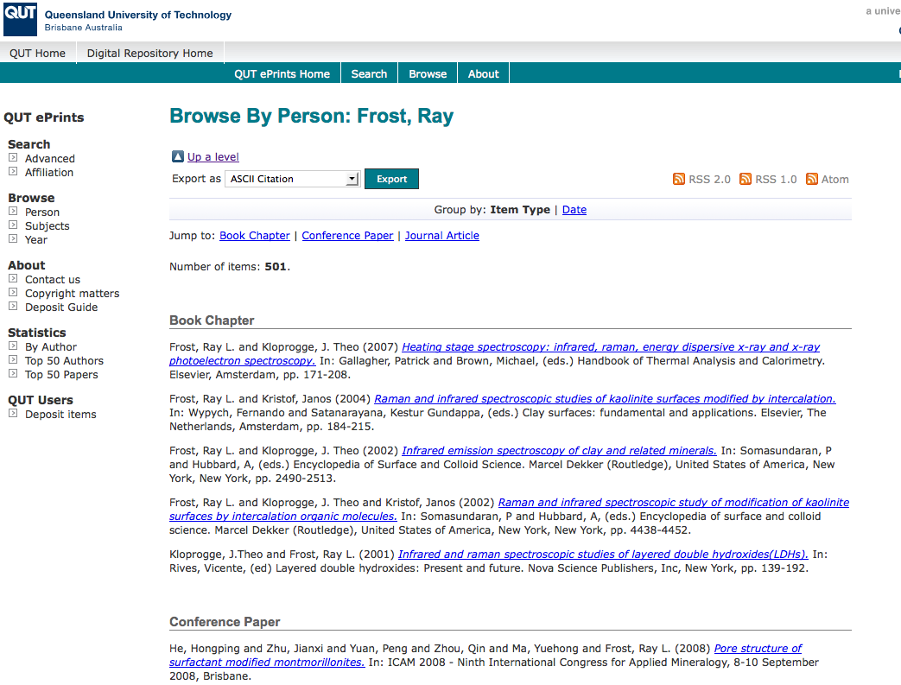
What OA means to a researcher

Slide 22
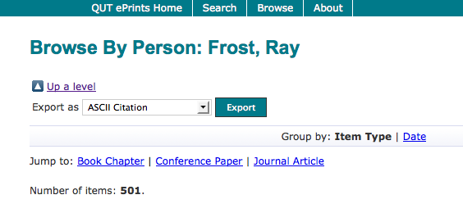

Slide 23
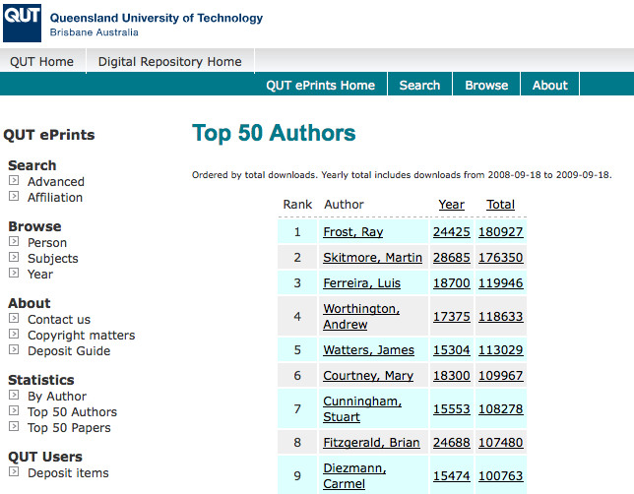

Slide 24
Top authors (by download)

Slide 25
Ray Frost’s impact

Slide 26
Top authors (by download)

Slide 27
Martin Skitmore (Urban Design)

Slide 28
Engineering
Citations
Data: Gargouri & Harnad, 2010

Slide 29
Clinical medicine
Citations
Data: Gargouri & Harnad, 2010

Slide 30
Social science
Citations
Data: Gargouri & Harnad, 2010

Slide 31
Profiling and marketing

Slide 33
Notes:
33

Slide 34
Download timeline

Slide 36
For institutions?

Slide 37
Why an institutional repository?
Fulfils a university’s mission to engender, encourage and disseminate scholarly work
Complete record of its intellectual effort
Permanent record of all digital output
Research management tool
‘Marketing’ tool for universities
Provides maximum Web impact for the institution

Slide 38
Institutional advantages from Open Access
Visibility
Usage
Impact
Institutional profiling and marketing
Research advantages

Slide 39
Usage

Slide 40
ORBi: Université de Liège

Slide 41
Downloads from ORBi

Slide 42
Impact and profiling

Slide 43
The U.Southampton conundrum
The G-Factor (universitymetrics.com)

Slide 45
Webometrics

Slide 46
Research advantages

Slide 47
EU CIS studies

Slide 48
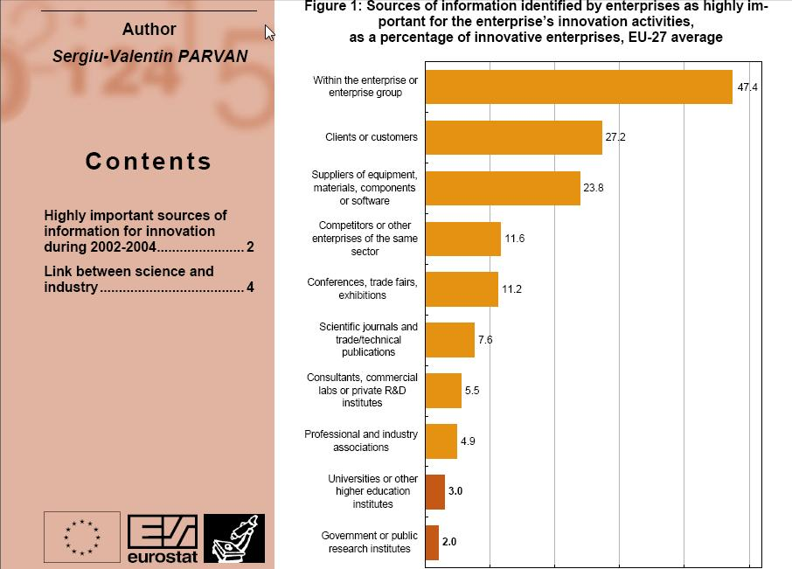

Slide 49
Total Research Income: QUT and sector
Data: Tom Cochrane, Deputy Vice-Chancellor, QUT

Slide 50
Dr Evonne Miller Senior Lecturer, Design, QUT
“Just last week, the General Manager of Sustainable Development from an Australian rural industry called me – based on reading one of my research papers in ePrints.
He loved what he read ..... and we are now in discussion about how we can help them measure their industry’s social impacts.”

Slide 51
Economic advantages

Slide 52
Rationales and assumptions
Obvious direct cost savings (subscriptions, ILL, PPV)
Open Access makes it easier to find and retrieve the material a researcher needs to:
READ
WRITE papers
Carry out PEER REVIEW work
Open Access obviates the need to spend time seeking permissions or dealing with copyright and licensing issues
No duplication, blind alleys, etc …

Slide 53
National pictures (Houghton et al, 2009, 2010)
Annual € savings from moving to: | UK | Netherlands | Denmark | US federal agencies
OA journals (‘Gold’ OA) | 480 million | 133 million | 70 million | Value of benefit over 30 years amounts to some $1 billion, 6 times the cost of archiving the material
OA repositories with subscriptions (‘Green’ OA) | 125 million | 50 million | 30 million
OA repositories with overlay services | Circa 480 million | Circa 133 million | Circa 70 million

Slide 54
University UK: Annual savings from OA
GBP per annum

Slide 55
Societal value

Slide 56
Daniel Coit Gilman First President, Johns Hopkins University
It is one of the noblest duties of a university to advance knowledge and to diffuse it, not merely among those who can attend the daily lectures, but far and wide.

Slide 57
University of Edinburgh Strategic Plan 2008-12
“The mission of our University is the creation, dissemination and curation of knowledge.”

Slide 58
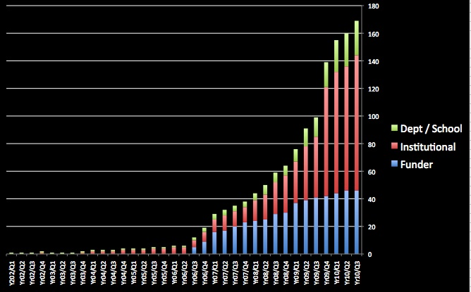
Open Access mandatory policies

Slide 59
Resources
General, comprehensive resource on Open Access:
OASIS
(Open Access Scholarly Information Sourcebook)
www.openoasis.org
For policymakers, institutional managers:
EOS
(Enabling Open Scholarship)
www.openscholarship.org

Slide 60
Thank you for listening
a.swan@talk21.com
www.openscholarship.org
www.keyperspectives.co.uk
www.openoasis.org

