Slide 1
Well, what are the opportunities offered by the new scholarly communication landscape?
Alma Swan
Convenor
Enabling Open Scholarship
The Scholarly Communication Landscape: Opportunities and challenges Manchester, UK, 30 November 2010

Slide 2
Some context

Slide 3
Old paradigms of research dissemination
Use of proxy measures of an individual scholar’s merit is as good as it gets
The responsibility for disseminating your work rests with the publisher
The printed article is the format of record
Other scholars have time to search out what you want them to know

Slide 4
New paradigms of research dissemination
Rich, deep, broad metrics for measuring the contributions of individual scholars
Effective dissemination of your work is now in your hands (at last)
The digital format will be the format of record (is already in many areas)
Unless you routinely publish in Nature or Science, ‘getting it out there’ is up to you

Slide 5
Unaffordable system
Data: Lee Van Orsdel; Bill Hooker; American Research Libraries

Slide 6
Some figures
The value of peer review in UK: £165million per annum
The value of editor duties: £55 million per annum
The value of editorial board duties: £6 million per annum
Data: JISC, 2010; Houghton et al, 2009

Slide 7
Ineffective system
“Access is still a major concern for researchers” (Research Information Network, UK, 2009)
WHO survey (2000)
  56% of research-based institutions in lower-income countries had NO current subscriptions to research journals
  Nor had they for the previous 5 years
  We will never close the “10/90 gap” unless we change the system

Slide 8
Open Access
Immediate
Free (to use)
Free (of restrictions)
Access to the peer-reviewed literature (and data)
Not vanity publishing
Not a ‘stick anything up on the Web’ approach
Moving scholarly communication into the Web Age

Slide 9
Open Access – Why?
Research moves faster and more efficiently
Greater visibility and impact
Better monitoring, assessment and evaluation of research
Enables new semantic technologies (text-mining and data-mining)
Publicly-funded research should be freely available to the ‘public’

Slide 10
Open Access: how
Open Access journals (www.doaj.org)
Open Access repositories
Open Access monographs

Slide 11
Open Access journals
Content available free of charge online
In many cases, free of restrictions on use too
Some charge at the ‘front end’
More than half do not levy a charge at all
Around 5750 of them
Listed in the Directory of Open Access Journals (DOAJ)

Slide 12
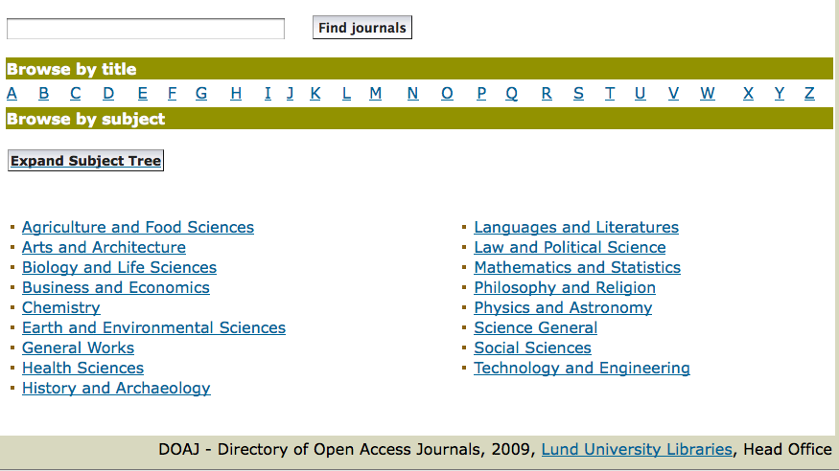
DOAJ categories

Slide 13
Open Access repositories
Digital collections
Most usually institutional
Sometimes centralised (subject-based)
Interoperable
Form a network across the world
Create a global database of openly-accessible research
Currently c1750

Slide 14
How to make your work
Open Access through a repository
Prepare your paper and submit it to your journal of choice for peer review
Make any changes required as a result of the peer review process
Submit the final version to the journal
Deposit that same final version to your repository through the normal deposit procedure that applies in your institution
N.B. Your repository staff may check journal copyright conditions on your behalf, or you may do so yourself using the SHERPA RoMEO service at http://www.sherpa.ac.uk/romeo/

Slide 15
What’s in it for authors?

Slide 16
Author advantages from Open Access
Visibility
Usage
Impact
Personal profiling and marketing

Slide 17
Visibility

Slide 18
An author’s own testimony on open access visibility
“Self-archiving in the PhilSci Archive has given instant world-wide visibility to my work. As a result, I was invited to submit papers to refereed international conferences/journals and got them accepted.”

Slide 19
Usage

Slide 20
A well-filled repository

Slide 21
And it gets used

Slide 22
Impact

Slide 23
Impact
Range = 36%-200%
(Data: Stevan Harnad and co-workers)

Slide 24
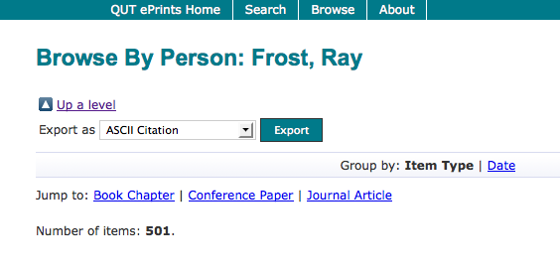
What OA means to a researcher

Slide 25
Top authors (by download)

Slide 26
Ray Frost’s impact

Slide 27
Top authors (by download)

Slide 28
Martin Skitmore
(Urban Design)

Slide 29
Engineering
Citations
Data: Gargouri & Harnad, 2010

Slide 30
Clinical medicine
Citations
Data: Gargouri & Harnad, 2010

Slide 31
Social science
Citations
Data: Gargouri & Harnad, 2010

Slide 32
Profiling and marketing

Slide 34
Notes:
34

Slide 35
Download timeline

Slide 38
How to make your work
Open Access through a repository
Prepare your paper and submit it to your journal of choice for peer review
Make any changes required as a result of the peer review process
Submit the final version to the journal
Deposit that same final version to your repository through the normal deposit procedure that applies in your institution
N.B. Your repository staff may check journal copyright conditions on your behalf, or you may do so yourself using the SHERPA RoMEO service at http://www.sherpa.ac.uk/romeo/

Slide 39
For institutions?

Slide 40
Why an institutional repository?
Fulfils a university’s mission to engender, encourage and disseminate scholarly work
Complete record of its intellectual effort
Permanent record of all digital output
Research management tool
‘Marketing’ tool for universities
Provides maximum Web impact for the institution

Slide 41
Institutional advantages from Open Access
Visibility
Usage
Impact
Institutional profiling and marketing
Research advantages

Slide 42
Usage

Slide 43
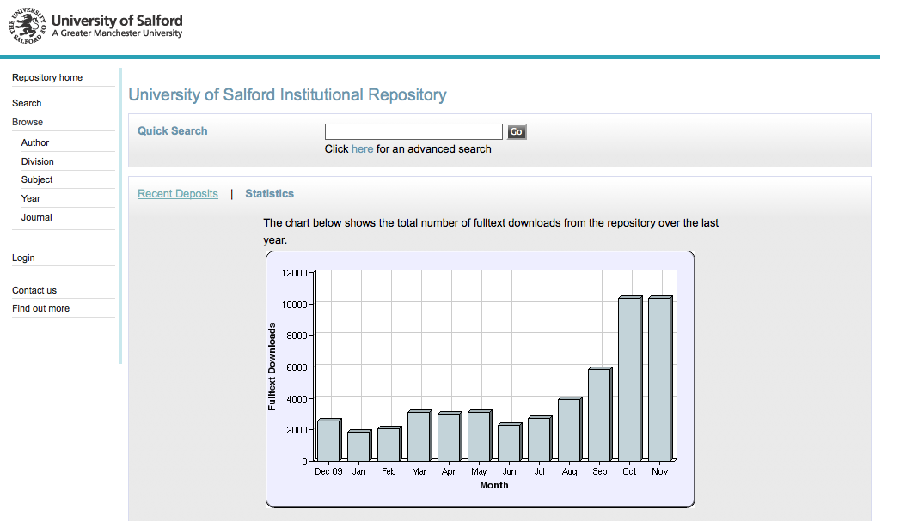
2173 deposits to date

Slide 44
Impact and profiling

Slide 45
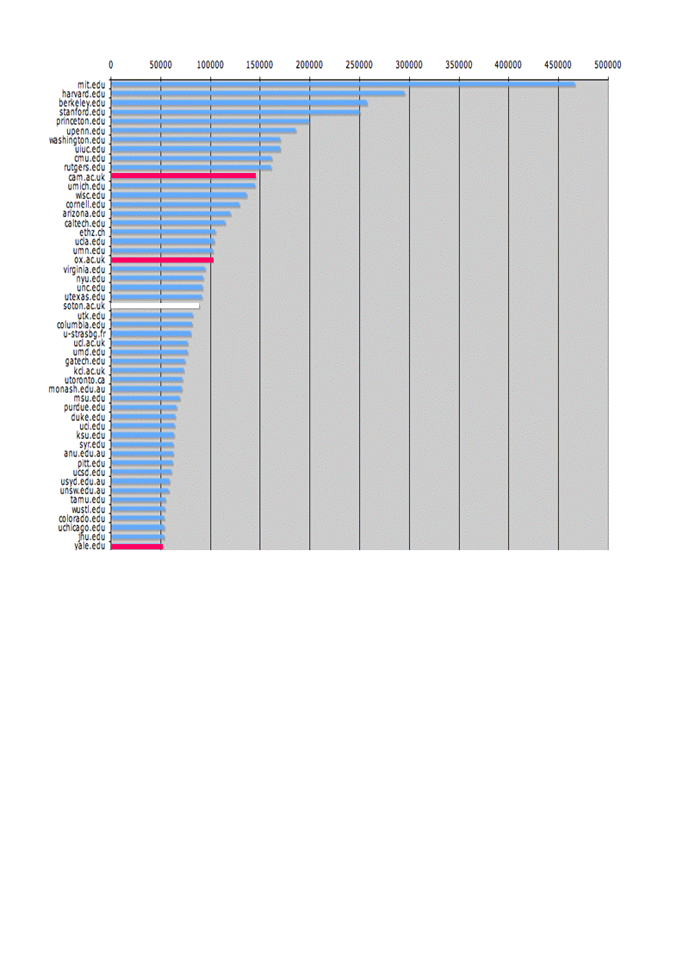
The U.Southampton conundrum
The G-Factor (universitymetrics.com)

Slide 47
Webometrics

Slide 48
Research advantages

Slide 49
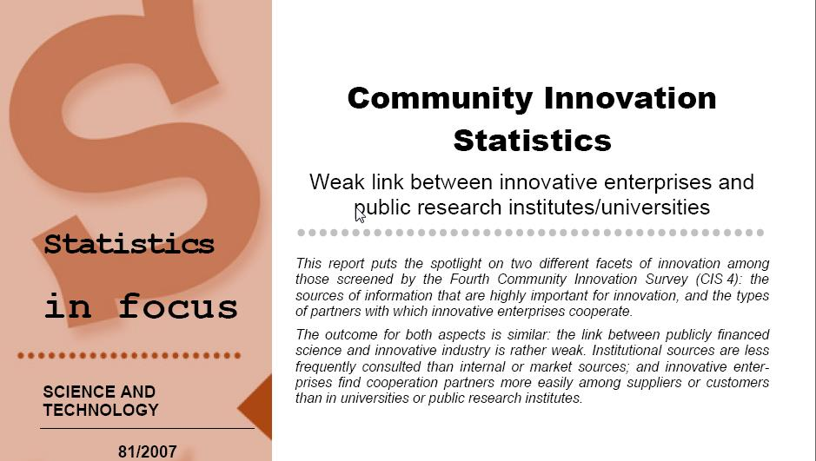
EU CIS studies

Slide 50
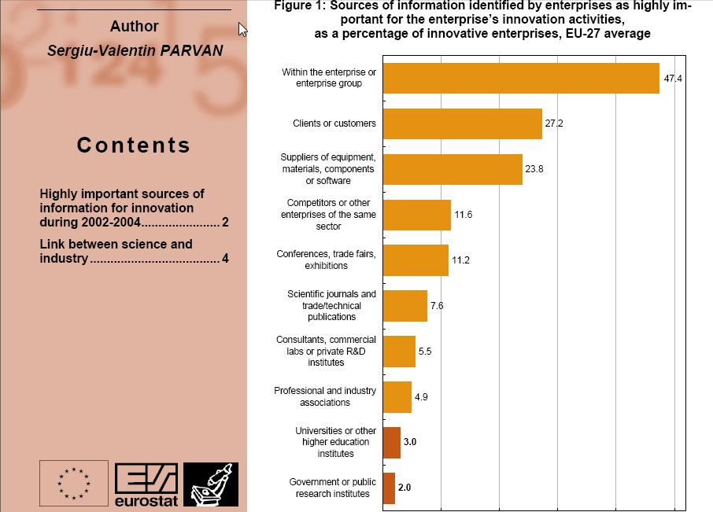

Slide 51
Total Research Income: QUT and sector
Data: Tom Cochrane, Deputy Vice-Chancellor, QUT

Slide 52
Dr Evonne Miller
Senior Lecturer, Design, QUT
“Just last week, the General Manager of Sustainable Development from an Australian rural industry called me – based on reading one of my research papers in ePrints.
He loved what he read ..... and we are now in discussion about how we can help them measure their industry’s social impacts.”

Slide 53
Economic advantages

Slide 54
University UK:
Annual savings from OA
GBP per annum

Slide 55
Societal value

Slide 56
Daniel Coit Gilman
First President, Johns Hopkins University
It is one of the noblest duties of a university to advance knowledge and to diffuse it, not merely among those who can attend the daily lectures, but far and wide.

Slide 57
University of Edinburgh
Strategic Plan 2008-12
“The mission of our University is the creation, dissemination and curation of knowledge.”

Slide 58
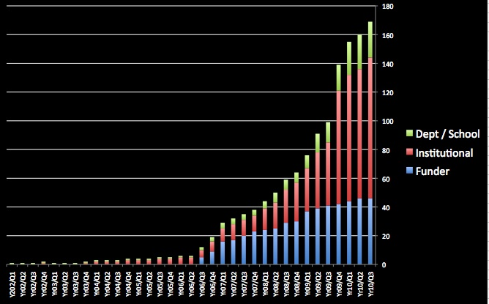
Open Access mandatory policies

Slide 59
Resources
General, comprehensive resource on Open Access:
OASIS
(Open Access Scholarly Information Sourcebook)
www.openoasis.org
For policymakers, institutional managers:
EOS
(Enabling Open Scholarship)
www.openscholarship.org

Slide 60
Thank you for listening
a.swan@talk21.com
www.openscholarship.org
www.keyperspectives.co.uk
www.openoasis.org

Slide 61
Lost citations, lost impact
Say, Open Access brings 50% more citations
Only around 15% of research is Open Access
….. so 85% is not
University of Manchester is therefore losing 85% of the 50% increase in citations (conservative end of the range) that Open Access brings (= 42.5%)

Slide 62
What lack of Open Access means to the University of Manchester
Articles: 5535 articles 2009
Number of citations: 14,868
If all had been OA, there would have been (42.5% more) 22,106 citations, and ...
Say, the University invests £100m in research per annum ...
…this means lost impact worth £42.5m to the university in that period

