Slide 1
The economic case for Open Access
Alma Swan
Key Perspectives Ltd
Truro, UK
Repositories Support Project: Open Access – the impact for libraries and librarians 10 December 2010, London, UK

Slide 2
Economic modelling of OA
John Houghton and colleagues (2009)
Identified the activities in the scholarly communication system
Attached costs to each, and thus to the system
Modelled the economic benefits of new, alternative scholcomm scenarios
Australia, UK, Netherlands, Denmark and US federal agencies
Individual universities (Swan, 2010)
Key Perspectives Ltd

Slide 3
Rationales and assumptions
Obvious direct cost savings (subscriptions, ILL, PPV)
Open Access makes it easier to find and retrieve the material a researcher needs to:
READ
WRITE papers
Carry out PEER REVIEW work
Open Access obviates the need to spend time seeking permissions or dealing with copyright and licensing issues
etc (no duplication, blind alleys …)
Key Perspectives Ltd

Slide 4
‘Houghton Model’
Available to download online
Anyone can use their own data to populate it
Models three alternative Open Access communication scenarios (plus other scholarly communication-related issues)
Models the end-point (an Open Access world)
Key Perspectives Ltd

Slide 5
Three scholarly communication scenarios
Self-archiving in repositories (‘Green’ Open Access)
In parallel with subscription journals
Instead of subscription journals, via repositories with overlay services
Open Access journals (‘Gold’ Open Access publishing)
Key Perspectives Ltd

Slide 6
National pictures (Houghton et al, 2009, 2010)
Annual € savings from moving to: | UK | Netherlands | Denmark | US federal agencies
OA journals (‘Gold’ OA) | 480 million | 133 million | 70 million | Value of benefit over 30 years amounts to some $1 billion, 6x the cost of archiving the material
OA repositories with subscriptions (‘Green’ OA) | 125 million | 50 million | 30 million
OA repositories with overlay services | Circa 480 million | Circa 133 million | Circa 70 million
Key Perspectives Ltd

Slide 7
Individual universities
Results reported for 4 institutions with research income varying from 2 million GBP to 200 million GBP p.a.
2 further institutions modelled by request
Series of workshops around UK: further c20-25 universities modelled
Key Perspectives Ltd

Slide 8
Universities differ
Do things differently in libraries
Buy journals in different ways
Run more or less elaborate repositories
Employ different numbers of people
Pay people different salaries
Key Perspectives Ltd

Slide 9
University UK: Annual savings from OA
£ per annum
Key Perspectives Ltd

Slide 10
Savings from OA via repositories
GBP per annum
Key Perspectives Ltd

Slide 11
Savings from OA via OA journals
Key Perspectives Ltd

Slide 12
Societal value
Key Perspectives Ltd

Slide 13
Photos: UNDP

Slide 14
Enabling innovation
Key Perspectives Ltd

Slide 15
“With a small oncology company … it is imperative that I have access to the literature. But small companies do not have the "deep pockets" necessary...
The for-profit journal publishers have effectively barred access to key scientific information except to those who can afford their outrageous fees.
Much of the most innovative work is being done at companies like mine that cannot afford to pay $30+ per paper or pay per-search charges in abstracts or journal collections.”
Terence Dolak, SDR Pharmaceuticals, Andover, NJ, USA
Key Perspectives Ltd

Slide 16
“We submitted a patent application .... the patent authorities that stated that [some of this] was known and published [in] a scientific paper.
This came approximately at the same time as we were about to close a financing round. As a consequence our closing was delayed .... In this period we were really broke and we could not afford to do any experiments. New experiments were essential .... otherwise we would have to withdraw four other patent applications we had filed.
The lesson is that if we had had access to the scientific paper then we would have been in a much better position.”
CEO, small pharmaceutical company, Denmark
Key Perspectives Ltd

Slide 17
EU CIS studies
Key Perspectives Ltd

Slide 18
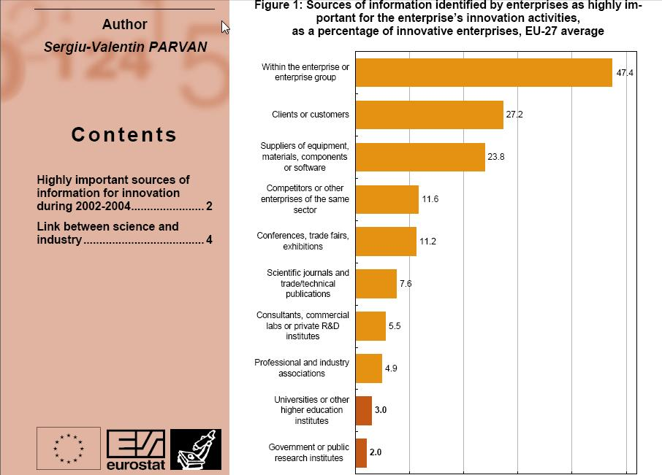
Key Perspectives Ltd

Slide 19
Total Research Income: QUT and sector
Data: Tom Cochrane, Deputy Vice-Chancellor, QUT
Key Perspectives Ltd

Slide 20
Dr Evonne Miller Senior Lecturer, Design, QUT
“Just last week, the General Manager of Sustainable Development from an Australian rural industry called me – based on reading one of my research papers in ePrints.
He loved what he read ..... and we are now in discussion about how we can help them measure their industry’s social impacts.”
Key Perspectives Ltd

Slide 21
Resources
General, comprehensive resource on Open Access:
OASIS
(Open Access Scholarly Information Sourcebook)
www.openoasis.org
For policymakers, institutional managers:
EOS
(Enabling Open Scholarship)
www.openscholarship.org
Key Perspectives Ltd

Slide 22
a.swan@talk21.com
www.openoasis.org
www.openscholarship.org
www.keyperspectives.co.uk
Key Perspectives Ltd

