Slide 1
The Open Access advantage
Alma Swan
Convenor
Enabling Open Scholarship
Open Access, Open Data: Cologne, Germany, 13/14 December 2010

Slide 2
Open Access
Immediate
Free (to use)
Free (of restrictions)
Access to the peer-reviewed literature (and data)
Not vanity publishing
Not a ‘stick anything up on the Web’ approach
Moving scholarly communication into the Web Age

Slide 3
Advantages from Open Access
Visibility
Usage
Impact
Profiling and marketing
Economic advantages

Slide 4
Visibility

Slide 5
An author’s own testimony on open access visibility
“Self-archiving in the PhilSci Archive has given instant world-wide visibility to my work. As a result, I was invited to submit papers to refereed international conferences/journals and got them accepted.”

Slide 6
Professor Martin Skitmore School of Urban Design, QUT
“There is no doubt in my mind that ePrints [his university repository] will have improved things – especially in developing countries such as Malaysia … many more access my papers who wouldn’t have thought of contacting me personally in the ‘old’ days.
While this may … increase … citations, the most important thing … is that at least these people can find out more about what others have done…”

Slide 7
ORBi: Université de Liège

Slide 8
Downloads from ORBi

Slide 9
Usage

Slide 10
A well-filled repository

Slide 11
And it gets used

Slide 12
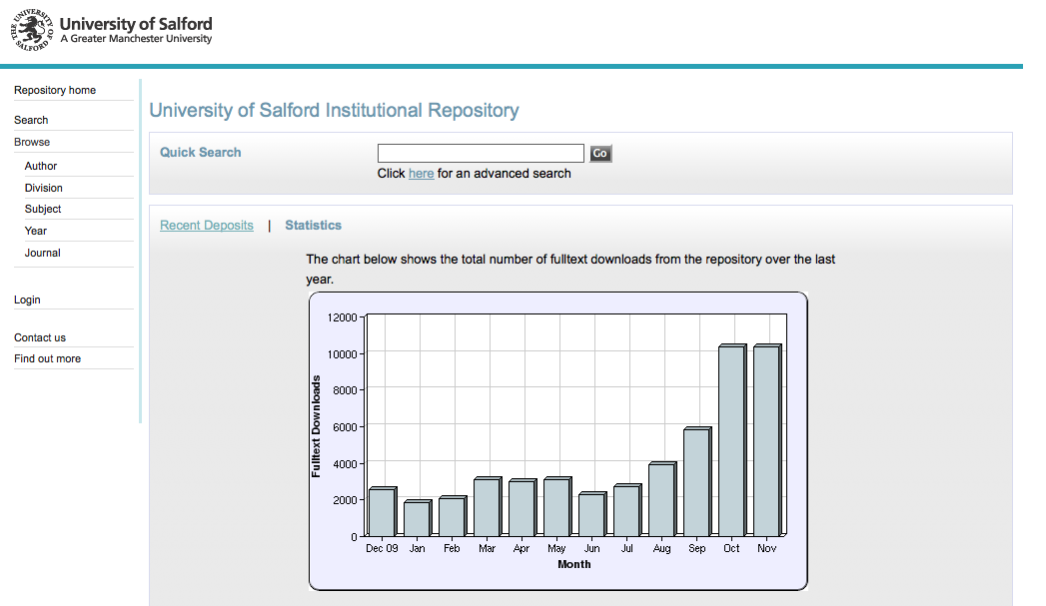
2173 deposits to date

Slide 13
Impact

Slide 14
Impact
Range = 36%-200%
(Data: Stevan Harnad and co-workers)

Slide 15
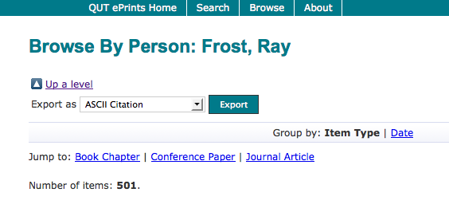
What OA means to a researcher

Slide 16
Top authors (by download)

Slide 17
Ray Frost’s impact

Slide 18
Top authors (by download)

Slide 19
Martin Skitmore (Urban Design)

Slide 20
Engineering
Citations
Data: Gargouri & Harnad, 2010

Slide 21
Clinical medicine
Citations
Data: Gargouri & Harnad, 2010

Slide 22
Social science
Citations
Data: Gargouri & Harnad, 2010

Slide 23
The U.Southampton conundrum
The G-Factor (universitymetrics.com)

Slide 25
Webometrics

Slide 26
Profiling and marketing

Slide 29
Economic advantages I: Open Access offers savings

Slide 30
National pictures (Houghton et al, 2009, 2010)
Annual € savings from moving to: | UK | Netherlands | Denmark | US federal agencies
OA journals (‘Gold’ OA) | 480 million | 133 million | 70 million | Value of benefit over 30 years amounts to some $1 billion, 6 times the cost of archiving the material
OA repositories with subscriptions (‘Green’ OA) | 125 million | 50 million | 30 million
OA repositories with overlay services | Circa 480 million | Circa 133 million | Circa 70 million

Slide 31
University UK: Annual savings from OA
GBP per annum

Slide 32
Economic advantages II: knowledge transfer and collaborations

Slide 33
EU CIS studies

Slide 34
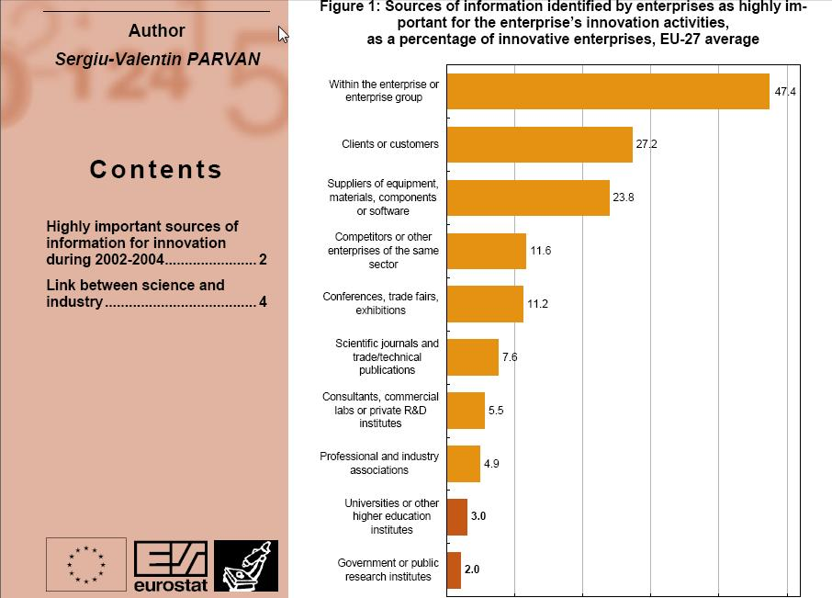

Slide 35
Total Research Income: QUT and sector
Data: Tom Cochrane, Deputy Vice-Chancellor, QUT

Slide 36
Dr Evonne Miller Senior Lecturer, Design, QUT
“Just last week, the General Manager of Sustainable Development from an Australian rural industry called me – based on reading one of my research papers in ePrints.
He loved what he read ..... and we are now in discussion about how we can help them measure their industry’s social impacts.”

Slide 37
Economic advantages III: better outreach, better sales

Slide 38
Downloads from ORBi

Slide 39
Resources
General, comprehensive resource on Open Access:
OASIS
(Open Access Scholarly Information Sourcebook)
www.openoasis.org
For policymakers, institutional managers:
EOS
(Enabling Open Scholarship)
www.openscholarship.org

Slide 40
Thank you for listening
a.swan@talk21.com
www.openscholarship.org
www.keyperspectives.co.uk
www.openoasis.org

