Slide 1
Partial discharge analysis of defective three-phase cables
An overview of an ongoing project involving the generation and analysis of PD within distribution cables
J. A. Hunter, L. Hao, D. J. Swaffield, P. L. Lewin, N. Cornish, C. Walton, M. Michel
19 January 2011
Notes:
Please use the dd month yyyy format for the date for example 11 January 2008. The main title can be one or two lines long.

Slide 2
Introduction
38 000 km of 6.6 kV and 11 kV medium voltage (MV) cables supplying London with an estimated replacement cost of £4 Billion [1]
The majority of which is of paper insulated lead covered (PILC) construction and was laid in the 60’s & 70’s
Shift in condition monitoring philosophy for these assets
Our objective - replicate “in service” conditions for a range of defective cable samples and collect PD data
Through analysis of this data, develop a better understanding of the PD phenomena associated with the failure mechanisms that effect this type of hardware
[1] Matthieu Michel. ‘Comparison of off-line and on-line partial discharge MV cable mapping techniques. In Electricity Distribution’ CIRED 2005. 18th International Conference and Exhibition on, page 1

Slide 3
Research plan
Design an experiment that allows for safe rated voltage, current and temperature control over a three-phase cable
Fabricate a number of defective cable samples
Increase the functionality of the experiment to allow for mechanical damage to the samples
Capture PD data from a range of cable samples under rated conditions, over an extended period
Analyse the PD data looking for source specific characteristics and trends in activity over time
Notes:
Noise threshold, Protection, conventional PD detection (IEC 60270) AND the use of HFCTs Bandwidths!
Continuity in construction, noise level, PD source
Blah
Mechanical electrical water thermal damage

Slide 4
Experiment design
Notes:
If using a school logo, make sure that if you have a long page title, it does not encroach on the logo. Allow about 2cm around the logo. Run the page title onto two lines if necessary.

Slide 5
Cable sample design
Noise reduction of “virgin” samples
Ensure that fabrication process is the same for all samples
Representative of identified “life reducing” defects
Significant PD activity
Straight lead joints containing fabrication defects that exaggerate the electrical stress within the joint
Notes:
10 m cable lengths were terminated and connected in a loop to allow current induction via current transformers
Look at two of these defect examples in more detail

Slide 6
“Spike on the Ferrule” defect
Representative of poor joint construction
Asymmetric geometry – should produce identifiable PD signals
Not too severe a defect as to fail immediately
14 mm metal spike introduced during the joint fabrication process (on phase 2 pointing at phase 1)
Notes:
Straight lead joint

Slide 7
Mechanical stress
Two mechanical tests
Test 1: Mechanical limit
Fast evolution of PD activity
Test 2: “Root compression”
Sustained pressure
Mechanical crushing rig for use on joints and cable sections

Slide 8
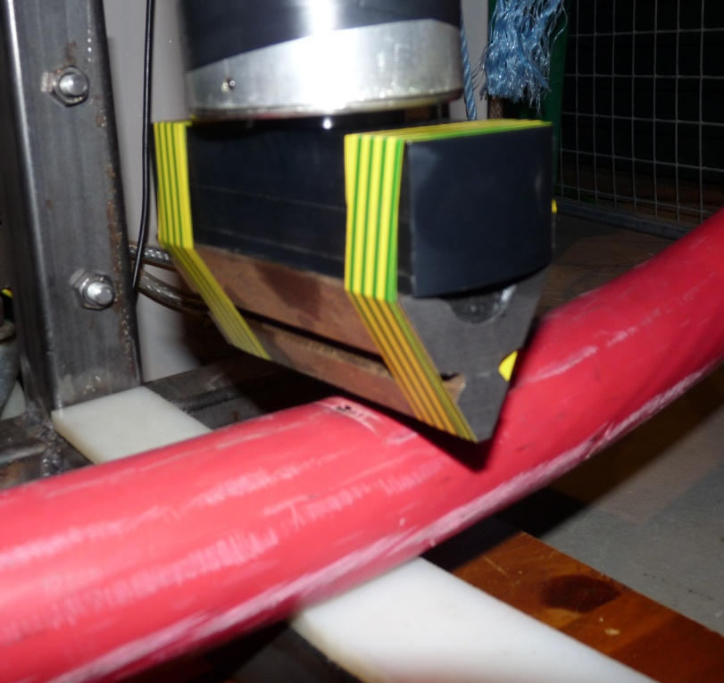
Mechanical crushing test #1
Repeated crushing using sharp bar-plane configuration
40×3000 lb crushes
limited PD activity
Mtronix- slow evolution
Protection activation– experiment isolated.
Max. voltage = 3.5 kV after tripping
A fault occurred before a large dataset could be amassed
Cable crushing in progress

Slide 9
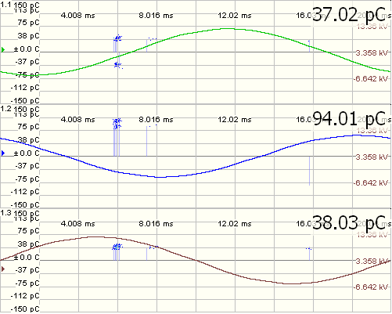
Initial results
Significant PD produced by defect - isolated by increasing temperature
PD activity occurs at a specific phase angles
Cross talk is observed on the other phases
Detailed analysis of these PD pulses is required to extensively characterise them
Three-phase phase resolved PD plot produced by “Spike” sample at rated temperature
Notes:
5 nC of PD produced by virgin sample
2. Phenomena dominated by a single or pair of voltages

Slide 10
Conclusions
Full recovery of failed cable sample after removal of pressure and 1.5 hrs of heating at rated temperature (65 ºC)
Strong temperature relationship with PD activity for these types of cable
The peak apparent charge is in the range of nC - common in PILC cable samples at room temperature
Adding stress relief tape to sample terminations reduces the magnitude of PD produced by the cable itself
Notes:
If using a school logo, make sure that if you have a long page title, it does not encroach on the logo. Allow about 2cm around the logo. Run the page title onto two lines if necessary.

Slide 11
Future work
Thoroughly characterise the PD signals produced by different sources
Classification of PD signals produced by different defects using a novel feature vector and machine learning technique
Development of the crushing experiment is required
Continue to record PD activity from a range of sources
Further investigate the relationship between the various failure mechanisms that effect these types of asset and the associated PD activity

Slide 12
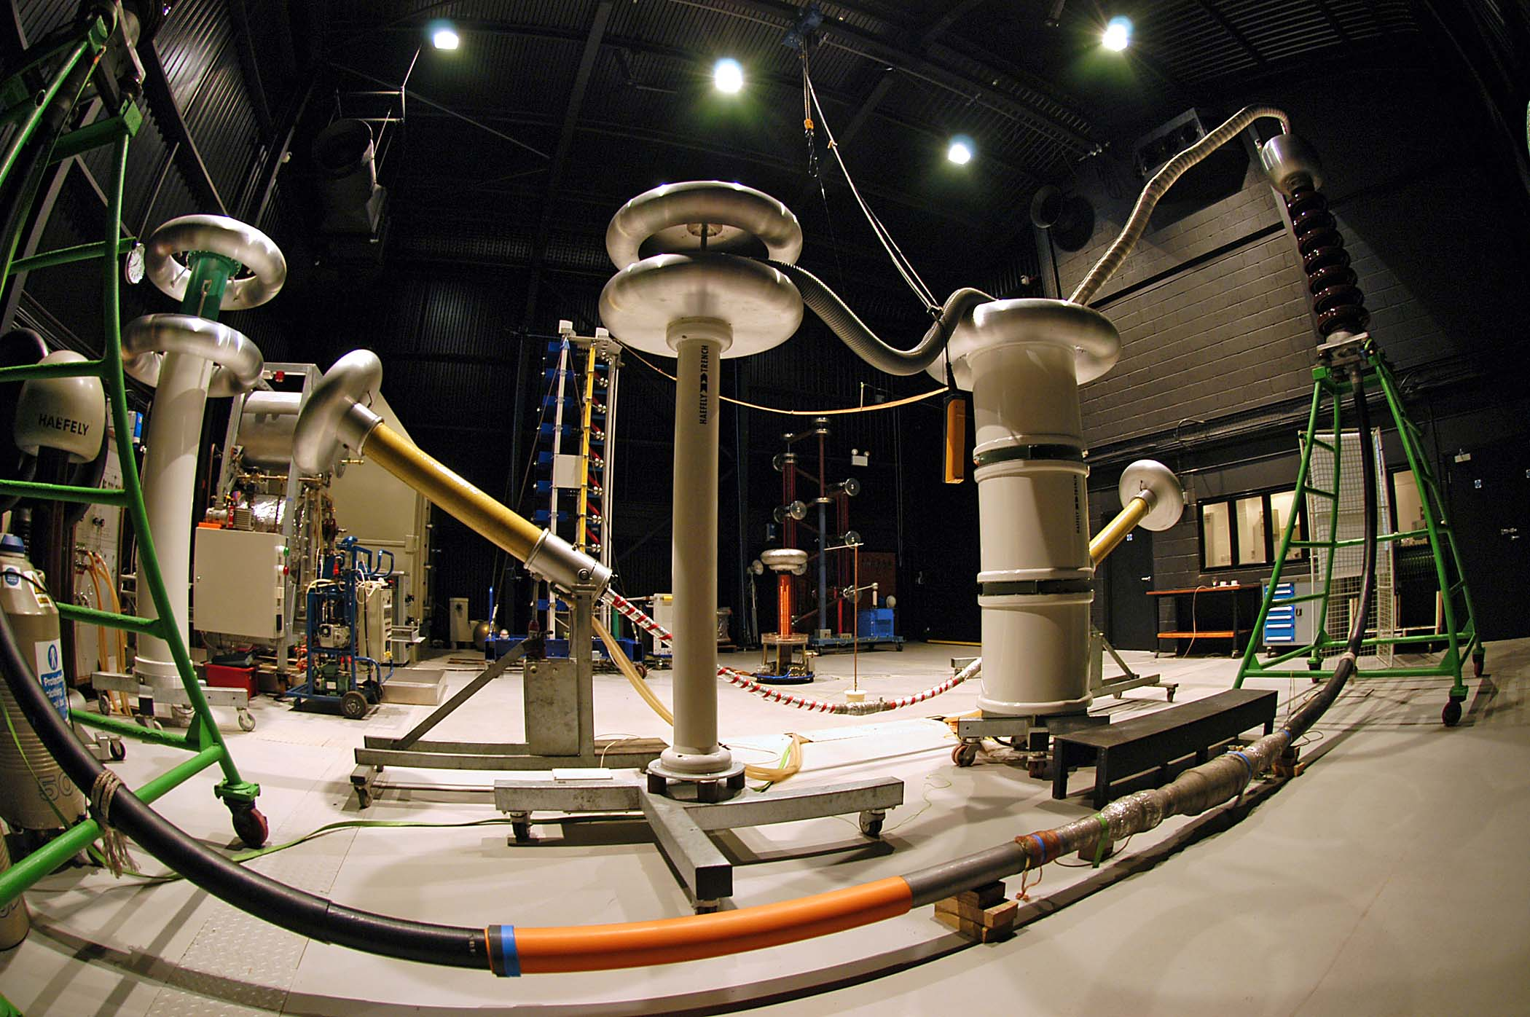
Notes:
You can use a full-bleed image to create impact on a page. Caption the image as shown.

