Slide 1



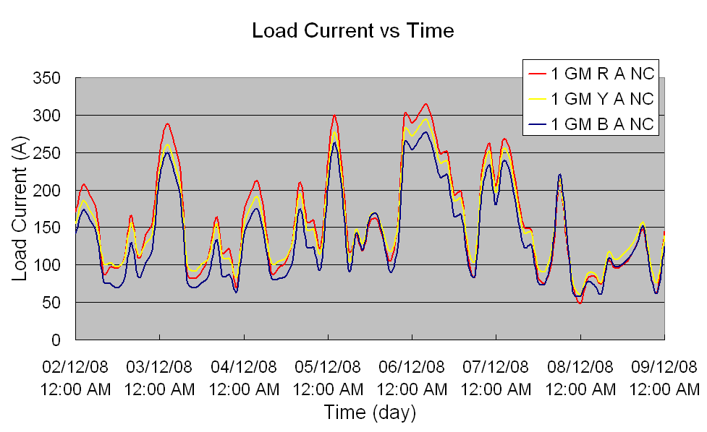
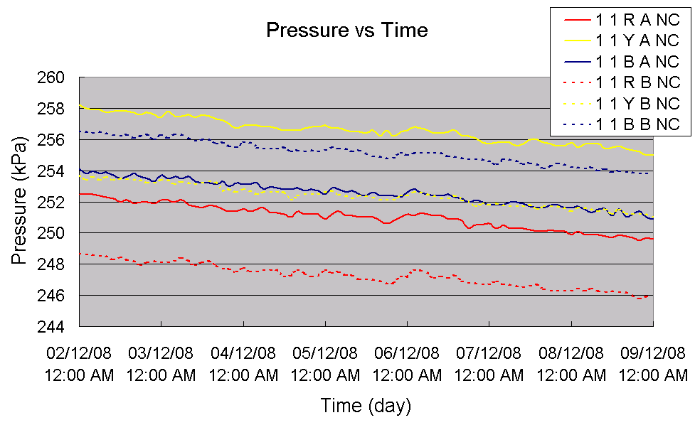
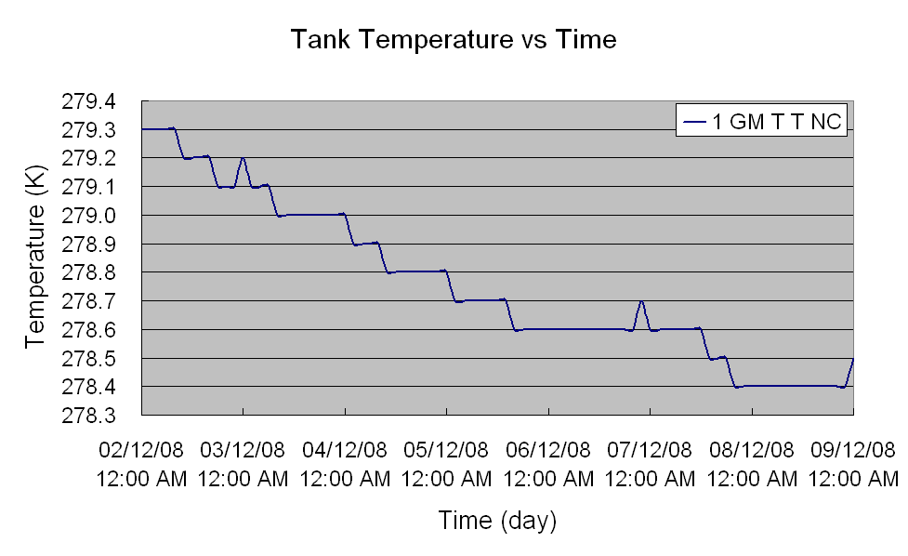
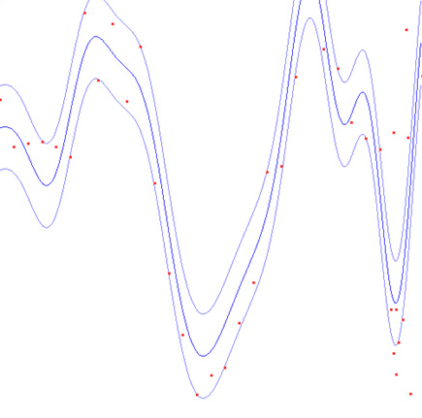
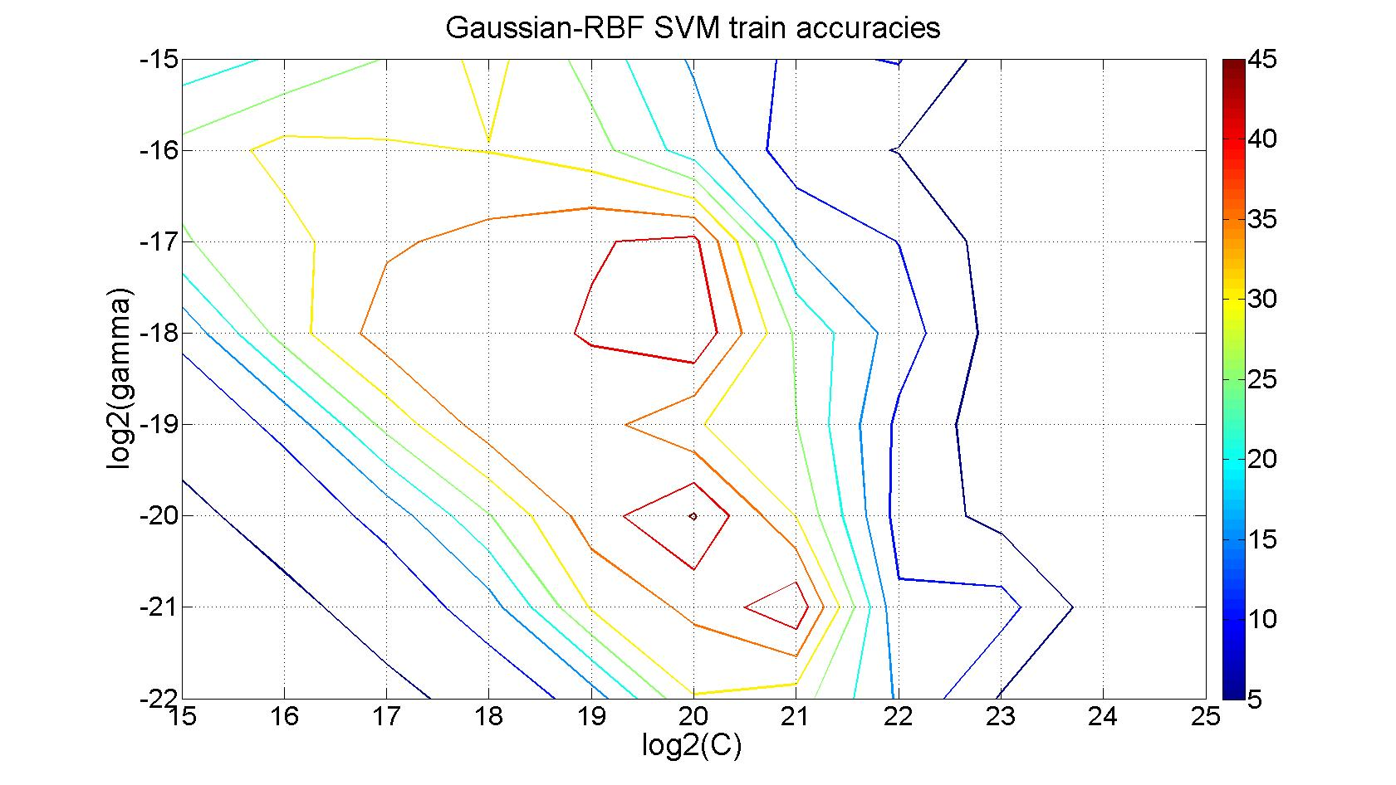
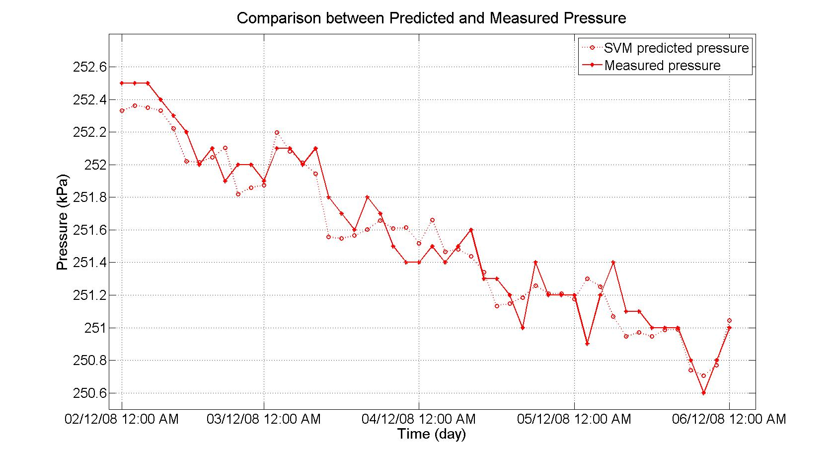
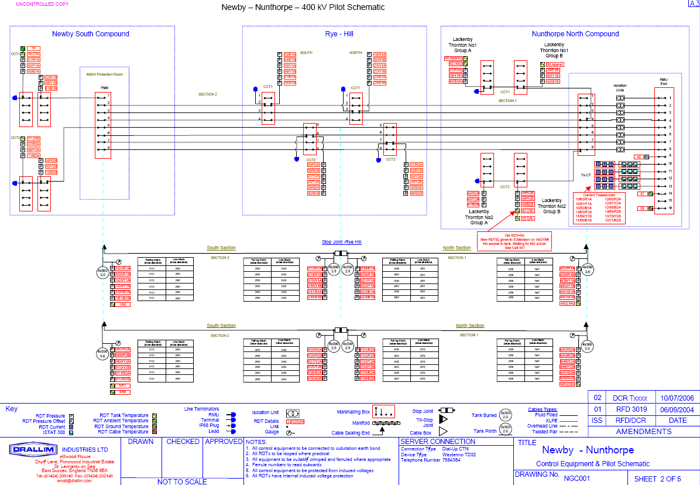
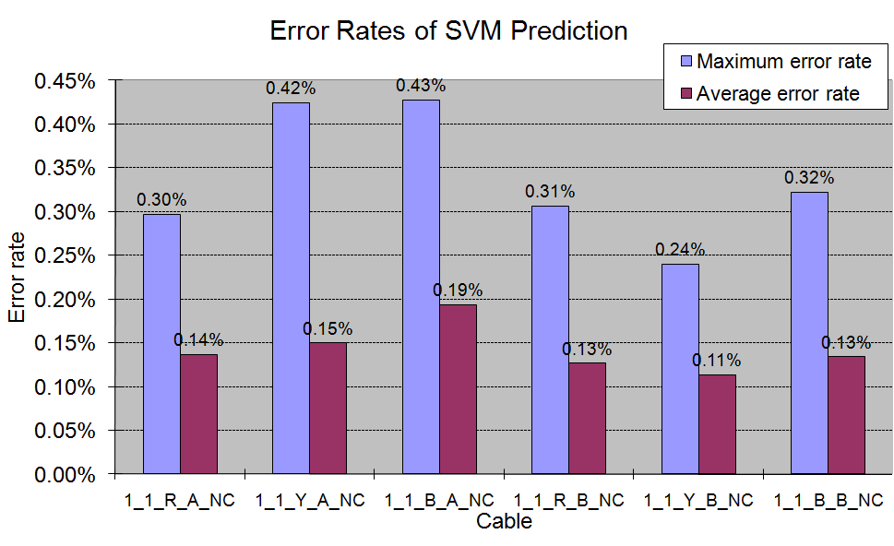
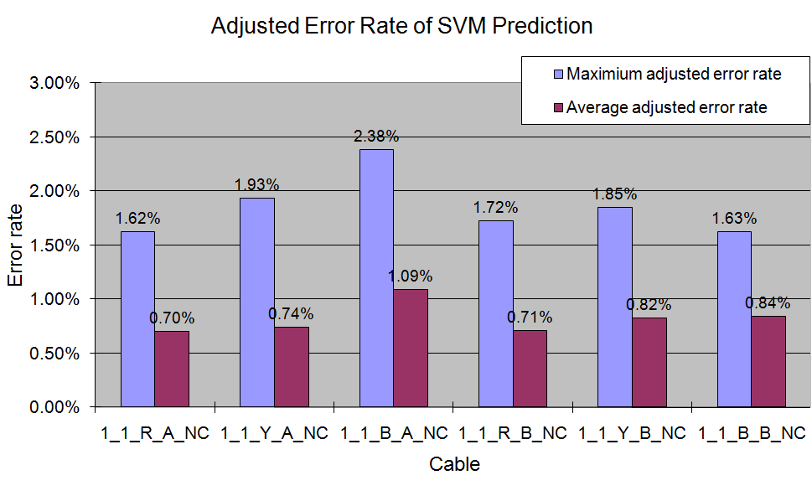
A New Method to Improve the Sensitivity of Leak Detection in Self-Contained Fluid-Filled Cables L. Hao¹, P. L. Lewin¹, S. G. Swingler¹ and C. Bradley² ¹University of Southampton, Southampton, UK ²National Grid, UK
Introduction
Raw Data and Data Pre-processing
Fluid-filled cables are the most widely used type of transmission cable in power networks due to their outstanding performance and long service history. As a fluid filled system, the cable circuit may have the potential to leak due to damage caused by unforeseen circumstances such as environmental effects, manual intrusions, installation problems or manufacturing defects. Leakage from a fluid-filled cable may have great impact on the reliability of network operation and cause environment contamination. Therefore, detection and location of leaks along the cable route is of interest to system operators.
Research to date has considered the detection of leakage from high pressure fluid-filled (pipe type) cables. Many methods have been investigated. However, due to the sensitivity or feasibility of these proposed methods, they have not been widely applied in the field. System operators need to be convinced that reliable detection or location of leak is readily achievable.
Moreover, there is little published research on detection of leaks for low pressure (self-contained) fluid-filled cables, due to the difficulties in measurement compared with pipe type cables. Proposed methods to date require rearrangement of the cable circuit and additional equipment whilst taking the circuit out of service.
A method of real-time detection of leaks for self-contained fluid-filled cables without taking them out of service has been assessed and a novel machine learning technique has been employed. This approach is based on the analysis of the measureable physical parameters of a 400 kV oil-filled cable system, in terms of pressure, temperature and load current, obtained from sensors of the existing condition monitoring system. A regression analysis based on the use of the Support Vector Machine technique is employed to predict future oil pressure trends in the cable system.
Figure 3 Load current in cables of circuit 1 group A
Figure 4 Pressure in cables of circuit 1 at north compound
Load current
1 A CT resolution
Pressure
0.1 kPa pressure RDT sensitivity
Temperatuer
0.1 °C (K) temperature sensitivity
Sampling interval
2 hours (nominal)
Figure 5 Temperature of cables of circuit 1 at north compound
Cable and Cable Route
Support Vector Machine Regression for Data Analysis
400 kV
2000 mm² copper conductor
Polypropylene paper laminate (PPL) insulation
Corrugated seamless aluminium (CSA) sheath
PVC anti-corrosion over sheath
5.7 km total length
Double circuits
Two cables per phase
10 straights and 1 stop joint per cable
The Support Vector Machine (SVM) is a method for finding functions from a set of labelled training data. The function can be either a classification function or a regression function. This learning machine uses a central concept of linear function (classification SVC and regression SVR) and kernel mapping for a number of learning tasks.
SVR Training
Gaussian Radial Basis Function: K(x_{i}, x_{j}) = exp(-γ||x_{i}-x_{j}||²)
Cross-Validation: 5-fold cross-validation
Grid-search : γ and C
Training data: 4 days
Figure 1 Schematic diagram of the arrangement of the cable circuits
Figure 6 SVM regression
Cable Monitoring System (Drallim)
Figure 7 Training accuracies for cable 1_1_R_A_NC
Figure 8 Predicted and measured pressure for cable 1_1_R_A_NC (4 days training data)
Results
Figure 2 Schematic diagram of Drallim cable monitoring system
Figure 9 Prediction error rates for cables 1_1_RYB_AB_NC
Figure 10 Adjusted prediction error rates for cables 1_1_RYB_AB_NC
Pressure Remote Digital Transducers (RDT)
4 pressure RDTs/ cable × 12 cables = 48 pressure RDTs
Temperature RDTs
4 oil tank temperature RDTs
2 ambient temperature RDTs
1 ground temperature RDT
Current RDTs
1 current RDTs/cable × 12 cables = 12 current RDTs
Error rate is calculated:
Adjusted error rate is calculated:
P_{p} – predicted pressure P_{m} – measured pressure P_{F} – pressure falling alarm
Conclusions
Improved sensitivity compared to the existing pressure falling and low alarm system
The use of DTS and RTTR system may provide improved detection sensitivity and feasibility of locating leaks
Contact details :
lh3@ecs.soton.ac.uk
University of Southampton, Highfield, Southampton, SO17 1BJ, UK

