Slide 1

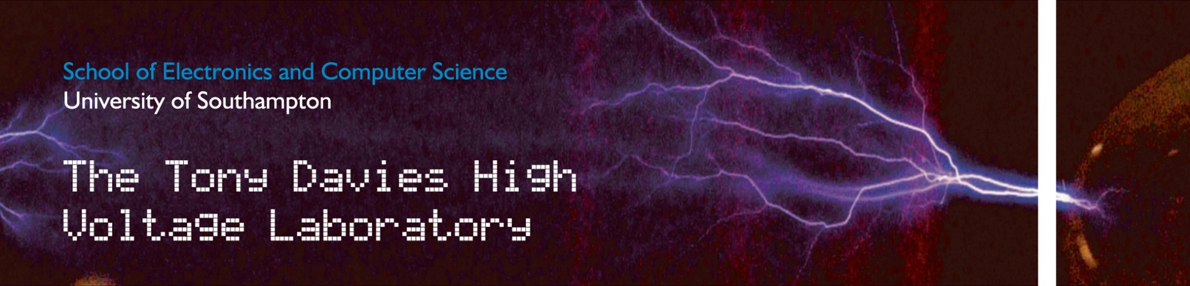
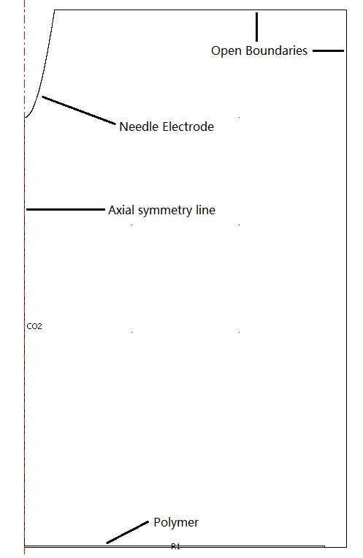
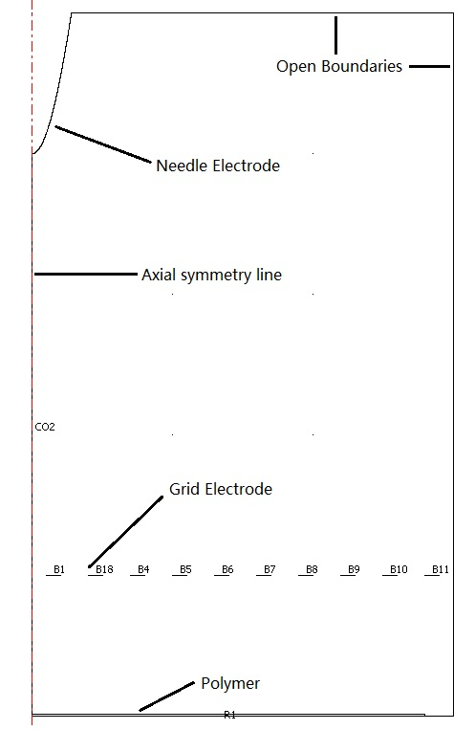
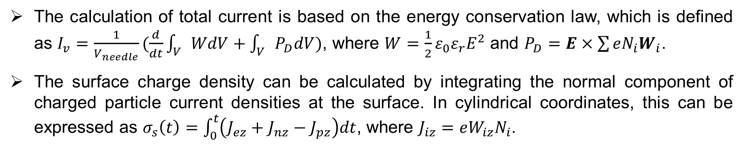

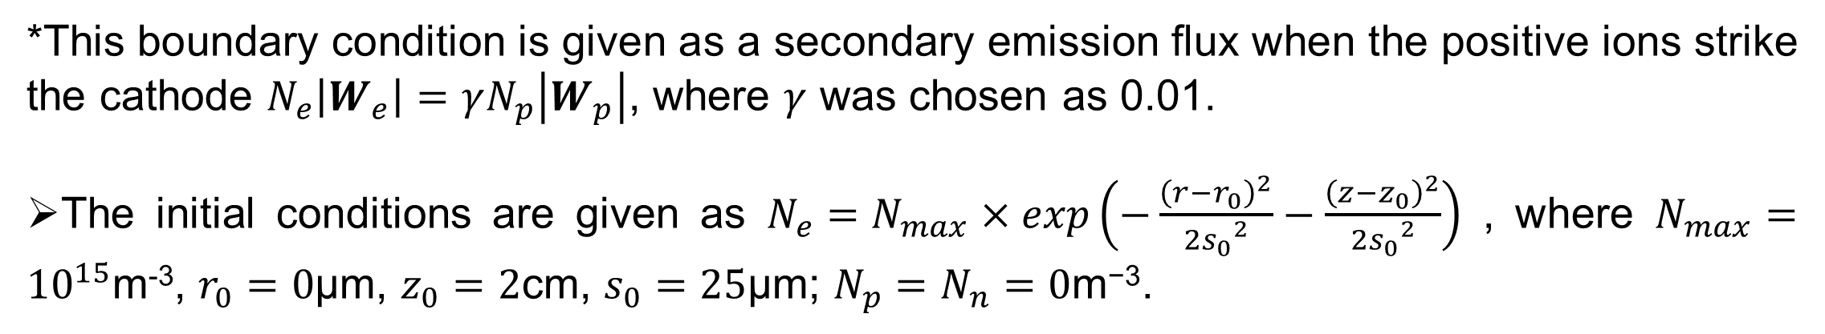
Numerical Modelling of Needle-Grid Electrodes for
Negative Surface Corona Charging System
Y. Zhuang*, G. Chen and M. Rotaru
University of Southampton, Southampton, UK
Introduction
Simulation Results
Surface potential decay measurement is a simple and low cost tool to examine electrical properties of insulation materials. During corona charging stage, needle-grid electrodes system shown in figure 1 is often used to achieve uniform charge distribution on the surface of the sample.
Two models (the needle only and the needle-grid charging system) based on gas discharging physics using COMSOL Multiphysics has been built to study the effects of geometrical parameters and voltage values of the charging system on the surface potential of the film sample and its characteristics with time.
The calculation of total current is based on the energy conservation law, which is defined as $I_{v}=\frac{1}{V_{needle}}(\frac{d}{dt}\int_{V}{WdV+\int_{V}{P_{D}dV}})$, where $W=\frac{1}{2}ε_{0}ε_{r}E^{2}$ and $P_{D}=E×\sum{eN_{i}W_{i}}$.
The surface charge density can be calculated by integrating the normal component of charged particle current densities at the surface. In cylindrical coordinates, this can be expressed as $σ_{s}\left(t\right)=\int_{0}^{t}{\left(J_{ez}+J_{nz}−J_{pz}\right)dt}$, where $J_{iz}=eW_{iz}N_{i}$.
Figure 1 Corona charging system
Model Description
A well-known hydrodynamic drift-diffusion model was used and it consists of a set of continuity equations coupled with Poisson’s equation.
$$\frac{∂N_{e}}{∂t}=N_{e}α\left|W_{e}\right|−N_{e}η\left|W_{e}\right|−N_{e}N_{p}β_{ep}−∇∙\left(N_{e}W_{e}−D_{e}∇N_{e}\right)$$
$$\frac{∂N_{p}}{∂t}=N_{e}α\left|W_{e}\right|−N_{e}N_{p}β_{ep}−N_{n}N_{p}β_{np}−∇∙\left(N_{p}W_{p}\right)$$
$$\frac{∂N_{e}}{∂t}=N_{e}η\left|W_{e}\right|−N_{n}N_{p}β_{np}−∇∙(N_{n}W_{n})$$
$$∇∙\left(ε_{r}∇V\right)+\frac{e}{ε_{0}}\left(N_{p}−N_{e}−N_{n}\right)=0$$
where t is time, e the electronic charge, $ε_{0}$ the dielectric constant of free space, $ε﷮r$ the relative permittivity and V the electric potential; subscripts e, p, n represent electrons, positive and negative ions respectively; $N_{e}$, $N_{p}$ and $N_{n}$ are the ion number density; $W_{e}$, $W_{p}$ and $W_{n}$ the electron, positive and negative ion drift velocities; $α$, $η$, $β$ and D the ionisation, attachment, recombination and electron diffusion coefficients respectively.
The geometries of the models include a 174µm radius of curvature needle setting perpendicular to a grid electrode (the thickness is neglected) and a 28mm diameter with 50µm thickness polyethylene. The bottom surface of the polyethylene is grounded and it is 2cm and 0.5cm away from the needle electrode and grid electrode respectively. The needle electrode was set as -6500V and the grid electrode -1000V.
Figure 3 Current waveform
Figure 4 Surface charge density
Discussion and Conclusion
Figure 2 Corona charging system simulation geometry
From figure 3, an impulse current is found in both systems and Trichel pulse can be observed in the needle only system, however, the amplitude and the appearance time is different. The reason is because that in the needle only system, the electrical potential at where the grid electrode placed is around -600V and in the Needle-Grid system it increased to -1000V, therefore, the electric field at the needle is lower in the Needle-Grid system, which delay the first impulse current.
Figure 4 shows the charge density alone the polymer surface for both systems. It can be seen that the impulse current leads a big step increase for the charge density. The curves shape of these two systems are different. The grid electrode is too closed to the polymer, therefore changes its shape at the beginning.
Other researchers have already proved that higher value of needle electrical potential (which can be known as higher electric field) will not effect the amplitude of the impulse current, but make it appears quicker [1]. Therefore, more simulation will be done by using different grid voltages or positions should be adjusted and all the models need to be run for a longer period to observe the effect of adding the grid electrode on surface potential.
Boundary and Initial Conditions
Boundary condition
Application mode | Convection and diffusion N_{e} | Convection and diffusion N_{p} | Convection and diffusion N_{n} | Electrostatics V
Axial symmetry line | Axial symmetry | Axial symmetry | Axial symmetry | Axial symmetry
Needle electrode | Flux* | Convective flux | Concentration=0 | Electrical potential
Grid electrode | Convective flux | Convective flux | Concentration=0 | Electrical potential
Polymer upper surface | Convective flux | Insulation/Symmetry | Convective flux | Surface charge
Open boundaries | Convective flux | Convective flux | Convective flux | Zero charge/Symmetry
Reference
*This boundary condition is given as a secondary emission flux when the positive ions strike the cathode $N_{e}\left|W_{e}\right|=γN_{p}\left|W_{p}\right|$, where $γ$ was chosen as 0.01.
The initial conditions are given as $N_{e}=N_{max}×exp\left(−\frac{{\left(r−r_{0}\right)}^{2}}{{2s_{0}}^{2}}−\frac{{\left(z−z_{0}\right)}^{2}}{{2s_{0}}^{2}}\right)$ , where $N_{max}={10}^{15}$m⁻³, $r_{0}=0$µm, $z_{0}=2$cm, $s_{0}=25$µm; $N_{p}=N_{n}=0\text{m}\text{−3}$.
[1] Tran, T. N., Golosnoy, I. O., Lewin, P. L. and Georghiou, G. E. (2011) “Numerical modelling of
negative discharges in air with experimental validation”, Journal of Physics D: Applied Physics, 44.
Contact details :
yz205@ecs.soton.ac.uk
University of Southampton, Highfield, Southampton, SO17 1BJ, UK

