Slide 1
Using TAMA to Understand Online Lives
Clare Hooper
Eindhoven University of Technology

Slide 2
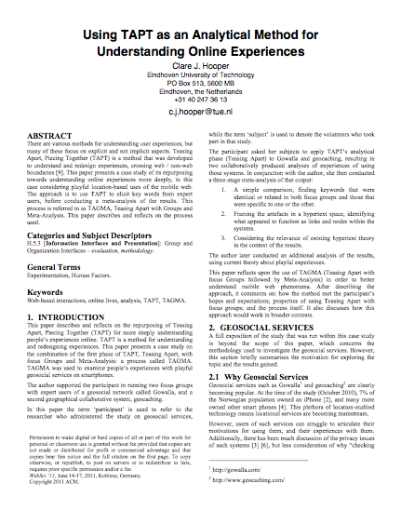
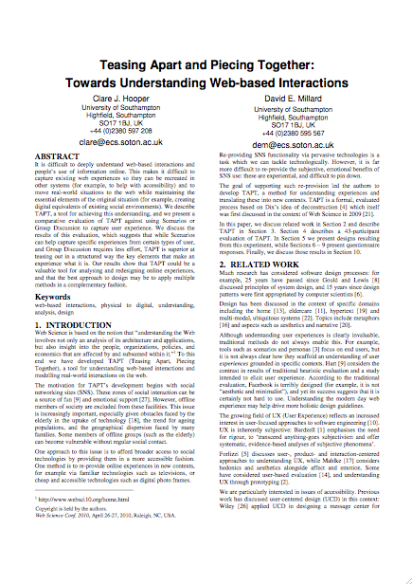
Teasing Apart with Meta Analysis

Slide 3
The case study
(I shall not be talking about geosocial services today)
Notes:
Interview; 2 focus groups; interview; meta analysis; interview. This was in parallel with 3 other studies of TAPT, which corroborated the findings.

Slide 4
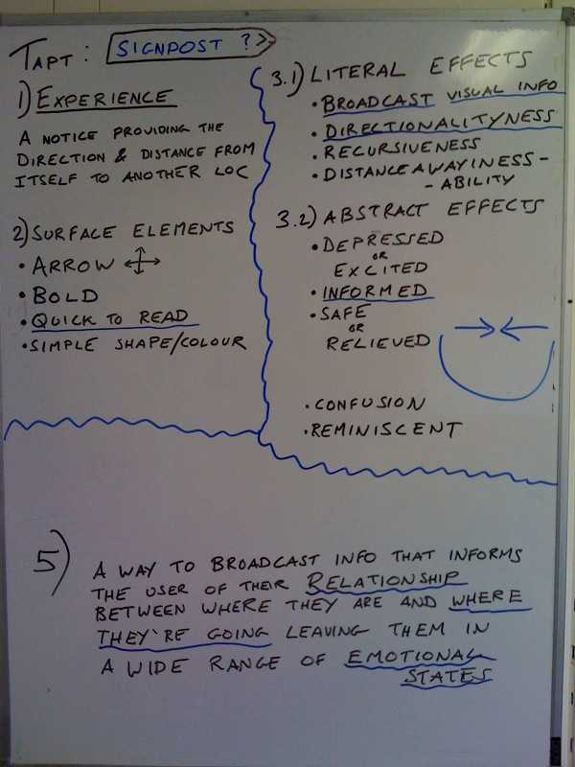
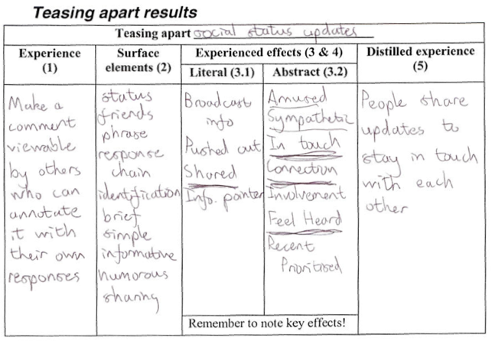
Notes:
Describe TA, note that:-
Subjects express their experiences
Technology-neutral (experience-focused) descriptions
Rapid; repeatable; rich data!

Slide 5
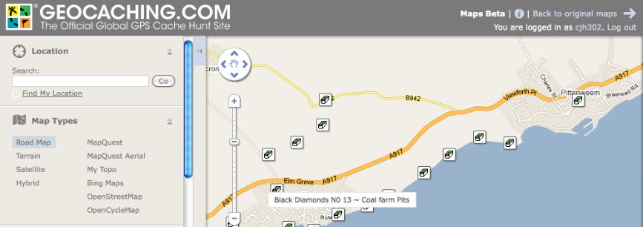
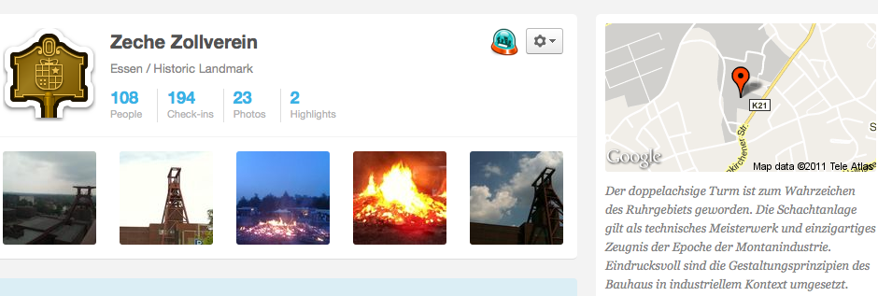
Notes:
Group discussion helped subjects reach more powerful insights
Interpretation of instructions
Physical set-up and group size → group dynamics?

Slide 6
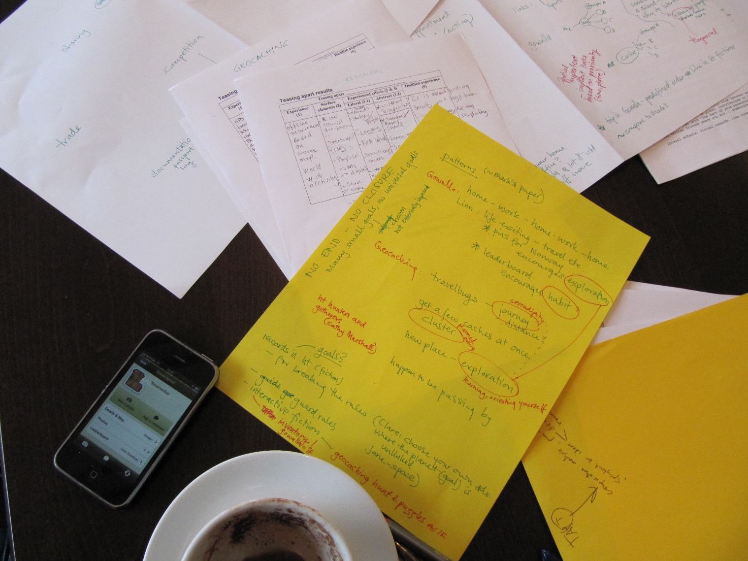
…with Meta Analysis
Describe it
Notes:
Meta analysis: 1) simple comparison (related and contrasting keywords); 2) hypertext perspective, links ‘n’ nodes; 3) examining existing hypertext theory (key words start point), and later, playful experience theory (abstract effects start point)
Prior frameworks: increase understanding, verify findings

Slide 7
Teasing Apart with Meta Analysis
Flexibility
Teasing Apart: focus groups, researchers, anonymous participants…
Meta Analysis: seek patterns, or categorise effects, or…
Users articulate experiences in technology-neutral terms
A way to understand online lives!

