Slide 1
Cross-disciplinary methods for understanding experience
Clare Hooper, Eindhoven University of Technology

Slide 2
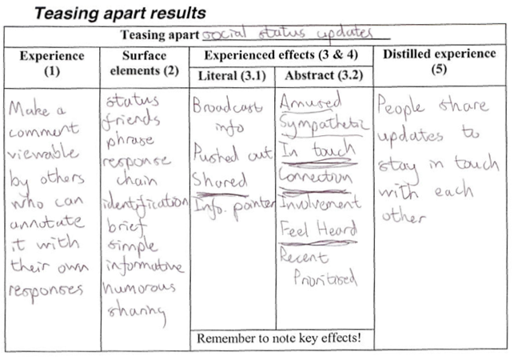
Teasing Apart,
Piecing Together (TAPT)
Notes:
For understanding and redesigning experiences
Analyse on various levels, then redesign
E.g. social networking (web → voice). Location finding (signposts/tour guides → digital).

Slide 3
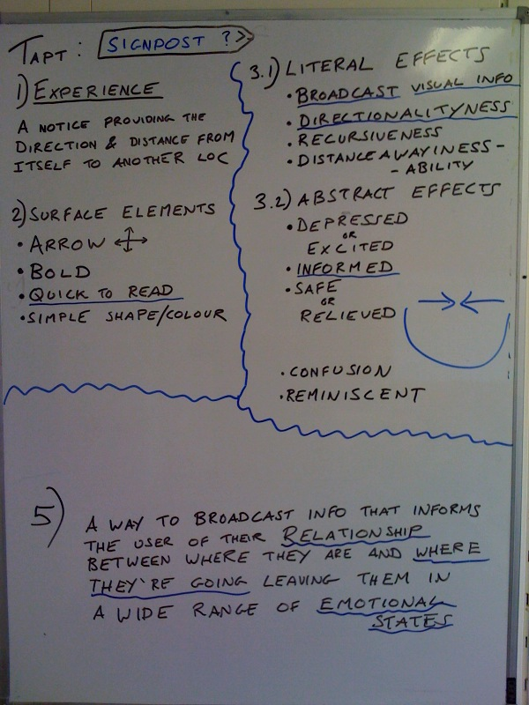
Teasing Apart,
Piecing Together (TAPT)
Notes:
For understanding and redesigning experiences
Analyse on various levels, then redesign
E.g. social networking (web → voice). Location finding (signposts/tour guides → digital).

Slide 4
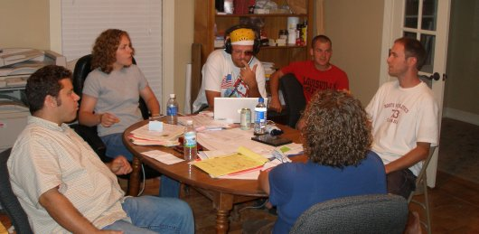
Context Mapping
Preparation
Sensitization: participants are sent packages to trigger, encourage, and motivate them to think about the area in question
Meetings in which participants do generative exercises
Analysis
Communicate results
Image: http://www.rebuildlakeshore.com/2007/06/16/the-07-summer-team/
Notes:
For mapping user interaction with products: what’s good and bad.
Sensitisation phase, ppl think about the area; generative meetings
E.g. understand collocated meetings in ID

Slide 5
Comparison
Ease of use
  No big issues (but TAPT is quicker!)
Email: c.j.hooper@tue.nl Twitter: @clarejhooper

Slide 6
Comparison
Ease of use
  No big issues (but TAPT is quicker!)
Type of insight
  Both yield tacit knowledge
  TAPT strong at emotional/social aspects
  CM strong for group generation of ideas
Email: c.j.hooper@tue.nl Twitter: @clarejhooper

Slide 7
Comparison
Ease of use
  No big issues (but TAPT is quicker!)
Type of insight
  Both yield tacit knowledge
  TAPT strong at emotional/social aspects
  CM strong for group generation of ideas
How to choose?
  TAPT for: understanding diverse individual experiences; compare and contrast; redesign
  CM to ask “How do we improve this thing?”
Email: c.j.hooper@tue.nl Twitter: @clarejhooper

