Slide 1
Corrosive Sulphur & Oil Passivation
Transformer Oil Passivation and Impact of Corrosive Sulphur
P. S. Amaro¹, J. A. Pilgrim¹, P. L. Lewin¹, R. C. D. Brown² , G. Wilson³, P. Jarman³ ¹ The Tony Davis High Voltage Laboratory, University of Southampton
²Chemistry, University of Southampton
³ National Grid, Warwick
18 January 2012
Notes:
Please use the dd month yyyy format for the date for example 11 January 2008. The main title can be one or two lines long.

Slide 2
Presentation Overview
Effects of Corrosive Sulphur in Insulation Oil
Development of Faults
Detection Mechanisms
Current Research Focus
Transformer Oil Passivation
Physical Property Changes
Short & Long-term Effects
Conclusion and Further Work
Notes:
If using a school logo, make sure that if you have a long page title, it does not encroach on the logo. Allow about 2cm around the logo. Run the page title onto two lines if necessary.

Slide 3
Corrosive Sulphur Impacts
Notes:
Use divider pages to break up your presentation into logical sections and to provide a visual break for the viewer. The title can be one or two lines long.

Slide 4
Corrosive Sulphur
“Elemental sulfur and thermally unstable sulfur compounds in electrical insulating oil that can cause corrosion of certain transformer metals such as copper and silver” ASTM D2864
Not formed in transformer’s normal operational conditions
Known sources of contamination: poorly refined crude oil, addition of chemical compounds
Other Suspected sources: gaskets, water-based glues, copper and Kraft paper
Notes:
If using a school logo, make sure that if you have a long page title, it does not encroach on the logo. Allow about 2cm around the logo. Run the page title onto two lines if necessary.

Slide 5
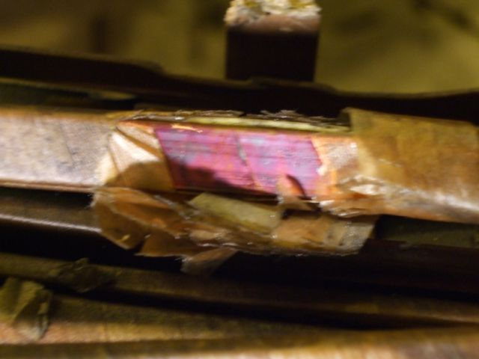
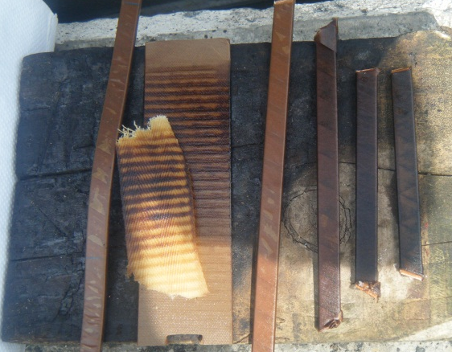
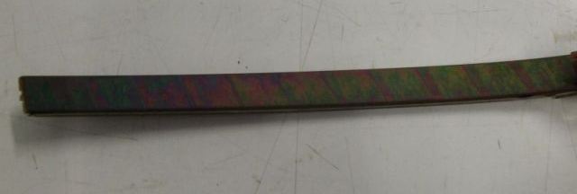
Sulphur Compounds
Multiple Sources = Multiple Compounds
Thiophens, Disulphides, Thio-ethers, Mercaptans, Sulphur
Dibenzyl-disulphide (DBDS) was identified experimentally to be primary compound in corrosive sulphur related faults
Increasing order of corrosion
Contaminated Conductors (G. Wilson, National Grid)
Notes:
If using a school logo, make sure that if you have a long page title, it does not encroach on the logo. Allow about 2cm around the logo. Run the page title onto two lines if necessary.

Slide 6
Cu₂S Faults Development
DBS
DBDS
Schematic of Cu₂S formation mechanism (CIGRE Final Report 2009, WG A2-32)
Notes:
If using a school logo, make sure that if you have a long page title, it does not encroach on the logo. Allow about 2cm around the logo. Run the page title onto two lines if necessary.

Slide 7
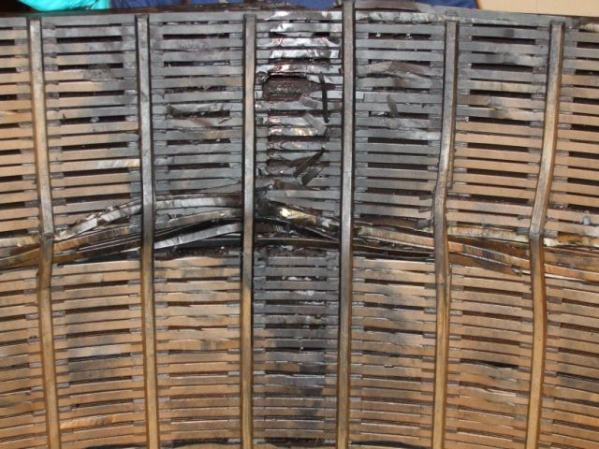
Fault Location in Transformer
Copper Conductor
Insulating Paper
Cu₂S
Short-Circuited
Cu₂S
Copper Conductor
Cu₂S transformer fault (G. Wilson, National Grid)
Copper Sulphide accumulates and bridges two coil turns
Due to the semiconductive nature of Cu₂S a short circuit occurs and a turn-to-turn fault is developed

Slide 8
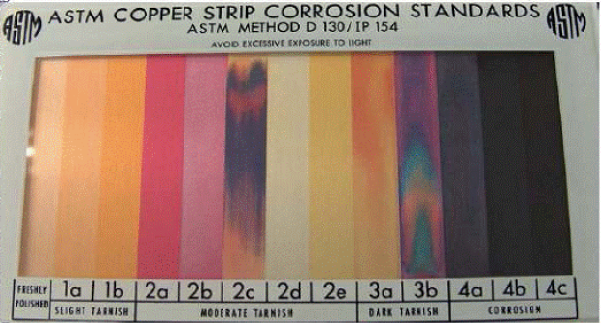
Detection Methods
Qualitative Plain Copper ASTM D1275A/B & Covered Conductor Deposition (CCD) IEC 62535 Tests
Copper strip immersed in oil, accelerated aging conditions
CCD has a layer of Kraft paper around the copper strip
ASTM copper strip corrosion standard
Quantitative Test
Alumina-based solid phase extraction + Gas Chromatography-Mass Spectrometry (GC-MS) detect DBDS to a level of 0.1 ppm (Toyama et al., 2009)
Notes:
If using a school logo, make sure that if you have a long page title, it does not encroach on the logo. Allow about 2cm around the logo. Run the page title onto two lines if necessary.

Slide 9
Mitigating Techniques
Oil Replacement
5-12% of contaminated oil remains after retro filling
Quantity of oil absorption materials, shape of the transformer tank, the location of the drainage valve
Oil Depolarisation
Combination of solid reagents, chemicals and sorbents
Reduces DBDS content to 5 mg/kg (5 ppm)
Transformer can be on or off-load
Also removes metal passivator and water content
Passivation
Notes:
If using a school logo, make sure that if you have a long page title, it does not encroach on the logo. Allow about 2cm around the logo. Run the page title onto two lines if necessary.

Slide 10
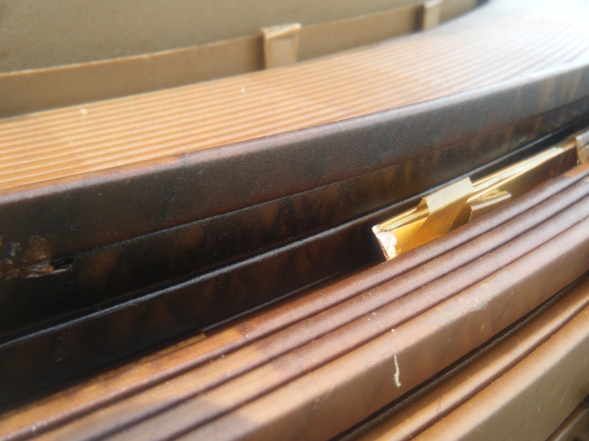
Research Objectives for Cu₂S
Relationship of variables such as Temperature and Oxygen
Measurable electrical property changes
Model the degradation process
Develop an online condition monitoring technique for Cu₂S
Cu₂S Deposition on Insulation Paper (G. Wilson, National Grid)
Notes:
If using a school logo, make sure that if you have a long page title, it does not encroach on the logo. Allow about 2cm around the logo. Run the page title onto two lines if necessary.

Slide 11
Transformer Oil Passivation
Notes:
Use divider pages to break up your presentation into logical sections and to provide a visual break for the viewer. The title can be one or two lines long.

Slide 12
Oil Passivation
Passivation is a technical term used to define the formation of non-permeable surface layers on metal
Triazole-based passivators
1,2,3-benzotriazole (BTA)
Irgamet 39TM (CIBA Speciality, Basel, Switzerland)
Previous use of passivators:
Japan for reducing streaming charging tendency, Australia for improved oxidation inhibition
Notes:
If using a school logo, make sure that if you have a long page title, it does not encroach on the logo. Allow about 2cm around the logo. Run the page title onto two lines if necessary.

Slide 13
Effects of Passivation
Short-term
Suppress Copper Sulphide
The increase of H₂, CO and CO₂ concentration is occurs in the first seven days after passivating the insulation oil.
Long-term
The passivation is depleted and oil returns to its corrosive level
Notes:
If using a school logo, make sure that if you have a long page title, it does not encroach on the logo. Allow about 2cm around the logo. Run the page title onto two lines if necessary.

Slide 14
Research Objectives for Passivation
Stability of the non-permeable surface layers on metal
Effects on Oil and Paper insulation
Relationship of passivator to metal (m²) and to DBDS(ppm)
Thermal & Electrical property alterations
Analytical tools to quantify the degradation of passivator
Notes:
If using a school logo, make sure that if you have a long page title, it does not encroach on the logo. Allow about 2cm around the logo. Run the page title onto two lines if necessary.

Slide 15
Conclusion & Future Work
Notes:
Use divider pages to break up your presentation into logical sections and to provide a visual break for the viewer. The title can be one or two lines long.

Slide 16
Conclusion
Corrosive Sulphur & Oil Passivation
Define Relationship between enviromental variables
Detect electrical properties changes
Model degradation process
Current stage of research project
Assessment of the corrosive sulphur and oil passivation state-of-the-art knowledge

Slide 17
Future Work
Frequency Dielectric Spectroscopy (FDS)
Use low frequency range spectrum to evaluate paper, pressboard dielectric loss and oil conductivity
Previous experiments have been able to identify different moisture contents in Kraft paper
Polarisation Depolarisation Currents (PDC)
Applied dc , short circuit to ground, voltage build-up
Each materials has specific relaxation times

Slide 18
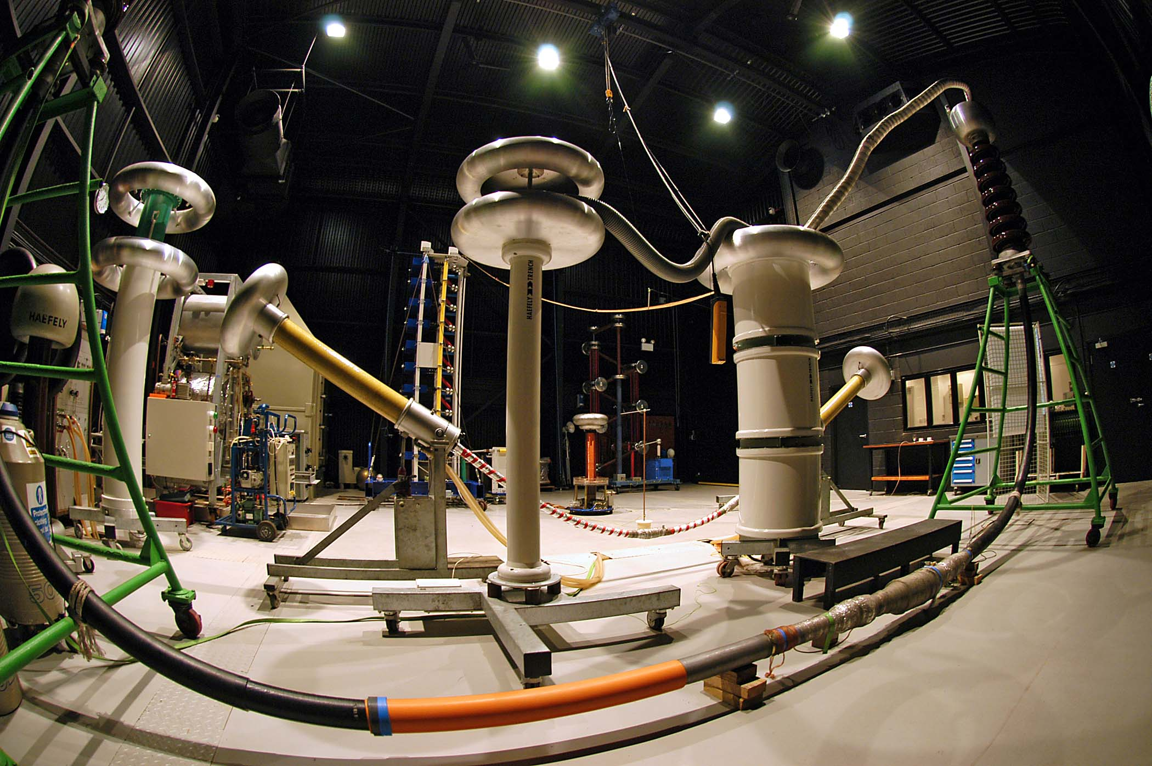
Thank you
Notes:
You can use a full-bleed image to create impact on a page. Caption the image as shown.

