Slide 1
A View from Hampshire
Jonathan Montgomery
Chair NHS Hampshire

Slide 2
The Government’s Objectives
Increased power to patients
Better outcomes and service quality
Strong leadership and greater freedom for frontline professionals

Slide 3
Our NHS is not broken…
We are living longer
We are living ‘better’
Patient satisfaction is improving

Slide 4
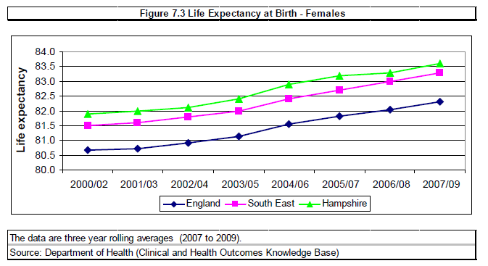
Living Longer

Slide 5
Living Better: Hampshire
3% fewer than national average of people reported a limiting long-term illness
Significantly less likely to suffer hip fracture over 65 than national average
Significantly less likely to die early of heart disease and stroke or cancer than national average
Notes:
Comparing age standardised rates, less likely to suffer a hip fracture in Hampshire than in England (467.1 per 100k population v 479.2) – worse in Southampton, better in IoW.
but still 14.9%

Slide 6
Views on the local NHS
86% satisfied with the running
81% think it provides good services
90% are satisfied with their GP
80% say the NHS helps improve their and family’s health and wellbeing
35% expect improvements; 20% to get worse (England 27% & 30% respectively)

Slide 7
Although it may be broke
We are living longer
We are living ‘better’
Patient satisfaction is improving

Slide 8
The Downside…
Only 28% think health and social care service work well together
Only 14% think they can influence decisions in the NHS
Only 47% think the NHS is increasing their choice over care and treatment
Notes:
Figures for Hampshire

Slide 9
Four Key Ideas
‘No Decision About Me Without Me’
Public Health returns to local authorities
Commissioning Reform
Increasing Patient choice
‘Any Qualified Provider’

Slide 10
‘No Decision About Me Without Me’
Taking responsibility for ourselves
Choosing your GP & hospital (‘Any Qualified Provider’)
Personal budgets for continuing care
Health Watch
Stronger voice and more control for public
Lay members on commissioning bodies
Consultation and engagement duties
Openness
Public meetings
Duty of candour

Slide 11
Public Health
Local authorities and the well-being agenda
Prevention
Tackling Inequalities

Slide 12
Commissioning Reform
Clinical Commissioning Groups
National Commissioning Board
Specialised Commissioning
Primary Care Commissioning
Commissioning Support
Health and Well-being Boards

Slide 13
Clinical Commissioning Geography

Slide 14
Illustrative Spend Hampshire

Slide 15
Health and Wellbeing Boards
JSNA
JH&WBS
Elected Counsellors
Adult Social Care
Clinical Commissioning Groups
NHS Commissioning Board?
Children
Public Health

Slide 16
Challenges
Responsibilities of Secretary of State
Privatisation?
Service Provision
Commissioning Support
Fragmentation?
The ‘Nicholson Challenge’
Quality, Innovation, Productivity and Prevention
Medical and health care ethics

Slide 17
The Objectives
Increased power to patients
Better outcomes and service quality
Strong leadership and greater freedom for frontline professionals

