Slide 1

Keeping the Lights On
Prof Paul Lewin*, Dr Liwei Hao, Samantha Tye, Mark Mitchison
and Justin Steele-Davies
Notes:
Key words
- Independent eLearning resources
- Electrical Engineers shortfall and ways of addressing it.
- Working with industry on non-accredited material
Abstract for conference submission
The project name is derived from the current term ‘Keeping the lights on’, which sums up the power production, transmission and distribution challenges of the future. The small area addressed by this activity is the massive skills shortage that is looming within the power industry. The aim of the project was to provide a taster of the training available at universities and interest employers/ees in undertaking more extended courses. The taster also provided valuable learning resource in its own right on key topics within the power industry. The aim of this session will be to provide an overview of the technologies used for delivery, the integration with the parallel masters programme and the feedback from students and staff within industry. Some of the key challenges and successes both within HE and industry with also be discussed.
Outline
The importance of collaboration within the power engineering sector, (both training and research / validation)
Limited provision for this type of training means this is an area that HEIs can add value if they have the expertise
Who choses the syllabus, industry or HEIs?
Distance learning and the challenges in working with un-registered students
Technologies for delivery all built upon prior work, Recorded lectures, Virtual Experiments, Dynamic Computer Aided Assessment and the Virtual Learning Environment
All the key outputs are available for use by industry and HEIs
Student response self study material, not an undergraduate perspective
Sign posting to key issues if this type of material is to be developed else where
Outcomes from the project and how they have informed institutional plans going forward
Other valuable applications / extensions of the activity for health and safety etc.

Slide 2
Introduction
Electrical Power Engineering Industry
Loss of expertise, 95% retired in 2025 (NSAP)
Significant recruitment of Graduates
Significant future change in infrastructure, £35bn
Limited electrical power content in degree courses
Clear need for resources to assist in upskilling the current/future workforce and also to provide materials for use within HEI degree programmes
Notes:
The main title can be one or two lines long.

Slide 3
Completed Modules
Cable Circuit Design
Transmission and Distribution Systems
Conventional and Nuclear Generation
Network Analysis
Transformers and Switchgear
Still under testing
Notes:
The main title can be one or two lines long.

Slide 4
Module layout
Each work package is 40 hours (minimum) | No. | Student hours | total
Guide to module and learning objectives | 1 | 0.5 | 0.5
Lecture (30mins) slides to accompany lectures | 6 | 2 | 12 | 6 – 8 lectures in each module
Objective tests | 6 | 0.5 | 3 | 5 – 8 questions: multiple choice, true/false, numerical calculation, matching, short answer
Virtual experiment | 1 | 3 | 3 | Introduction , interactive experiment and quiz
Work sheets | 2 | 2 | 4 | Original and well-designed expanded questions
Supporting text and examples | 6* | 1 | 6 | ELEC modules lecture notes
Examination question sheets | 6* | 1 | 6 | ELEC modules exam papers
Recommended text and web links | 6* | 1 | 6 | Library and internet resources
 | Total student time |  | 40.5
Notes:
The main title can be one or two lines long.

Slide 5
Simulations and experiments
Simulations based on models
http://ve.soton.ac.uk/ves/phasor.html
Virtual Experiments direct from the lab
http://ve.soton.ac.uk/ves/transformer.html

Slide 6
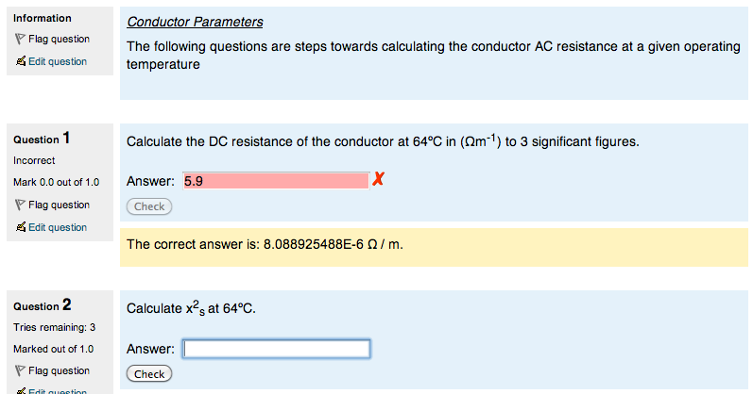
Tutorials and Objective tests
Tutorials
https://www.hestem.soton.ac.uk/lectures/cable_circuit_operation_1/
Objective test

Slide 7
Issues and Barriers
Staff turnover
Training takes time
Getting to know the staff
eLearning staff have lots of projects
Academic Staff buy-in
Some keen, others required incentives
Creative Commons
Notes:
The main title can be one or two lines long.

Slide 8
Pathways to Impact
National Grid
Two level approach; Training management team and Asset Engineers
Feedback from a NG foundation engineer in his 2nd year
Competition, especially from Europe
Electricity Alliance
In house training
Competency assurance
Distance learning degrees
Graduate experience
Notes:
The main title can be one or two lines long.

Slide 9
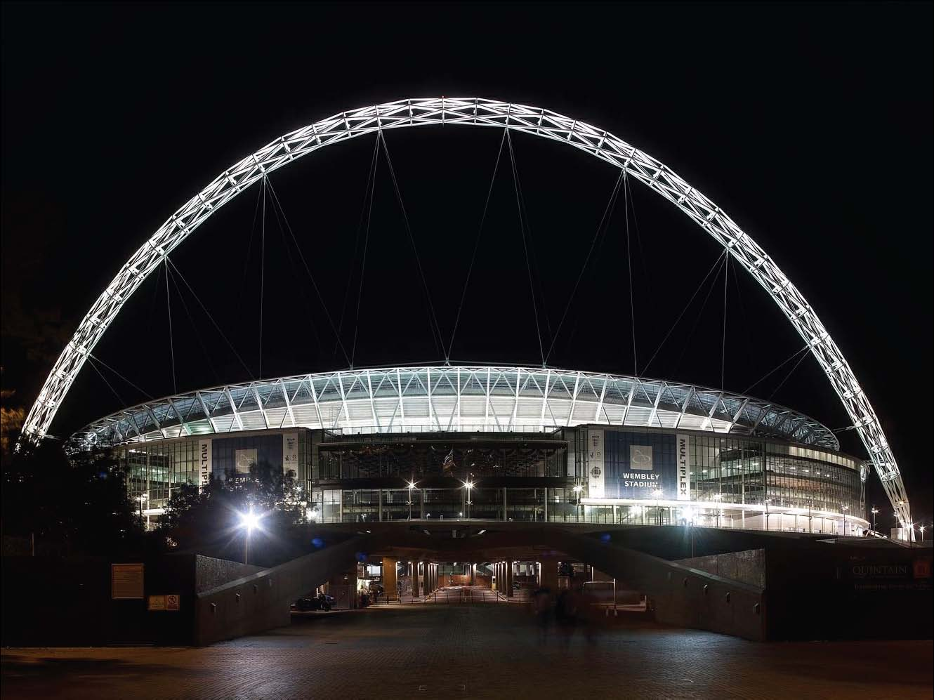
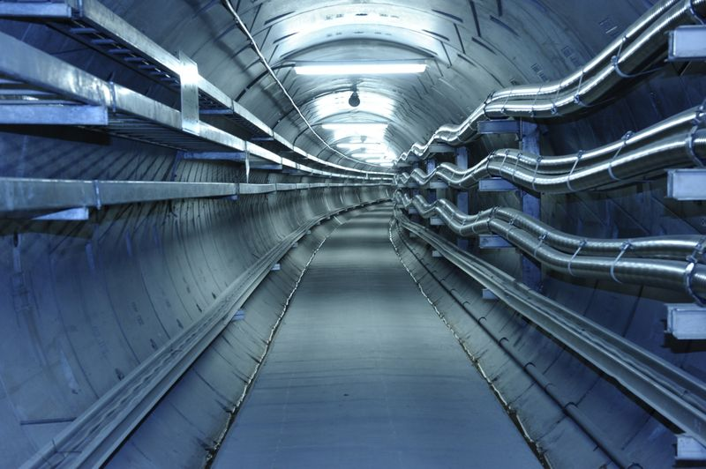

Slide 10
Pathways to Impact
Development of resources seen to be of great benefit to existing UoS Courses;
MSc in Energy and Sustainability with Electrical Power Engineering
Huge increase in size of cohort (40+ 2011/12)
Materials also available for Power Academy students – improve their knowledge prior to summer placements
Papers planned for submission to the IJEEE
Material being developed for Malaysia EEE degree
Sustainability of work
Notes:
The main title can be one or two lines long.

Slide 11
Spin-off activity
Development of High Voltage Laboratory Induction materials
Use of ‘virtual experiment’ approach to develop specific training for experiments
Large scale: 1 MV Impulse Generator
Fragile and/or expensive: Spectrometers
Recruitment
Notes:
The main title can be one or two lines long.

Slide 12
Thank you and Links
hestem.ac.uk/news/virtual-experiment-manual
hestem.ac.uk/activity/value-chemistry-and-physics-students-recorded-lectures
Camtasia / Panopto
Moodle 2.1 QE, and Martin Greenhow
http://www.mathcentre.ac.uk:8081/mathseg/

