Slide 1
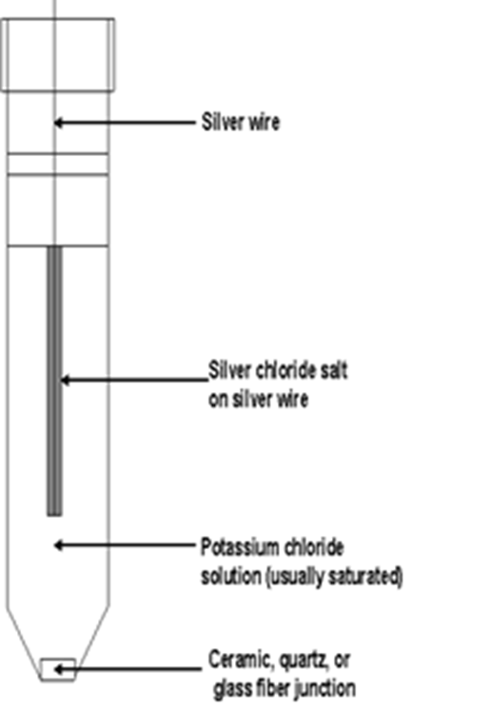
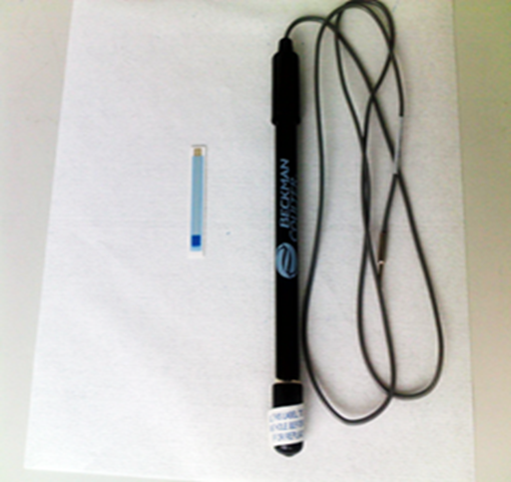
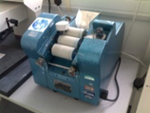
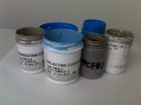
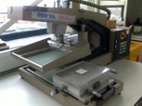
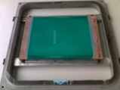
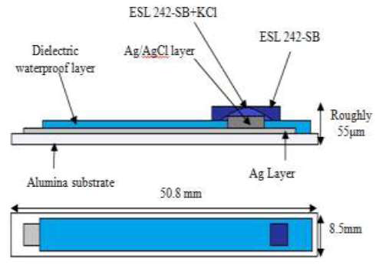
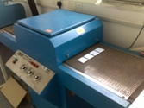
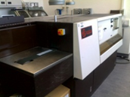
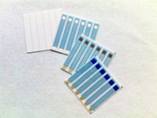
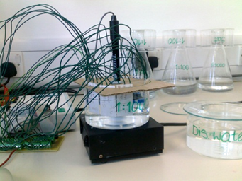
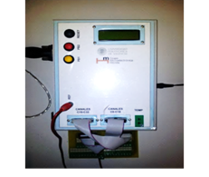
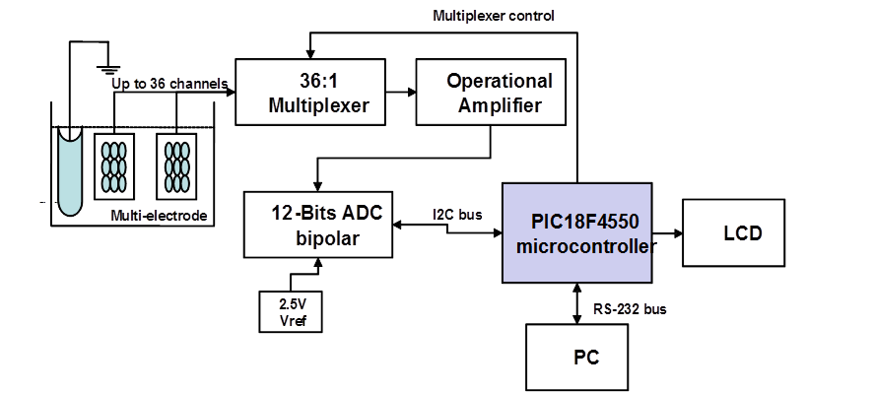
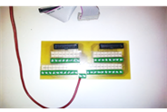
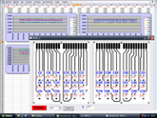
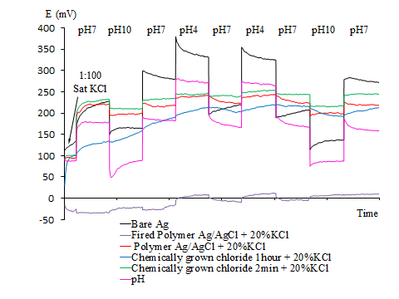
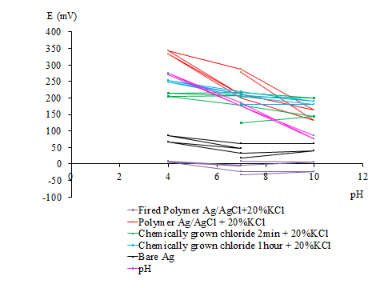
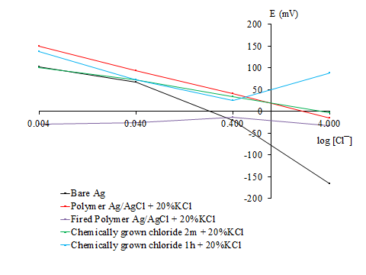
Performance of miniaturised Thick-Film solid state pH sensors Monika Glanc-Gostkiewiczª, Marios Sophocleous^{b}, John Atkinson^{b}, Eduardo Garcia-Breijo^{c} ^{a, b}Faculty of Engineering and the Environment, University of Southampton, United Kingdom ^{c}Instituto de Reconocimiento Moleculary Desarrollo Technológico, Universidad de Valencia, Spain
+
Rivers are the habitats for living organisms and any changes of the alkalinity or acidity of the water can be critical to the survival of aquatic life. Agriculture industry is a major user of water resources. It also contributes intensely to water pollution through processes such as use of pesticides, fertilisers, spreading of slurries or manure. To detect the contamination of water courses, a network of early warning systems of in situ water miniaturised electrochemical sensors is required as a simple alternative to the current methods of detecting pollution in rivers [1].
1. Introduction
Objective
The performance of novel solid state Thick-Film pH sensor for water quality sampling suitable for deployment in remote catchment areas is presented.
The miniaturised screen printed planar pH sensors are an alternative to the commercially available pH electrode and reference electrode, which have many disadvantages such as high-cost, large size, mechanical fragility and limited shape [2].
One of the approaches for improvement of the ruggedness of the pH electrode is the implementation of metal oxides as ion selective electrodes used in combination with screen printed silver/silver chloride (Ag/AgCl) reference electrodes.
To investigate a formulation and production process of the alternative thick film pH sensors.
To develop a miniaturised solid state Ag/AgCl Thick-Film reference electrode which will attempt to mimic commercial single junction reference electrode.
${AgCl}_{(s)}$+ $e^{−}↔ {Ag}_{\left(s\right)}$+ ${Cl}^{−}$
E= $E^{θ}+ \left(\frac{RT}{nF}\right)$ ln $\frac{\left(Oxi\right)}{\left(Red\right)}$
E = $E^{θ}+ \left(\frac{RT}{nF}\right)$ ln $\frac{\left[AgCl\right]}{\left[Ag][{Cl}^{−}] \right.}$
E = E$θ − \left(\frac{RT}{nF}\right)$ ln $\left[{Cl}^{−}\right]$+ $\left(\frac{RT}{nF}\right)$ ln $\frac{[AgCl]}{\left[Ag\right]}$
E = E$θ=0.0592\log\left[{Cl}^{−}\right]+0.592 (k)$
Silver wire
Silver chloride salt on silver wire
Fig. 1 Commercial Ag/AgCl reference electrode (right) versus Thick-Film Ag/AgCl reference electrode (left)
Saturated KCl solution
Ceramic, quartz or glass liquid junction
Fig. 2 Commercial Ag/AgCl single junction reference electrode
2. Fabrication of pH sensors
Screen-printing fabrication process
Materials
1. Ink preparation
2. Screen-printing
Thick Film pH sensors consist of two separate electrodes, the pH ion selective electrode and a Ag/AgCl reference electrode.
Glass dielectric layer
Glass ESL 4905 CH
Salt matrix layer
Polymer ESL 242SB + 20%KCl
Glass dielectric layer
Polymer GEM 2020823D2
Active layer
Ruthenium Polymer C50502D7
3. Drying/Curing
4. Firing
5. Final product
Active layer
Roughly 55 µm
Roughly 55 µm
Experimental setup
Alumina substrate
50.8 mm
Conductor layer
Silver ESL 9912 A
Alumina substrate
50.8 mm
Conductor layer
Platinum gold ESL 5837
(a)
8.5 mm
(b)
8.5 mm
Fig. 5. Cross-sections of Thick-Film reference electrode (a) and pH ion selective electrode (b)
Fig. 3. The electrodes
experimental setup
Table 1. Details of the reference electrodes active layer materials [3]
Fig. 4. Data logger and the block diagram of the measurement system
Electrode type | Polymer Ag/AgCl | Fired Polymer Ag/AgCl | Chemically grown layer 2 m | Chemically grown layer 1h
Active layer | GEM C61003P7 | GEM C61003P7 | * | *
* An electrode silver window was chemically coated with a thin layer of silver chloride by electroplating in 1M HCl.
3. Results and Discussions
Fig. 6. Thick-Film pH sensors in pH buffers.
Fig. 7. pH response of T-F pH sensors
Fig. 8. Chloride ion response of T-F reference electrodes.
To ensure a stable voltage of the reference electrode across different ionic concentrations the outer active layers of the electrode consisted of KCl powder in polymer binder to function as a salt matrix layer was applied to mimic the commercial gel-filled Ag/AgCl reference electrode design.
The grains of the potassium chloride powder form paths in the electrode top layer through which the salt leach out from the electrode into the electrolyte. Several different weight percentages of KCl with 0.6, 3, 6, 20, 66 and 71% respectively were tested.
The reference electrodes with the higher concentration of potassium chloride in the salt matrix layer tend to drift faster and in the consequence their lifetime is also limited.
Fig. 7 and 8 illustrate the sensitivity of T-F devices to pH and chlorine ion concentration. The Fired Polymer Ag/AgCl+ 20%KCl reference electrode demonstrate nearly stable potential response in all tested solutions.
4. Future work
Presumably the drift rate of the reference electrodes may be influenced by the change of AgCl and Ag ratio in the Ag/AgCl paste. The optimum ratio of Ag/AgCl ratio needs to be experimentally defined during further investigations because up to now in all experiments only one type of Ag/AgCl paste was used: Gwent C61003P7 – Ag/AgCl 60:40.
References
[1] Gut U, Vonau W, Zosel J. Recent developments in electrochemical sensor application and technology – a review. Meas. Sci. Technol. 2009;20:042002
[2] Haskard M, Pitt K. Thick-Film Technology and Applications. Port Erin: Electrochemical Publications Ltd; 1997.
[3] ] Atkinson JK, Glanc M, Boltryk P, Sophocleous M, Garcia-Breijo E. An investigation into the effect of fabrication parameter variation on the characteristics of screen-printed thick-film silver/silver chloride reference electrodes. Microelectronics International 2011;28/2:49-52.
Corresponding author email address: M.Glanc@soton.ac.uk
Acknowledgement

