Slide 1
Visualising eduroam
What we can do now, what we need to do in the future
...and a trivial afterthought
Mark O’Leary
June 2010

Slide 2
Agenda
Free effort?
Visualising eduroam
Transition to RadSec
Restoring visualisation: IF-MAP
Trivial solution?

Slide 3
Free Effort?
An NREN’s primary role is delivery of the network
But we do try to be members of the broader educational community
Arguably, there is a ‘social responsibility’ obligation on us to provide opportunities for student engagement with our activities

Slide 4
Free Effort?
University IT courses increasingly use ‘real-world’ project activities to provide students with experience
The University of Southampton runs a five week ‘Group Design Project’ for MSc students each year
JANET(UK) ‘plays the customer’ for a GDP team
3rd year of collaboration

Slide 5
Free Effort?
We specify an achievable task with a programming component
The students do the work, and communicate their ongoing management of the project
We provide feedback that contributes towards their assessment
Valuable learning experience and useful deliverables: win-win!

Slide 6
Free Effort?
GDP 08/09
Wireless Location Awareness

Slide 7
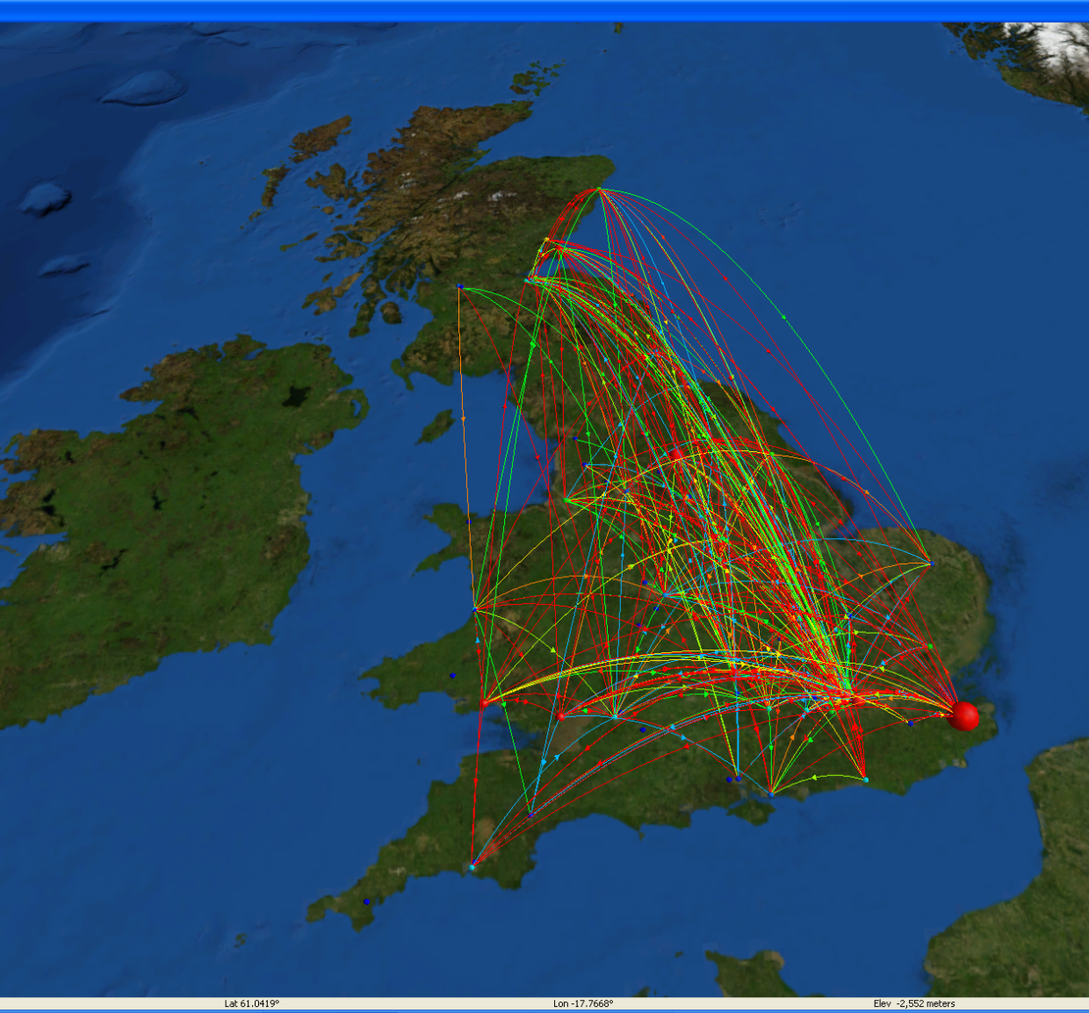
Free Effort?
GDP 09/10
Visualising eduroam
Thanks to:
Sam Miller
Dan Stoner
Richard Clarke
Lesley Oakey
Dr Tim Chown

Slide 8
Free Effort?
GDP 10/11
Another eduroam-related project
Watch this space!

Slide 9
Why visualise data?
“A picture is worth a thousand words”
The pattern of eduroam transactions is complex
difficult to spot even broad trends
Is eduroam successful?
A fundamental question.
possibly more of a talking point in the UK than elsewhere?

Slide 10
Goals of Visualisation
Analytical
Usage patterns & levels
Diagnostic
Error conditions highlighted, geographically located
Promotional Tool
Compelling picture of usage
Unattended demo mode

Slide 11
Caveats
Privacy protection: don’t display data that allows an individual users travels to be inferred.
Blurring: temporal aggregation
Blurring: image manipulation techniques
Authorisation: role-based data release policies

Slide 12
Design

Slide 13
Demonstration
Roaming sites
‘Flight map’ transaction arcs
Bar chart activity monitoring

Slide 14
Seeing the sites

Slide 15
Flight Map

Slide 16
Filtered view

Slide 17
Data charts

Slide 18
Heat Map

Slide 19
The Big Picture

Slide 20
But...
Current eduroam design is based on binary peering, so the originator of requests to be proxied at the national level is always obvious.
However, standard RADIUS ‘shared secret’ security is considered by some to be imperfect

Slide 21
Suddenly... RadSec
“RADIUS over TCP/TLS” – advanced standardisation, split into multiple documents
Secures the RADIUS packet exchange, but removes any hints to the origin of the roaming transaction!
Monitoring and visualisation will be increasingly undermined as RadSec adoption increases

Slide 22
IF-MAP to the rescue
MAP = Metadata Access Point
Developed by the Trusted Computing Group (TCG), as part of the Trusted Network Connect (TNC) suite of standards

Slide 23
IF-MAP Characteristics
Standardises the kind of data gathering we currently use SNMP and Syslog for
Aggregates and correlates data from disparate systems
Allows arbitary extensions to support new use cases without the limitations of a global schema
Allows ‘subscription’: automatic notification of changes
Simple to implement!

Slide 24
In or Out?
IF-MAP was designed for use cases internal to the network domain
Primarily for ‘next generation’ NAC
What if we adapted it to allow inter-domain sharing of metadata?

Slide 25
Use Case: eduroam

Slide 26
Use Case: eduroam

Slide 27
TWO Tasks
Enable RADIUS proxies to log directly to an IF-MAP instance
Directly modify one or more RADII?
PERL module or similar to allow arbitrary logs (and services) to be tailed into IF-MAP
Secure a MAP instance such that it may be exposed outside the organisation firewall
Authentication/Authorisation – Federation?
Improved server security model

Slide 28
Trivial?
“Tri via” – the meeting of three roads
Traditional site for placement of community noticeboards ~100 A.D.
So, if we are doing this for eduroam...
Does collecting a lot of ‘trivial’ local data give a more valuable emergent picture of larger scale features?

Slide 29
A possible future?
Many classes of metadata are of interest between community members
Domain ‘network weather’
Shared intelligence (IDS etc.)
Some classes of metadata could usefully be aggregated at the JANET core
JRS/eduroam stats is just one example...

Slide 30
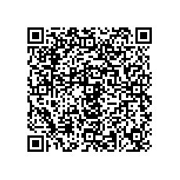
Thanks for listening!
Are there any questions?
Mark.O’Leary@ja.net

