Slide 1
International Society for Complementary Medicine Research
Long term conditions: developing global, integrative and sustainable solutions.
Deborah Fenlon PhD RGN
12.04.2013
Notes:
Please use the dd month yyyy format for the date for example 11 January 2008. The main title can be one or two lines long.
Changing practice and empowering patients
Thursday octboer 13.25 to 13.45

Slide 2
Cancer survivorship:
Working with biographical disruption
Deborah Fenlon PhD, RGN
Notes:
Based on my work in breast cancer.

Slide 3

The number of people living with cancer in the UK on 31 Dec 2008 . . .
Notes:
3
Until we started working in this field no-one had asked the question ‘how many people are there in the population who have had cancer.’

Slide 4

The annual rate of increase of cancer prevalence is . . .
Notes:
We can’t ignore this group

Slide 5

Cancer survivors
By 2030 projected to be 3 million.
(Maddams et al 2009, 2012)

Slide 6
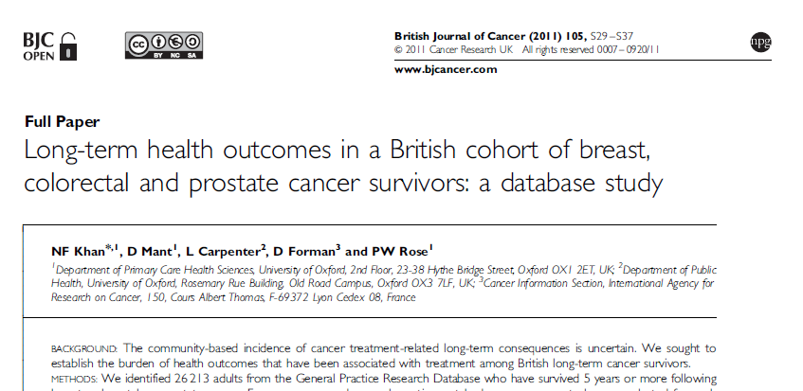
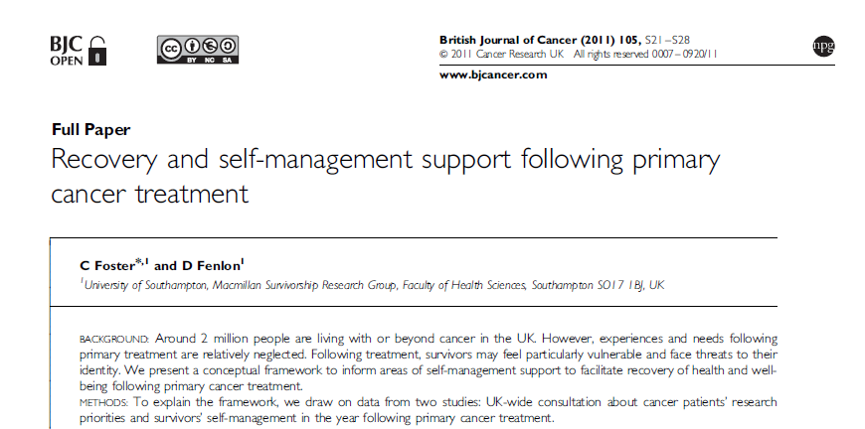
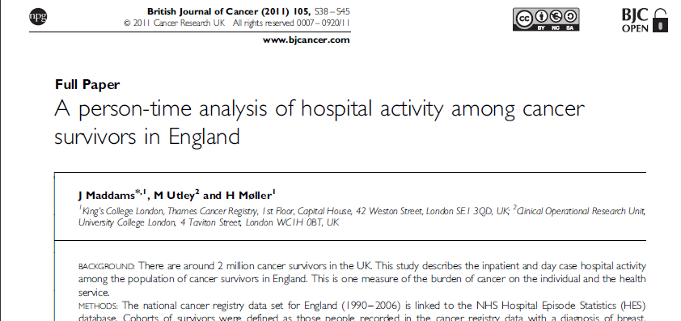
British Journal of Cancer: Survivorship Supplement 2011
Long term consequences (Khan et al)
Health service use (Maddams et al)
Lower confidence (Foster & Fenlon)
BJC Supplement, November 2011
Notes:
We know that there are long term consequences to cancer treatment
In a study of 26,000 cancer survivors Khan et al. found an increase in heart failure, chronic heart disease, osteoporosis, diabetes and hypothyroidism
We know that cancer survivors have a significantly higher amount of hospital admissions after treatment has ended than similarly aged controls.
And we know that patients may be particularly vulnerable at the end of treatment and lack confidence, for example in accessing support, returning to work etc.

Slide 7
Survey of cancer survivors
40% said life was affected ‘more than a little’ by cancer
53% harder dealing with emotional than physical needs
60% experienced problems in a close relationship
32% reported job disruptions or loss
72% reported depression at some point in their recovery
70% felt their physician had been unable to help with their non medical needs
(Lent 2007)
Notes:
Most of whom had received cancer diagnosis more than 2 years prior to survey

Slide 8
Post treatment problems in cancer
47% express fear of recurrence
40% prostate cancer patients report urinary leakage
19% colorectal cancer patients report difficulty controlling their bowels.
62% breast cancer survivors experience joint pain (Fenlon et al. in press)
70% women after breast cancer experience menopausal symptoms (Canney and Hatton, 1994)
Notes:
Physical problems and resultant impact on QoL are persistent.

Slide 9
Hot flushes
median 5 flushes per day (range 1-30)
median severity 5 out of 16 (range 1-16)
median problem rating was 5 out of 10
72% women had disturbed sleep
over a third were more than five years since diagnosis
50% had finished menstruation more than 5 years ago.
  (Fenlon 2005)
Notes:
To focus on just one of these problems – hot flushes
In my study I gathered data on every hot flush experienced by 150 women during the course of a week.
2 women had over 20 flushes every day for the week of the diary.
In those with disturbed sleep, half of all the nights on record were disrupted. And in a third of the nights over one hour’s sleep was lost.
Flushing can continue for a very long time.

Slide 10
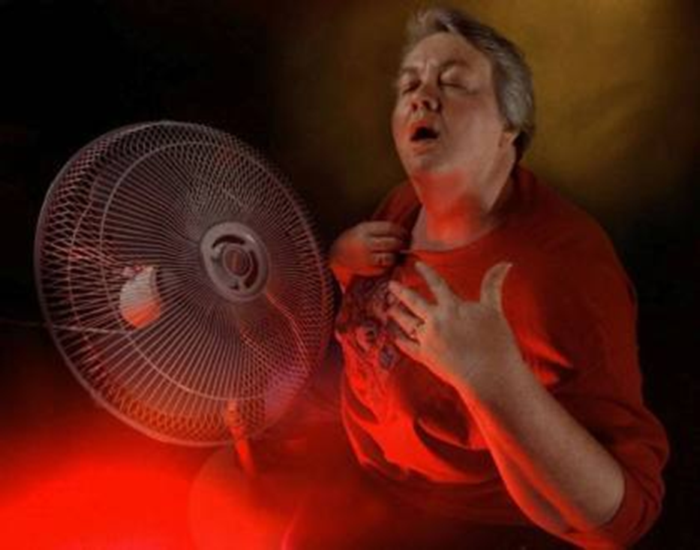
‘It’s as though somebody has built a furnace inside you and it's your whole body. It starts almost at your feet and works up and you just feel as though you are literally on fire inside…’
(Fenlon 2007)
Notes:
I conducted interviews with 8 of the women to try to get an idea of what the experience is actually like. I chose a variety of experience – not just going for the worst ones.

Slide 11
‘To me it felt like… probably like a child wetting the bed… very distressing, and, and in the morning I would really feel terribly upset, and, and that’s something when you are so out, so out of control.’
(Fenlon 2005)
Notes:
Night sweats

Slide 12
‘…I could no sooner have a man sleeping in my bed than fly to the moon… … there's no way I could enter into a new relationship now.’
  (Fenlon 2007)

Slide 13
‘I found this site, and said "These women are me" Started with knee pain, ankle pain, then came stiffness all over. Hands swelling and stiff. Decreased range of motion. Fatigue. Night sweats, waking me up. Chest discomfort. Surely this is not the price we pay for hope! I thought I was just paranoid. I could barely walk when getting up in the morning. I work on my feet all day and by the end of the day, my legs were aching and burning. If I sat down for a while, I got stiff.’
(askapatient.com 2007)
Notes:
This woman was talking about the experience of taking aromatase inhibitor treatment, which is given for a minimum of 5 years.
Surely this is not the price we pay for hope?

Slide 14
‘I'm mostly irritated with not being able to work-out or play with my nieces because aunty's knees hurt or b/c aunty can't run that fast anymore. It's really heart-breaking and my will is being chipped at little by little. I didn't bargain for this at all…’
(askapatient.com 2007)
Notes:
This woman was 36 years old

Slide 15
Biographical disruption
Disruption of ‘taken for granted assumptions and behaviours’
Disruption of explanatory frameworks
Practical response to disruption – mobilisation of resources
(Bury, 1982)
Notes:
I wanted to talk about Michael Bury’s notions of biographical disruption and how the diagnosis of a chronic illness disrupts ones expectations of what life is about.
He says that being faced with a
Chronic illness involves a recognition of the world of pain and suffering, possibly even of death, which are normally only seen as distant possibilities or the plight of others.
This disruption of ‘taken for granted assumptions and behaviours’ involves attention to bodily states not usually brought into consciousness.
There are profound disruptions in explanatory systems normally used by people and the loss of the expected life course, such that a fundamental re-thinking of the persons’ biography and self-concept is involved.
Then there is the response to this disruption, and the mobilisation of resources, in facing an altered situation

Slide 16
Characteristics of chronic illness
Chronic illness | Cancer | Cancer survivorship
Facing uncertainty, suffering and mortality | Facing uncertainty, suffering and mortality | Facing uncertainty, suffering and mortality
Insidious onset | Often sudden and unexpected | Realisation that consequences may be long lasting or permanent
Often hidden or unrecognised by others | Rarely hidden | Others expect a return to complete health or ‘normality’
Difficulty in legitimating illness | Has legitimacy and public profile | Difficulty in legitimating long term changes
Difficult to see disease as ‘other’ and therefore separate to self | Cancer seen as ‘other’ and reified | On-going problems cannot be reified.
(Bury, 1982)
Notes:
Bury’s work was based in chronic illness and this has been taken up by those working in cancer.
In many ways cancer is not like chronic illness.
There is usually a more sudden onset and it is highly legitimate, to the point that one is ‘allowed’ to withdraw from the normal burdens of life and, for a while, dependant on others.
As well as this, cancer is almost seen as a concrete identity which is ‘other’ and separate to the self.
So that it is easier to perceive oneself as a victim of external forces.
This finishes at the end of active treatment.
Yet people are left with many ongoing and longlasting changes.
So cancer survivorship is like chronic illness
Demonstrated by quote in next slide

Slide 17
‘Being ill means to some extent you can abdicate responsibility and learn to be helpless and dependant. It is very scary when you then have to resume control and learn to be an adult again who functions in relationship with others.’
Hubbard and Forbat (2012)

Slide 18
Constructions of living with cancer
Disruptive to everyday life many years after diagnosis and treatment
A persistent and on-going threat
A disease that heightens cancer survivors’ sense of their own mortality
A disease that invokes a change to self, disrupting anticipated identity.
Hubbard and Forbat (2012)
Notes:
Hubbard and Forbat have taken Bury’s ideas of biographical disruption and developed them to describe what is happening in cancer survivorship.
And they found that Cancer is:
Disruptive to everyday life many years after diagnosis and treatment
A persistent and on-going threat
A disease that heightens cancer survivors’ sense of their own mortality
A disease that invokes a change to self, disrupting anticipated identity. And what they expected the future would bring.

Slide 19
Transition at end of treatment
Coming to the end of primary cancer treatment may be a particularly vulnerable time and some people may lack confidence to manage the impact of cancer/treatment on their lives
People want support to regain confidence
(Ward et al., 1992; Allen et al., 2009; Foster & Fenlon, 2011)
Notes:
We have done some further work particularly focused on the transition to survivorship from the end of primary treatment
and found that
people’s confidence may be knocked after their cancer and that they need to be supported to regain self confidence in their own ability to manage the problems they face after cancer.
They can also be supported in their own self care or self management activities; what we call supported self management

Slide 20
Reflection:
Loss of Self
Reconciliation (Moving Forward)
Isolation
Restoration
Notes:
I did some work with Breast Cancer Care to ask women what kind of resource they wanted at the end of their cancer treatment.
and these were also the issues that they were raising
They were reflecting on their new situation in moving from this acute to the chronic phase,
They were realising their many losses
They felt lonely and isolated as people expected them to get back to normal and their sources of support were being removed
They had a lack of confidence in taking up their life again
But they wanted to affirm that they could move forward, that life could be good again, just that it would be different.

Slide 21
Reflection
Feelings of elation and fear
Need time to assimilate what they have endured
Many women feel they have new landscape to navigate
An on-going need for support and information
A strong need to understand the signs and symptoms of recurrent disease
A formalised system to have a holistic assessment of risk and need

Slide 22
Disruption of explanatory frameworks
Fundamental re-thinking of self
‘…, you got issues then with your whole identity, the blueprint of who you are.’
‘… I’d lost all my long blonde hair, I had very tiny curls that were grey, I was a totally different me and I didn’t know who the hell I was.’
Fenlon et al (in submission)
Notes:
Search for causation and meaning
A fundamental rethinking of the person’s biography and self-concept

Slide 23
Loss of self
‘You’re not…I’m not the same person. Not necessarily a bad thing…getting to know the new me is not always easy. That’s something I wasn’t prepared for.’
Notes:
Renegotiating identity
Underwent a process of grieving of their identity and life before breast cancer
Relationships
Sexuality

Slide 24
‘Loss of income, power, status, particularly if you can no longer work. This is unsettling but needs to be faced by everyone at some point in their lives. If it happened earlier than you planned it can leave you feeling abandoned and isolated from your peer group. Before cancer I felt about 35; after cancer I felt about 85.’
Hubbard and Forbat (2012)
Notes:
You should be
HALF WAY BY NOW

Slide 25
‘The most overwhelming thing to me about cancer and its aftermath was, in short, LOSS
- loss of control
- loss of confidence in my body and how it operates
- loss of energy and spontaneity
- loss of purpose
- loss of others
- loss of layer of skin
- loss of identity and sexuality…’
Hubbard and Forbat (2012)

Slide 26


Notes:
These images came from a triptych in an exhibition at the Royal Academy.
For me they sum up so much about identity, gender and our worth.
These two images illustrate that way that women are viewed in the eyes of our society.
The first one is of a beautiful, healthy, young woman, with lovely skin and hair and sexually available.
The second is of a woman covered and nearly invisible. Presumably post menopausal, no longer young and beautiful.
Her place is to look towards death and to take care of the next generation.
I would like to suggest that the change represented here could represent some of the losses endured by women experienceing change after cancer, such as menopause. For those women going through an early, chemotherapy induced menopause because of their cancer, this may be a difficult change to accept.

Slide 27
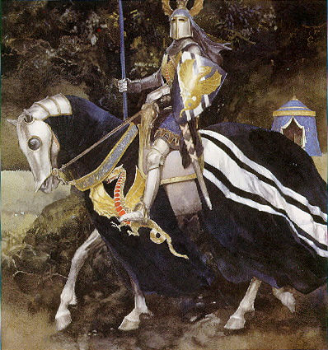
Notes:
And a similar story for men, where their identity is tied up in their strength, their virility, their ability to be the knight in shining armour:
If they are no longer able to work, fatigued, have sexual problems and other symptoms, what does this say to them about who and what they are and their worth in society.

Slide 28
Isolation
‘I wept. I didn’t really know why except that I felt lost and lonely.’
‘… she said, we’ll send for you in a year, you know? You’ve had your, your mammogram and will have another one in a year. And I felt it was a bit like being sent out in a rowing boat without, without oars, you know?
Fenlon et al (in submission)
Notes:
Pressure to present an image of wellness and coping
Others assumed they would just go back to their old lives with little adaption
Sensitive to the reaction of the wider social network

Slide 29
Restoration
‘… you will feel differently about yourself and you’ll need to regain your confidence in the way you look and, and your desirability, uh, but these things will return.
‘There is a ……..it’s a new normal now and that’s how I describe it to people. It’s the new normal. It’s still great, it’s just getting better and every day, every month and hopefully this time next year I’ll be two years past it.’
Fenlon et al (in submission)
Notes:
Self management: some used strategies to restore their lives after breast cancer (diet, exercise, complementary therapies, coaching
Employment: anxiety and loss of confidence about returning to work
Resources to support and assist them in moving forward with their lives
Need to think about link to next slide

Slide 30
‘I went out for lunch with a friend yesterday, and it reminded me how things used to be with you, when we would sit and talk for hours. I so miss the old funny, witty, Caroline – I miss our talks about love and life and books. I really admire how you’re dealing with cancer by writing the blog, and talking about it – I know that you have built yourself a big circle of support, but I can only wish you well from the periphery. I have a phobia about illness, and now those talks we had have been replaced by the evil big C - you’re all about the cancer.
Notes:
Before moving on to our response as health professionals I want to go back to bury’s model and mobilisation of resources
- the way in which the individual has to respond to the changes that illness has brought to them and how they renegotiate their place in society.

Slide 31
I want the old Caroline back, and until she comes back, I can’t really be at the centre of things; and in the future, you will need someone who doesn’t remind you of the bad times. I want our friendship to still be about all those other things, that will return to you when all this horror is over. Don’t let cancer destroy who you are. When this is over, I’ll always be around and be your friend.’
http://chemonights.blogspot.co.uk/2013/01/if-you-see-me-walking-down-street-walk.html
Notes:
The individual is drawn into rearranging her wider personal and community involvements.
Her life is disrupted not only because of functional limitations, but also because of the embarrassment that her limitations creat
This demonstrates how people with chronic illness are
Restricted in where they go, what they do. Social world shrinks, become more isolated.
They need to make adjustments and attempt to normalise in the face of disruption’
.

Slide 32
‘Because I miss the old Caroline, too, more than I can possibly say. And having it spelt out to me in writing, so very clearly, just how much I have changed, what I have lost, the difference in how others perceive me, broke me today in a way neither the cancer nor the chemo, separately or together, had previously been able to do.’
Notes:
And this is carolines response to that email from her friend.
DON’T READ IT

Slide 33
Health professional response
Recognise that changes may be long lasting and life changing
Opportunities for individuals to articulate the impact of cancer
Allow legitimate space to talk about their experiences and on-going problems faced
To ensure problems and difficulties are not dismissed or trivialised.
Hubbard and Forbat (2012)
Notes:
Help restore lost confidence

Slide 34
The Breast Cancer Care resource
A resource which reflects these experiences
A resource which helps people take control, restore confidence and a sense of self.
Partnership with health care professionals in planning on-going needs and care
There is a need for information on what is normal, what to look for in case of cancer coming back, and where to turn for support
Help to cope with social pressure to return to life as it was before

Slide 35

Breast Cancer Care
Moving Forward resource pack

Slide 36
Editorial: Richards et al. (2011)
‘[Foster & Fenlon] argue that regaining or recovery of lost confidence is an important aspect of recovery alongside physical and psychosocial problems, and that this requires a supportive infrastructure. Programmes that aim to promote rehabilitation and supported self-management should take account of this’ [S2]
Richards, M., Corner, J. & Maher, J. (2011) The National Cancer Survivorship Initiative: new and emerging evidence on the ongoing needs of cancer survivors. British Journal of Cancer, 105: S1-S4.
Foster, C. & Fenlon, D. (2011). Self management support following primary cancer treatment. BJC, 105: S21-S28.
Notes:
Mike Richards, in his editorial in the survivorship supplement for the British Journal of Cancer highlighted:

Slide 37
Life Coaching feasibility study
‘I was dreading going back to work to be quite honest with you, really, really dreading it. But I think [life coaching] gave me a lot more confidence. … I think it gave me the confidence not to be a martyr.’ (LC030)
(Wagland et al 2013)

Slide 38
Macmillan Survivorship Research Group
Understand recovery of health and wellbeing
Promote self-efficacy
Interventions to support self management

Slide 39
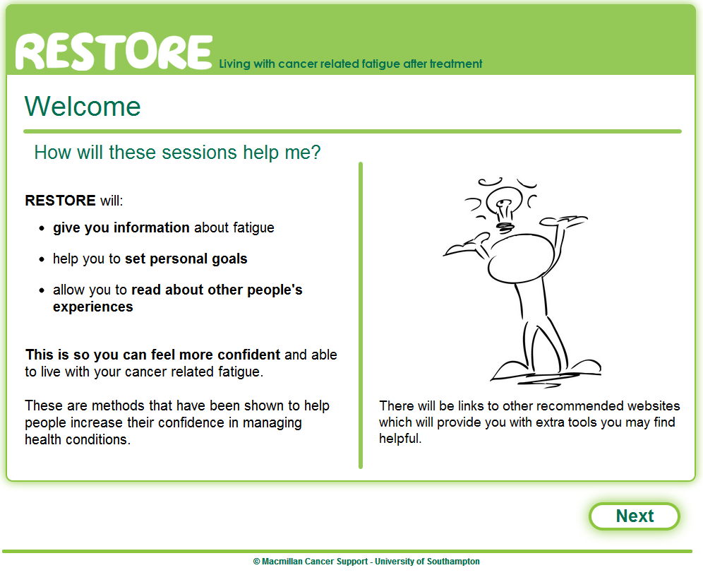
Session 1: Introduction
Notes:
CG

Slide 40
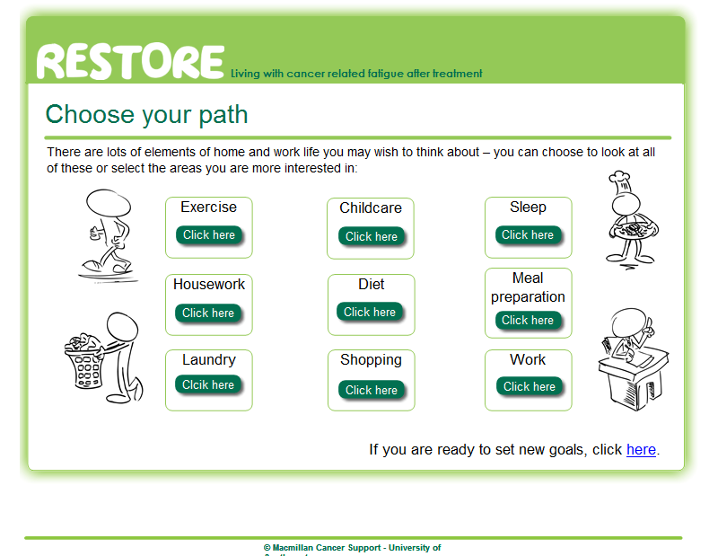
Session 3: Exercise, home life, diet, sleep and work
Notes:
CG

Slide 41
Southampton PTFU Pilot Project
Develop and test a supported self management approach to care of people receiving potentially curative treatment for breast, colorectal & testicular cancer
NCSI survivorship test site accompanied by comprehensive evaluation in conjunction with University of Southampton
Notes:
Another study that is taking place in combination with the Unviersity Hospitals of Southampton NHS Trust and the Faculty of Health Sciences.
In the light of the new NHS, tight resources, a change in focus to primary care and reduction in long term follow up for cancer patients
We designed a supported self management approach to follow up and care for people with breast, colorectal and testicular cancer.

Slide 42
Southampton PTFU Pilot Project
Develop a clear sustainable and safe pathway for patient triggered follow up including ALL of the following:
  Assessment of patient suitability
  Patient preparation (exit interview and workshops)
  Signposting to other resources
  Provision of treatment summary/follow up care plan
  Continue routine follow up investigations
  Appropriate IT system support
  Telephone advice from specialist nurse
  Rapid access back for assessment by clinical team

Slide 43
Signposting
Mindfulness (Hoffman et al 2012) (Eyles et al 2013)
Relaxation training (Fenlon et al 2008)
Acupuncture for joint pain and hot flushes
Coaching (Wagland et al 2013)
Internet resources (Grimmett et al 2013)

Slide 44
Supported self management framework:
Whole System Change
Collaboration and partnership relationships
Assessment and survivorship care plan + an information prescription
ENABLER
Planned/telephone support/self initiated contact
ENABLER
Self management support – programme/
Advanced development training for professionals
ENABLER
Collaborative professional –patient relationship
Professional culture
Empowered, engaged and informed patients.
Prepared and skilled professionals.
Service redesign.
Tailored support and aftercare pathways
Notes:
Three enablers
Skills development programmes for professionals
Self management support options for patients/survivors
Institutional support for service redesign

Slide 45
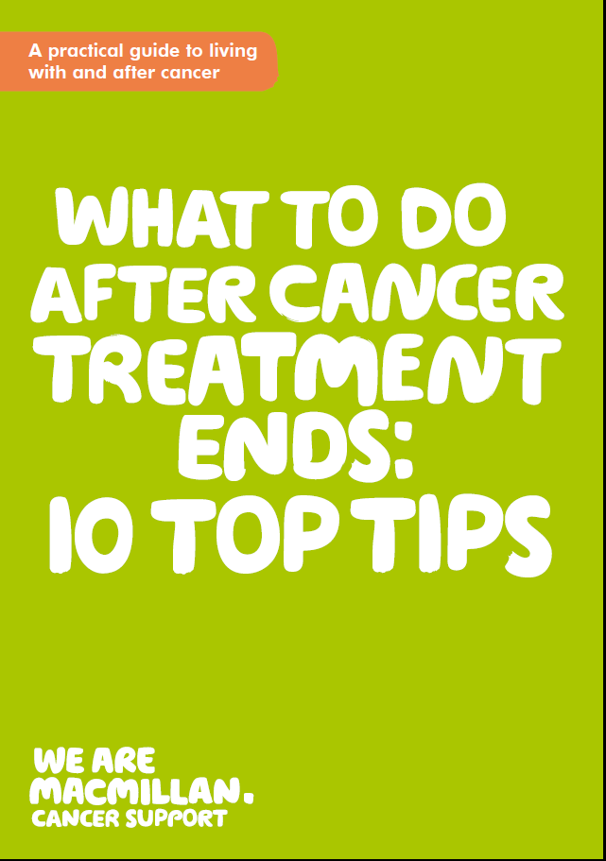

Slide 46
Ten Top Tips
Ask for a holistic needs assessment or end of treatment assessment
Ask for a treatment summary
Find your main contact
Be aware of any post-treatment symptoms
Get support with day to day concerns
Talk about how you feel
Try to lead a healthier lifestyle
Know what to look out for
Be aware of your own health
Share your experience

Slide 47
Conclusion
Cancer changes people
Multiplicity and longevity of symptoms
Identity change
Need support to regain confidence and move forward into positive cancer survivorship
  ‘Surely this is not the price we pay for hope?’

Slide 48
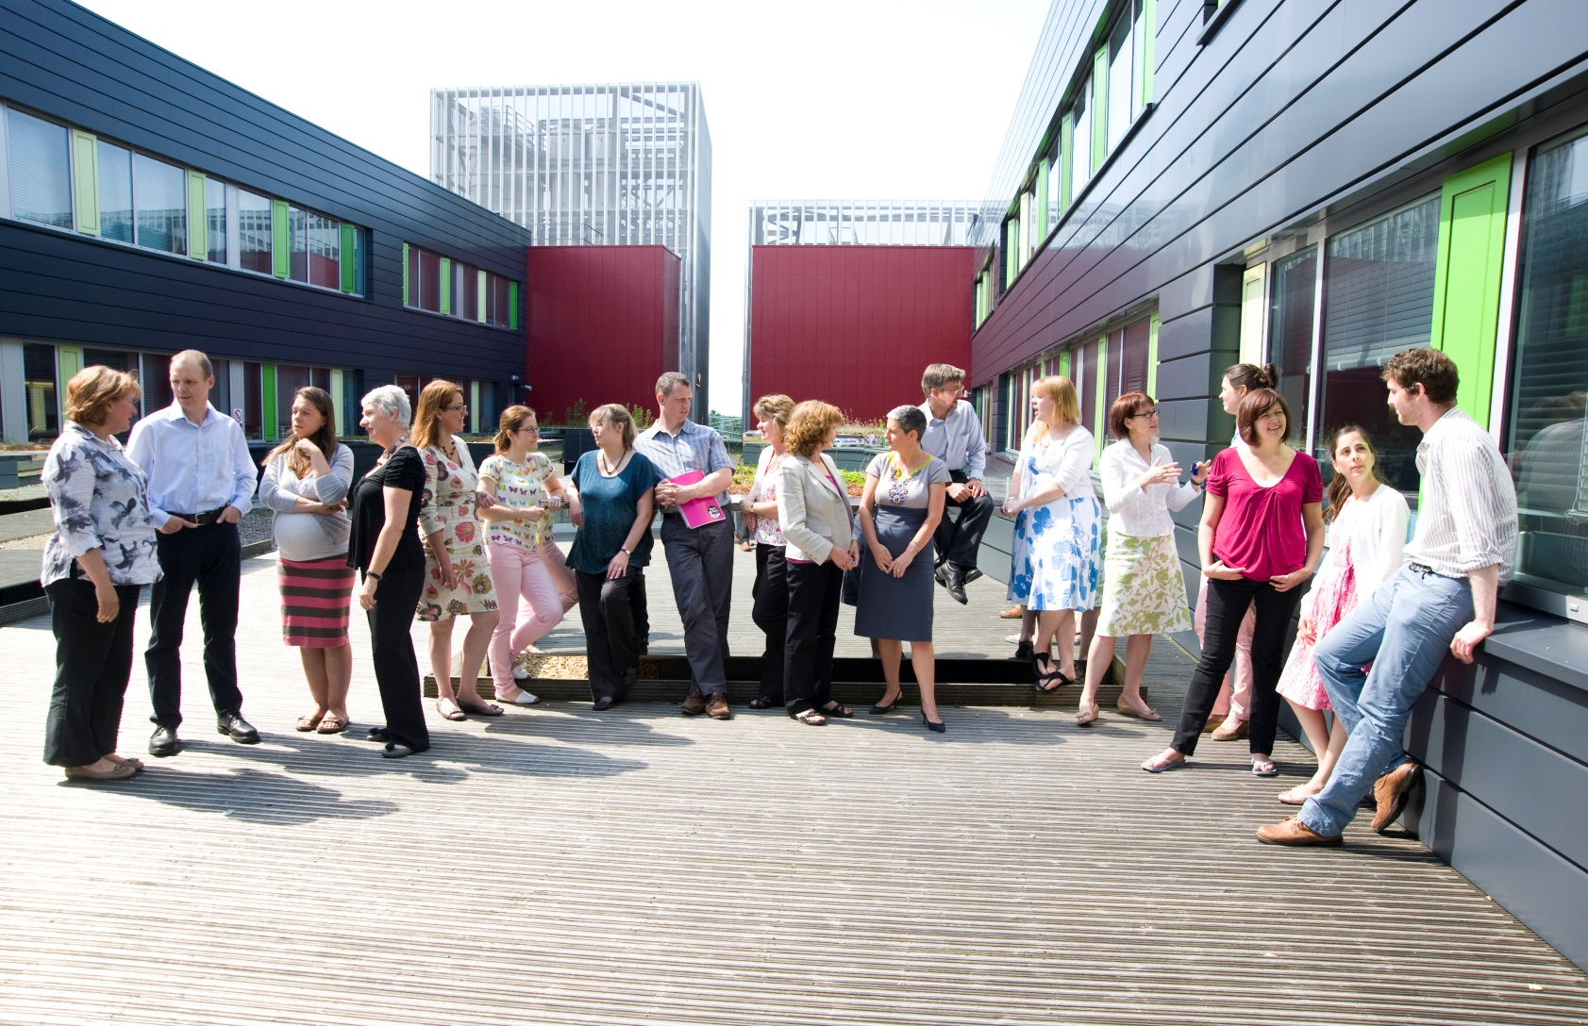
Cancer, Palliative and End of Life Care Research Group http://www.southampton.ac.uk/cpelc/
Notes:
Point out
Richard (next door)
Katya – evaluating PTFU
Members of MSRG
Alison –first clinical professor in cancer nursing
Ann Bowling - outcome measures
Sue duke – MSc programme lead

