Slide 1
Implementing DOIs for Data
DataPool supporting institutional service development
Simon Coles, Andrew Milsted, Wendy White
Jisc Managing Research Data Programme Workshop, Achievements, Challenges and Recommendations, 25-26 March 2013, Aston
Notes:
Please use the dd month yyyy format for the date for example 11 January 2008. The main title can be one or two lines long.

Slide 2
Policy context
Review contract issues – not many institutions in UK using service yet so issues to consider
BL and Soton colleagues very helpful exploring issues e.g. DataCite, BL, Institution - roles and responsibilities
Develop policy for when , how and who assigns DOIs
Library will have overarching responsibility for service, local/discipline gatekeepers for established users with pattern of activity

Slide 3
Data repository (Est 2003)
http://ecrystals.chem.soton.ac.uk/

Slide 4
Embedding in publishing

Slide 5
Researcher: about me… and the science
(Self) promoting and recognition
REF2014 (citation boost?), 2020- (credit for data publication?)
Promotion and career advancement
Recognition in the field
Coming out on top of peers and contemporaries
Early career profile and impact

Slide 6
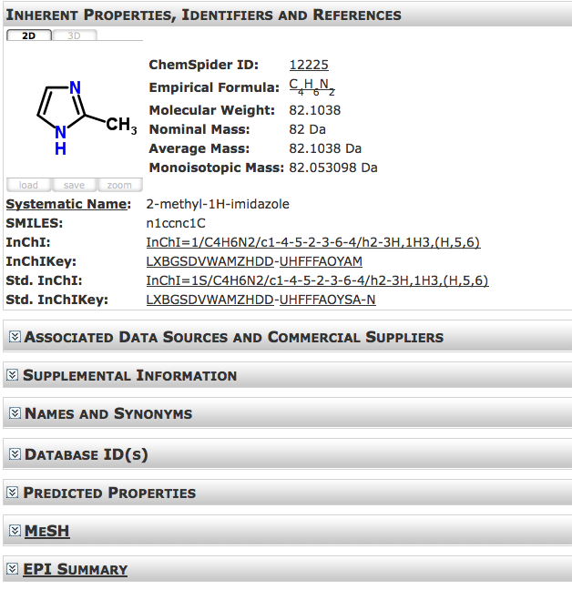
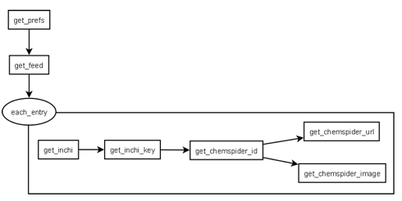
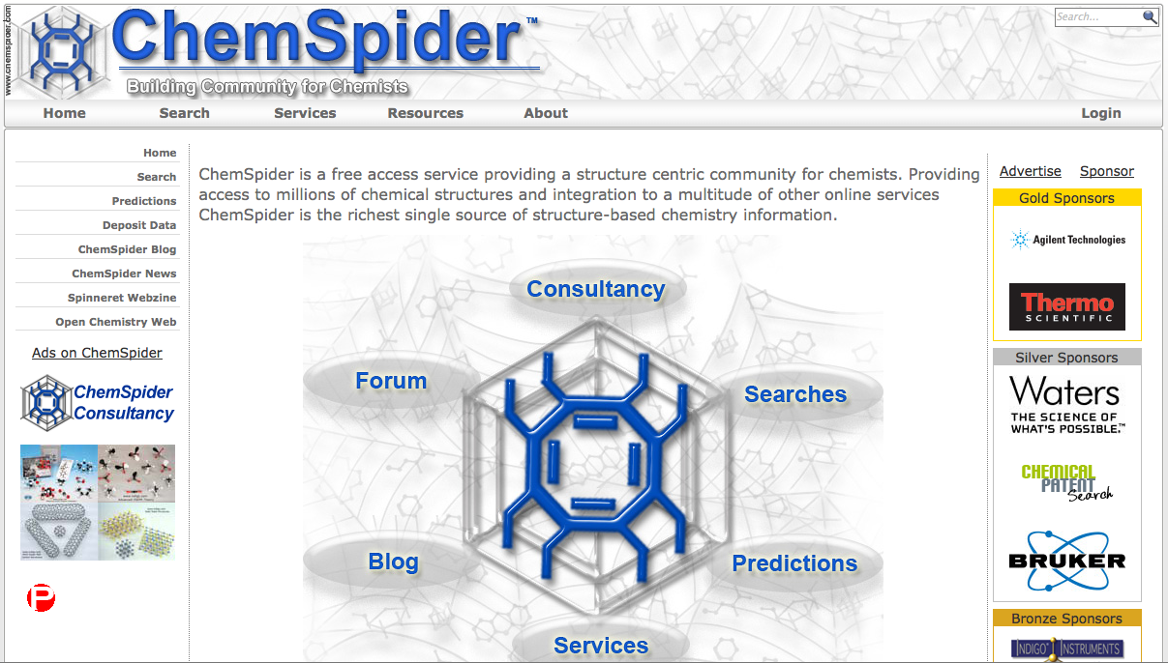
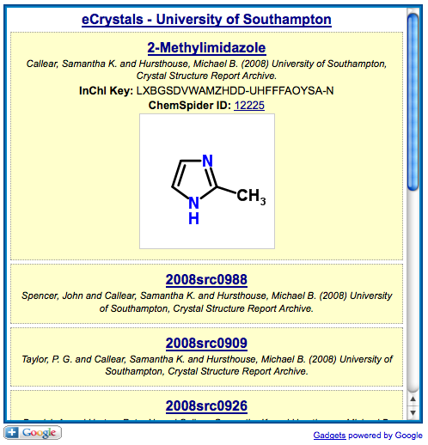
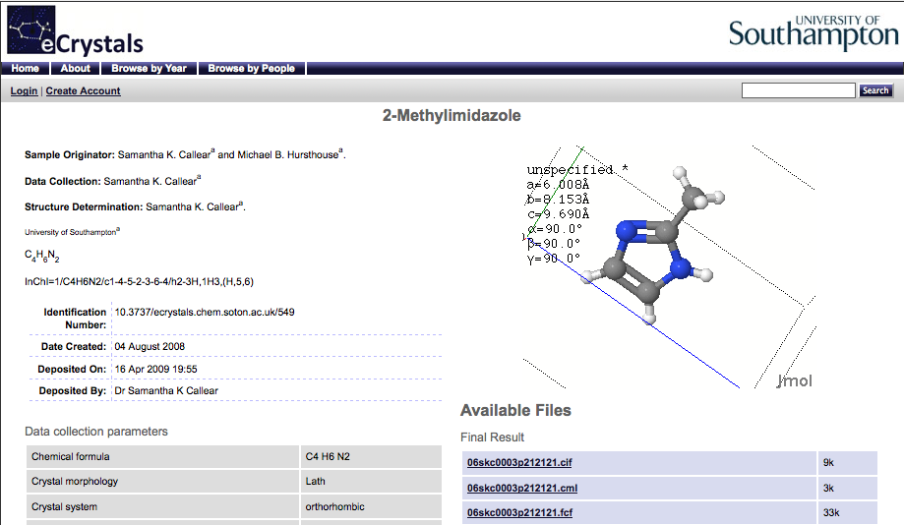
Enabling data-driven science – informatics, mash-ups
Powered by ORE-Atom

Slide 7
DataCite and eCrystals
Ready to go!
Easy to modify software
Institutional exemplar

Slide 8
DOI EPrints Workflow

Slide 9
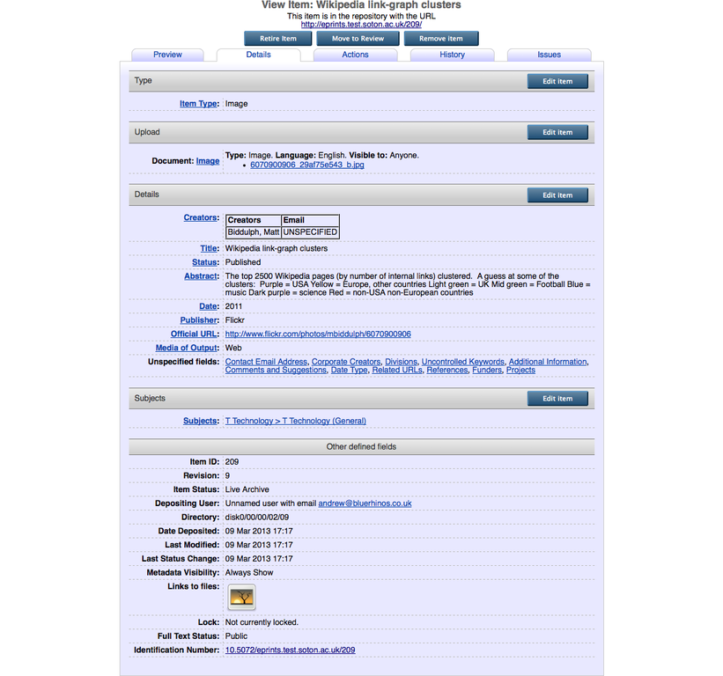

Slide 10
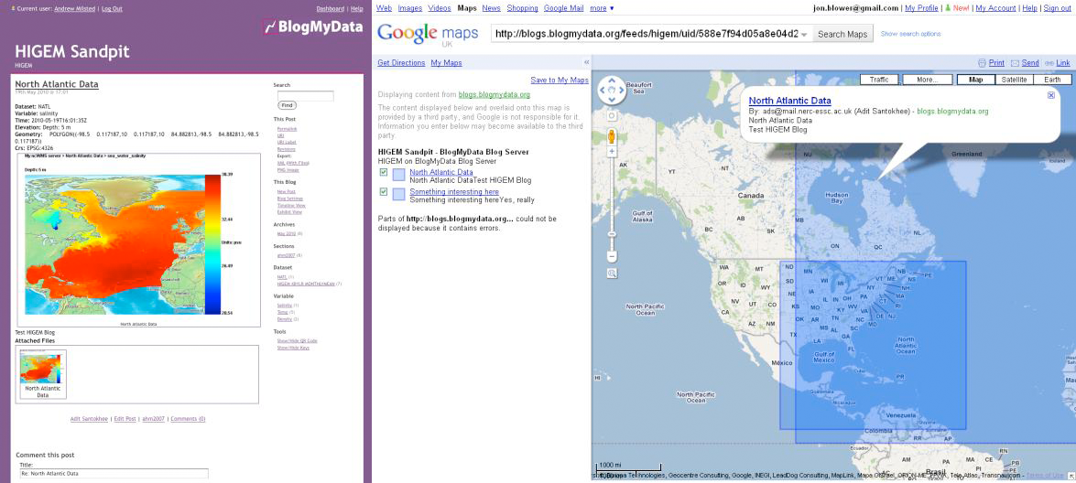
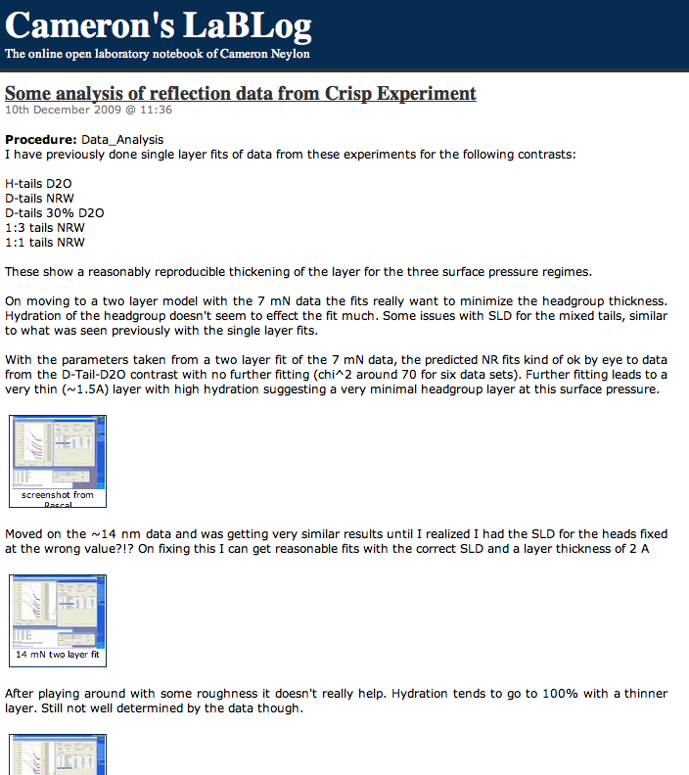
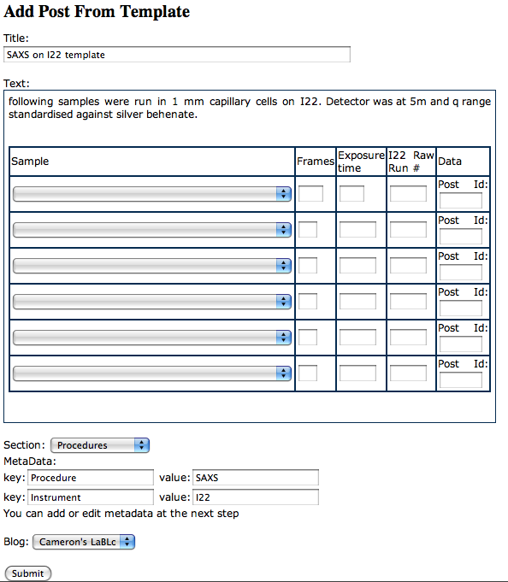
Labtrove
Labtrove.org
Numerous current installations
Blogs@Soton
http://biolabs.isis.rl.ac.uk
http://www.soton.ac.uk/~decode/ (Project management)
http://pzq.ourexperiment.org/ (Open Science)
http://www.blogmydata.org/ (Environmental Science)
Uptake in USA & Australia
Uptake at US National Lab (PNNL)

Slide 11
Publishing and notebooks
General methods
Experimental data
Observations
Summaries
Metadata and organisation
http://www.ourexperiment.org/synth_methyl_oxin/meta/SPECTROSCOPIC_METHOD/value/H-NMR

Slide 12
Publishing and notebooks
A real, current example – revisions just submitted

Slide 13
A multi-layer approach
Knowledge layer: ‘core’ metadata for discoverability akin to Dublin Core, DataCite, etc
Information Layer: ‘contextual’ metadata akin to the elements in CERIF [CERIF in practice (http://iridiummrd.wordpress.com/2011/12/09/195/) notably a) outcomes i.e. publications, patents; b) funding e.g. research council grant c) people e.g. project team members, d) organisation i.e. University, collaborators.)
Computation Layer: ‘detail’ metadata - a specific level giving the minutiae (formats etc) and enabling processing.

Slide 14
Knowledge layer: What is being made available and is it of interest to me? Can I access it?
Information Layer: At what granularity should data be made available or citable? What is an ELN record? If single datasets are given identifiers, what about collections of datasets, files within datasets or individual data?
Computation Layer: Can I automatically process this information?

Slide 15
DataCite and LabTrove
Broader trial
Longer timeframe
Software easy to modify
Several use cases
Cite whole notebook
Cite arbitrary collection of notes
Cite specific note
Cite specific attached data file

Slide 16
Granularity…
Granular Zoom

Slide 17
Cite a whole notebook
relatedIdentifier and relationType VERY useful here!

Slide 18
Citing notes
Reasonably trivial
Cite collections using categories (in LabTrove)

Slide 19
elnItemManifest
<?xml version="1.0" encoding="UTF-8"?>
<elnItemManifest unit="package" xmlns:xsi="http://www.w3.org/2001/XMLSchema-instance" xsi:noNamespaceSchemaLocation="elnItemManifest.xsd">
<title>Mass Spectrum of 3-Bromophenyl 1,3Dihydroindol 2H-one</title>
<keywords>
<keyword>Spectroscopic Method</keyword>
<keyword>Substituent</keyword>
</keywords>
<identifiers>
<primaryLocalIdentifier>5606</primaryLocalIdentifier>
< <accessIdentifier>http://www.ourexperiment.org/synth_methyl_oxin/5606/Spectrum_of_31Bromophenyl_1_3Dihydroindol2Hone.html</accessIdentifier>
</identifiers>
<contact>
<eMail>S.J.Coles@soton.ac.uk</eMail>
</contact>
<licensingBasis>Own Work: Released into the public domain (under Creative Commons CC0 license)</licensingBasis>
<relatedItems>
<item>
<relationship>Image file of mass spectrum</relationship>
<id>http://www.ourexperiment.org/data/files/4181/MS%20bromo.png</id>
</item>
</relatedItems>
<contributors>
<contributor>
<role>Author</role>
<name>Nicola Knight</name>
</contributor>
</contributors>
<content>
<description>Spectrum of 3-(1-Bromophenyl) 1, 3-Dihydroindol-2H-one</description>
<mimeType>text/plain</mimeType>
</content>
<source>LabTrove 2.3-r455 (Aurora)</source>
<dates>
<creationDate>2012-05-06T16:49:00+01:00</creationDate>
<releaseDate>2012-05-06T16:49:00+01:00</releaseDate>
<publicationDate>2012-05-06T16:49:00+01:00</publicationDate>
</dates>
</elnItemManifest>

Slide 20
Suffixes for DOIs
Would like to explore this – for sector discussion
Possible agreed list of extensions to facilitate text mining and predictive informatics
Could denote a licence, RDF etc.
Could reduce layering

Slide 21
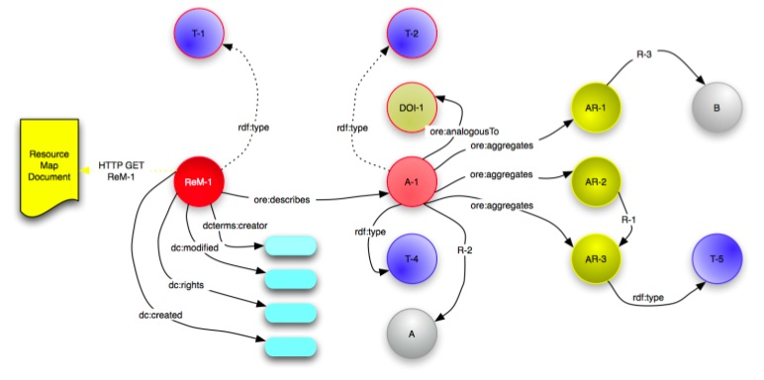
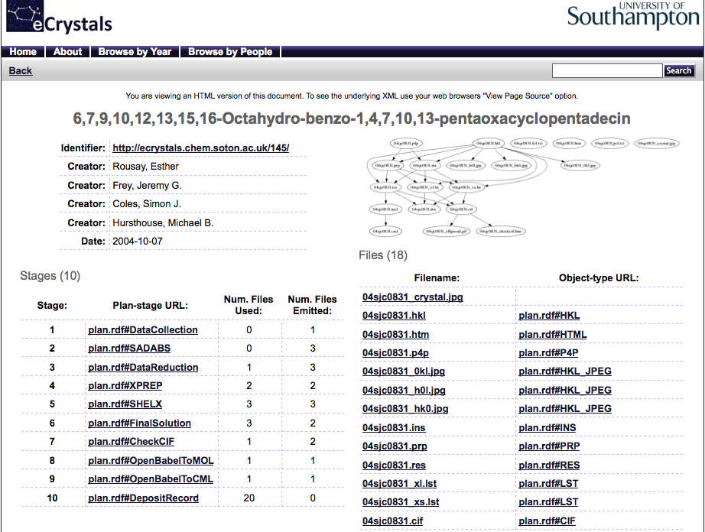
Plans and Provenance

Slide 22
Thanks

