Slide 1
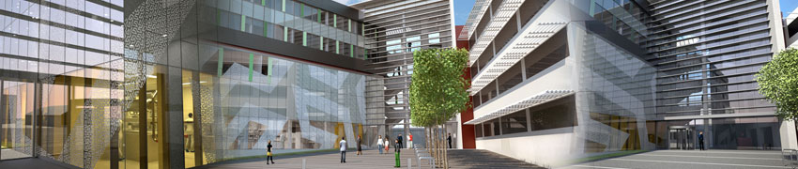
Magnetic Components in Electric Circuits
Understanding thermal behaviour and stress
Peter R. Wilson, University of Southampton

Slide 2

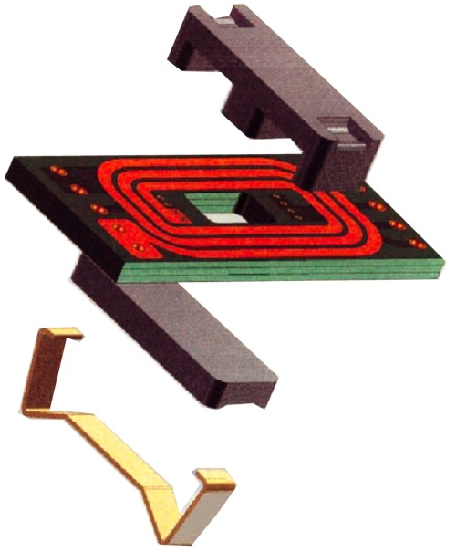
What are we trying to understand?
How are Magnetic Materials Affected by Temperature?
What is the impact on Magnetic Components?
How does this affect electric circuit behaviour?

Slide 3
Magnetic Material Characteristics
Ferrous Magnetic Materials exhibit hysteresis
  The magnetization of the material is partly reversible (no loss) and partly irreversible (loss)

Slide 4
Energy Lost in Magnetic Materials
The Material will therefore dissipate energy as heat under heavy loading:

Slide 5
The effect of environmental Temperature?
How does the overall temperature of the material affect its behaviour?
  Eventually the Curie point is reached and the material ceases to have any effective permeability
0.5
Data for a 3F3 Material, 10mm Toroid obtained by the author, measured using a Griffin-Grundy oven to control the temperature
0.4
0.3
0.2
B (T)
0.1
0
-0.1
-0.2
-0.3
-0.4
-150
-100
-50
0
50
100
150
H (A/m)
T=27
T=95
T=154

Slide 6
Modeling Magnetic Materials
Modeling Magnetic Materials is particularly complex, with several choices
  Jiles Atherton, Preisach, Hodgdon, et al
The Jiles Atherton model is often used in circuit simulators:

Slide 7
Jiles Atherton Model
The results are particularly good at predicting the BH loop behaviour in ferrites, however the Preisach model is often better for “square” loop materials

Slide 8
Building a Magnetic Component
To build a component (e.g. inductor) for electric circuits, we need both a core model and a winding:
mmf
c
Φ
Φ
p
c
Core
i
p
d
Φ
p
v
p
=
n
p
mmf
=
n
*
i
dt
p
p
p
Electrical
Domain
Magnetic
Domain

Slide 9
Adding the Thermal Dependence
To add dynamic thermal behaviour, use a network to effectively model the thermal aspects of the material and the environment
Power
Eddy
Current
Loss
Power
Winding
Loss
Current

Slide 10
Thermal Network Modeling
We have choices to make regarding the thermal network, in particular a distributed or lumped model
  In most cases a lumped model is perfectly adequate

Slide 11
Characterize the Magnetic Material
It is a relatively simple matter to characterize the magnetic material model by measuring its behaviour and calculating the resulting model parameters

Slide 12
Building a Circuit Model…
Using the characterized thermally dependent model of the core, winding models and a thermal network, we can make the electric circuit model (in this case a transformer) dynamically affected by temperature
U1
U3
U2
vp
1
3
1
2
3
1
I2
MMF
3
expja_th6
MMF
R4
1k
2
4
4
2
5
winding_th
5
winding_th
R3
10
tcore
U4
1
2
PARAMETERS___
Area 293u
Cth 0.07
D 3.8e-3
1
tair
U5
emission
R1
1G
U6
1
2
PARAMETERS___
C 700
Dens 4750
Vol 188n
ctherm
rconv
+
2
27
V1
-

Slide 13
Results of Dynamic Thermal behaviour
At ambient Temperatures, the model behaves very closely to the measured data

Slide 14
Results of Dynamic Thermal behaviour
At increased temperatures, the transformer output voltage drops due to reduced permeability

Slide 15
Dynamic Magnetic and thermal behaviour
The Flux Density decreases as the magnetic core temperature increases

Slide 16
Conclusions
The magnetic material can be modelled to reflect not only the complex BH curve, but also its dependence on temperature
The temperature can be introduced dynamically to the magnetic material model
The component can be modelled using a thermal network to accurately predict the dynamic thermal behaviour
A complete electric circuit can be simulated that includes dynamic thermally dependent magnetic component and accurately predicts its behaviour

Slide 17
References
Wilson, P. R., Ross, J. N. and Brown, A. D. “Magnetic Material Model Optimization and Characterization Software”. In: Compumag, 2001
Wilson, P. R., Ross, J. N. and Brown, A. D. “Dynamic Electrical-Magnetic-Thermal Simulation of Magnetic Components”. In: IEEE Workshop on Computers in Power Electronics, COMPEL 2000
P.R. Wilson, J.N Ross & A.D. Brown, “Predicting total harmonic distortion in asymmetric digital subscriber line transformers by simulation”, IEEE Transactions on Magnetics, Vol. 40 , Issue: 3 , 2004, pp. 1542–1549
P.R. Wilson, J.N Ross & A.D. Brown, “Modeling frequency-dependent losses in ferrite cores”, IEEE Transactions on Magnetics ,Vol. 40 , No. 3 , 2004, pp. 1537–1541
P.R. Wilson, J.N Ross & A.D. Brown, “Magnetic Material Model Characterization and Optimization Software”, IEEE Transactions on Magnetics, Vol. 38, No. 2, Part 1, 2002, pp. 1049-1052
P.R. Wilson, J.N Ross & A.D. Brown, "Simulation of Magnetic Component Models in Electric Circuits including Dynamic Thermal Effects", IEEE Transactions on Power Electronics, Vol. 17, No. 1, 2002, pp. 55-65
P.R. Wilson & J.N Ross, "Definition and Application of Magnetic Material Metrics in Modeling and Optimization", IEEE Transactions on Magnetics, Vol. 37, No. 5, 2001, pp. 3774-3780
P.R. Wilson, J.N Ross & A.D. Brown, "Optimizing the Jiles-Atherton model of hysteresis using a Genetic Algorithm", IEEE Transactions on Magnetics, Vol. 37, No. 2, 2001, pp. 989-993

